Slide 1
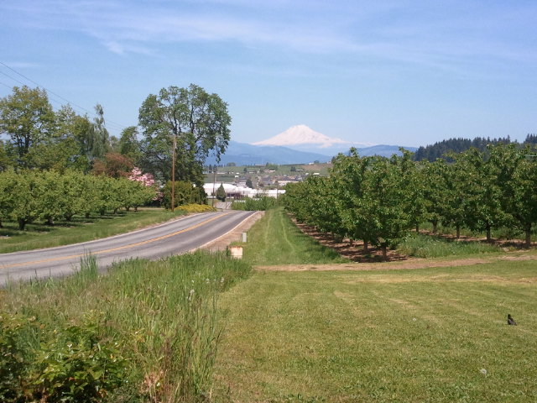
Behavioral Health in Agricultural Populations
Diane Rohlman, PhD
diane-rohlman@uiowa.edu
2016

Slide 2
This presentation was created as part of the Building Capacity Project of the Great Plains Center for Agricultural Health, NIOSH grant U54 OH007548. The copyright holder authorizes unrestricted use of these materials for non-profit, educational purposes only. The information in this presentation was accurate at the time it was prepared, it is the users responsibility to ensure accuracy of all information at time of use. Diane Rohlman, PhD Diane-rohlman@uiowa.edu University of Iowa Fred Gerr, MD Fred-gerr@uiowa.edu University of Iowa

Slide 3
Objectives
Describe the magnitude and impact of mental and behavioral health problems among agricultural workers.
Describes factors in the agricultural workplace that lead to increased psychosocial stress.
Identify unique psychosocial stressors experienced by members of agricultural subpopulations.
Apply models of psychosocial stressors to characterize the intensity and types of stressors experienced by members of agricultural populations.
Describe factors affecting the accessibility of mental health services in rural communities.
Understand the role of occupational psychosocial stressors on physical and emotional health and become familiar with the NIOSH Total Worker Health program.

Slide 4
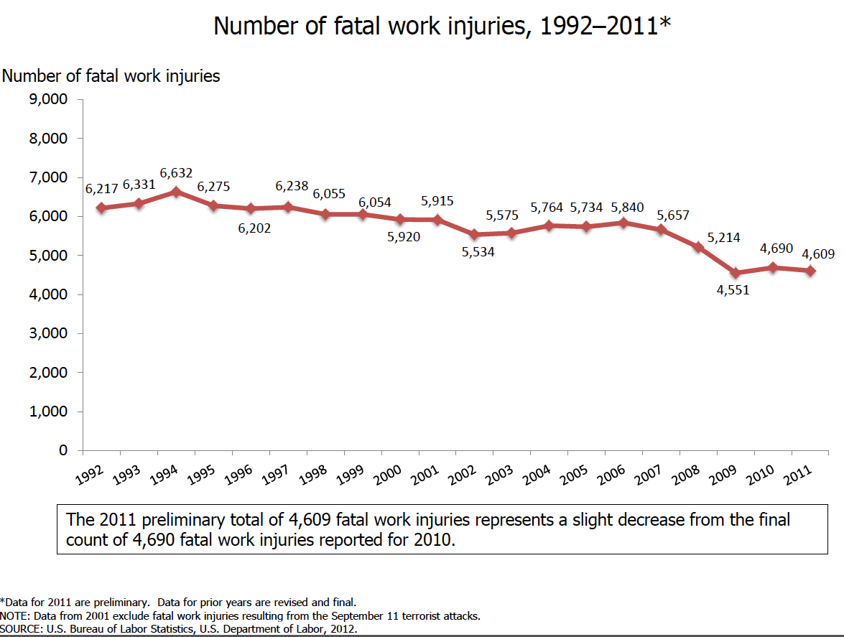
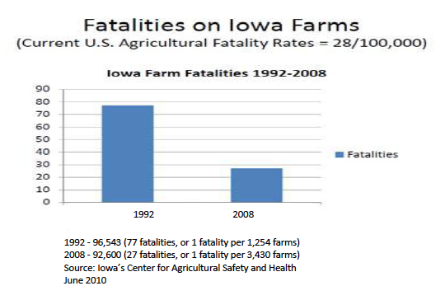
Behavioral Health Problems
Although recent NIOSH reports indicate that farm-related injuries and fatalities are declining
Increase in stress- related behavioral health problems including suicide, depression, and substance abuse (Rosmann 2010)
Behavioral Health: relationship between human behavior and physical health (focus on mental illness and substance abuse)
Notes:
In January 2011, Michael Rosmann Ph.D, Executive Director of Agriwellness
Inc. in Harlan, IA, distributed information including statements from the Daily Iowan
newspaper. The article highlighted the problem of suicide in rural counties: “Even though over
half of Iowa’s population lives in urban areas, from 2000-2008, 1,568 people committed suicide
in rural counties of Iowa, versus 1,382 in the state’s urban counties. Negative stigma about
seeking professional mental healthcare contributes to the problem.”

Slide 5
An Example…
Ben and Lois have been ranching for 15 years. The last few years, they have struggled financially. If prices are low again this year, they could lose the ranch. Ben has always been known as a responsible and outgoing member of the community. But now, under this level of financial stress, he looks tired and withdrawn. He’s been forgetting appointments, neglecting his livestock and skipping church.
Examples from Weigel and Penny – University of Wyoming

Slide 6
What are stressors in agriculture?

Slide 7
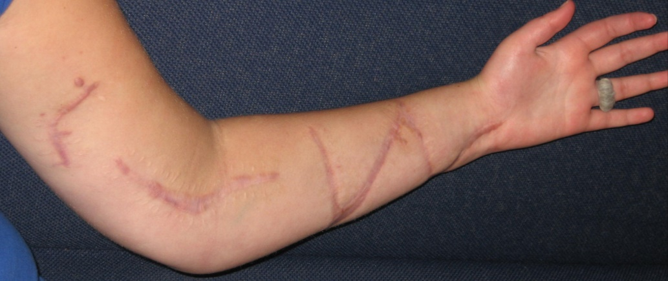
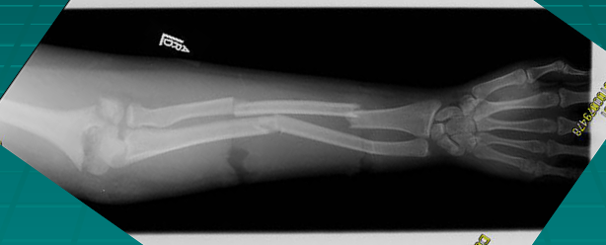
Health Conditions
Acute injuries → disabilities
Chronic health conditions
Access to care
Limited resources in rural areas
No insurance
Aging farm populations

Slide 8
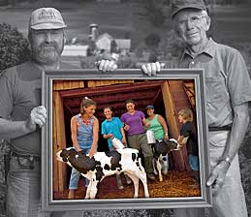
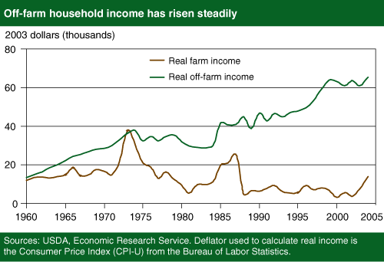
Family (+/-)
Notes:
Interpersonal conflicts (divorce, separation, children)
Roles of men and women
Off-farm jobs
As farming has become less profitable – women taking on more roles (off and on-farms) (Gallagher & Delworth, 2003)
Australian study found 81% of off-farm work → women
off-farm income accounts for 44% - 48% of farming family income (ABS, 2003)
Social isolation
Inter-generational transfer of farms
Can have multiple generations living in close proximity
Daughter-in-laws experience highest level of stress (position of limited power) (Marotz-Baden & Mattheis, 1994)
Can also provide social support

Slide 9
Economy
Low income/poor cash flow
Seasonal variations in income
Increases in debt loads and limitations by banks on loans
Conditions of market prices
Potential or actual loss of farm
How are economic stressors different for Farm Owners/Producers and Farm Workers?

Slide 10
Workplace
Lone workers
Long hours/infrequent days off
Physically demanding work → although this is changing!
Livestock problems (Avian Influenza)
Malfunctioning equipment
Lack of labor (harvest)
Crop yield uncertainty
Seasonal variations in work demands
Notes:
Physical Hazards – pesticide exposure, fertilizer, equipment, animals
Health Status – acute injuries, chronic health problems
Physical environment – terrain, size of farm, types of crops harvested
Interpersonal – interpersonal conflict with family, friends, neighbors, divorce, social isolation
Role strains – due to role incongruence, intergenerational transfer of farms lack of equailty and influence in farm activities
Hovey and Seligman (2006)
• No control of weather
• Large debt loads
• Government regulations
• High interest rates
• Machinery breakdowns
• Livestock problems
• Working long hours
• Crop yield uncertainty
• Disagreements with other family members in the operation of the farm

Slide 11
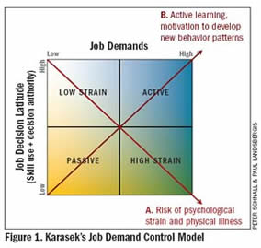
Job Demand and Control
Burdens put on the individual:
Work load
Time pressure
Fast-paced work
Monotonous work
Physical constraints
High Stress Jobs = low control (Decision latitude) and
high demand
(Psychological Demand)
Capacity of person to respond to demands:
Decide how to perform a task
Being allowed to solve problems
Being able to adjust the pace
Notes:
Owner/operator vs. Migrant farmworker

Slide 12
Karasek-Theorell Questionnaire (often-sometime-seldom-never/almost never)
Do you have to work very fast?
Do you have to work very intensively?
Does your work demand too much effort?
Do you have enough time to do everything?
Does your work often involve conflicting demands?
Do you have the possibility of learning new things through your work?
Does your work demand a high level of skill or expertise?
Does your job require you to take the initiative?
Do you have to do the same thing over and over again?
Do you have a choice in deciding HOW you will do your work?
Do you have a choice in deciding WHAT you will do at work?

Slide 13
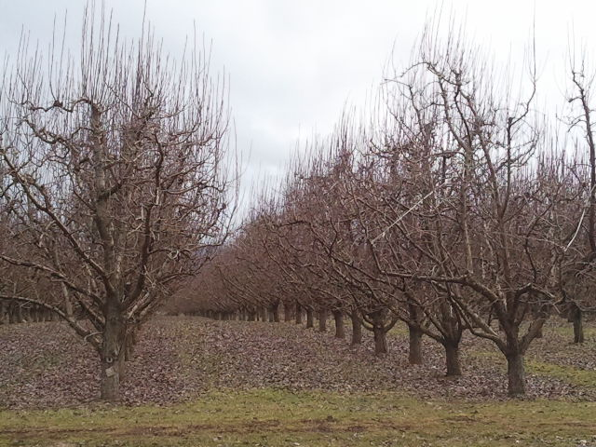
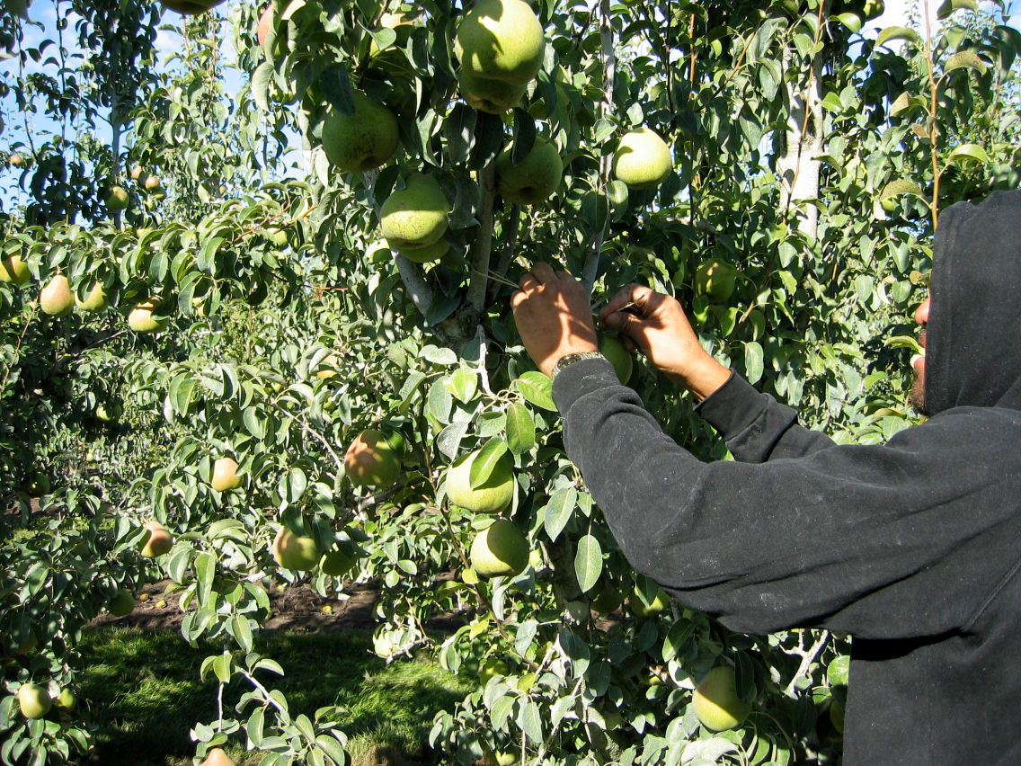
Variations in Work Demands
Pruning | Harvest
Inconsistent work days | Long work hours
Paid by hour/tree - lower pay | Paid by piece - higher pay
Varied Tasks | Fast/repetitive tasks
Lower physical demands | High physical demands

Slide 14
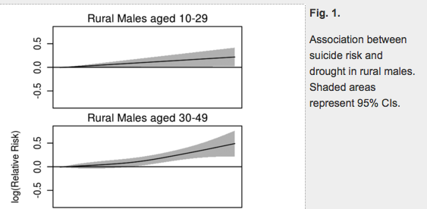
Physical Environment
Noise
Cold/ Hot Temperatures
Droughts/Floods
Environmental pollution
Hanigan et al., 2012. Suicide and drought in New South Wales, Australia, 1970-2007
Notes:
> vol. 109 no. 35
> Ivan C. Hanigan, 13950–13955, doi: 10.1073/pnas.1112965109
Suicide and drought in New South Wales, Australia, 1970–2007
Ivan C. Haniganª,^{b},¹,
Colin D. Butlerª,
Philip N. Kokic^{c}, and
Michael F. Hutchinson^{d}
Rural Remote Health. 2012;12:2071. Epub 2012 Oct 9.
Farmers' stress and coping in a time of drought.
Gunn KM, Kettler LJ, Skaczkowski GL, Turnbull DA.

Slide 15
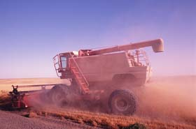
Culture
Independence
Social isolation
Long hours
Hard to get away from the farm
Little time for relaxation
Stigma associated with mental health problems
4/10 Canadian farmers feel they don’t need help manage stress and mental health issues (Little, 2005)
Less than half knew of any resources
Reasons for not seeking help: pride, independence, too busy, lack of confidence in the help available
Don’t seek help or delay seeking help
Notes:
Australian Journal of Rural HealthVolume 21, Issue 1, Article first published online: 6 FEB 2013
Little J. Embodiement and rural masculinity. In: Cambell
H, Mayerfeld Bell M, Finney M, eds.
Country Boys: Mas-
culinity and Rural Life
. University Park, PA: Penn State
Press, 2006; 183–202

Slide 16
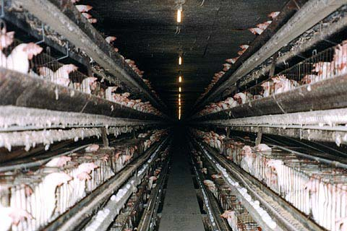
Government/Public Perception
Criticized for polluting environment
CAFOS (concentrated animal feeding operations)
Manure and waste water
Dust and odors
“Mad Cow Disease” or Bovine Spongiform Encephalopathy
Progressive neurological disorder of cattle from infection
Linked with varient Creutzfeldt-Jakob Disease in humans
UK epidemic in 1993 (180,000 cattle infected/4.4 million slaughtered) – Ban on British beef (1996-2006)
Swine flu in 2009 and Avian Influenza (2015)
→ Additional government regulations
Notes:
Other concerns:
Swine flu → initially pork flu in 2009

Slide 17
Midwest Farm Crisis of the 1980s
In the 1970s
Increase in agricultural exports (lowered trade barriers/Soviet purchase of American grain)
Farm incomes and commodity prices rose!
Low interest rates → increase in land purchases / purchase of equipment
Borrowed a lot of money → increased debt
In the 1980s
Interest rates went up → farmland value dropped 60% in some areas
Overproduction → glut in farm commodities
Carter imposes a grain embargo with Soviet Union (after invasion of Afghanistan)

Slide 18
An Example: Dale Burr
In 1988, there was a mini mass killing from a farmer that went over “the edge”. He was from a prominent family farm south of Iowa City. One day about this time of the year, he walked into Hills Bank, shot the president, John Hues, went to his neighbor, shot him fatality, shot his wife wounding
her, and finally shot himself.
This event was chronicled in a book “Lone Tree” by Bruce Brown. (Lone Tree is the mailing address of D. Burrs farm.)

Slide 19
Sources of Stress
Studies from England, Scotland, Wales, New Zealand, Canada, and US report…
Filling in government forms
Record keeping and paper work
Difficulty understanding forms
Dealing with workers compensation
Bad weather
New government regulations and policies
Complying with health and safety legislation
Money
Media Criticism
Time pressure
Increased work load at peak times
Bad weather
Notes:
Firth, Williams, Herbison, McGee (2007) Stress in New Zealand farmers. Stress and Health 23: 51-58
Farmers in England & Scotland (1988) and England (1999)
Top 3 stressors: filling in government forms, bad weather, adjusting to new government regulations and policy
UK (1998)
Record keeping and paper work, difficulty understanding forms, problems from new legislation
75% report concern about money
Coping with new legislation, amount of paper work, media criticism
Wales (2002)
Government policy, finance, time pressure
New Zealand (2006)
Increased work load at peak times, dealing with WC, bad weather, complying with health/safety legislation
Canada (2006)
High psychological distress (49% of male farmers vs. 20% in gen pop)
Prevalence of suicidal ideation (5.9% in male farmers vs. 3.9% in gen pop)
Iowa (1999)

Slide 20
Chronic Stress → Disease
Physiological changes in response to stress
General Adaptation Syndrome
Chronic stress can lead to long-term physiological changes

Slide 21
General Adaptation Syndrome
Stage 1: Alarm
First reaction to stress (fight/flight)
Activate Hypothalamic-Pituitary-Adrenal Axis
Stress hormones (cortisol, adrenaline, noradrenaline) released → give you energy to handle the stressors

Slide 22
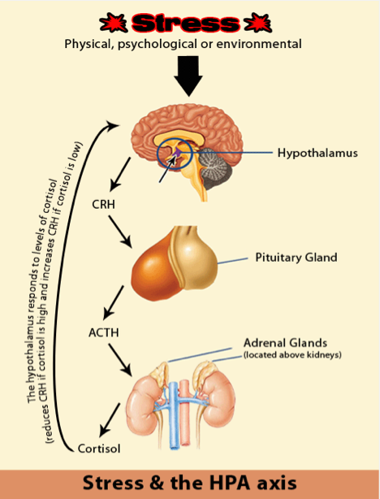
Hypothalamic-Pituitary-Adrenal Axis
Regulates many things
Temperature
Digestion
Immune system
Mood
Energy use
Chronic stress can lead to constant activation of this system
Hypothalamus sends impulses to Autonomic NS → increased heart rate, breathing, BP, dilates pupils
Feedback
Corticotrophin-releasing hormone – released in response to stress
Binds to receptors which produce adrenaline and noradrenaline
ACTH transported to adrenal glands – secrete cortisol

Slide 23
General Adaptation Syndrome
Stage 1: Alarm
First reaction to stress (fight/flight)
Activate Hypothalamic-Pituitary-Adrenal Axis
Stress hormones (cortisol, adrenaline, noradrenaline) released → give you energy to handle the stressors
Everything is working as it should → you have a stressful event, body alarms you with sudden burst of hormonal changes, which give you energy to deal with stressor

Slide 24
General Adaptation Syndrome
Stage 2: Resistance
If the source of stress is resolved or goes away then homeostasis begins to restore balance (recovery period)
Stress hormones return to normal → may have reduced defenses and adaptive energy
OR
If stress persists → body continues stays in a continuous state of arousal
Problems occur when you repeat this too often with little or no recovery

Slide 25
General Adaptation Syndrome
Stage 3: Exhaustion
Stress has continued for some period of time
Overload, burnout, adrenal fatigue → stress levels go up and stay up!
Chronic stress can damage nerve cells in tissues and organs
Thinking and memory impaired/tendency toward anxiety and depression
High blood pressure, heart disease, rheumatoid arthritis, other stress related illnesses

Slide 26
Adverse Health Effects
Cardiovascular disease
High blood pressure
Metabolic syndrome (group of risk factors that raise your risk for heart disease/diabetes/stroke)
Chronic Pain disorders
Abdominal disorders
Irritable Bowel Syndrome
Depression/Anxiety
Insomnia
5 Risk factors:
Large waistline
High triglyceride level
Low HDL cholesterol level
High blood pressure
High fasting sugar

Slide 27
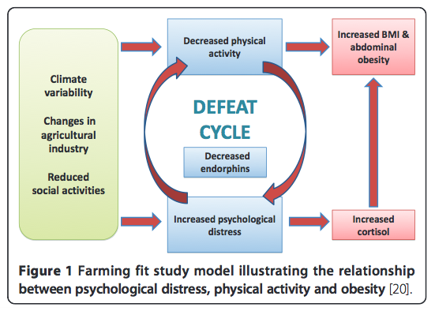
One intervention approach…
Australian farmers have poorer health
64% obese/overweight → 9% higher than national average
46% report psychological distress (33% nationally)
“Farming Fit” Study
6 month intervention study
Impact of physical activity on
Psychological health
Obesity
Other health outcomes
Results:
Reduction in weight and waist circumference
No mental health differences
Drought → Flood during study
Brumby et al., 2011 Reducing Psychological Distress and obesity in Australian farmers by promoting physical activity BMC Public Health
Notes:
Brumby
et al. BMC Public Health
2013,
13
:1018
http://www.biomedcentral.com/1471-2458/13/1018
The effect of physical activity on psychological
distress, cortisol and obesity: results of the farming
fit intervention program
Susan Brumby
1,2*
, Ananda Chandrasekara
1,2
, Peter Kremer
3
, Susan Torres
4
,ScottMcCoombe
1,2
and Paul Lewandowski

Slide 28
Demonstration
Notes:
Migrant Family Demonstration – from Mary Jo Ybarra-Vega (Migrant Health Coordinator, Quincy Community Health, WA)
Characters:
Padre
Madre
Hijo mayor
Hija mayor
Hijo menor
Hija menor
LINE UP IN A ROW
Let’s talk about the family in Mexico.
Traditionally what role does the father play?
macho (a true macho)
strong
protector
bread winner
head of the family
fair/just/honest
(machismo= is the male who is controlling, misuses his role, and power in the family)
What about the mother?
(Mexican families are matriarchal, “women allow the men to wear the pants in family but they are the ones that tell them which ones to wear”)
caretaker
homemaker
Supporter
They teach value, culture, language, and guide spiritual growth
will work outside the home
What about the kids?
They go to school
And they work with the family
And or work to help the family with basic needs
Children are responsible for younger siblings and other family members as well as helping with the elderly →Their total responsibility is to the family. Family is #1.
Life is hard – work is hard to find in Mexico – salaries are low
hear from a Cousin who lives in Iowa that there is lots of work, they invite him to come work in Iowa.
So family packs up and heads to Iowa!
EVERYONE STEPS FORWARD crossing the tape on the floor (symbolic of crossing the boarder -taking steps shows power)
Mexico
USA
the family is excited about the better life, more opportunities
However, they don’t know English, not sure what is going to happen
They arrive in Iowa and father is working in the swine factory
So now what’s happening to the household?
Father – limited English because he is working with his cousins, friends and other males and they only speak Spanish.
Mom- she will be working and she too has a full-time job and she is the primary caregiver to the kids she:
takes kids to school and goes to parent teacher conferences
doctor’s appointments
signs up for social services (WIC, MSS, Department of Social and Health Services, child care and the like)
Who is going to learn English the fastest(remember knowing language is power? → Kids
4 KIDS TAKE 2 STEPS FORWARD
Out of the 4 children, who learns the fastest? -> youngest kids
2 YOUNGEST TAKE 2 MORE STEPS FORWARD
What’s mom doing?– she is interacting with the schools and doctors for kids activities – learning some English and getting to know people in the community
MOM STEPS FORWARD
But kids need to translate for Mom
KIDS STEP FORWARD
Mom takes an English class
MOM STEPS FORWARD
Oldest son – may get a job – may get better job then father – may start speaking for the family and he is the first to get a license.
OLDEST SON STEPS FORWARD
What’s happening to the dad?
He stays where he is very near the line (interview dad, “what is happening to your family…how do you feel about what is happening to you and your family?”)
What happens to his role?
kids speak for him (he is loosing his place of honor as the macho)
he is not the only bread winner
the power dynamic has shifted
not fitting in with the culture including his own kids
kids given more responsibility and more power because of language and they know the culture and how things work.
kids acculturate faster – 2 steps
mom also faster – 1 step
do the kids listen to dad – maybe not
mom may take more of a role since she knows the culture better – she likes earning her own money
Separation between father and kids and husband and wife
This is where many of these families are at – but there can be even more going on:
New baby – which is a US citizen (called mix status family)
Mom gets stopped – tail light out on car – it is discovered she is undocumented and she is sent to a holding facility. Mom gets sent back to Mexico.
As a health care provider – use an interpreter and do not use the kids! Need to acknowledge and respect the parents – particularly focusing on the mother (since she is the primary caregiver) but important to also include father if he comes.
Men – prefer male physicians
need to have a cultural understanding of population you serve ( a hand shake goes a long ways)
need some way to connect – even a few words of Spanish is helpful
do not expect too much eye contact from Mexican nationals or first generation Mex.-Americans.

Slide 29
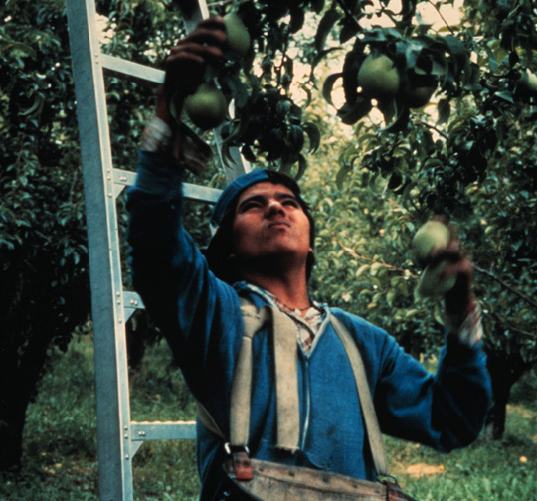
Migrant Farm Workers (National Agricultural Workers Survey 2007-2009)
Age: ~36 years
Gender: 78% male
Marital status: 59% married
2 + Children: 52%
Education: 8th grade (40% only primary)
Income: $12,500-$14,999
Speak English: 35% not at all; 27% a little
http://www.doleta.gov/agworker/naws.cfm
Notes:
NAWS – since 1989, interviews, US DOL

Slide 30
Demographics
Country of Origin
23% U.S.
75% México
2% Central America
1% Other
Legal Status
53% Undocumented
25% U.S. Citizen
21% Permanent Resident
1% Other (e.g. Visa)
Insurance Status
77% No Insurance
23% Insurance
Source of Insurance
46% Employment
19% Government
15% Self
12% Spouse
7% Other

Slide 31
Health Problems
Occupational exposures
Unintentional injuries
Pesticide exposure
Skin diseases
Eye injuries
Respiratory diseases
Lifestyle exposures
Oral health problems
Infectious diseases
TB, STDs, HIV
Mental health problems
Substance abuse
Chronic diseases
Nutrition deficiencies
Notes:
OCCUPATIONAL EXPOSURES Unintentional injuries -- There are two types:
(1) Repetitive Motions -- resulting in pain, sprain, or dislocation
(2) Single events -- causing cuts or tears, or lesser extent fractures or crush injuries
Pesticide exposure (2 types of exposure levels)
(1) Large dose exposure (e.g. during application of the pesticides)
(2) Low level exposure (e.g. during fieldwork)
Skin diseases
*caused by pesticide, chemical, plants, infections, and sun exposure
Eye injuries (2 types of injuries)
(1) Traumatic -- may be caused by plants, tools, equipment
(2) Environmental -- pesticides, chemicals
LIFESTYLE EXPOSURES
Oral health problems -- untreated caries, periodontal disease, missing & broken teeth
Mental health -- depression, anxiety, stress due to farm work
Substance abuse -- alcohol use
Chronic diseases -- overweight/obesity, diabetes, high cholesterol, hypertension
Nutrition deficiencies -- hunger, lack of nutritious foods (esp. for children)

Slide 32
Another Example
“Here there is no opportunity for promotion. I would need to go back to school to get different work, but all the time I am working and then I am too tired. I tell my kids that they need to study. Because the work changes all the time and it can go away at any moment with the weather if it rains or snows. My kids say they want to work with me and I tell them no that they need to study.”
- Oregon Farmworker

Slide 33
Barriers to Accessing Health Services
Linguistic
Most speak another language (e.g Spanish)
Cultural (e.g. Fatalismo)
Folk beliefs
Humoral theory of health (e.g. Hot-Cold)
Folk medicine/healers i.e. Curanderos
Low education (e.g. low literacy level)
Constant migration
Notes:
Constant migration -- causes three problems
(1) Makes knowing where health services are difficult
(2) Inhibits continuity of care
(3) Delay in seeking health care

Slide 34
Barriers to Accessing Health Services
Cost
No documentation
Do not qualify for health insurance, govt. programs
Fear of deportation
Lack of transportation
Fear of missing work
Loss of income and employment
Other factors
Cultural, structural, legal, financial, and geographical characteristics of clinics
Notes:
Constant migration -- causes three problems
(1) Makes knowing where health services are difficult
(2) Inhibits continuity of care
(3) Delay in seeking health care

Slide 35
Workers with H-2A Visas
Legal documentation to work in US
Guaranteed:
Hourly wage > minimum wage
Minimum average of 35 hours/week
Housing and round-trip transportation costs
Only work for employer that recruited them
If do not fulfill at least half contract period, must pay their own transportation costs
Notes:
Arcury, Summers, Talton, Nguyen, Chen, Quandt Job Characteristics and Work Safety Climate among North Carolina Farmworekrs with H-2A Visas. J Agromedicine. 2015l 20(1) 64-76
Migrant farmworkers are a vulnerable population. Migrant farmworkers with H-2A visas are the only agricultural workers with temporary work permits. Little research has directly focused on the job characteristics and work safety of workers with H-2A visas. This analysis (1) describes their personal and job characteristics, job hazards, and stressors; (2) describes their perceived work safety climate; and (3) examines associations of perceived work safety climate with job characteristics, job hazards, and stressors. Data are from a cross-sectional component of a larger study of farmworker pesticide exposure; in 2012 interviews were conducted with 163 migrant farmworkers with H-2A visas in North Carolina. The sample was limited to men aged 30 to 70 years. Migrant farmworkers with H-2A visas experience the same hazards as do other farmworkers. Their mean score on the perceived work safety climate scale 25.5 (SD=3.7) is similar to that of other farmworkers and other immigrant workers. Perceived work safety climate is associated with hours worked per week (p=0.02), precarious employment (p<0.001), planting and cultivating (p=0.002); topping tobacco (p=0.0012), and stress (p=0.02). Perceived work safety climate is particularly important for migrant farmworkers with H-2A visas because their labor contracts limit their options to change employers. Additional research on the status of work safety climate among agricultural workers is needed, as well as on the factors that affect work safety climate and on the safety characteristics that are affected by work safety climate. Policy changes that lead to improved work safety climate should be considered.

Slide 36
Anxiety and Depression in Mexican Farm Workers
Factors associated with greater anxiety and depression:
High acculturative stress
Low self-esteem
Family dysfunction
Ineffective social support
Low religiosity
Lack of control/choice in decision to live migrant life
Hovey and Magaña, 2000; 2002
Notes:
Personality Assessment Index

Slide 37
Migrant Farm Workers
Report high levels of stress related to mobility, language barriers, job security, financial concerns, and long workdays (Hiott et al. 2008; Kim-Godwin and Bechtel 2004)
Varies across season (Grzywacz et al. 2010)
Due to the seasonal nature of agriculture, farmworkers often experience periods of unemployment or job insecurity.
Self-reports of poor physical health are associated with physical job demands requiring awkward postures; self-reports of better health are associated with increased job control (Grzywacz et al. 2008)

Slide 38
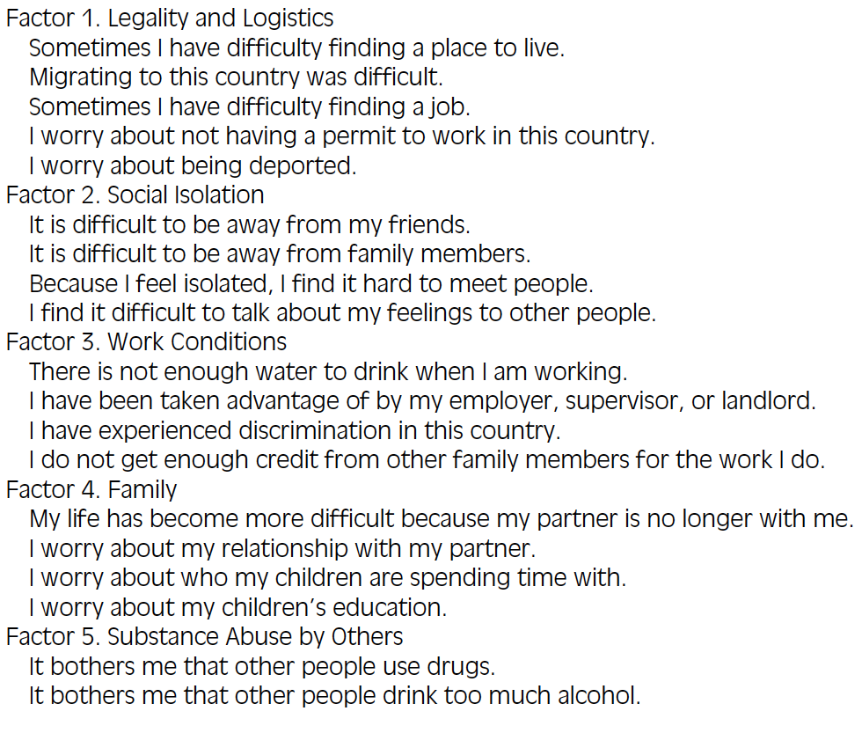
Migrant Farmworker Stress Inventory (MFWSI)
Migrant Farmworker Stress: Mental Health Implications
Hiott, Grzywacz, Davis, Quandt, Arcury; 2008 The Journal of Rural Health

Slide 39
Depression
One of most common mental disorders
“state of mood, a symptom, a syndrome or as a clinical diagnosis”
Higher prevalence in industrialized countries than non-developed ones
Negatively correlates with social status (Jaga and Dharmani, 2007; WHO, 2002)
Up to 4% of men and 8% of women suffer clinical depressive disorder, depressive symptoms much more common
From Freire & Koifman, 2013
Notes:
Depression is one of the most common mental disorders in
general medical care and can be seen as a state of mood, a symptom,
a syndrome or as a clinical diagnosis (http://www.who.int/
mental health/management/depression). Epidemiological studies
have shown that depression prevalence is higher in industrialized
countries than in non-developed ones and negatively correlates
with social status (Jaga and Dharmani, 2007; WHO, 2002). Up to 4%
of men and 8% of women suffer from a clinically significant depressive
disorder, while depressive symptoms are much more common
(WHO, 2002).
Suicide is one

Slide 40
An Example…
Roger holds down a job in town to supplement income from the family ranch. He is up before everyone else in the house on most days, and his schedule and lack of adequate sleep often have him feeling as if he does morning chores in a stupor. Although he is able to recognize stress signals, Roger sometimes feels powerless to address them. “There just isn’t any extra time in my day,” he says.
Examples from Weigel and Penny – University of Wyoming

Slide 41
Risk for Farm–Related Injuries
Farmers experiencing high economic related stress are 2 – 3 times more likely to experience a serious injury than farmers not experiencing high stress.
High stress, high work loads and limited social outlets → increases risk of injury
“We put in long hours, 14-16 hours a day, 7 days a week during the busy season. Normally we have a full-time employee, but with so little money in hogs we can’t afford it. We then have to put in longer hours. Then we do dumb things.” (Midwestern farmer)
Source: K. Thu, et al. (1997) Stress as a Risk Factor for Agricultural Injuries. Journal of Agromedicine
4(3/4) 181-191.
Notes:
This paper presents a comparative analysis from two
data sets, the NIOSH Iowa Farm Family Health and Hazard Survey
and the Iowa Farm and Rural Life Poll. The objective was to investigate
the role of stress as a possible risk factor for agricultural injuries.
The Iowa Farm Family Health and Hazard Survey is based on a
sample of 989 farm families in Iowa resulting in 390 useable responses
from 1994. The Iowa Farm and Rural Life Poll is a statewide
random sample of 3270 farmers in 1989 to which 2016 Iowa
farmers responded. Complementary dimensions of stress from each
survey are analyzed and shown to be strongly associated with agricultural
injuries

Slide 42
Suicide
One of the top 3 causes of death worldwide among 15-35 year olds (WHO 2000)
Has increased 60% in last 45 years
Higher incidence in developing countries
Primarily females in rural communities (London, 2009)
Males and urban communities in industrialized countries (Jaga and Dharmani, 2007)
Pesticide ingestion is the leading global means of suicide
Accounts for approximately 1/3 of the estimated 1 million cases annually
Depressive disorder accounts for 20-35% of all suicide deaths
Freire & Koifman, 2013

Slide 43
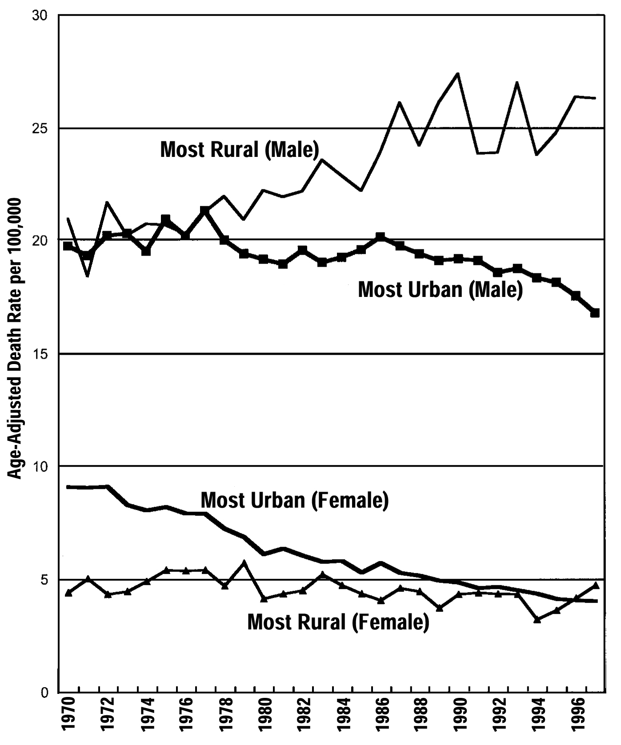
Age-Adjusted U.S. Suicide Rates
by
Urban-Rural,
1970 – 1997
Suicide rate higher in farmers than for non-farmers (Gunderson et al., 93; Stallones, 90; Inskip et al., 1996; Kelly & Bunting, 98; Stark et al., 06)
Source: Singh, G. K., & Siahpush, M. (2002). The increasing rural-urban gradients in U.S. suicide mortality, 1970 – 1997.American Journal of Public Health, 92(7), 1161-1167.
Produced by Michael R. Rosmann, Ph.D., June 2012

Slide 44
Comparison of Suicide by Farmers vs. Non-Farmers*
Farmers | Non-Farmers
Rate is twice the national average. | Rate is slightly below average.
Likely to occur in spring and fall. | More likely to occur in summer.
More likely to occur on Sunday, Monday and Tuesday. | More likely to occur on Wednesday, Monday and Saturday.
More likely to occur between 6:00 and 11:59 a.m. | More likely to occur in late p.m., early a.m.
Firearms are main method. | Greater variety of methods.
Few attempts precede suicide. | Many attempts precede suicide.
Source: Gunderson, P., Donner, B., Nashold, R., Salkowicz, L., Sperry, S., & Wittman, B. (1993). The epidemiology of suicide among farm residents or workers in five north-central states, 1980 - 1988. American Journal of Preventive Medicine, 9, 26-32.
Produced by Michael R. Rosmann, Ph.D., June 2012

Slide 45
Suicide Rates in France (2013)
Male farmers 20% more likely than general population to commit suicide
487 deaths between 2007-2009
3rd largest cause of death among agricultural workers (cancer, cardiovascular disease)
Highest in cattle farmers, 55-64 years old
Potential Reasons:
Increasing financial pressure
Revenue from farming fell 24% between 2007-2008 and 35% between 2008-2009
Social Isolation
30% of male farmers do not have a partner (dating sites aimed at farmers: http://www.atraverschamp.com/fr/)
http://www.france24.com/en/20131012-suicide-rates-france-farmers-study/
- report published by the French Institute for Public Health Surveillance
Notes:
http://www.france24.com/en/20131012-suicide-rates-france-farmers-study/
- report published by the French Institute for Public Health Surveillance (InVS) on Thursday

Slide 46
Important Factors in Suicide Deaths
Psychiatric disorders → depressive disorder
Occupational, relationship and financial problems
Running a small farm, having no confiding relationship, single status and visiting a general practitioner in last 3 months
Availability of fire arms
Malmberg, A., Simkin, S., Hawton, K. (1999) Suicide in farmers. British Journal of Psychiatry, 175, 103-105.
Malmberg, A., Hawton, K., Simkin, S. (1997) A study of suicide in farmers in England and Wales. Journal of Psychosomatic Research, 43, 107-111

Slide 47
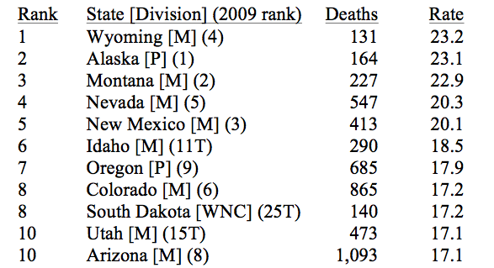
Rate, Number and Ranking of Suicide
US Total 38,364 12.4
Iowa 372 12.2
http://www.suicidology.org/c/document_library/get_file?folderId=262&name=DLFE-636.pdf

Slide 48
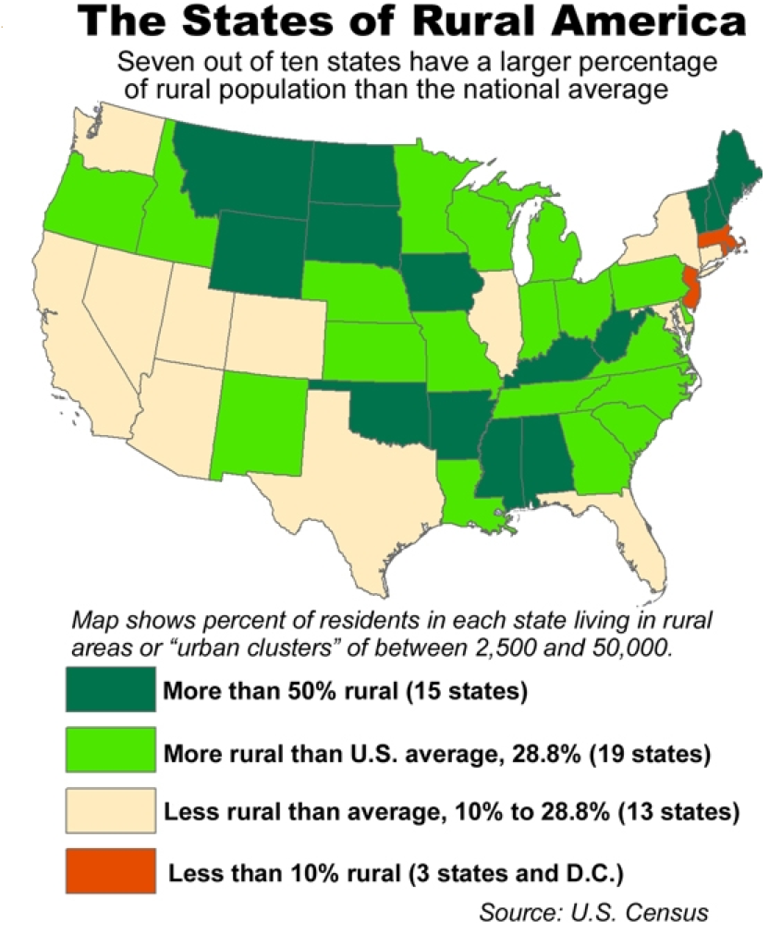

Slide 49
Pesticide Exposure and Depression
Pesticides (particularly OPs, carbamates):
Linked to depression and anxiety (Bazylewicz-Walczak et al. 1999; Beseler and Stallones 2008; Beseler et al. 2006, 2008; Mackenzie Ross et al. 2010; Onwuameze et al. 2013; Rehner et al. 2000; Salvi et al. 2003; Weisskopf et al. 2013; Wesseling et al. 2010)
Ag Health Study: association between specific pesticides and depression (Beard et al., 2014)
Both chronic exposure (Salvi et al. 2003, Bazylewicz-Walczak et al. 1999, Onwuameze et al. 2013, Mackenzie Ross et al. 2010) and poisoning (Beseler and Stallones 2008, Beseler et al. 2006, 2008, Wesseling et al. 2010)
Notes:
fumigants and organochlorine insecticides, and seven individual pesticides—the fumigants aluminum phosphide and ethylene dibromide; the phenoxy herbicide (2,4,5-trichlorophenoxy)acetic acid (2,4,5-T); the organochlorine insecticide dieldrin; and the organophosphate insecticides diazinon, malathion, and parathion—were all positively associated with depression in each case group, with ORs between 1.1 and 1.9.
Studies have reported higher suicide rates among farmers (Blair et al. 1993; Browning et al. 2008; Gunderson et al. 1993; Lee et al. 2002; Meltzer et al. 2008; Miller and Burns 2008; Page and Fragar 2002; Stallones 1990), although two studies found lower rates among Canadian farmers (Pickett et al. 1993, 1999). A review noted higher suicide rates among farmers than any other occupational group in the United Kingdom (Gregoire 2002).
Other studies suggested associations between chronic exposure to pesticides and suicide among farmers and other agricultural populations. In Australia, pesticide applicators had higher suicide rates than the general population (MacFarlane et al. 2009, 2010), whereas applicators in Italy had a lower rate of accidents and suicide (Torchio et al. 1994). Parrón et al. (1996) found higher suicide rates in an intensive agricultural area of southeastern Spain than in other areas with similar demographic and socioeconomic compositions; they tentatively attributed the increased rates to pesticide exposure. Colorado farmers potentially exposed to pesticides had higher suicide rates than the general population (Stallones 2006), and ecological and case studies suggested an association between organophosphate pesticide (OP) use and suicide (London et al. 2005).

Slide 50
Pesticide Exposure and Suicide
Studies have reported higher suicide rates among farmers (Blair et al. 1993; Browning et al. 2008; Gunderson et al. 1993; Lee et al. 2002; Meltzer et al. 2008; Miller and Burns 2008; Page and Fragar 2002; Stallones 1990)
although two studies found lower rates among Canadian farmers (Pickett et al. 1993, 1999).
Mixed findings examining chronic (low-moderate) exposure and suicide (Australia: MacFarlane et al. 2009, 2010; Spain: Parrón et al. 1996; US: Stallones 2006, Beard et al., 2011; South Africa: London et al. 2005)
Stonger evidence for poisoning/high exposure events and suicide
Notes:
Studies have reported higher suicide rates among farmers (Blair et al. 1993; Browning et al. 2008; Gunderson et al. 1993; Lee et al. 2002; Meltzer et al. 2008; Miller and Burns 2008; Page and Fragar 2002; Stallones 1990), although two studies found lower rates among Canadian farmers (Pickett et al. 1993, 1999). A review noted higher suicide rates among farmers than any other occupational group in the United Kingdom (Gregoire 2002).
Other studies suggested associations between chronic exposure to pesticides and suicide among farmers and other agricultural populations. In Australia, pesticide applicators had higher suicide rates than the general population (MacFarlane et al. 2009, 2010), whereas applicators in Italy had a lower rate of accidents and suicide (Torchio et al. 1994). Parrón et al. (1996) found higher suicide rates in an intensive agricultural area of southeastern Spain than in other areas with similar demographic and socioeconomic compositions; they tentatively attributed the increased rates to pesticide exposure. Colorado farmers potentially exposed to pesticides had higher suicide rates than the general population (Stallones 2006), and ecological and case studies suggested an association between organophosphate pesticide (OP) use and suicide (London et al. 2005).

Slide 51
Pesticides and Suicide: Conclusions
Multiple risk factors for depression and suicide
Higher suicide rates among farmers
Evidence is growing that demonstrates link between pesticide exposure and depression and suicide
Pesticide poisoning (or high exposures) stronger evidence
Weaker evidence examining chronic/low exposures
Notes:
Increasing evidence of high pesticide exposure/poisoning and risk of psychiatric disorder, including suicidal behavior (Mackenzie Ross et al., 2010; MacFarlane et al., 2011; Wesseling et al., 2010; Zhang et al. 2009)
Cross-sectional studies (exposed/unexposed) report association between exposure and depression (Colorado farmers, Costa Rica banana workers, Norwegian farmers, UK Sheep farmers, female farmers in Poland, Egyptian pesticide formulators and applicators)
Agricultural Health Study (case control) found greater self-reported diagnosis of depression in female spouses of pesticide applicators who had poisoning and self-reported depression higher in applicators with self-reported poisoning
Limited evidence on impact of chronic low-dose exposure
AHS – multiple measures of exposure
>89,000 (private and commercial pesticide applicators + spouses) – NC and IA
goals are to investigate the effects of environmental, occupational, dietary, and genetic factors on the health of the agricultural population.
Began in 1993 – 3 phases ( phase 3 - 2005-2010)
Higher rates of depression and other psychiatric conditions have been linked to exposure to pesticides, particularly organophosphate insecticides, and living on or near farms (Bazylewicz-Walczak et al., 1999; Beseler and Stallones, 2008; Beseler et al., 2006, 2008; Carruth and Logan, 2002; London et al., 2005; Mackenzie Ross et al., 2010; Meyer et al., 2010; Rehner et al., 2000; Salvi et al., 2003; Stallones and Beseler, 2002a, 2002b; Villeneuve et al., 2009; Wesseling et al., 2010). Only a few of the previous studies of pesticide exposure and depression, however, were prospective (Bazylewicz-Walczak et al., 1999; Beseler and Stallones, 2008; Salvi et al., 2003).
Low safety knowledge and depression associated with greater risk for injury (Beseler and Stallones 2010 AJIM)
Depression linked to poor health, financial difficulties and history of pesticide poisoning
Also linked to safety behaviors on the farm (Beseler and Stallones 2006 JAgroMed)

Slide 52
Limitations of these studies
Measures of exposure
Often based on job title or years worked
May not accurately represent exposure
Focused on OPs – which have a biological plausible explanation for link to depression
Case definition
Self-report vs. validated scales (and are they appropriate for the population?)
Study design
Small Sample Size
Don’t consider other risk factors

Slide 53
Coping Strategies
Social Support – network of friends/relatives
Women often have better networks than men
Sometimes occurs in workplace → but farms may be different
Dating service?
Fun/Laughter
Relaxation/Meditation
breathing controlled and heart rate and BP lowered
Physical Activity/Exercise
Provides outlet for flight or fight response
May also take you out of stress-provoking situation
Problem-focused Coping
Cognitive appraisal (use problem solving)
Time management/Assertiveness (saying “no”)

Slide 54
Sowing the Seeds of Hope Hotlines/Helplines (1999-2010)
43,852 calls were made to SSoH hotlines/helplines during a 26 month period from September 1, 2005 to October 31, 2007
Reasons for calling the hotlines:
Marital/family concerns – 24.6%
Problems coping with daily activities –27.7%
Feeling Depressed – 27.7%
Alcohol/drug abuse – 4.9%
Gambling – .6%
Stress over finances – 14.3%
Data from Michael R. Rosmann, Ph.D., June 2012
Notes:
The Sowing the Seeds of Hope program (1999-2010)provided behavioral health services to uninsured, underinsured and other at-risk farm and ranch families and agricultural workers. Seven states (Iowa, Kansas, Minnesota, Nebraska, North Dakota, South Dakota and Wisconsin) formed the regional program in 1999.

Slide 55
Sowing the Seeds of Hope Hotlines/Helplines (Cont.)
79% lived on farms and were farmers
11% lived on farms and were connected with agriculture but were not farmers
10% were farmers and lived in town
1.6% of callers (i.e., 685 out of 43,852 callers) reported suicidal ideation; 77 persons reported a suicide and 56 persons had attempted suicide
54.5% of the callers were female
Produced by Michael R. Rosmann, Ph.D., June 2012

Slide 57
What does the farm community want?
Interviewed farm owner and operators
Need for physicians to understand the culture of the farming community
Farming heritage + business side of farming
Occupational exposures in farming
Chemicals, animal wastes, animal-borne illnesses, etc. + stress
Recommendations to improve the health of farmers
Not always feasible to go to doctor → more self-help information, increase accessibility to services (mobile units, weekend office hours)
Anderson et al., 2011
Notes:
Culture – intergenerational + small man operation – no time to go see doctor, weather, may have to take entire day off

Slide 58
Access to services
Rural Population
Lower number of mental health providers
Remote locations – long distance to services
Stigma of small community
Stoic and Self-Reliant
Reluctant to admit need help

Slide 59
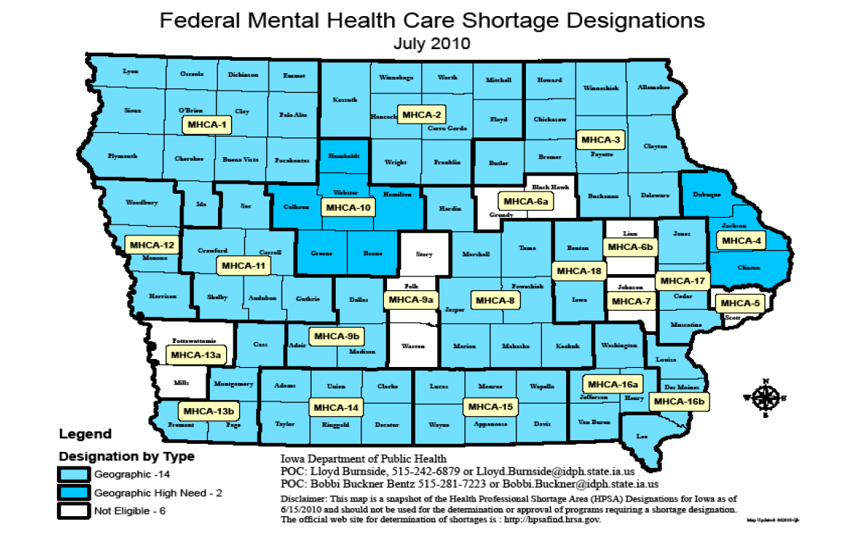
Facts about Iowa
Iowa ranks:
47th among states in psychiatrists per capita
46th among states in psychologists per capita
28th among states in social workers per capita
High percentage of mental health professionals, ages 55 or over, which predicts an increase in mental health workforce shortage (Iowa’s Mental Health Workforce Report, 2006)
Eighty-nine of Iowa’s 99 counties are designated as Mental Health Care Shortage areas
The federal government officially recognizes there are not enough mental health professionals to provide a sufficient level of care in these counties.
The 10 counties in Iowa that do not meet the designation of a shortage are all counties that are also metropolitan statistical areas.
HRSA National Center for Health Workforce Analysis
Notes:
This designation qualifies the facilities in the geographic area to apply for federal funding for provider loan
repayment. It also allows facilities in these areas to hire J-1 visa physicians through the State
Conrad 30 program. Iowa also has limited loan repayment funds available through the Iowa
Department of Public Health PRIMECARE program and through the State Loan Repayment
Program (SLRP).

Slide 60
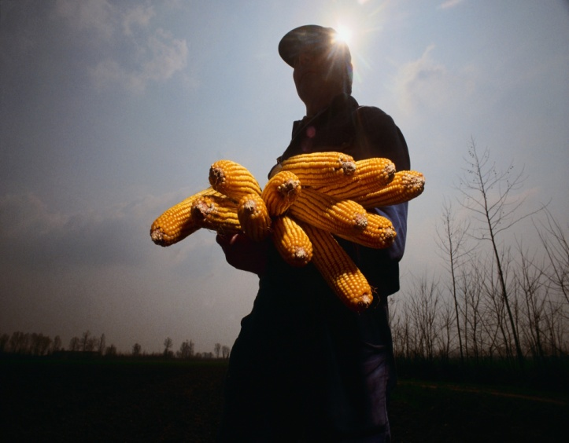
In conclusion…
Learned about stressors faced by farmers and their families
Have an understanding of the people living and working in rural communities
Understand some of the unique hazards faced by people living in these communities

Slide 61
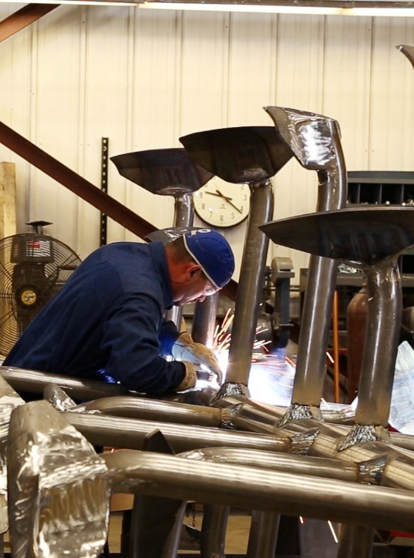
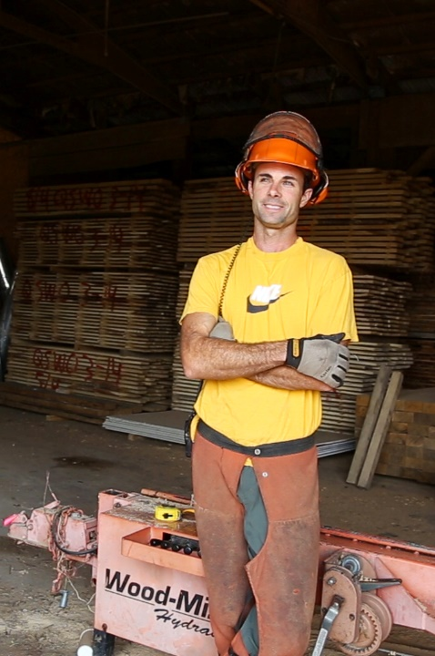
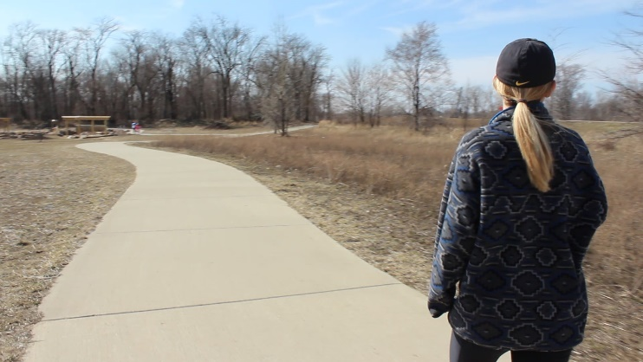
Total Worker Health™

Slide 62
We know that agricultural work is dangerous…

Slide 63
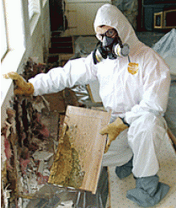
Traditional Workplace Hazards
Physical | Biological | Chemical | Biomechanical | Safety
Noise Radiation Temperature Vibration | Pathogens Molds | Gases Vapors Dusts | Force Posture Repetition Vibration | Machines Equipment Slips/trips/falls
Notes:
Much of the focus has been on controlling hazards in the workplace
Here are traditional hazards that can lead to injuries and illnesses
Repetition: Highly repetitive movements
Posture: Working at extremes of posture or using sustained (so-called “static”) body positions
Force: Activities that require high or sustained muscle forces (e.g., lifting)
Vibration: An interesting one; some consider vibration under the “Physical” category
In fact, I don’t consider the use of “ergonomic” to describe the hazard as entirely correct. We think of ergonomics as the solution rather than the problem. So, the “ergonomic” factors might all be better listed under physical or, if I had my way, the “ergonomic” category heading could be changed to something like “Biomechanical”

Slide 64
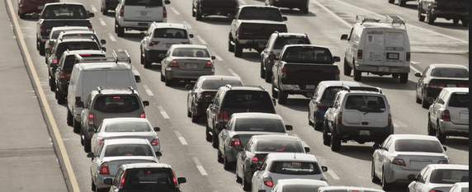
But there are other threats facing workers…
What about agriculture?
Notes:
Shift work
Violence in the workplace
Job demands
Sedentary work
Commute times

Slide 65
Health Behaviors
Substance use
Unhealthy eating
Lack of exercise
Work Factors
Shift work
Workplace assaults
Lack of decision making authority
Time pressure/workload
Lack of affordable childcare
Physical fatigue
Low wages
Workplace Effects
Presenteeism Absenteeism
Insurance costs
Injury risks
Health Outcomes
Low back pain
High blood pressure
Cardiovascular disease
Depression
Notes:
It is now recognized that aspects of the workplace (scheduling, shift work; physically demanding work; chemical exposures) not only increase the risk of injury and illness, but also impact health behaviors (smoking, physical activity) and health outcomes (sleep disorders and fatigue, obesity, musculoskeletal disorders) (Miranda et al., 2015; Zhang et al., 2015). In turn, ill health and chronic conditions can impact performance at work, increasing risk for injury, absenteeism, and reduced productivity (Goetzel et al. 2004 ). Programs that expand the traditional focus of occupational safety and health of protecting workers from work-specific safety and health hazards to include the promotion of health and well-being have been shown to be more effective than programs addressing these separately (Sorenson et al., 2013; Anger et al., 2015).
Failure to consider work organization factors can also limit the success of WHPs. Shift scheduling, involuntary overtime, lack of affordable childcare, lack of adequate
transportation, employee medical insurance coverage and sick leave, and low wages may all directly affect workers’ access, free time, or ability to exercise or prepare healthy meals. Factors in the work environment including night work, work pace, occurrence of assaults, low decision latitude, and other psychosocial stressors can all increase the prevalence of risk factors such as cigarette smoking, alcohol use, unhealthy eating patterns, lack of leisure-time exercise, and obesity [Brisson et al., 2000; Kivimki et al., 2001; Parkes, 2002; Chandola et al., 2005; Wemme and Rosvall, 2005; Kouvonen et al., 2005a,b; Albertsen et al., 2006; Ostry et al., 2006; Vaananen et al., 2009
Low-income workers
have reported their eating and exercise behaviors to
be adversely affected by time pressure, physical fatigue,
and low control over workload and scheduling, as well as by limited food options in the workplace [Champagne
et al., 2012].

Slide 66
Obesity in the Workplace
35% of adults in US are obese (79 million)
$73.1 billion in costs attributable to full time employees (insurance expenses, absenteeism, presenteeism)
Higher risk for injury (1.2-2x)
Workers compensation costs incrementally higher (1.5-7x) as BMI increases
Return to work after injury also incrementally higher (4-13x) as BMI increases
Notes:
Again we see impacts in the workplace

Slide 67
Today’s Workplace/Workforce Reality
>50% of US adults believe that they are subjected to higher than healthy amounts of stress, and believe stress in their lives is increasing
WHO estimates US workplace costs of $300 billion (absenteeism, turnover, accidents, presenteeism)
Longer return to work after injury
Related to increases in disease risk, musculoskeletal disorders, prevalence of psychological disorders, and potentially workplace injuries
Notes:
The what, the why and the how

Slide 68
Evolution of Total Worker Health
Traditionally the focus was to reduce injury and illness in the workplace by controlling workplace hazards
Changing nature of work has identified other workplace factors (i.e., work organization) that lead to adverse health outcomes
Total Worker Health focuses on interventions that mitigate every modifiable risk factor to promote health and wellbeing on and off the job.
Notes:
cut across occup and non-occ domains if goal is to prevent preventable disease must commit to mitigating every modifiable risk factors

Slide 69
Work-Home Integration
Stress that results from work can intrude into our family lives and vice-versa
Chemical exposures on the job can be brought home inadvertently on work clothes and expose family members
Long hours, weather, family, chronic injuries and illnesses can all impact work
Agricultural workforce is aging
Notes:
These examples demonstrate that there is a connection between factors in the workplace and home that interact – both work to home and home to work…

Slide 70
Agricultural Work
There are multiple risk factors for workplace injuries and illnesses:
Large machinery (injury and illness)
Chemical exposures
Seasonal work
Physically demanding
Fatigue
Work and home are the same
Workforce: older/younger, farmworkers
More sedentary behavior
Need for interventions that address risk factors that cut across occupational and non-occupational boundaries
Interventions that address multiple risk factors for common illnesses

Slide 71
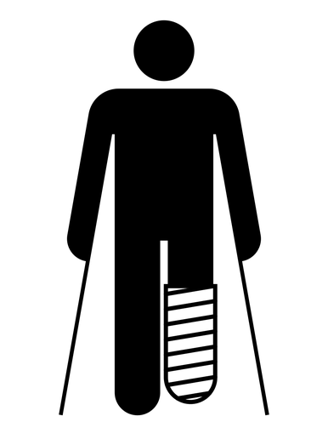
Total Worker HealthTM
Interrelated exposures and health outcomes that affect people at work and at home
Addresses health outcomes that carry significant personal, workplace, and societal burdens

Slide 72
Total Worker Health® is…
Notes:
policies, programs, and practices that integrate protection from work-related safety and health hazards with promotion of injury and illness prevention efforts to advance worker well-being.

Slide 74
Challenges with TWH in Agriculture
Need to first control the “traditional” occupational hazards
Small farms (many of them are family farms)
May not have organizational infrastructure for implementing safety and health programs including TWH
Safety culture
Safety and health expertise
Not regulated/inspected by OSHA

Slide 75
Healthier Workforce Center @ Iowa
Center Goals
Implement, evaluate and compare health protection and health promotion models
Identify and promote Total Worker Health best and promising practices
Serve as a state and national resource center for employee health programs, services and policies
www.hwce.org
Notes:
Also approaching 4 million nonfatal injuries
Total costs in the hundreds of billions
Plus unaccounted pain, suffering and economic impacts

