Slide 1


Slide 2
Building and Retaining a Member Population
Do Your Strategies Change as the Market Shifts from Volume to Value?
Thomas J. Manak
Associate Vice President, Sg2
Iowa Healthcare Executive Symposium
September 24, 2015
Notes:
Notes from Tom:
Inform the Board that all elements are in place – it’s about coordinating/integrating them

Slide 3
Your Challenges for Today’s Health Care
How do you
act with confidence
in an age of uncertainty?
How do you create a strategy of abundance
in an age of scarcity?

Slide 4
Markets in Motion—The Execution Challenge
“
“
We just had our best year ever. We love fee-for-service.
“
“
We are all in on population health.
“
“
We’re just trying to make sure that the rate of change inside of our organization stays ahead of the rate of change outside.

Slide 5
An Expert’s Position
Cost is the issue
  Define costs
Engage physicians as partners
  Which physicians
Build value-based relationships with employers
  A different competition
Think beyond Medicare
  Impact of Change Forecast
Build a system of health, not a hospital
  System of CARE
Note: Paul Keckley, PhD

Slide 6
The More Things Change the More Things Stay the Same
Fee for Service
Bundled Payment
Population Health
VOLUME
COMMONALITIES

Slide 7
Current State of Health Care Reform

Slide 8
At the Heart of Health Care Reform…
Efficiency
Well-defined care paths
Less costly sites
of care
Coordinated care
Increased access
Predictive care paths
Quality and Safety
Provider error
Unnecessary care
Readmissions
Avoidable conditions
Lack of care coordination
Value
70%
Waste
30%
Sources: Inskeep S. Budget chief: For health care, more is not better. National Public Radio. April 16, 2009; Congressional Budget Office Report, 2008.
Notes:
Get rid of waste
Improve quality
Note: As we move through the day we will address the Orthopedic specific savings opportunities (in the activity following this module and Wade will cover in more detail for bundled and episode-based payment).
“The good news is that by attacking waste, we can reduce healthcare costs without adversely affecting the quality of care or access to care.”
Paper-based system that discourages sharing of medical records accounts for 6% of annual overspending.
Unnecessary care to protect against malpractice makes up $200-$300 billion a year.
Fraud - $200 billion a year
Administrative inefficiency and redundant paperwork – 18% of waste
Medical mistakes $50-100 Billion
Preventable conditions (ex - uncontrolled diabetes) $30-50 billion a year
We spend twice as much as Canada on billing and administration, employing 1.66 clerical workers per doctor.

Slide 9

The Real Health Care Reform:
Across the Health Enterprise
Is About Long-term Changes in Payment Incentives
Quality improvement
Hospital-acquired conditions
30-day readmissions
Potentially avoidable admissions
Inappropriate sites of care
Trade-offs between payment models
  Eg, bundled payment, partial capitation
New care delivery models
  Eg, accountable care organizations
The Accountable Care Act sets the foundation for payer and provider collaboration and coordination, but the future will play out in the private sector.
Notes:
began before the health care reform debate and will continue after
It means that the private market is going to have to take a serious look at ways to cut costs
We have been talking about the landscape. Currently
Costs are unsustainable
System is inefficient
Fails to reward quality
Ultimately the goals are to structure the system to meet the goals on the right (enumerate)
These goals can be achieved by moving towards alternate care delivery models
Alternate delivery models will only be instituted once proper incentives are put in place
Incentives
Payment models are only one piece of the puzzle—address supply of services
Thinking about how we pay for care is important—the goal is to direct incentives so that we reward appropriate treatment
Another way to say this is that we need systems to emphasize quality (structures; processes; outcomes) over volumes
Can involve changing the unit of care (transition from FFS to capitation); can also involve additional carrots/sticks (P4P)
Recognize that supply can also be addressed in other ways:
Actual $ of payment—a blunt instrument because it has the net effect of dis-incentivizing care, even when that care is appropriate. Can distort markets. Cutting reimbursement has the potential to drive providers from the marketplace rather than impacting behavior
Preauthorization
Supply(# of providers) is impacted locally in all sorts of ways (licensure; admitting privileges; malpractice premium availability; eligibility to participate in PPO/HMO networks)
Demand for services can also be affected—primarily by influencing out of pocket costs

Slide 10
Sg2’s Views on the Direction of Value-Based Payment
Narrow/tiered networks are here to stay, but they will evolve.
Accountable Care Organization will continue, but the models will become more prospective.
Payer/provider convergence is inevitable, but it will take many paths.
Bundled payment is ultimately an “inside play.”
Price transparency is coming soon, but its impact will take time.
Clinically Integrated Networks provides virtual relationships to improve quality, System of CARE, and more.
1
2
3
4
5
6
Notes:
Sg2’s point of view
Point 1:
About 50% chose narrow networks, but less satisfied with access – on the public exchange [Year 1]
17% shifted to a broad network when next year enrollment came [Year 2]
70 bills being floated around network adequacy – state legislatures; skeptical about impact
No evidence against narrow networks
Point 2:
Around 750 ACOs serving 25M people
Commercial vs. Medicare
Pure open access model – give way to better configurations
Continue to perpetuate and grow
3 main challenges: 1) attribution (how can you be held accountable if you don’t know who? More transparency is needed); 2) leakage – 50-60% leakage? (must give way to steerage); 3) economic model
Provider sponsored ACO – you don know until afterwards who is attributed to you
ACOs as a learning lab
Point 3:
Yes … and more
Not determinalistic
Point 4:
Positive outlook
Increased collaboration among providers, payers, docs, etc.
Many got into this for strong market play – but, seeing more as an inside play (e.g., alignment of docs)
Clean up what’s broken in your SoC
CMS just came out with Comprehensive Joint Replacement Program – 1/1/2016:
Mandatory for 75 markets, picked based upon large volumes and broad variability
5 Years
At risk for 90 day episode
First year – no risk; risk in years 2-4
Point 5:
Consumers have not yet figured out how to shop for care yet
Active steerage – e.g., imaging and lab
For years until we get into real era of price transparency beyond websites
Consumers don’t have a habit of shopping
Castlight looking at redoing model
Can’t demonsrate value to consumer

Slide 11
Has The Accountable Care Organization Model Run Its Course?
Elusive economics of shared savings
“Leakage” in open access model a fatal flaw
Claims data lag slows improvement
Idealism mixed up with power politics of local markets
Revert to volume-based model
Accelerate toward full-bore risk
SO NOW WHAT?
Mixed model?
Notes:
ACOs – much more of a laboratory or learning lab. Sg2 feels – not the answer.

Slide 12
Start With a Population of One
Care Manager (RN) Primary clinical contact for noncomplex patients in active case management
Care Manager
Care Navigator
Complex Care
Care Navigator
Primary contact for the patient, responsible for triaging care needs and coordinating services
Complex Care Manager (RN or NP)
Primary clinical contact for complex patients in active case management or disease management
Primary Physician
Behavioral
Health
Primary Physician Patient’s principal care giver may be PCP or specialist depending upon patient disease profile.
Complex Care Manager, Behavioral Health (LCSW) Conducts special assessments for behavioral health
ACO Patient
Palliative Care
Community
Support
Palliative Care Manager
Palliative care manager can be engaged by physician, patient’s family or patient following consultation.
Dietitian
Community Services Coordinator
Coordinates community and social services (transportation, nutritional programs, pharmacy assistance, etc)
Nutritionist/Dietitian
Develops tailored nutritional plans for patients
Additional Patient Support
        Pharmacist/PharmD—performs postdischarge med rec via telephone
        Monarch Medical Directors, Hospitalists and SNFists
        Patient Assistance Line—24/7 availability via telephone
Note: Slide originally presented by Monarch
HealthCare at Sg2 Care Coordination meeting
and used with permission.

Slide 13
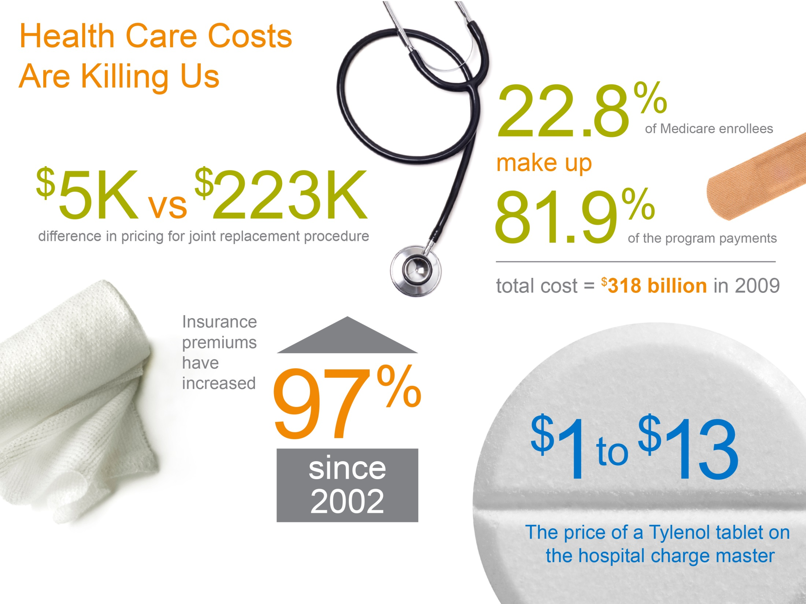
Sources: CMS. Office of Informational Services. Data from the Standard Analytical Files: Data Development
by the Office of Research, Development and Information. 2009; Kaiser and Health Research and Educational Trust. Survey of Employer-Sponsored Health Benefits, 1999–2012; CMS. Administration offers consumers
an unprecedented look at hospital charges [press release]. May 8, 2013; America’s Health Insurance Plans,
Center for Policy and Research. Recent Trends in Hospital Prices in California and Oregon. December 2010.

Slide 14
Prepare for Pricing Pressure
Change Healthcare Transparency Matrix
ELLIOT CAREBUNDLES OFFER HIGH-QUALITY CARE AT LOWEST PRICE WITH NO BILLS
Ultrasound
472
%
CT Scan
794
%
variability
$100–$572
variability
$300–$2,681
$1,995
Colonoscopy
$4,995
Hernia Repair
$5,995
Knee Arthroscopy
“
For providers who say, ‘I don’t compete on price,’ the question becomes, ‘How do you make additional data available to showcase your quality? What else are you willing to provide to enable informed decisions?’
“
—Doug Ghertner, President and CEO,
Change Healthcare Corporation
Sources: Elliot Health System. Elliot CareBundles offer high quality care at the lowest price with no bills [press release]. February 26, 2014;
Sg2 Interview With Change Healthcare, 2014.

Slide 15
Payers Opening Up Price Data
Blue Cross Blue Shield Estimated Treatment Costs: Upper GI Endoscopy*
Anil Tumbapura | $708
Ronald Schwarz | $829
Rex Surgery Center of Cary | $1,829
Duke Raleigh Hospital | $2,062
Rex Hospital | $3,112
WakeMed | $3,274
Raleigh
Breast
MRI
Knee Replacement
Knee Arthroscopy
3X
0.5X
10X
*Selective providers within 20-mile radius of Raleigh, NC.
Source: Blue Cross and Blue Shield (BCBS) of North Carolina. Estimated treatment cost results web page. Accessed January 2015.
Notes:
The state came out with their own look at pricing – lots of criticism
Then, BCBS came out with pricing information (without telling anyone). Feedback: critical from providers; consumer groups say it’s confusing
In first 3 weeks, 18,000 hits
This is more about setting the stage for negotiation, getting strong payment rates
“Price transparency is still finding its way.”
One of the best ways: for them (payer) to come to you because of your value equation
Openness to get paid for what (seeing info from competitors)
Trusted relationship with physicians still rules the day
Transparency hasn’t caught on yet
BCBS – advertising this as “becoming trusted partner” with patient – stealing that relationship from provider
Payment rate to providers

Slide 16



Is this The “Old” Model of Growth?
BUILD CAPACITY
RECRUIT PHYSICIANS
SIGN CONTRACTS
Notes:
The old model:
build, build, buildl; Hill Burton
Docs as your sales force
Contract with payors

Slide 17
What Changed?
OP Growth
Employee
Family
21%
38%
$ 9,695
(family OOP cost)
of covered
workers offered
+
$13,520
IP Growth
≥ $ 1,000
(employer cost)
-4%
=
$ 23,215
deductible plan
(year coverage for family)
944
Diabetes Apps on iTunes
Apps = applications; IP = inpatient; OOP = out-of-pocket; OP =outpatient.
Sources: Kaiser/HRET Survey of Employer Health Benefits, 2013; 2014 Milliman Medical Index; Application Search on iTunes, May 2014.
Notes:
Diabetes number – in the past, you only had two options: 1) appointment with physician or ED
Family of 4

Slide 18
Utilization Shifts Redefine Growth Opportunities
Adult Inpatient Forecast
US Market, 2015–2025
Adult Outpatient Forecast
US Market, 2015–2025
Discharges
Millions
Volumes
Billions
5-Year
10-Year
5-Year
10-Year
+21%
+7%
+15%
+13%
+16%
+8%
–4%
–2%
Sg2 IP Forecast Population-Based Forecast Sg2 OP Forecast
Note: Forecast excludes 0–17 age group.
Sources: Impact of Change® v15.0; NIS; PharMetrics; CMS; Sg2 Analysis, 2015.
Notes:
Peds:
Children’s Hospital = -2%
Non-Children’s Hospital = -6%

Slide 19
Factors Behind Weak Inpatient Volumes
Shift to observation status
Continued rise in deductibles, coinsurance
Increasing trend toward outpatient settings of care
Job growth ≠ health benefits growth
Practice pattern shift on the part of providers?
Growth in this environment is difficult but possible; the strongest, smartest organizations are growing and taking market share.

Slide 20








Sg2 Sites of Care Highlight Growth Opportunities Across the Continuum
2015 Site of Care Volumes and 5-Year Forecast, Adults
US Market, 2015–2020
Emergency Department
Inpatient
Acuity
+3% |  | Volume
 |  | 107M
–2% |  | Volume
 |  | 31M
Virtual
Volume in 2020
98M
In 2020, 7% of all evaluation and management visits will be delivered in a virtual care setting.
Hospital Outpatient/ Ambulatory Surgery Center
Skilled Nursing Facility
+12% |  | Volume
 |  | 483M
+4% |  | Volume
 |  | 4.6M
Home
+15% |  | Volume
 |  | 139M
Urgent/Retail Care
Office/Clinic
+7% |  | Volume
 |  | 13M
+9% |  | Volume
 |  | 2.4B
Other
+12% |  | Volume
 |  | 221M
Note: The analysis excludes 0–17 age group. Other includes nonhospital locations such as OP rehab facilities, psychiatric centers, hospice
centers, federally qualified health centers and assisted living facilities. Sources: Impact of Change® v15.0; NIS; PharMetrics; CMS; Sg2 Analysis, 2015.

Slide 21
Evolving Your Continuum of Care as a Channel Strategy

Slide 22

The Next Step in Your Growth Strategy Is Understanding Patient Flow
Where do patients enter the system?
Where do they go from there?
How many interactions do
they have per episode?
Are we losing patients to
our competitors?
How do we improve the
patient journey?
Notes:
Answer these business questions with Sg2 Patient Flow:
How do I drive share? How do I grow?
Which MDs/ MD Groups do I lean on?
Who do I acquire?
What other partners can I leverage to steer business to me?
How do I improve my SoC? My clinical product? My customer experience?
When patients leave do they come back?
How do I tackle eal upstream/downstream planning?
How do I make the best bets on site selection?
How do I decompress site-specific volumes?
How do I ensure that customers (esp. attributed lives) stay with me?
Answering key questions with data
Various entry points for patients: potential patients become actual patients
What limits this from happening: broken referral network; capacity issues; etc. What are the limitations?
Channels – active steerage
Radiology Example (information from Radiology Business Management Association):
47% have seen passive steerage (posting cost differential data)
65% have seen active steerage (calls to patients from payers or radiology benefit managers)

Slide 23

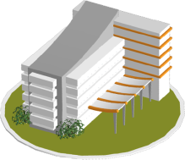


Continuum of Care Example: Breast Cancer
Hospital Surgical Suite or Ambulatory Surgery Center
Radiation Oncology Center
Inpatient (Medical) Management
Medical /Oncology and Primary Care Physician Offices
Multidisciplinary Care Conference
Imaging and Diagnostic Center
Survivorship (Virtual)
Infusion Suite
Primary Care Physician or Ob/Gyn Offices
Home
Screening Centers
Self
ASC = ambulatory surgery center;; MDC = multidisciplinary care; Med/Onc = medical oncology; Ob/Gyn = obstetrics/gynecology; PCP = primary care physician; Rad/Onc = radiation/oncology.
Source: Sg2 Analysis, 2015.
Notes:
Key message about Breast Cancer in one market using data:
Sample AMC – 93% of surgical patients had surgery at the hospital after having their mammogram there;
Sample Community Hospital – 39% of surgical patients had surgery at the hospital after having their mammogram there. Surgical patients lost to: 1) In-system hospital (26%); 2) Competitors – 1 health system and 2 AMCs (34%)
New breast cancer system of care – adapted it to breast cancer
The care continuum
Each box is a node or site of care – important thing not the node themselves, but the line that connects them
3 areas – diagnosis, early care, acute treatment, ongoing treatment, survivorship
Owned, affiliated and virtual sites of care -
Patient information and patient needs - What is the patient’s experience like as they move through this path?
Clinical decisions - How are clinical decisions made along this path? Are they coordinated? Are the evidence based?
Operations and logistics – Logistically, how does a patient move through? What are the operational challenges at each node and between nodes? Do patients fall through the gaps?

Slide 24
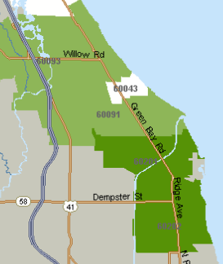
Know Where Consumers Receive Services
Spine Services
Chicago North Shore Area
2012–2013
Total Spine Services for 2 Zips
13% Physical Therapists
12% General Acute Care Hospitals
5% Other
69% Chiropractors
KEY QUESTIONS
Where are patients going for care?
Who are they seeing?
What is the patient pattern across the continuum?
Volume by Zip Code
100,000 to 119,000
50,000 to 99,999
20,000 to 49,999
3,000 to 19,999
Note: Other includes emergency medicine physicians, internal medicine physicians, sports medicine specialists; this analysis excludes lab.
Sources: Health Intelligence Company, LLC; Sg2 Ambulatory Market Share v1.0; Sg2 Analysis, 2014.
Notes:
Ask the group: who do you think saw the majority of these spine cases?
These graphics show all activity (visits, procedures, rehab, etc) across all sites of care (hospital, OP, private therapy locations, etc)
Includes all ages

Slide 25










Sg2 Channel Strategy Principles
Consumers follow predictable, but variable
pathways across the continuum.
Expect many nuances by disease, market
and patient. —DATA MATTER.
Channel strategy includes
consumer acquisition and retention.
Channels can optimize the
consumer journey across sites of care.
You can identify, quantify and influence channel patterns.
The one who controls the channels optimizes growth.
Notes:
Focus on “keepage” instead of “leakage” – huge play with care coordination.

Slide 26

Build a Multichannel Approach for Sustainable Growth
Sg2 Channel Spectrum by Maturity
Complementary and Alternative Medicine Providers
Ambulatory
Campuses*
Specialty
Care
Clinics
Consumer Decision
Support Tools
Acute Care
Facilities
and EDs
Freestanding
EDs
Employer
On-site
Clinics
Retail
Clinics
System-Wide Clinical Contact Centers
Primary
Care
Clinics
Consumer-Facing Virtual Health
Freestanding Imaging and Diagnostic Centers
Payer
Contracts
Direct Employer Contracting
Urgent
Care
Clinics
Affiliations and
Partnerships
Clinician-to-Clinician Virtual Health
Community Organizations
Physical
Relational
MATURE
EVOLVING
EMERGING
*Ambulatory campuses vary widely, from multidisciplinary, comprehensive centers to facilities focused on specific services (eg, outpatient rehab, endoscopies, urgent care). Source: Sg2 Analysis, 2014.

Slide 27
Consumerism and Retail as a Critical Channel

Slide 28


What
Chicago-Area
Health Care Providers
Know About Me . . .
CVS
How frequently I use my inhaler.
I got a flu shot in October.
I had suspected pneumonia last Fall.
I don’t plan my shopping for milk.
I have children.
My passport was just renewed.
Where I took my last vacation
Where I live and my likely commuting pattern
My Doctor
Lab values
Prescribed albuterol for infrequent asthma
Hospitals/
Health Systems
Nothing
LEVEL OF INTERACTION
Never
30 minutes/year
A few visits/month; app downloaded on my iPhone
Notes:
Patient who has never been to the hospital.
Hospitals know some financial and some clinical

Slide 29
Understand Market Influencers of Consumer Behavior
Health benefits design
Narrow networks
Public and private exchanges
Coverage
Choice
Availability
of Information
Price and quality transparency
Rising Expectations
Digital connectivity
“My” continuum of care network
Notes:
Reverse auctions
Recent report – healthcare is a step above (just) the airline industry with regard to meeting expectations

Slide 30
Connecting Care Through Coordination

Slide 31
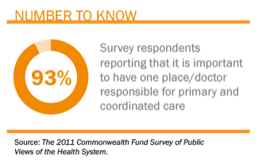
What Is Care Coordination?
A systematic effort to ensure that patients receive high-quality care appropriate to their medical needs and personal preferences, and that services are integrated across settings and over time.
Survey respondents
reporting that it is important
to have one place/doctor
responsible for primary
and coordinated care.

Slide 32
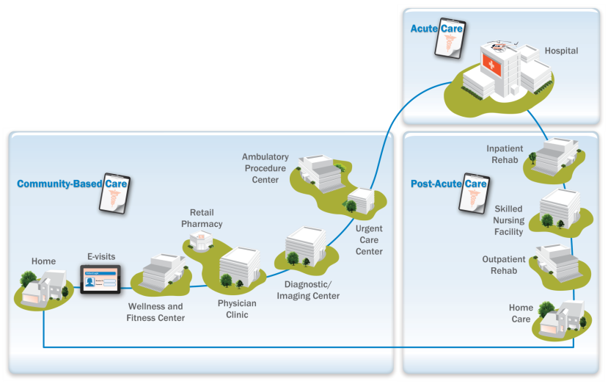
Why Care Coordination Is the Key to Healthcare Strategy
Care coordination spans the continuum of care,
connecting patients’ needs with appropriate services.
Care
Managers
Primary Care Network
Information
Systems and Analytics

Slide 33
Care Coordination Addresses Multiple Motivating Factors in Healthcare
Care Coordination
Cost
Quality
Patient Experience
Workforce

Slide 34
Coordination of Care is a Key Theme of Vision 2020’s Strategies and Tactics
Planning Guidelines | Care Coordination-Related Strategies
Regionalization | Serve as the regional referral center for physician groups in high opportunity geographies Establish a telehealth network to strengthen relationships with other providers, improve access to care in rural areas Become the regional provider of choice for Tulsa and in the regions by establishing a network with rural hospitals
Grow the Clinic | Expand primary care footprint in the community and the key regional geographies Consider establishing new specialty clinics in regions with high growth and limited access to care
Measureable High Quality Across the Continuum of Care | Reduce readmissions through robust alignment and management of post-acute care provider relationships Redesign clinical pathways for specific patient populations to minimize adverse outcomes Develop continuum of care strategy to manage quality across care continuum (variation, utilization) Re-evaluate opportunities to partner with retail providers and employers in regions
Integration Toward Population Health | Expand team-based approach in primary care to maximize existing work force and meet patient needs Continue to explore and grow patient centric medical homes to manage complex patients Integrate behavioral health into primary care practice to improve access to services, manage patients Establish disease management programs for key conditions to reduce costs to the system
Workforce Development and Education | Recruit advanced practitioners and build clinical teams to offset future physician shortages Develop specific strategic plan to optimize use of Advanced Practitioners across organization
Financial Viability | Manage costs across the entire care continuum to capture the shift from volume to value

Slide 35
We Need a Greater Focus on the Driving Factors of Health
Determinants of Health
15% Social Circumstances
30% Genetic Predispositions
Shortfalls in Medical Care 10%
 | Environmental Exposures 5%
 | Behavioral Patterns 40%
Source: McGinnis JM et al. Health Aff (Millwood). 2002;21:78–93.

Slide 36
How Do We Focus on The Provision of Care?
How Are
We Managing
the 95%?
95%
Prospective
Occasional
Chronic
5%
Patients
High-Risk
Patients

Slide 37
Strategies to Manage 5% High-Risk Population
Risk stratify target groups.
Tailor care coordination roles.
Redesign primary care and post-acute care.
Integrate behavioral health into primary care and ED.
Engage patients as care partners.
Deploy virtual health to meet clinical management needs.
Tailor care coordination roles.

Slide 38
Contact Centers Generate Workforce Efficiency and Improved Access
HEALTH SYSTEM A
Mary: Age 35
Health Concern: Headache and sinus pressure
Mary calls PCP office (schedule is full).
Mary schedules appointment with competitor’s PCP.
HEALTH SYSTEM B
Clinical Contact Center
PCP unavailable (schedule full)
Sam: Age 52
Health Concern: Abdominal pain
Call is automatically routed to clinical contact center.
Alternate PCP not available (after hours)
Sam calls his PCP office to schedule appointment.
Contact Center Nurse:
Triages situation
Schedules/directs Sam to appropriate and available care setting
Sam is scheduled with Health System B’s Urgent Care Center (immediate availability).
Notes:
Health System A – Typical
Health System B & Clinical Contact Center:
Provides alternative: Advocate has gone to market with a 24 hour guarantee
Seamless interface
LPNs included
Allows growth strategy and getting patient to right location; reduce leakage
Generate 24 hour response or appointment availability
Identify unused appointment availability
Open access for scheduling
Disease management
Follow-up case management
Control channels – reduce leakage

Slide 39

Optimized Care Team Extends Care Coordination Beyond the Health System
Community Team Model
“Half of the ideal care team will be nonlicensed… working in neighborhoods, schools and at worksites.”
—Douglas Wood, MD, Medical Director, Center for Innovation, Mayo Clinic
Physician Team Leader
RNs and APNs care for simple to complex patients.
Care coordinators (nonclinical) focus on engagement, activation and wellness.
RN = registered nurse. APN = advanced practice nurse.

Slide 40
Post-Acute Care Includes Four Key Sites of Care
Site | Appropriate Patients
Long-term Acute Care | Critically complex patients; Length of stay >25 days; ventilated patients
Inpatient Rehab Facilities | Provide intensive services after an injury, illness or surgery; tolerate and benefit from at least three hours of daily therapy.
Skilled Nursing Facilities | Offer short-term skilled care and rehabilitation services to beneficiaries after an acute-hospital stay of at least 3 days.
Home Health Agencies | Provide skilled care to beneficiaries who are “homebound.”
Notes:
Hospice is a big 5th

Slide 41
Goals for Post-Acute Care Have Evolved
Under Payment Reform
 | Fee-for Service Era | Penalty Avoidance Era | Accountability Era
Finances | Acute length of stay reduction | Length of stay and readmission | Common bottom line with shared responsibility for cost
Access | Broader is better | Access and low readmissions | Access balanced by cost-effectiveness
Efficiency | Ease of access | Access and low readmissions | Essential under global payment
Quality | Site specific | Matters in so far as it impacts readmissions | Quality impacts finances, efficiency and market share
Integration | Silos | Partners in readmission reduction | Interdependent
Shared Measures | None | Readmission rates and site specific | Cost, quality, patient satisfaction
Reputation | Site specific | Site specific | Reputation linked across the entire episode of care
Source: Sg2 Interview With David Storto. Partners HealthCare, 2013.
Notes:
Accountability Era takes into account global payment and episode of care
SNF and HH are now required to report readmissions – penalties will be happening shortly

Slide 42
Be Aware of the Wild Cards and Execute Effectively

Slide 43
What Did the Future Look Like in 2005?
Readmission penalties hit
ACOs invented and soon number more than 500
Big data comes to hospitals
2005
The recession
The Affordable Care Act becomes law
Today
Mobile apps take off
Barack Obama elected president
Apple’s iPhone changes the industry
EHR adoption grows
A permanent SGR fix
SGR = sustainable growth rate.
Notes:
Let’s take a step back a decade to 2005
Imagine you were planning forward then
You couldn’t have foreseen any of these events, and yet how many of them drastically disrupted you?

Slide 44
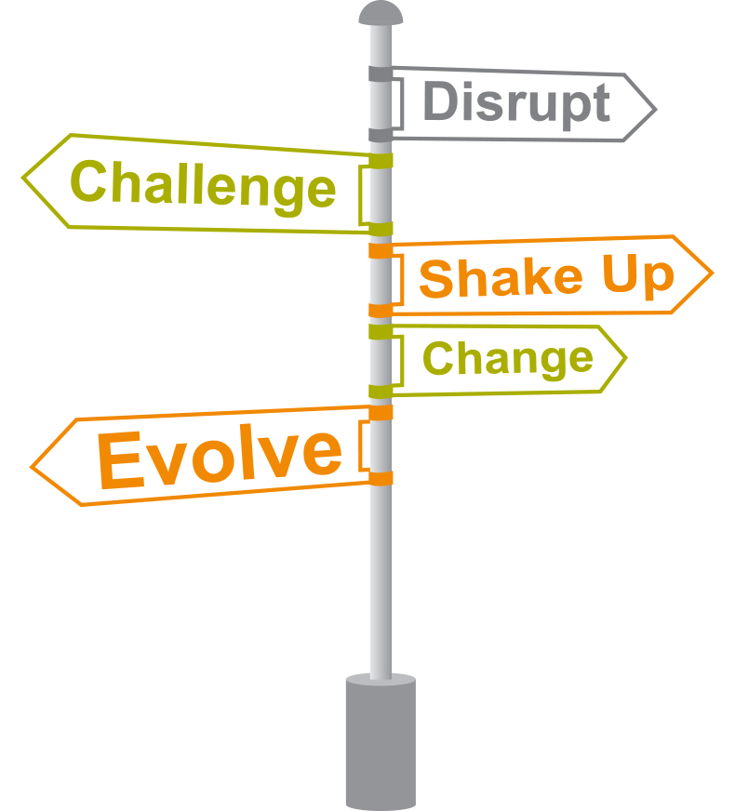
Disruptors Abound, and Will Likely Influence Health Care More and More
Reinventing everything about laboratory testing
Scaling expertise in personalized medicine
Maximizing human capabilities with wearable computer interfaces

Slide 45
What Does the Future Look Like Now?
Health reform is back on the national agenda
Sequestration is extended indefinitely
Site neutrality: HOPD payments equal ASCs’
95% of payments non-FFS
Today
2025
Half of all E&M visits are virtual
A second recession
Public option established on exchanges
Medicare’s Trust Fund is no longer solvent
90% of hospital revenue is OP
ASC = ambulatory surgery center; E&M = evaluation and management; FFS = fee-for-service; HOPD = hospital outpatient department.
Notes:
Similarly, there will be disrupters in the next 10 years that you can’t foresee
Any of these could happen—how would you respond if they did?

Slide 46
Key Imperatives For The Future
1
Position in the “value driven” world …
… but don’t lose sight of current payment models
Evolve the continuum of care.
Take a broader view of channel strategy.
Prepare to engage with the consumer.
Watch for the wild cards that may disrupt.
Excel in execution.
2
3
4
5
6
7

Slide 47
Questions
?

