Slide 1


Slide 2
Value Based Reimbursement:
Succeeding with Payments Based on Attributed Lives
Ray Herschman
President/COO
xG Health Solutions
Confidential property of xG Health Solutions, Inc.
Re-creation or delivery to another party in any format is strictly prohibited.

Slide 3

Industry Trends
All constituents are under some level of pressure to enact change
Increasing consensus that alignment and collaboration are necessary to survive
Prior managed care failures and improved information technology applications are changing the approach to collaboration
New opportunities for innovation are revealing themselves across the entire continuum of care
Burning Platform for Healthcare Transformation

Slide 4
Healthcare Spending Continues to Grow
Recent moderation in trend is promising, but not clear yet whether structural
Unsustainable Spending Growth

Slide 5
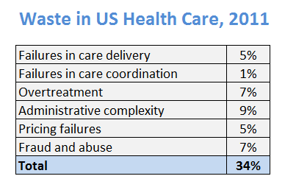
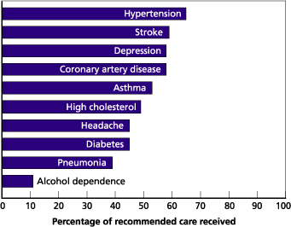
Traditional Healthcare Financing Creates Waste
Berwick & Hackbrath JAMA 2011
Source: National Report Card on Quality of Health Care in America, Rand Corp report
Are we getting our money’s worth?

Slide 6
Before 2014
2014 - 2017
2017 and 2022
Regulatory Reform/Private Sector Restructuring
Federal/state regulations
Interpretation and preparation
Private exchange investments
Rationalizing DB health coverage/self vs fully insured
Implementation & Adaptation
Public exchanges open
Private exchange adoption
Movement from B2B to B2C
Benefit and network redesign
Transparency
Consumer activation and agitation
New Normal
Localized choice
Level playing field & competition
Regulatory refinement
Insurance Coverage Transformation
New Normal
Innovation, proto-types and proof of concept
Volume to Value
Broad range of collaborative care models
Cost, quality and patient experience transparency
Competition based on cost and quality
Clinical data interoperability
Radical improvement in quality & value
Provider accountability/control (VBR)
Provider-driven health management
Carve-in / re-aggregation of total costs
Rapid adaptation/maturity of proven models of care delivery
Emergence of new enablers/intermediaries – data, analytics, services, devices
Patient Centered Medical Homes
Bundled Payment/(warranty)
Accountable Care Organizations
EMR, HIE and Analytics
P4P, Shared savings, Shared risk
Care Delivery
And Reimbursement Transformation
Health Care Market Transformation:
2 Major Vectors of Change

Slide 7
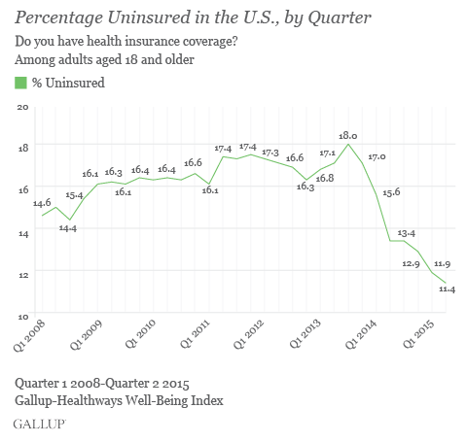
Decreasing Volume of Uninsured
The Coverage Gap is Closing

Slide 8
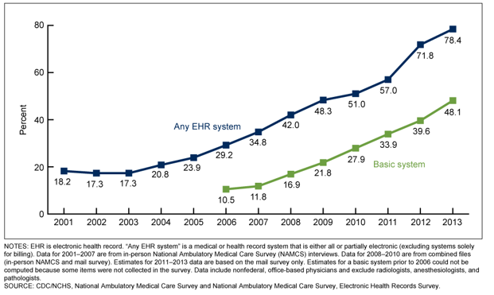
Percentage of Office-Based Physicians with EHR systems: United States, 2001-2013
Electronic Health Record Adaption

Slide 9

Payment Transformation:
Age-old Question
Is Answered…

Slide 10
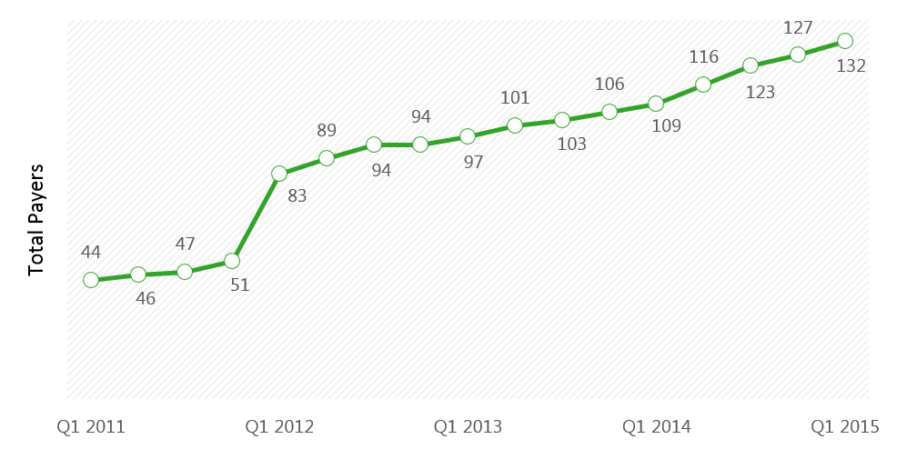
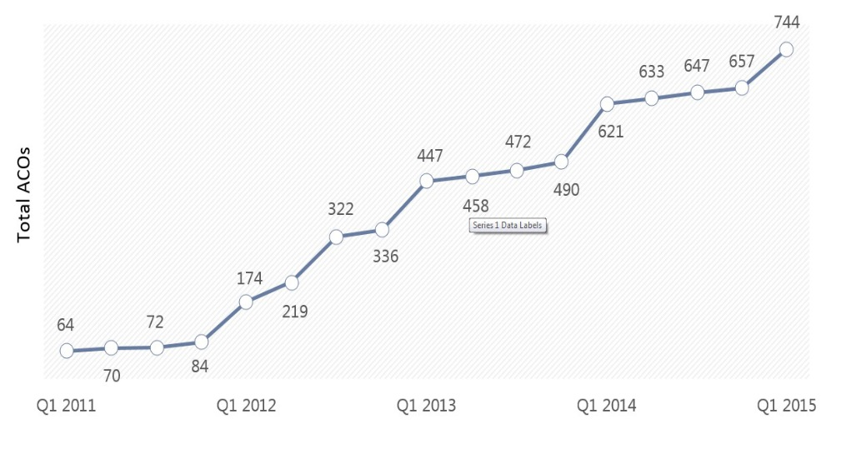
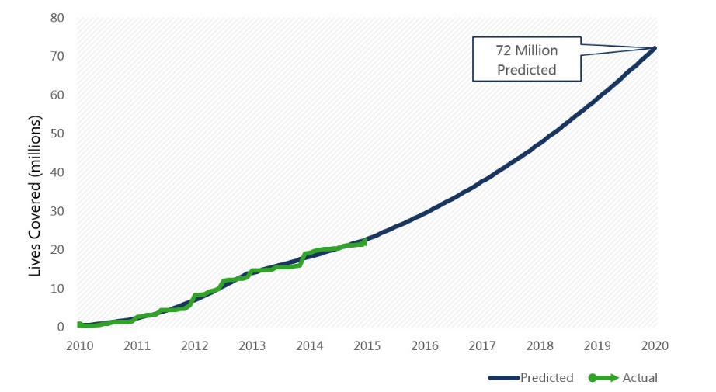
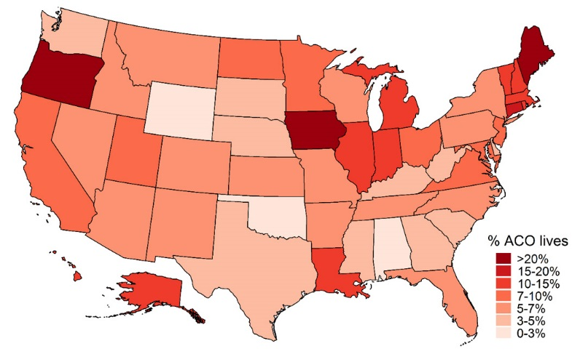
Increase in Number of Payers Participating in Accountable Care
Increase in Medicare ACOs
Source: Health Affairs Blog with data from Leavitt Partners February 2013.
Source: Leavitt Partners, Growth and Dispersion of Accountable Care Organizations: Q1 2015 Update.
Covered Lives Growth Estimates
Geographic Distribution of ACO Covered Lives
10
Source: Health Affairs Blog with data from Leavitt Partners February 2013.
Source: Leavitt Partners, Geographic Distribution of ACO Covered Lives January 2015 Update.
Volume to Value Migration Accelerating:
Population Based Value Based Reimbursement

Slide 11

Current way healthcare is paid for leads to higher cost
Quality is an afterthought - concept of warranty is foreign
Transparency regarding quality and total cost of care for an episode is lacking (informed consumer?)
Today, there is no easy connection between benefit designs and episodic/bundled payment
Episodes of Care – Bundled Payments:
What Is the Plan? A Problem in Need of a Solution

Slide 12
Increasing partnerships with hospital systems, primarily around bundled care for ortho/cardiac procedures for adults
Large Employers Are Getting In The Mix
Illustrative examples
Source: AonHewitt
Black Hills Surgical Hospital agreement with South Dakota
state employees for lower-back procedures
Mayo Clinic agreement
with Walmart for cardiac
and spine procedures
Northwestern Memorial Hospital agreement with GE for orthopedic procedures
Cleveland Clinic agreement with Boeing, Walmart,
and Lowe’s for cardiac and
orthopedic procedures
VMMC contract for
cardiac and spine
procedures with
Walmart
Geisinger agreement
with Walmart for
cardiac and
spinal care
UCSF contract for
various procedures
with CalPERS
Johns Hopkins
agreement with
PepsiCo for cardiac
and orthopedic
procedures
Hoag contract for
orthopedic procedures
with Kroger employees
Carolinas HealthCare
agreement with
local employers for
cardiac care
Colorado Business
Group on Health
agreement with
local employers for
cardiac care
Scott & White
agreement with
Walmart for cardiac
and spine procedures
Mercy Hospital
agreement with
Walmart for cardiac
and spinal care
Strong interest from employers in creating bundled payments around high volume procedures such as hips, knees and backs
Source: FierceHealthcare, Advisory Board Company, CalPers

Slide 13
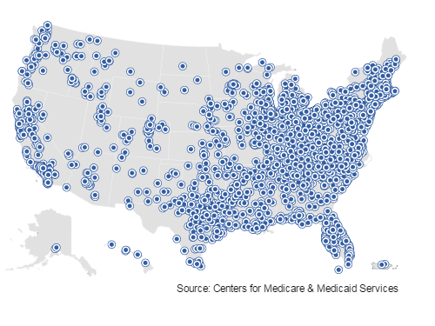
Federal and State Stakeholders as Catalysts
July 1, 2015, 2115 phase 2 (risk bearing) participants
CMS Driven - Bundled Payment for Care Improvement (BPCI)
State Driven – Ohio, Arkansas, Washington, etc.
Commercial Insurance Driven
Public/Private Partnerships Increasing

Slide 14

            June 09, 2011 Los Angeles Times
WellPoint to buy CareMore Health Group for about $800 million
“The deal is part of an effort by WellPoint to boost its presence in the senior care market. CareMore, based in Cerritos, has 26 clinics in California, Nevada and Arizona that specialize in caring for people on Medicare.”
          October 2012 AIS Report on BCBS Plans
N.C Blues Plan Invests in Urgent Care to
Cut ER Costs
“...the catalyst for the deal with FastMed came following a review of data regarding ER visits by members...Non-emergency ER visits represent about 14% of all ER claims paid by the insurer, and a 5% shift away from ER use to urgent care clinics could reduce medical spending by $8 million annually.
                July 2011 Managed Care Magazine
Humana Steps Back To Seize the Future
“When Humana recently purchased Concentra, a company that, among other things, operates 300 stand-alone clinics, the plan entered familiar terrain. Before becoming primarily a health insurance company in 1993, Humana was the nation’s largest for-profit hospital company.”
            November 20, 2012 Pittsburgh BusinessTimes
Highmark-WPAHS talks get underway
“The acquisition must be approved by the state Insurance Department, which would also open the doors to an additional $200 million infusion for WPAHS from Highmark. Highmark has already committed $200 million to WPAHS as part of its effort to create a $1 billion medical network to compete with the University of Pittsburgh Medical Center.”
                September 1, 2011 WALL STREET JOURNAL
UnitedHealth Buys California Group of 2,300 Doctors
“UnitedHealth Group Inc. will acquire the operations of a major southern California physician group, in the latest example of how lines are blurring between insurance companies and health-care providers..”
            January 17, 2013 CNBC
New Cigna Medical Group Health Center Opens
“The treatment center is designed to provide cutting-edge health care to Cigna customers through easy access to primary care physicians...”
Source: Revive Health Marketing
Payers Becoming Providers

Slide 15

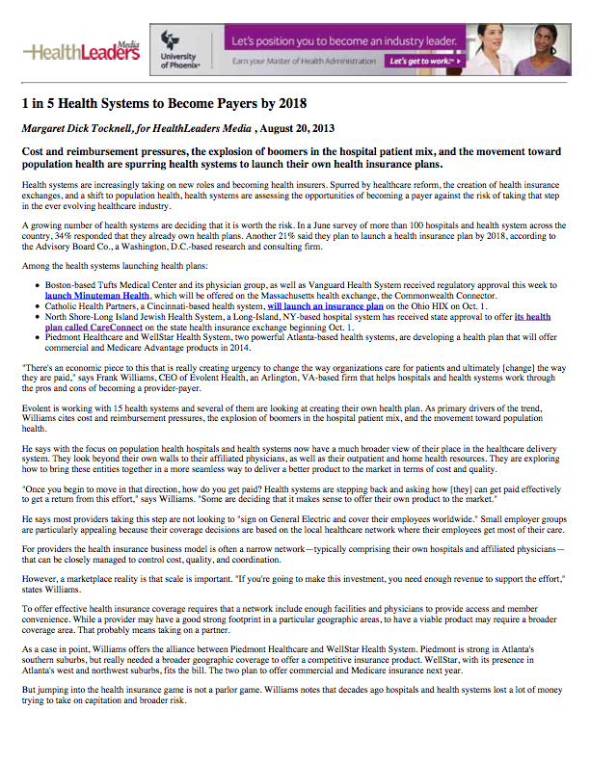
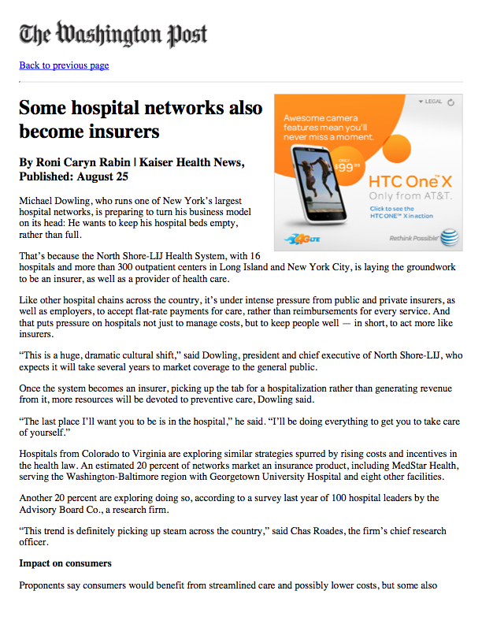
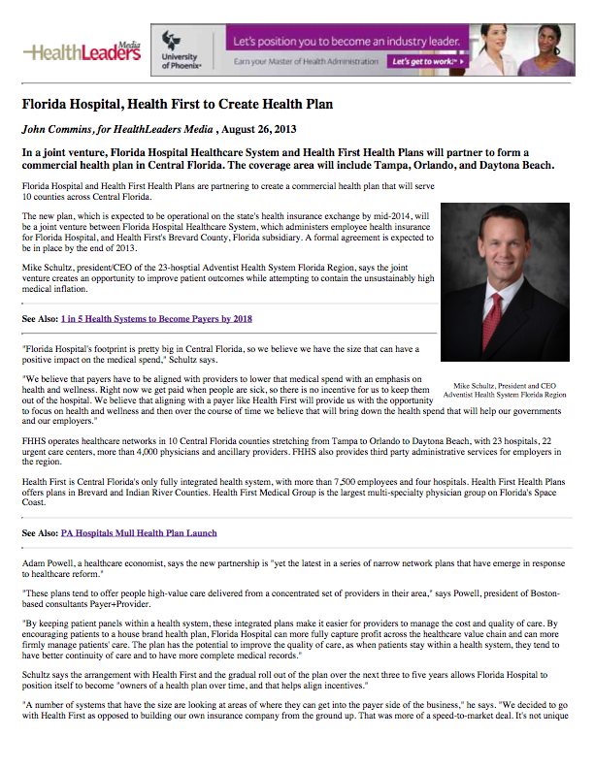
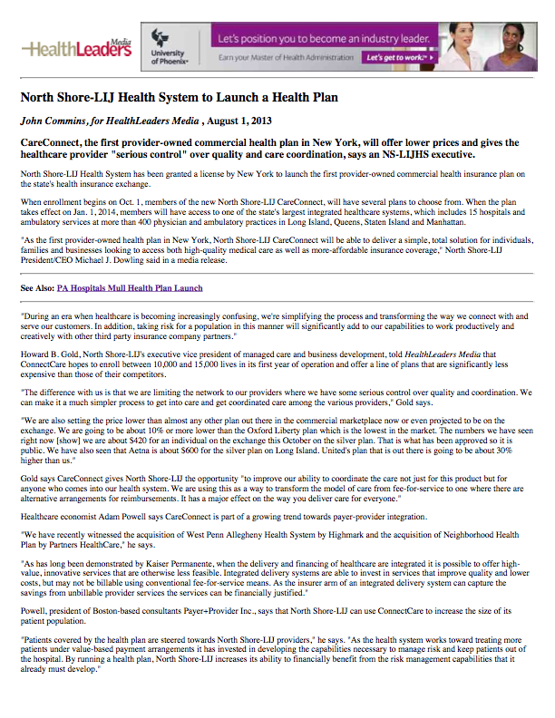
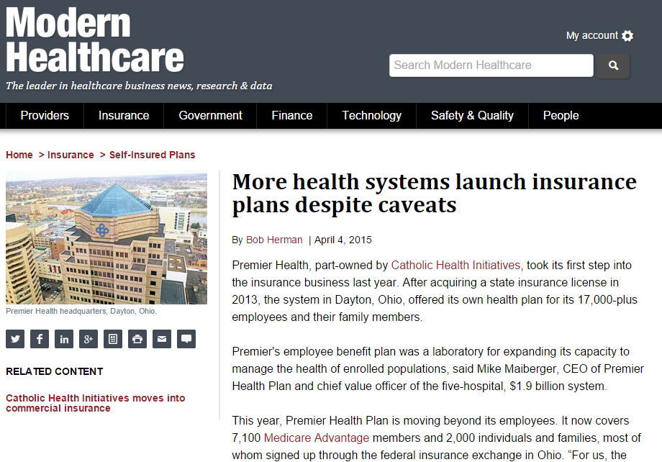
Providers Becoming Payers

Slide 16

Provider/Payer Partnerships
Creating Partnerships
Defining the value of provider and payer relationships from the health plan perspective
Defining the value of provider and payer relationships from the provider perspective
Positioning your organization for healthcare reform by aligning goals and tactics

Slide 17
So…….
What does it mean?
col·lab·o·ra·tion
kəˌlabəˈrāSH(ə)n/ A recursive process where two or more organizations work together to realize shared goals
part·ner·ship
pärtnərˌShip An arrangement where parties agree to cooperate to advance their mutual interests
Trust : One party (trustor) is willing to rely on the actions of another party (trustee); the situation is directed to the future. The trustor (voluntarily or forcedly) abandons control over the actions performed by the trustee. As a consequence, the trustor is uncertain about the outcome of the other's actions; they can only develop and evaluate expectations. The uncertainty involves the risk of failure or harm to the trustor if the trustee will not behave as desired

Slide 18
Integrated Care Delivery
Primary Care Physicians
Specialty Care Physicians
Outpatient Hospital Care and ASCs
Inpatient Hospital Acute
Care
Long Term Acute Hospital Care
Inpatient Rehab Hospital Care
Skilled Nursing Facility Care
Home Health Care
Post Acute Care (PAC) Episode Bundling
Acute Care Episode with PAC Bundling
Acute Care Bundling
Medical Home
Source: The American Hospital Association (AHA)
Rethinking the Organization of Care
Creating “Systemness”

Slide 19
Succeeding with Payments Based on Attributed Lives
  Population Health Management in Action:
  Primary Care Re-Design and Diabetes Systems of Care
18

Slide 20



2000-2006
Enterprise Data Warehouse
Evidence-Based Protocols
Health Plan – Clinical Enterprise Collaboration
PGP Demo (ACO Precursor)
1996
EHR
2013-2014
Medicaid Risk
Management of Specialty Pharma
2011-2012
Clinical Decision Support Integrated into or Interfaced with EHR
Transitions of Care
2007-2010
Value Reengineering
  Primary care redesign
  Advanced PCMH, with embedded case managers
Geisinger’s Decades of Innovation

Slide 21








xG Health Was Created to Generalize and Scale Geisinger Innovations and Know-How
PRODUCT DEVELOPMENT
& SERVICE DELIVERY
CORE OPERATIONS
Mandate: Execute Core Business/Innovate
Mandate: Generalize/Disseminate/For Profit
Geisinger Health Plan
Evaluation & Roadmap
Reduced Cost
of Care
Care Redesign
Quality & Safety
Research
Improved Quality and Coordination of Care
Population Management
IP Development
&
Refinement
IP
IP
xG Health
IP Productization
Analytic
Services
Improved Clinical Outcomes
Clinical Enterprise
Geisinger Support Services
EHR Optimization
Innovation & Transformation
Bundled Payments
Improved Patient & Provider Satisfaction
Confidential property of xG Health Solutions, Inc. - Re-creation or delivery to another party in any format is strictly prohibited.

Slide 22
Providing Scale Across Industry
2010-2014
Generalizing
2015+
Implementing at Scale
Adapted Geisinger approaches to various environments
Implementing
Advanced PCMHs and training ‘Commando RNs’
Proved they work in
those environments
Implementing
evidence-based best practices
Developed scalable approaches
Data analytics
Bundled payment for episodes
Actionable cost and care management orientation
Integrating results of data analyses into clinical workflow

Slide 23
Guiding Principles of Primary Care Redesign
Primary Care Physician led team-delivered care
Care team members functioning at “top of the license”
Monthly Care Team meetings
Patient Centered
Primary Care
Design
Population
Specific Care
Management
Population identification, segmentation and risk stratification
Manage both high risk and lower acuity and well population
Embedded case management approach for high risk
Medical
Neighborhood
360°care systems – SNF, ED, hospitals, HH, pharmacy, etc.
High value referral systems across full continuum of care
Transitions of care across care settings
Performance
Management
Patient and clinician satisfaction
Cost of care, utilization, efficiency
All-or-none sets of performance measures
Value-Based
Reimbursement
Fee-for-service with P4P payments for quality outcomes
Total cost of care (PMPM) targets
Payments aligned with measured performance metrics
Primary care redesign serves as foundation of patient-centered medical home

Slide 24
Guiding Principles of Workflow Redesign
Eliminate
Automate
Delegate
Incorporate
Activate
Eliminate all non-value-added work
Automate as manual tasks as possible
Delegate office visit-related work to trained non-physician staff
Incorporate new workflows into provider practice
  Use hardwired reminders and EHR tools to enhance care reliability and efficiency
Activate patients and families to participate in their care

Slide 25
Guiding Principles of a System of Care
System of Care Components
Established Techniques
Guideline development
Education
Measurement
Timely feedback of data
Patient education
New Techniques
Delegated team responsibilities
Strategies to pull patients into care
Non-office-visit-based care
EHR reminders
Pay-for-performance

Slide 26
Case Study: Diabetes Management
Lifetime Medical Costs for Treating Type 2 Diabetes
Lifetime Medical Costs for Men
Lifetime Medical Costs for Women
$124,700
$130,800
$106,200
$110,400
$84,000
$85,500
$54,700
$56,600
59%
Age at Time of Diagnosis
Age at Time of Diagnosis
~27.75 million
~1.7 million
Number of people in United States with Type 2 Diabetes
New Cases of Type 2 Diabetes Every Year
Source: American Diabetes Association, American Journal of Preventive Medicine, September 2013
Goal is to eliminate system waste, improve care and reduce cost

Slide 27

All-or-None Bundle Measures
Measures percentage of patients who receive all related services, not the scores of the individual measures
Better reflects the patient’s interest and desire to have all recommended care provided
Encourages systems approach to achieving all goals rather than work on one measure at a time
Gives a more comprehensive scale for tracking systemic improvements
Nolan T, Berwick DM. All-or-none measurement raises the bar on performance.
_{JAMA 2006;295:1168-70}
Pretend it’s your mother

Slide 28
Case Study: Diabetes Performance Measure Set
Measures | Quality Standard
HgbA1C – patient specific goal | Meets patient goal on problem list
LDL – patient specific goal | Meets goal or on high-intensity statin
Blood pressure goal | Meets patient goal on problem list
Urine protein testing | Yearly
Pneumococcal immunization | Once <65, Once >65 (at least 5 yrs. after 1st test)
Smoking Status | Non-smoker
Patients who achieve ALL of the above standards | Diabetes Management Bundle Percentage
All-Or-None Performance Measures

Slide 29
Results at Geisinger Health System
What we know:
Not all patients achieve each measure – for example, not all patients with diabetes should have a HbA1c < 7
Individual component scores for GHS were above the ADA recommended goals
Yet initial compounded GHS score was only 2.4%
Easy to recognize that a dramatic restructuring of the care provided to patients with diabetes is needed
All-Or-None Performance Measures

Slide 30
All-or-none set of performance measures for diabetes
Case Study: System of Care for Diabetes
Applying the principles of workflow redesign:
Eliminate
Automate
Delegate
Incorporate
Activate
Notable Process Improvements
Provide clinical decision support – health management and evidence-based alerts
Expand patient-specific strategies using registry report data
Identify care gaps
Refocus on patient-centered strategies – patient report cards
Restructure physician compensation packages
Workflow Redesign

Slide 31
Examples of Workflow Redesign
Eliminate all non-value added work
Automate | Computer/EHR Alerts and reminders as pre-visit planning Reminder letters – care gaps outreach
Delegate | Clerical Scheduling of flu/pneumococcal, follow-up Clinic Nurse Immunizations, lab testing, foot exam Case Manager High-intensity coordination/education
Incorporate | Nurses Rooming process to measure evidence-based alert Providers Alerts and reminders for complex decisions
Activate | Patients and Families Patient portal, patient report cards
Workflow Redesign

Slide 32
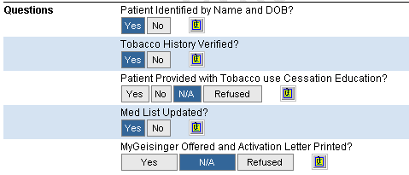
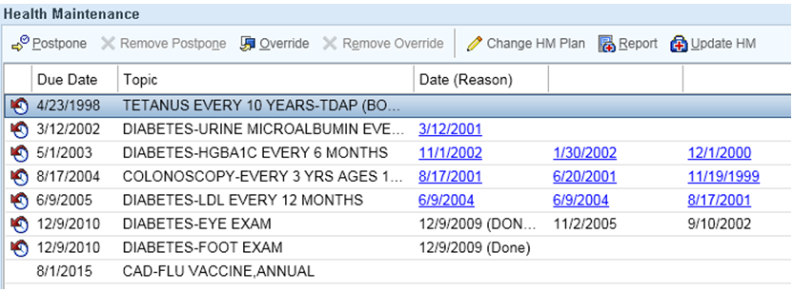
Optimizing Electronic Health Records
EHR Enhancements: Nurse Rooming Process
EHR Enhancements: Health Management Reminder
Workflow Redesign

Slide 33
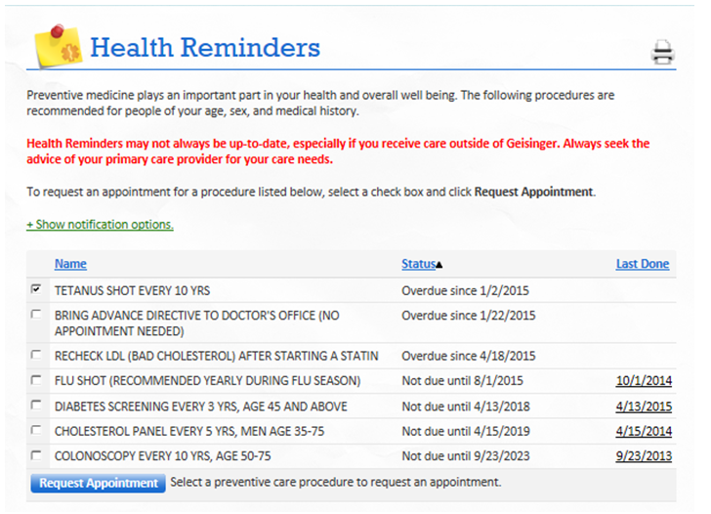
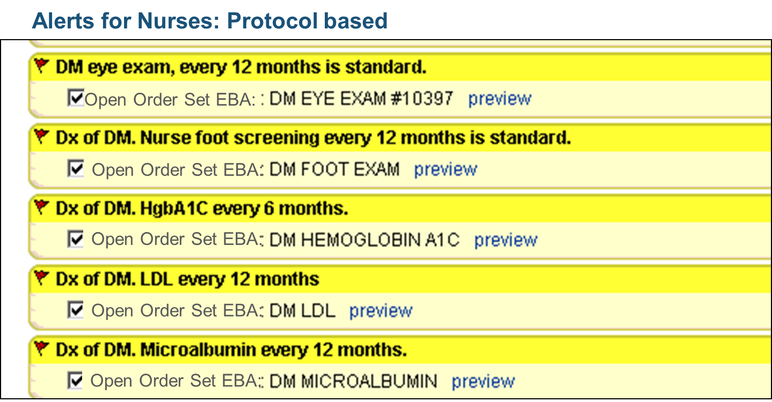
Patient Activation: Portal-Based Report Card
Optimizing Electronic Health Records
EHR Enhancements:
Diabetes Management Evidence-Based Alerts
EHR Enhancements: Diabetes Management Evidence-Based Alerts
Workflow Redesign

Slide 34


Prevention and Chronic Disease Letter Automation
Optimizing Electronic Health Records

Slide 35
Timely data feedback is key success driver
Electronic Health Records to Support a System of Care
1
EHR facilitates clinical data collection without manual chart reviews
Data collected on an individual physician basis; summarizing data into site reports encourages
team-based solutions and accountability
Diabetes set of performance measures currently includes nine components
Performance measures metric is percentage of site patients who achieve all nine of their diabetes goals
2
3
4
EHR Optimization

Slide 36
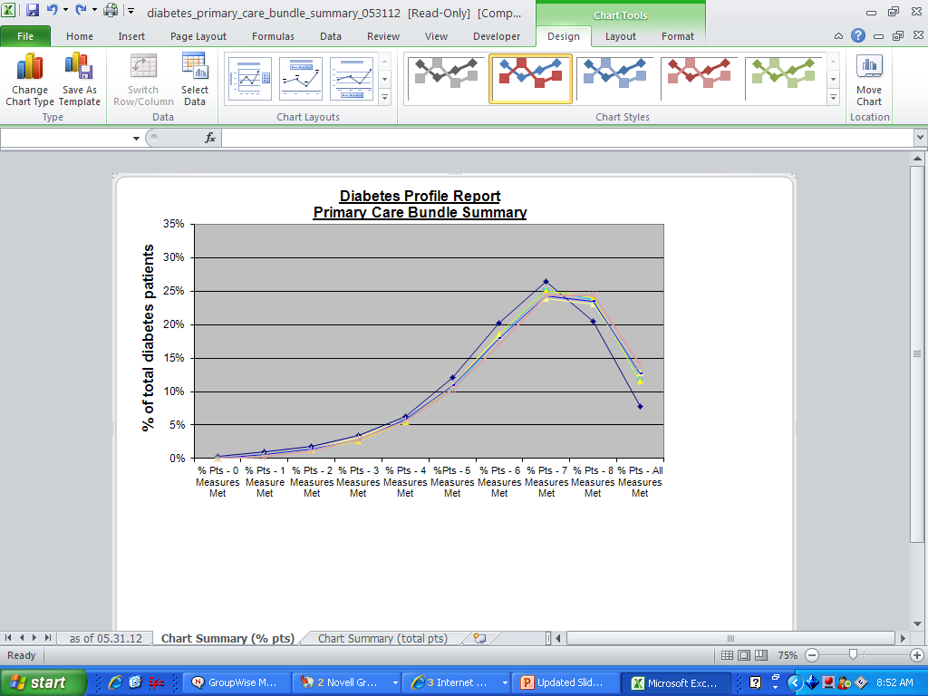
Diabetes Performance Measure Set Improvement
Entire Population Shifts Toward Better Care
Diabetes Profile Report Primary Care Performance Measures Summary
Measure Set Increases

Slide 37
Improving Diabetes Care for 29,825 Patients
Measuring Results, Improving Outcomes
Diabetes Performance Measures Percentage | 3/06 | 4/14 | 3/15 | 4/15
Number of Patients | 20,178 | 27,960 | 30,165 | 29,825
Diabetes Bundle Percentage | 2.4% | 13.9% | 17.7% | 18.0%
% Pneumococcal Vaccination | 59% | 79% | 80% | 80%
% Microalbumin Result | 58% | 78% | 77% | 77%
% HgbA1c at Goal | 33% | 47% | 47% | 47%
% LDL at Goal | 50% | 60% | 65% | 65%
% BP at Goal | 39% | 79% | 76% | 76%
% Documented Non-Smokers | 74% | 85% | 85% | 85%

Slide 38
Improving CAD Care for 18,361 Patients
Measuring Results, Improving Outcomes
CAD Performance Measures Percentage | 3/06 | 4/14 | 3/15 | 4/15
Number of Patients | 13,688 | 17,227 | 18,448 | 18,361
CAD Bundle Percentage | 8% | 26% | 30% | 30%
% LDL <100 or <70 if High Risk | 38% | 62% | 70% | 70%
% ACE/ARB in LVSD, DM, HTN | 65% | 79% | 78% | 78%
% BMI Measured | 79% | 99% | 99% | 99%
% BP < 140/90 | 74% | 79% | 79% | 79%
% Antiplatelet Therapy | 89% | 95% | 94% | 95%
% Beta Blocker use S/P MI | 97% | 97% | 97% | 97%
% Documented Non-Smokers | 86% | 86% | 86% | 86%
% Influenza Vaccination | 60% | 79% | 75% | 75%
37

Slide 39
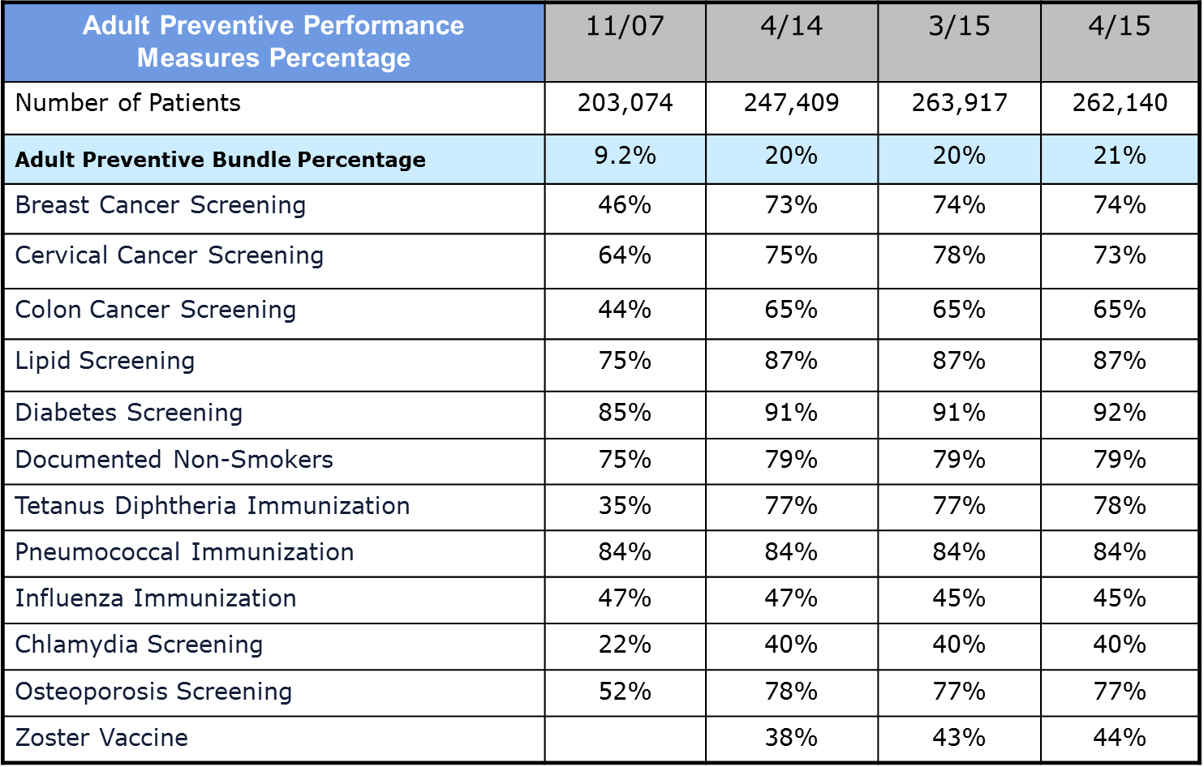
Improving Preventive Care for 262,140 Patients
Measuring Results, Improving Outcomes

Slide 40
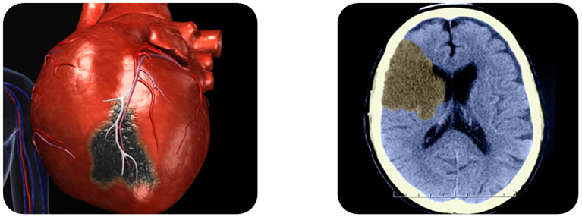
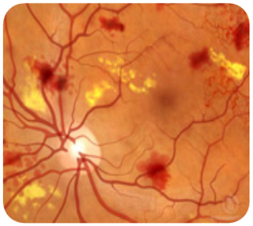
Diabetes Management Results
305 MI’s prevented
140 strokes
prevented
166 cases of retinopathy prevented
NNT
to prevent 1
MI
NNT
to prevent 1
Stroke
NNT
to prevent 1
retinopathy
82 patients
170 patients
152 patients
Source: Primary Care Diabetes Bundle Management: Three-Year Outcomes for Microvascular and Macrovascular Events ( FBloom; TGraf; WStewart; GSteele, et. al. , June 2014 (20(6); 175-182)
Notes:
Results in patients treated with our System of Care for DM compared to a propensity-matched population of GHP patients who were not treated with the system of care. Number of events in the 2 populations started to diverge in the first year and were statistically significant at the end of year 3.

Slide 41
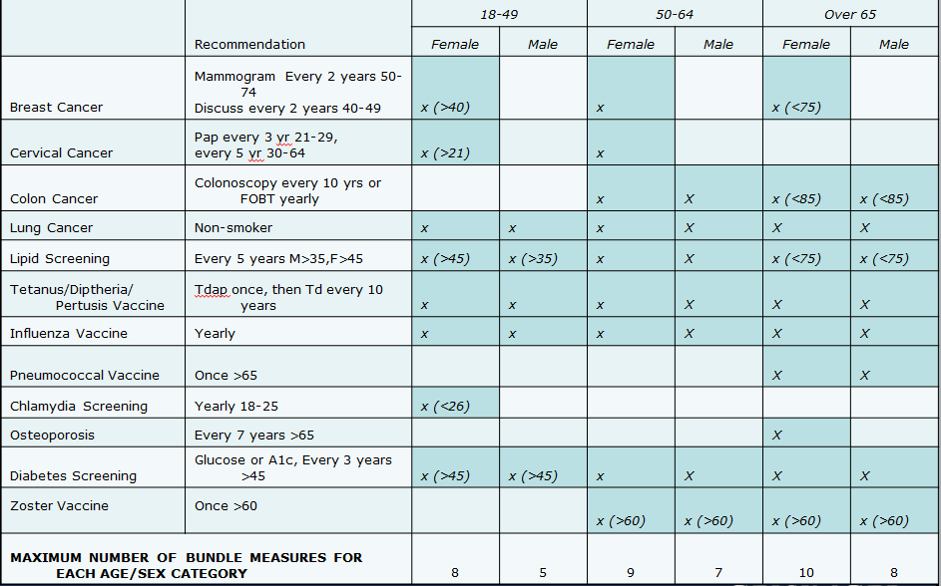
Clinical Quality Measures: Adult Prevention

Slide 42
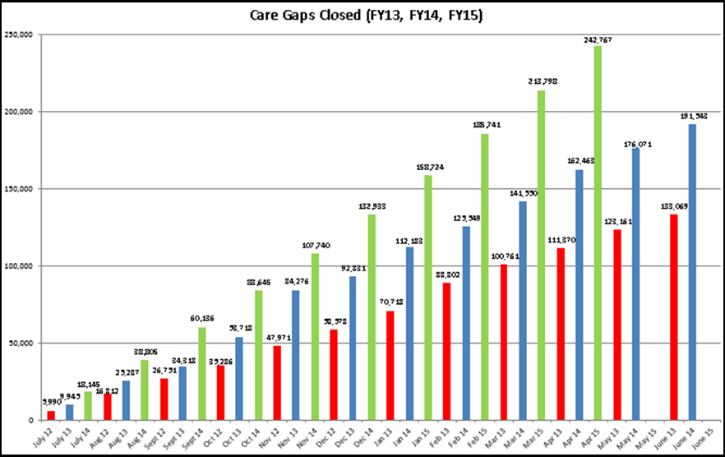
Increase in Care Gaps Closed
FY 2015
FY 2014
FY 2013

Slide 43
Practice Redesign Accelerates P4P Arrangements
Practice Redesign Accelerates P4P Arrangements
1
Insurers starting to pay more for higher-quality performance
  Geisinger Health Plan and other HMOs
  Medicare
Geisinger primary care physicians earn 10-20% of salary based on quality performance
$10,000/year available for diabetes, CAD, and adult prevention and hypertension incentives
2
3

Slide 44
Impact of Geisinger Care Model on Quality and Cost
Acute care admissions
Demonstrated improvement in the risk
of heart attack, stroke, and retinopathy
in individuals with diabetes
27.5%
3-year results in 25,000 patients
305 MIs prevented
140 strokes prevented
166 cases of retinopathy prevented
All cause
30-day readmissions
72%
Patients say quality
of care improved when they worked with
a case manager
34%
Note: Outcomes represent the period 2007—2012 and more than 80,000 Geisinger Health Plan members in Geisinger Health System practices.

Slide 45
Lessons Learned Along The Way
It is not the tool created in the EHR, but the tool’s implementation into a system of care that makes it successful
Reliability improves when practice is redesigned to spread the work out over a team and gives each team member clearly defined roles
Measures are never perfect, but they improve with time and are vital for:
    Providing timely, accurate feedback
    Monitoring the change process
Compensation helps focus attention, but is not sufficient to drive change
1
2
3
4
Not just reengineering – this is for the “long haul”

Slide 46
Where can we start?
Questions to ask on Monday
1
Does our organizational vision allow adaptation to value-based system?
  Dollars are catalyst for change, but not a sustainable strategy – Changing culture is!
Do we have clinical champions to accelerate change?
  No matter the initiative (bundles, P4P, shared risk, etc.), strong clinical leadership is essential
Have we created a system of accountability throughout our organization?
  Any number measured should be directly related to actionable interventions and engender potential behavior change (if needed)
Have we maximized our potential for collaborative partnerships?
  Revert back to organizational vision and aggressively evaluate partnerships that support achievement of the vision
Do we have the appropriate technology in place to support our provider teams?
  Hard-wired alerts, standardized order sets and streamlined documentation help take the focus off of administrative work and put it back on the patient
2
3
4
5

Slide 47
Succeeding with Payments Based on Attributed Lives
Shift Happens
Questions

