Slide 1


Slide 2

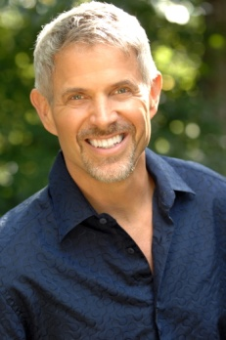
Collaborative Leadership in Times of Change – Engaging and Influencing Today’s Physicians
Dike Drummond MD
d
TheHappyMD.com
©www.TheHappyMD.com
Dike Drummond MD
@thehappymd

Slide 3
Today’s Objectives
Understand Physician Resistance
The Two Missing Pieces to Influence
New Ways to Establish Collaboration
Practical – Tactical – Tools You Can Use
Follow on the Handout
This is your Action Plan going forward

Slide 4
Dike Drummond – TheHappyMD.com
MD Mayo Medical School 1984
Family Practice Residency, Redding, CA
40 doc multispecialty group, Mount Vernon, WA
- Executive Committee Chair
- Managed Care Medical Director
Career ending burnout 1999
- Dead end – no visible support

Slide 5
Dike Drummond – TheHappyMD.com
Alt Med, Executive Coach, Serial Entrepreneur
2011 TheHappyMD.com Launch
4355 physician members in 63 countries
Training and Individual Coaching for Physicians
Burnout Prevention - Leadership Development
854 Hours of 1 on 1 coaching in 2013
Consulting for Healthcare Organizations
Leadership - Engagement - Disruptive Physician
Intervention

Slide 6

Set the Stage
Let’s Get Real …
MACRO & Theory
To
Ground Level Tactics
Influence Happens
One Relationship At a Time

Slide 7


Set the Stage
Can Only Happen One on One
You are a Gardener Tending
a Field of Relationships

Slide 8
Set the Stage
GOAL:
Connect
Influence
Behavior Change
Sustain & Repeat

Slide 9
Set the Stage
The Missing Pieces to Influence
MACRO =
Engage -> Align
One on One =
Know -> Like
Enroll –>
-> Trust

Slide 10
Set the Stage
The Missing Pieces to Influence
Know > Like > Trust
Enroll > Engage > Align

Slide 11
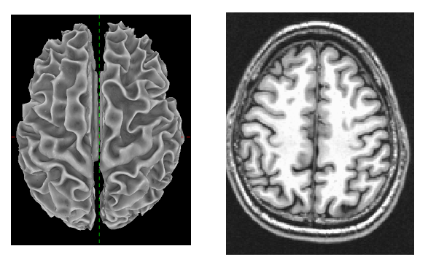
Set the Stage
To Influence a Doctor,
Let’s Understand What
Makes Them Tick

Slide 12
Let’s Play A Game !

Slide 13


Slide 14
Connect all the dots using four straight lines WITHOUT lifting the pen from the paper

Slide 16
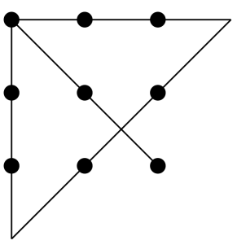

Slide 17
What stopped you from
solving the puzzle right away ?

Slide 18
What box are you talking about ?

Slide 19
This one ?

Slide 20
You had to step Out of the Box?

Slide 21
You had to step out of Your Comfort Zone

Slide 22
Your Comfort Zone
Everything you
Know & Trust
Have
Do
The Scary / Unknown

Slide 23

Your Comfort Zone
Their Practice

Slide 24

Your Comfort Zone
Their Practice
Your Project

Slide 25
Your Comfort Zone
Their Practice
FUN !
Your Project

Slide 26
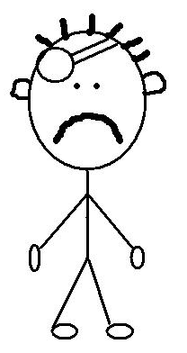
Your Comfort Zone
Their Practice
FUN !
Your Project
F_ _ _

Slide 27
Your Comfort Zone
Their Practice
FUN !
Your Project
FEAR

Slide 28
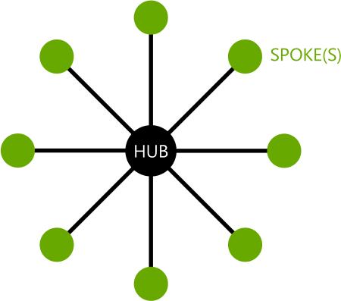
A Clinicians Comfort Zone
DX
Every Doctor has a Hub and Spoke Comfort Zone
Each SPOKE is a different PATH to a Diagnosis in the Physician’s Specialty
DX
DX
DX
DX
DX
DX
DX

Slide 29
A Clinicians Comfort Zone
DX
The Spoke is a COMFORT PATH
- a tried and true Diagnosis and Treatment Algorithm
DX
DX
DX
DX
DX
DX
DX

Slide 30
A Clinicians Comfort Zone
Doctor’s Comfort Zone is Diagnosis Specific
A PATH Based on two things
- Training and History
- Their LAST BAD OUTCOME

Slide 31

A Clinicians Comfort Zone
CHF
DANGER ZONE

Slide 32
A Clinicians Comfort Zone
YOUR PROJECT
Asks them to step off their tried and true path into
the DANGER ZONE

Slide 33
A Clinicians Comfort Zone
CHF
DANGER ZONE

Slide 34
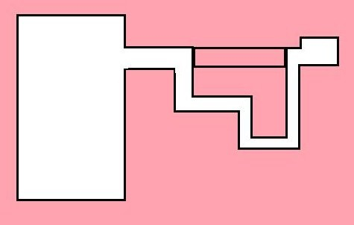
A Clinicians Comfort Zone
CHF
DANGER ZONE

Slide 35
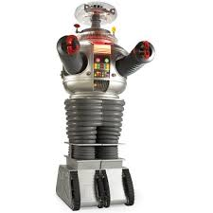
A Clinicians Comfort Zone
Outside the Comfort Zone …
- Patients get Sick
- They DIE
- I get Sued
- or Lose my License
These Fears are REAL

Slide 36
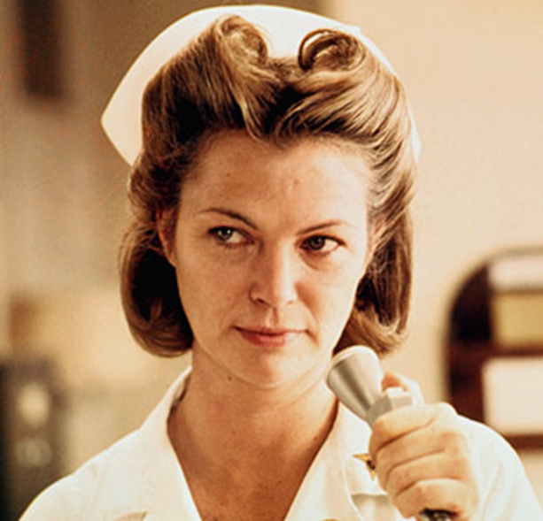

TRUST
Resistance is NORMAL

Slide 37
TRUST
Resistance is NORMAL UNTIL …
Until I can TRUST YOU enough
to step into the DANGER ZONE
with you and your project

Slide 38

TRUST
TRUST
LIKE
QUESTION:
How can every contact with my Physicians build TRUST ?
KNOW

Slide 39
TRUST
d
Your Trust Account
;
FULL
TRUST
EMPTY
Time

Slide 40

TRUST
d
Your Project will move at the Speed of Trust …
;

Slide 41
A Clinicians Comfort Zone
The #1 Trust Building Skill is
E M P A T H Y

Slide 42
A Clinicians Comfort Zone
You must be able to put yourself
In THEIR SHOES
And Communicate in a way that
They GET
That YOU GET
THEM

Slide 43
TRUST
TRUST BUILDERS ?
Transparency/Honesty/Integrity
Impeccable Communication
Accountability/Team Player
Win:Win
Consistency Over Time

Slide 44
TRUST
Trust Catalyst:
In a new relationship
Find a commitment you can make that adds value
Then Keep It

Slide 45
Trust & Enroll
The Missing Pieces to Influence
Know > Like > Trust
Enroll > Engage > Align

Slide 46
Enrollment – 4 Concerns
- Safety / Risk
- Efficacy
- Bandwidth
WIIFM
Notice MONEY is NOT
on this List

Slide 47
Enrollment – 4 Concerns
- Safety / Risk
- Efficacy
- Bandwidth
WIIFM
Money cannot be
the primary motivation

Slide 48
Enrollment – 4 Concerns
1) SAFETY / RISK
Convince me this is safe for the patient
Show me there is no RISK - because I will be the one getting sued – not you

Slide 49
Enrollment – 4 Concerns
2) EFFICACY
Convince me this will do what you say it will
AND that this is a significant improvement over what we are doing now

Slide 50
Enrollment – 4 Concerns
3) BANDWIDTH
Please tell me that I won’t have to do anything MORE than I am doing right now
(An average of 1 in 3 doctors are burned out on any given day)

Slide 51
Enrollment – 4 Concerns
4) W.I.I.F.M.
What’s In It For Me ?
How does this improve my quality of life ?

Slide 52
Enrollment – 4 Concerns
Communication Tip:
Match Doctor’s Twin Style Needs
Be Brief
Be Bright
Be Gone
AND Have Complete References
Think “Bullet Points”

Slide 53
Enrolled -> Engaged
Enrollment = “Buy In”
“I am interested enough in the benefits to invest my time and energy”
Next Step is Engagement
Only NOW can you
Influence Behavior

Slide 54
Engagement Tactics
1) Hold the Vision
2) Always Build Trust
3) TIGHT feedback loops
4) Celebrate All Wins

Slide 55
Engagement Tactics
Hold the Vision
Be Crystal Clear on the
Highest Benefit of Your Project
The “Why”
Over Communicate It

Slide 56
Engagement Tactics
2) Always Build TRUST
100% Team Player
Always Visible & Available
Pull MORE than Your Weight
Human Connection / Caring

Slide 57
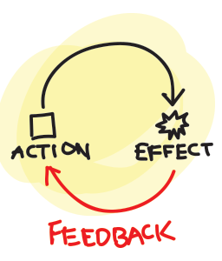
Engagement Tactics
3) Tight Feedback Loops
ALWAYS have a simple,
quick feedback loop
Are we on track? (in the Danger Zone)
Over Communicate the first round of results

Slide 58
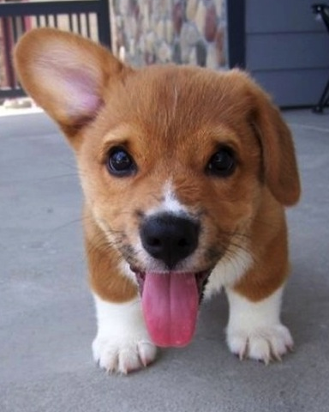
Engagement Tactics
4) Celebrate All Wins
Acknowledge and Thank Everyone for All Effort and Progress
Treat ‘em Like Dogs
[let’s practice]
d

Slide 59
Ultimate Goal
Trust – Enrollment – Change
Your Leadership Creates an
Environment that Grows
Bigger People

Slide 60
Ultimate Goal
START
FUN !
FEAR

Slide 61
Ultimate Goal
FINISH
FUN !

Slide 62
Ultimate Goal
You restore their faith that
positive change is possible
Success is when they ask,
“What’s Next?”

Slide 63
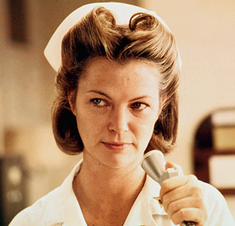
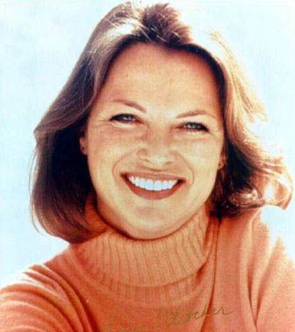
Louise Fletcher

Slide 64
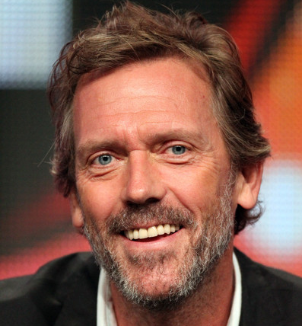

Hugh Laurie

Slide 65
Sustain & Repeat
Resistance -> Preferred Partner
Trust – Caring – Success
What is Your “Special Sauce” ?
d

Slide 66
Set the Stage
GOAL:
Connect
Influence
Behavior Change
Sustain & Repeat

Slide 67
Connecting
What are your “Best Practices”
for connecting with
Doctors
Gatekeepers
[let’s find out, shall we ?]
d

Slide 68
Connecting
Gatekeepers
Same rules apply
Know > Like > Trust
Enroll > Engage > Align
FULL
TRUST
EMPTY
Time

Slide 69
Connecting
Have a plan that builds Trust
and creates Enrollment
Rehearse your conversation
– including VM
Stand out
Be Persistent

Slide 70
Seal the Learning
Please stand up
Find a Partner
What is the biggest thing you learned ?
What new action will you take ?
When ?
3 Minutes

Slide 71
Collaborative Leadership in Times of Change – Engaging and Influencing Today’s Physicians
Dike Drummond MD
d
TheHappyMD.com
©www.TheHappyMD.com
Dike Drummond MD
@thehappymd

