Slide 1


Slide 2
Effective Use of Teams for Organizational Change
Marcia Ward, PhD
Professor and Doctoral Program Director,
Health Management and Policy
Timothy Gutshall, MD
Vice President and Chief Medical Officer
Wellmark
Tom Evans, MD
President and Chief Executive Officer
Iowa Healthcare Collaborative

Slide 4
Successful Physician Integration into Healthcare Systems
36th Annual Iowa Healthcare
Executive Symposium
Friday, 10.31.14
10:30 - noon

Slide 5
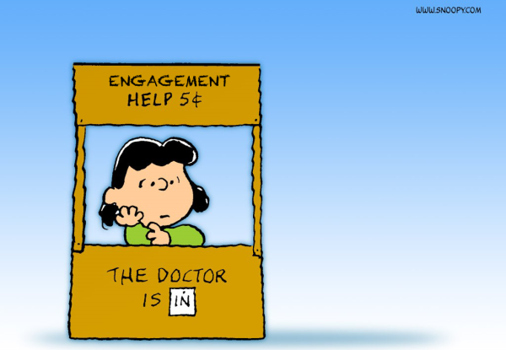
Focus: Reality-Based Guidance

Slide 6
Focus
Reality-Based Guidance
Notes:
Ian

Slide 7
Panelists
65 years of combined experience
Over 1,400 directly managed physicians (not counting other clinicians)
4,400 network physicians
450 physicians moved into alignment with health systems
275 physicians recruited
Notes:
Ian

Slide 8
Ian Montgomery ‘79 MA, CMPE Clinical Associate Professor EMHA Program Director Department of Health Management and Policy
Notes:
Ian

Slide 9
Aric Sharp ‘97 MA, FACHE, CMPE Vice President, Accountable Care Organization UnityPoint Health
Notes:
Aric

Slide 10
Eric Mooss
’04 MHA, FACHE, CMPE
Executive Director
Primary Care, Banner Health
Notes:
Eric

Slide 11
Our Five Basic Assumptions
“Format Follows Finance.” The Volume-to-Value transformation is underway.
2. Physician influence is key to Triple
Aim progress.
3. Few healthcare organizations have
no physician-integration strategy.
Notes:
Eric

Slide 12
4. Most organizations can offer a variety of alignment mechanisms.
5. Most physicians are now employed by non-physician-owned organizations.

Slide 13
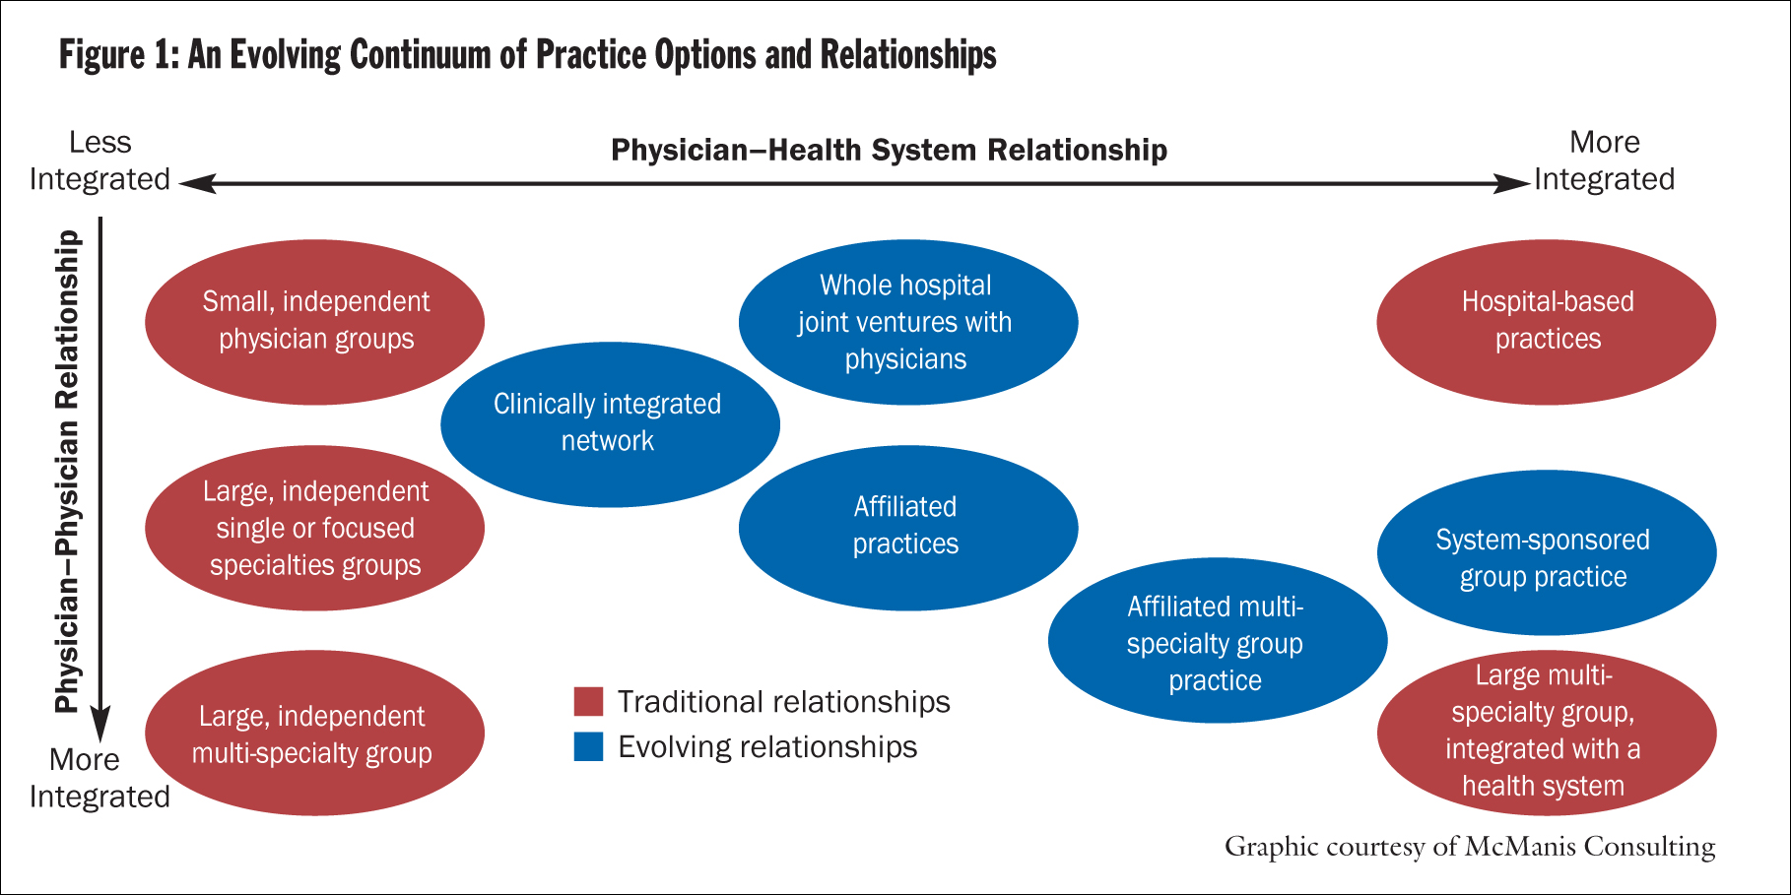
Physician Alignment: Paths to Partnership in “CHA” November-December 2008 Marc Bard, MD, Paul Conlon, Pharm.D., JD, Gale Gartner, and P. Terrence O'Rourke, MD
Notes:
Ian

Slide 14
Three Framing Questions for Today
Is physician employment the endgame?
What are the top integration failures?
What are the top integration successes?
Notes:
Ian

Slide 15
Is physician employment typically the best solution as we move to a value-based financing environment?
Notes:
Ian

Slide 16
What are the top physician integration failures?
Notes:
Ian

Slide 17
What are the top physician integration success factors?
Notes:
Ian

Slide 18
Conclusions

