Slide 1
What We Know,
What We Don’t Know, and What We Think We Know
About the Affordable Care Act
Brad Wright, PhD
October 31, 2014

Slide 2

A Review of the Literature
Pick One from Column A
And One from Column B
The Impact of the ACA on…
What the ACA means for…
Early effects of the ACA on…
ACA Implementation and…
Hospitals
State Medicaid Programs
Pharmacists
Mental Health Parity
Dentists
Primary Care Providers
[Insert Medical Specialty Here]

Slide 3

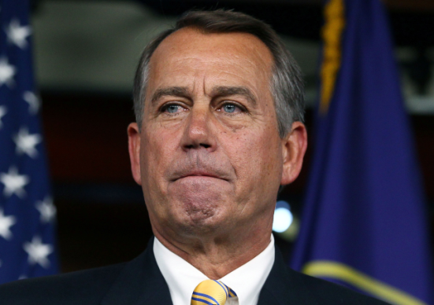

What I’m NOT Talking About

Slide 4
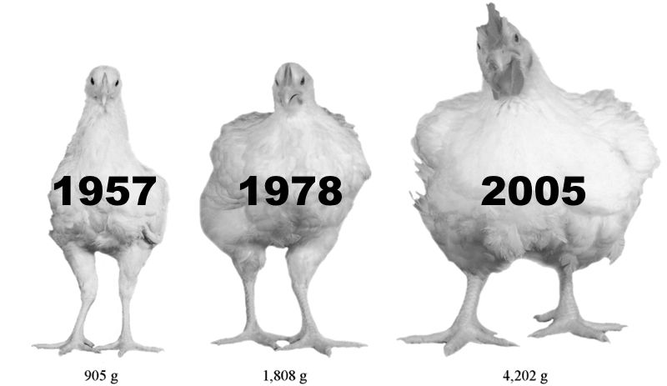
What Do Chickens and Healthcare Have in Common?
http://ps.oxfordjournals.org/content/early/2014/09/26/ps.2014-04291.abstract

Slide 5
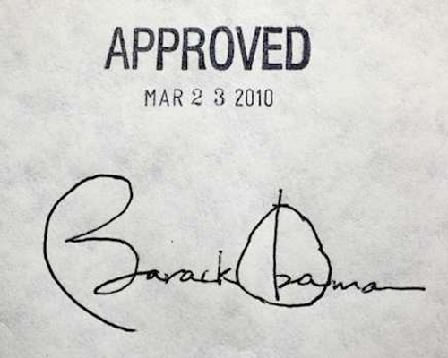

The Patient Protection and Affordable Care Act
Individual mandate
Medicaid expansion
Subsidized private HIE
Preexisting condition ban
Employer mandate
And lots of other stuff

Slide 6
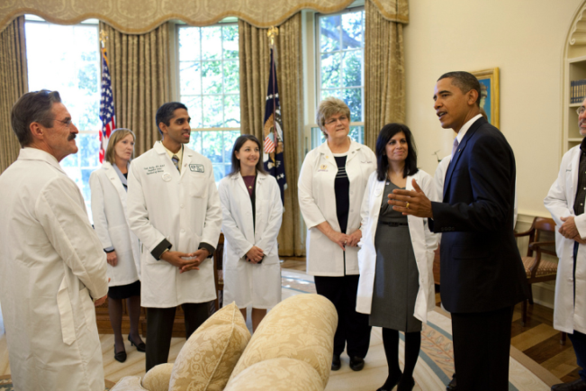
October 1, 2014 Policy Changes
Larger than expected DSH payment cuts
Readmissions Penalty Program
  Maximum penalty now 3%
  COPD, knee & hip arthroplasty now included
Value-Based Purchasing Program
  Withhold increases to 1.5%
  Now based on 4 domains
    Clinical process of care (20%)
    Patient experience of care (30%)
    Outcomes of care (30%)
    Efficiency (20%) (new for FY 2015)
Mullin J. The big cuts coming for safety-net hospitals in the new fiscal year; Mullin J. What to know about readmission penalties in the new fiscal year; Mullin J. What to know about value-based penalties in the new fiscal year. The Advisory Board Company. October 1, 2014.

Slide 7
What Do Physicians and Free Clinic Patients Know About the ACA?
Petrany SM, Christiansen M. Knowledge and perceptions of the Affordable Care Act by uninsured patients at a free clinic. Journal of Health Care for the Poor and Underserved, 25(2): 675-82; Rocke DJ, et al. Physician knowledge of and attitudes toward the Patient Protection and Affordable Care Act, 150(2): 229-34.

Slide 8

There Are Also Gaps In The ACA
Insurance gaps
  States not expanding Medicaid
  Opt to pay penalty
  Undocumented immigrants
  Narrow networks
Supply-side barriers
  Adequate workforce
  Willing-providers
Non-financial barriers

Slide 9
How Big Are the Gaps?
23 – 31 million remain uninsured
  20 – 33% are undocumented immigrants
Physicians exiting Medicaid/Medicare market
  9% will stop taking new patients
  2% will stop taking current patients
  29% remain undecided
Even harder to quantify
  Churning between coverage
  Non-financial barriers to care
Congressional Budget Office and others; MedScape Physician Compensation Report 2013.

Slide 10

If We Expand Coverage…
More people seek care
Workforce shortages
Waitlists
Rationing
Socialized Medicine
Death Panels

Slide 11
Take a Deep Breath
Evidence from MA provides hope
Other New England states for controls
Medicare patients w/ chronic disease:
  No decrease in visits to doctor pre/post reform
  No decrease in quality process measures
  Slight increase in health care costs
Limitations
  MA had low uninsured rate pre-reform
  Only looks at 65+ Medicare beneficiaries
Joynt K, et al. The impact of Massachusetts health care reform on access, quality, and costs of care for the already-insured. Health Services Research. 2014. doi: 10.1111/1475-6773.12228

Slide 12
Young Adult Provision
What We Know
  Increased coverage among 19 – 25 year olds
  Largest percentage point increases for:
    Men (+ 9.7)
    Unmarried (+ 8.1)
    Blacks (+ 11.3)
    Unemployed (+ 9.1)
What We Don’t Know
  Is it having any impact on their health?
What We Think We Know
  Seem more likely to have usual source of care
  Less likely to delay care because of cost
Sommers BD, et al. The Affordable Care Act Has Led To Significant Gains In Health Insurance And Access to Care for Young Adults. Health Affairs 32(1): 165-74.

Slide 13
Medicaid Expansion
What We Know
  28 states + DC expanding
  6 via waver (including Iowa)
  Politically driven and red states need most help
What We Don’t Know
  If and when remaining states will participate
What We Think We Know
  Medicaid coverage provides peace of mind, but doesn’t improve health outcomes
Baicker K, et al. The Oregon experiment—effects of Medicaid on clinical outcomes. New England Journal of Medicine. 2013;368:1713-22.

Slide 14
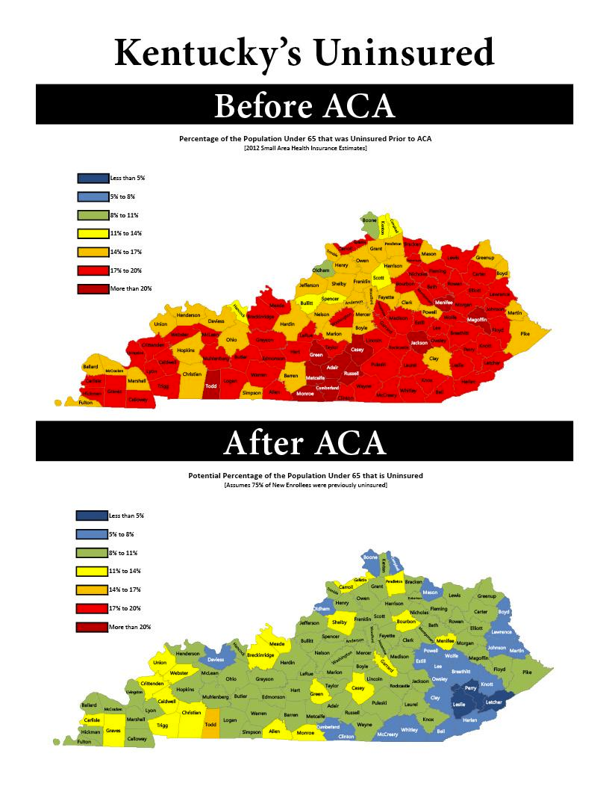
http://yarmuth.house.gov/press/uninsured-rates-drop-in-every-kentucky-county-under-the-affordable-care-act/

Slide 15
Financial Protection of
Medicaid Expansion
Uninsured
Medicaid
RAND Brief. Will the Affordable Care Act make health care more affordable? RB-9734-CMF, 2013

Slide 16
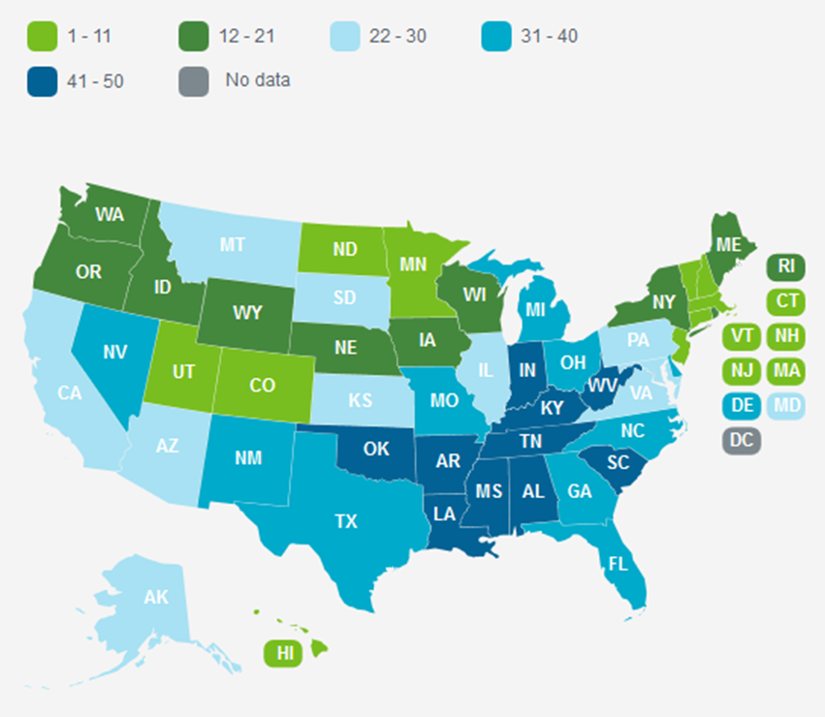
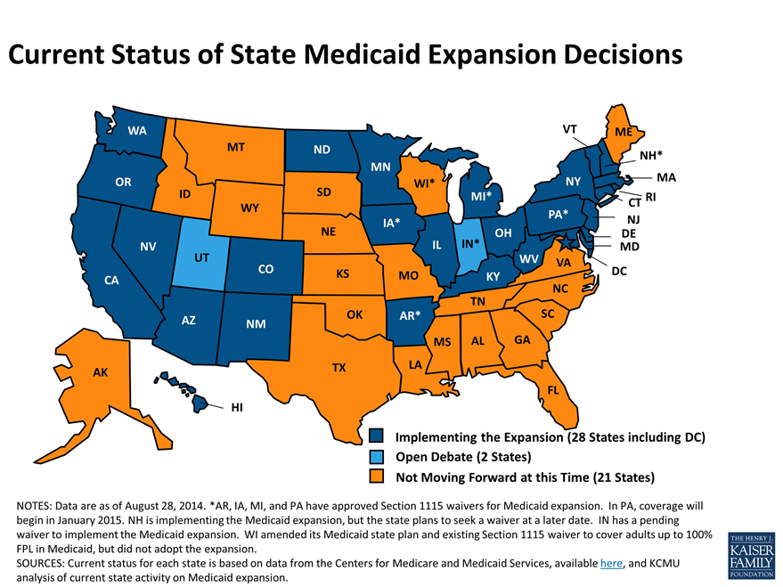
Are We Further Defining
Two Americas?
America’s Health Rankings
Medicaid Expansion
http://www.americashealthrankings.org/reports/annual
http://kff.org/health-reform/slide/current-status-of-the-medicaid-expansion-decision/

Slide 17
Health Insurance Exchanges
What We Know
  At least 8 million people have enrolled
  2014 premiums 16% lower than CBO projection
  More insurers are joining exchanges in year 2
What We Don’t Know
  What will happen in next open enrollment?
  Will employers drop coverage?
What We Think We Know
  Another 17 million will enroll by 2017
  State/federal gov’t may address issue of narrow networks
Diamond D. In every state so far, more insurers are asking to participate in Obamacare. The Advisory Board Company. June 12, 2014; Blumenthal D, Collins SR. Health care coverage under the Affordable Care Act—a progress report. New England Journal of Medicine. 371(3):275-81.

Slide 18
Financial Protection of
Health Insurance Marketplace
Individual market pre-ACA
Individual marketplace plan
RAND Brief. Will the Affordable Care Act make health care more affordable? RB-9734-CMF, 2013

Slide 19
New Coverage Under the ACA
Blumenthal D, Collins SR. Health care coverage under the Affordable Care Act—a progress report. New England Journal of Medicine. 371(3):275-81.

Slide 20

Emergency Departments As Sentinels
What We Know
  ED use didn’t increase disproportionately in MA
  ED use did increase disproportionately in OR
What We Don’t Know
  What will happen nationally?
  What role will ED play in ACOs?
What We Think We Know
  If workforce can’t meet demand or access isn’t convenient, inappropriate ED use will increase
  EDs more profitable under ACA (profit margin 11.7% vs. 7.3%)
McClelland M, et al. The Affordable Care Act and emergency care. American Journal of Public Health. 104(10): e8-e10; Wilson M, Cutler D. Emergency department profits are likely to continue as the Affordable Care Act expands coverage. Health Affairs. 33(5): 792-9.

Slide 21


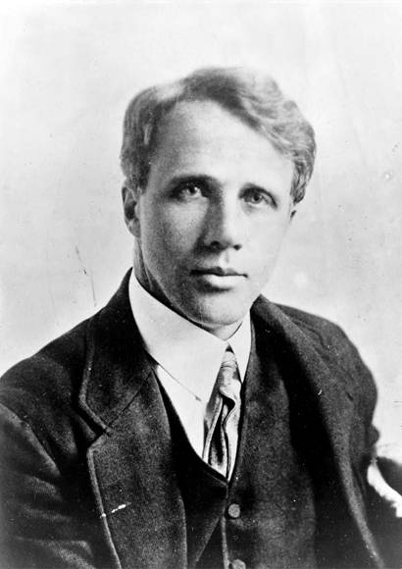
There Will Be Answers

Slide 22



Thank You!
brad-wright@uiowa.edu
www.healthpolicyanalysis.com
@bradwrightphd

