Slide 1


Slide 2



Managing the Volume to Value Transition: The Critical Role of Leaders
James Tinker Lecture
University of Iowa College of Public Health
October 30, 2014
Presented by:
William F. Jessee, M.D., FACMPE, Chief Medical Officer & Senior Advisor
INTEGRATED Healthcare Strategies

Slide 3
WHAT WE DELIVER
HR CONSULTING
PHYSICIAN SERVICES
TOTAL COMPENSATION & REWARDS
ENGAGEMENT SURVEYS
MERGER & ACQUISITION ADVISORY
ONE Source,
YOUR Solutions
MSA EXECUTIVE SEARCH
GOVERNANCE & STRATEGY

Slide 4
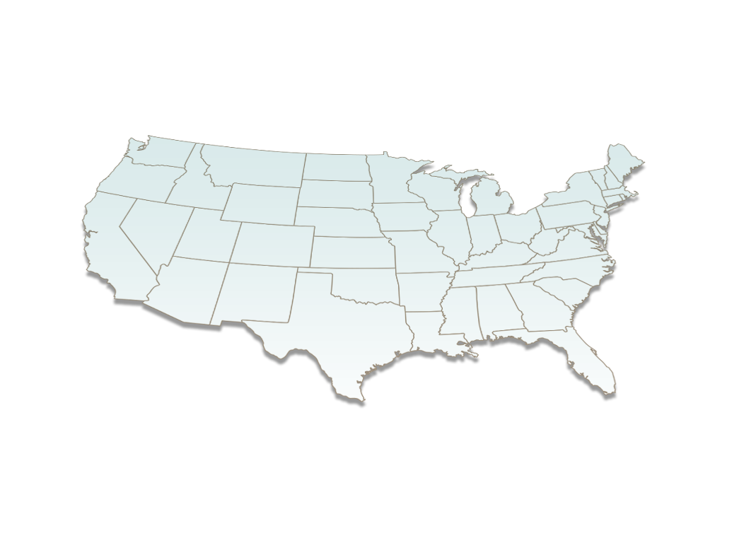
WHERE WE ARE
office locations
Minneapolis
Los Angeles
Kansas City
Boston
Dallas

Slide 5






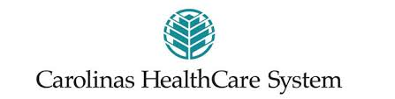
































Leaders in Healthcare: WHO WE SERVE
Notes:
We serve a "who's who" of healthcare organizations, including more than 1,200 major healthcare providers, 1,800 hospitals and 700 independent and affiliated medical groups

Slide 6

Today’s Questions
Why is a transition from volume to value going on?
What barriers are organizations encountering in attempting to improve population health?
What is the role of leaders in the transition?
How can we all lead more effectively?

Slide 7
What’s so bad about a system where revenues are driven by volume?
Costly (“the more you do, the more you make...”)
Wasteful
No incentives for quality or safety
Encourages more interventions, which increases risk
No incentives for efficiency

Slide 8
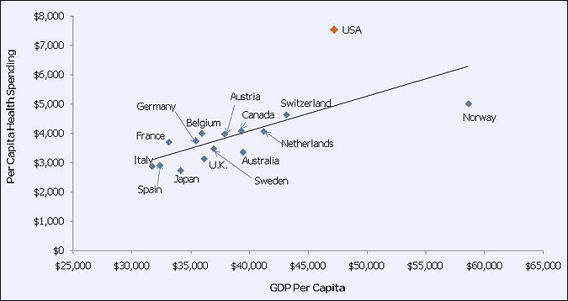
Healthcare Spending vs GDP

Slide 9
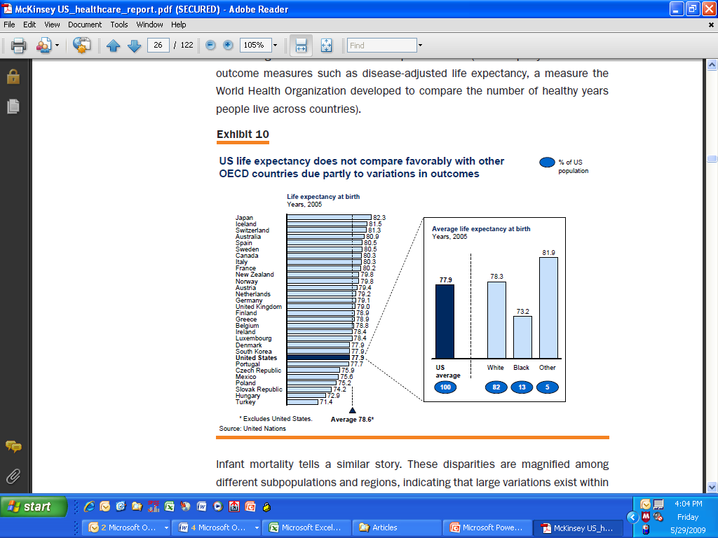
We get less than we pay for...

Slide 10
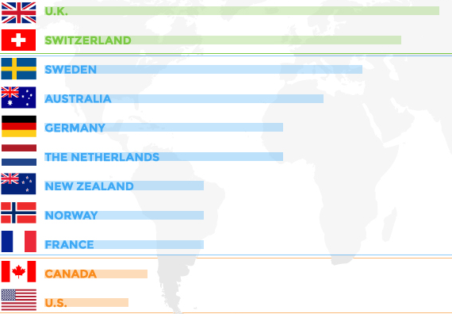
A recent study compared 11 nations on healthcare quality, access, efficiency, and equity, as well as indicators of healthy lives such as infant mortality. Source: K. Davis, K. Stremikis, D.Squires, and C. Schoen. Mirror, Mirror on the wall: How the Perfomarce of the U.S. Health Care System Compares Internationally, 2014 Update, the Commonwealth Fund, June 2014
OVERALL HEALTHCARE RANKING
Low
High

Slide 11
Why would a value-driven payment system be better?
Rewards quality, safety and efficiency
Encourages keeping people healthy (“population health”)
Encourages keeping people out of hospitals
Discourages waste

Slide 12
How much “waste” is there?
IOM estimates 30% of US total healthcare cost is waste
http://resources.iom.edu/widgets/vsrt/healthcare-waste.html

Slide 13


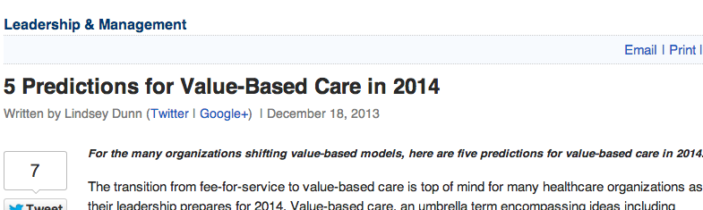


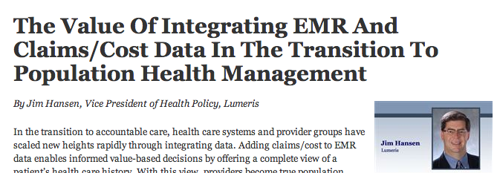
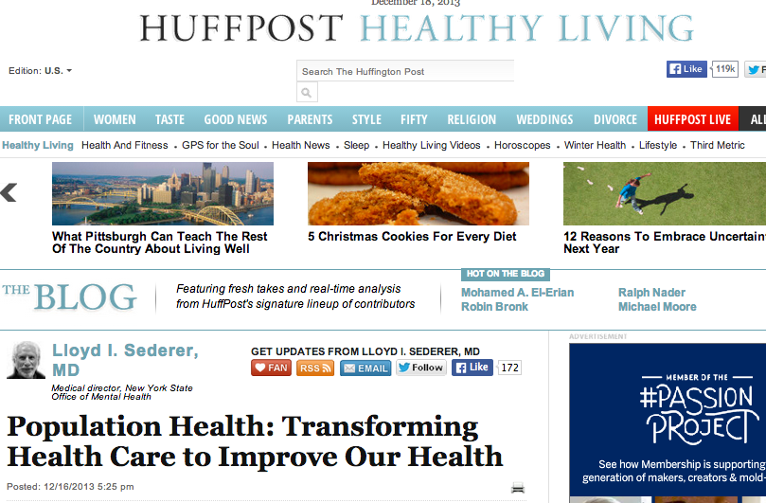
Many stakeholders believe: “Population health management is the way out of the crisis”

Slide 14
Some Definitions
POPULATION HEALTH MANAGEMENT
“the technical field of endeavor which utilizes a variety of individual, organizational and cultural interventions to help improve the morbidity patterns (i.e., the illness and injury burden) and the health care use behavior of defined populations” — Michael Hillman, Testimony before the Subcommittee on Health of the House Committee on Ways and Means, 2002-04-16.
“a proactive, patient-centric approach to health and healthcare that engages patients and physicians in prevention, wellness, care coordination and care management with the goals of improving outcomes and reducing cost” — Cynthia Kilroy, Senior Vice President-Provider Strategy at Optum
“improving the overall health status and lowering the cost of care for a specific population” — Dr. David Nash, Dean of Jefferson School of Population Health and Rita Numerof, principal of Numerof & Associates

Slide 15
Some Definitions
ACCOUNTABLE CARE
Arrangements under which the organizations and clinical professionals providing care for a specific population are held accountable for its safety, quality, efficiency, and degree of patient satisfaction, based upon valid and reliable measures of each.
VALUE-DRIVEN PAYMENT
Payment for health services based, at least in part, on measures of safety, quality, efficiency and patient satisfaction
CAPITATION
Fixed payment for managing the care of a specific population

Slide 16
How much “Value-driven payment” is there? Not a lot—yet…
40%
38%
18%
53%
of commercial insurance payments were at least partially value-oriented, Nationwide in 2014*
of hospital payments included
of physician payments included
Of those “value-driven” payments, involved providers at risk
That includes shared savings, shared risk, partial or condition-specific capitation, FFS base plus P4P, bundled payments, full capitation (15%)
*Catalyst for Payment Reform, www.catalyzepaymentreform.org

Slide 17
Still mostly FFS
Largest value-based component (15%) is full capitation (mostly in California)
Only 0.1% bundled payments
2% FFS shared savings
12.8% FFS with performance bonus

Slide 18
And California drives much of the change
55.4%
34%
of payments in California are at least partially “value-driven” (including 40.7% on full capitation) and 86% of those payments place providers at risk*
is the prevalence of “value-driven payments” in the rest of the country when you back out the California numbers
*Catalyst for Payment Reform, www.catalyzepaymentreform.org

Slide 19
Nonetheless…
That the change is coming seems unquestionable
Will probably vary greatly from one market to the next in terms of what new mechanisms will be introduced and how quickly they will be implemented
The vast majority of provider organizations are trying to position themselves to be ready for the change...
...without shooting themselves in the foot by implementing prematurely

Slide 20

How much “population health management” activity is there?*
Health Systems
41% of health systems report having begun
88% of health systems plan to begin soon
Mostly focused on Medicare and Medicaid populations
But 61% of initiatives also cover commercial populations
Only 25% of initiatives use medical homes
But 92% use care managers, 69% use NPs
Health Plans
58% of health plans actively engaged in it
* 2014 Healthcare Benchmarks, Population Health Management, Healthcare Intelligence Network

Slide 21
What needs to change?
If we are serious about managing population health, we need:
A cultural transformation, from treating illness to managing health
An economic model that rewards (providers, patients) for keeping people OUT of inpatient care—or at least doesn’t reward them only for doing as much as possible
Robust data and analytic tools to allow managers and clinicians to better manage the health of people they serve
Greatly improved communication and coordination among care providers
Better alignment of executive, physician and staff compensation with population health goals

Slide 22
Some barriers to change…
Lack of accountability (for managing care and cost of care)
Prevailing payment method is pay per unit of service
Volume orientation of executives and physicians
Psychological commitment to doing whatever is needed or wanted to care for patients, without regard for cost-effectiveness or efficacy or quality of care
High fixed costs—so hospitals need to keep beds filled, keep utilization of capital equipment high
Inadequate data and systems
No payment for managing/maintaining/improving patients health
Little coordination of care

Slide 23
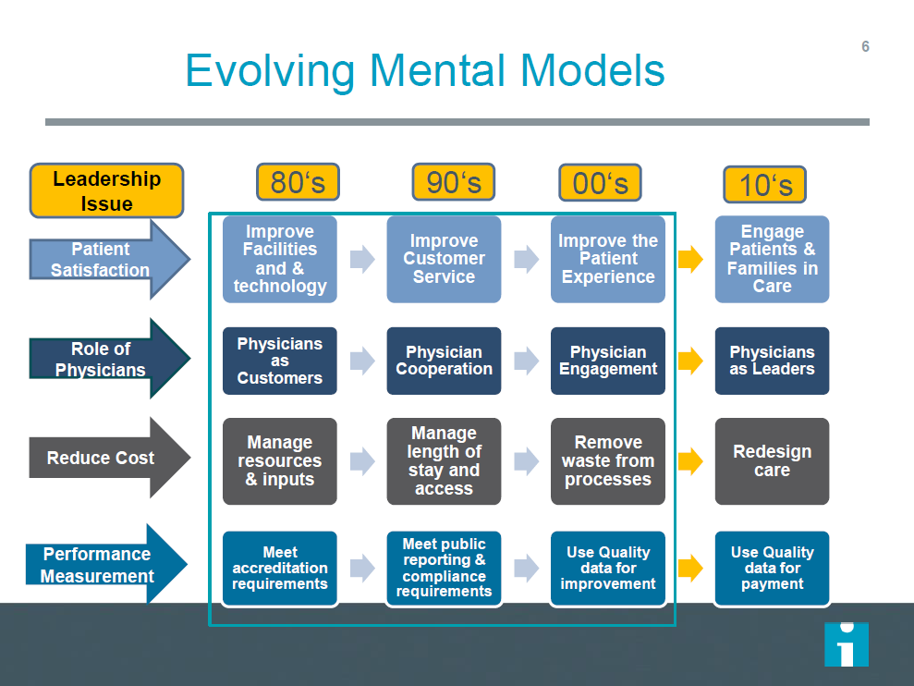

Slide 24
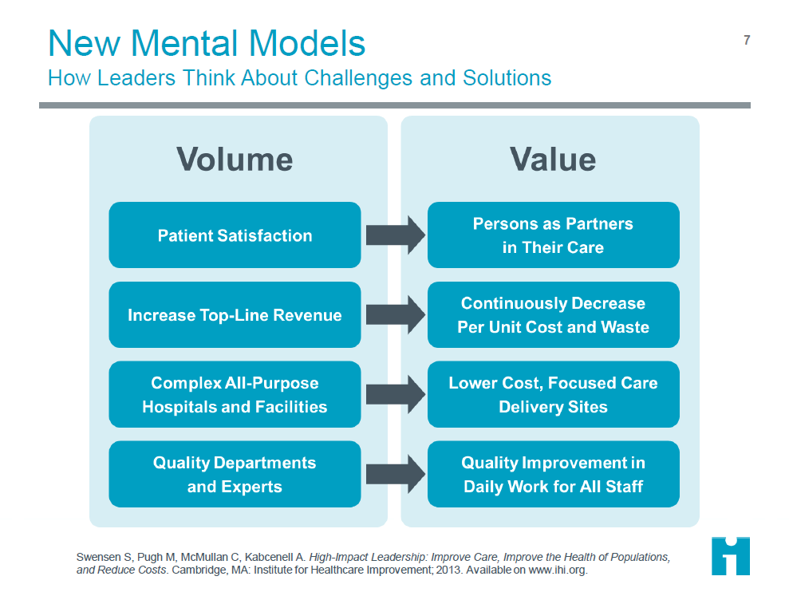

Slide 25

Leadership...
“A leader is a person you will follow to a place you wouldn't go by yourself.”
Joel Barker

Slide 26
Leadership Challenges
Creating a value-driven culture, while still living in a volume-driven payment environment
Getting buy-in to the need for change from board, management team, staff and physicians
Integrating physicians and other clinicians into the organization
Aligning compensation and rewards with goals
Breaking old habits

Slide 27
What makes an effective leader?
Vision
Sense of mission
Ability to communicate the vision and mission
Trust in others
Mastery of self
Ability to help motivate others
*Elizabeth Jeffries, The Heart of Leadership, 1992

Slide 28
“Trust” is essential to effective leadership
Trust is a function of:
Reputation
Risk
Repetition
Reward
Founded on truthfulness
Slowly earned, but can be quickly burned

Slide 29
“Trust” is...
The basis for:
Engagement
Commitment
Accountability
Focus
Patrick Lencioni

Slide 30
Five principles for effective leaders
1. No whining
2. Educate potential leaders on the business and service aspects of healthcare
3. Set an example by your behavior
4. Develop your and their leadership skills
Listening
Reflecting what you heard
Stealing ideas shamelessly
Persistence
Flexibility

Slide 31
Five principles for effective leaders
5. Be a change agent
Identify and surface conflicts
Resolve them constructively
Continuously improve

Slide 32
Lessons Learned
While the industry recognizes a need to move to population health management / value driven payment, progress is slow
The changes will require a significant shift of culture and values
Compensation is an important tool in making that shift, but not the only one
Acquiring and using the data needed to manage population health (and run performance-based compensation programs) is a challenge

Slide 33
The bottom line
Healthcare increasingly DEMANDS measurable performance (on measures of safety, quality, efficiency and patient satisfaction)
Performance REQUIRES alignment, engagement and integration of the work force—and a CULTURE committed to performance
Performance-based incentive compensation can be a valuable tool—but a strong performance management system is even more important and essential to managing the changes needed

Slide 34

DISCUSSION
October 30, 2014 Managing the Volume to Value Transition: The Critical Role of Leaders

