Slide 1


Protecting Community Objectives
In the Affiliation to Full-Integration Continuum
Xi Zhu, Ph.D.
Joseph R. Lupica, JD

Slide 2
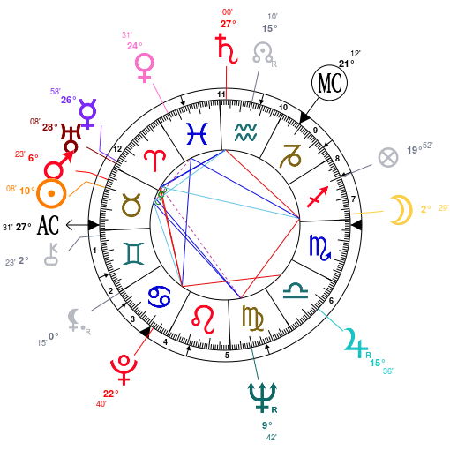
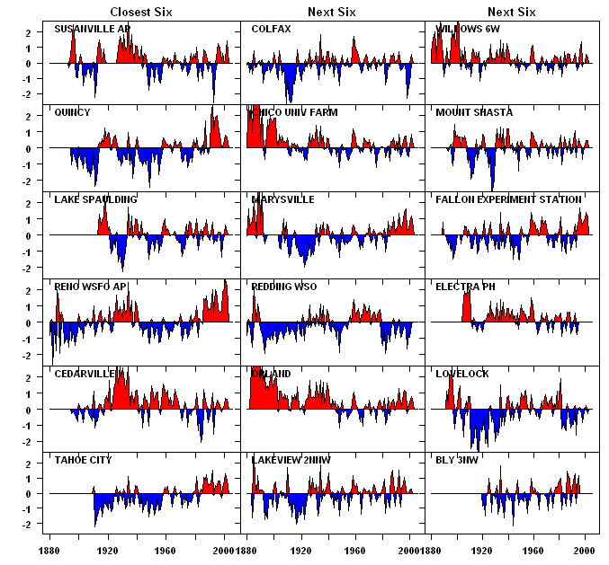
TRENDS?

Slide 3
TRENDS?
METRO HOSPITALS
NON-METRO HOSPITALS
Source: American Hospital Association Annual Survey, 2007-2012
Notes:
AHA definitions:
Network - “Network is a group of hospitals, physicians, other providers, insurers and/or community agencies that work together to coordinate and deliver a broad spectrum of services to their community. Network participation does not preclude system affiliation.”
System - “System is defined by AHA as either a multihospital or a diversified single hospital system. A multihospital system is two or more hospitals owned, leased, sponsored, or contract managed by a central organization. Single, freestanding hospitals may be categorized as a system by bringing into membership three or more, and at least 25 percent, of their owned or leased non-hospital preacute or postacute health care organizations. System affiliation does not preclude network participation.”

Slide 4
TRENDS?
Rear-View Mirror: All the Usual Statistics
10% of Community Hospitals Acquired/Merged (AHA Rpt)
Drivers: Capital needs & Cost Control
Trade independence for benefits of consolidation
Rescue for Underperformers
Local Control: Give it up for “System-ness”
Govern Behavior: With rules from System HQ
What’s Next: Brave New World
Acquisition/Merger no longer a given
New Drivers: Lives! Population Health/ Network Alignment
Seek Interdependence to support shift from FFS to ‘FFV’
Some rescue features, but also a quest for Excellence
Local Control: Structured for collaboration
Govern Behavior: With network Incentives

Slide 5

Questions we hear from our Clients:
Will the Brave New World force me to change my behavior?
From: FFS Volume
To: Risk-based Population Health Value?
“All our profit centers become (gulp) cost centers???”
If I shift my behavior today, I destroy our volume.
So, When and How do we make that big shift?
“Wait –we can get paid for being a cost center???”

Slide 6
Questions we hear from our Clients:
So … What does all this Brave New World talk have to do with
Affiliation?

Slide 7
Will the Brave New World make me change my behavior?

Slide 8
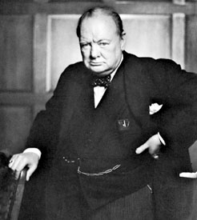
A BRAVE NEW WORLD?
“You can always count on Americans to do the right thing –
after they’ve tried everything else.”
Cost-plus Medicare
PPS
Capitation
APGs
BBA
Coverage expansion
Is single payer system next??
Are we changing healthcare – or just changing funding?
How does each “thing” we try motivate healthcare value?
Q1 Q2 Q3

Slide 9

A BRAVE NEW WORLD?
“Oh, the times . . .”
Q1 Q2 Q3

Slide 10
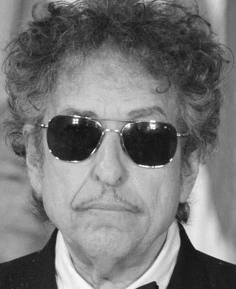
A BRAVE NEW WORLD?
“. . . they are a-changin.”
Old Times – Volume-Based
“Pay-by-the-click” Encounters
Reimbursement favors high-cost Tertiary hospitals and procedures
FILL THOSE BEDS!
New Times – Value-Based?
Accountable Value: Triple Aim
High-cost hospitals and procedures become Cost Centers
EMPTY THOSE BEDS!
Instead, let’s try keeping the community healthier.
W H A T A C O N C E P T
Q1 Q2 Q3

Slide 11
If I shift my behavior today, I destroy our volume…
Will incentives really shift to reward value?
(“All this future tense is killing me”)

Slide 12
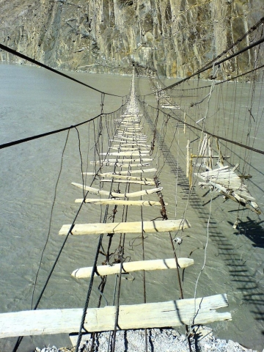
“WILL” INCENTIVES REALLY SHIFT?
They are already shifting, so
get ready to cross that sturdy bridge
over the chasm
from
volume-based incentives
to
value-based payment
Q1 Q2 Q3

Slide 13
MEANWHILE, HOW DO WE GET PAID?
Your guess is as good as ours.
But we do have a hint
(and changing the ownership of a hospital has nothing to do with it)
Q1 Q2 Q3

Slide 14
HOW DO WE CROSS THAT BRIDGE?
Hint: One Step at a Time
Near Term:
Low-risk population health strategies
Find my institution’s value niche in a Network of Care,
Build relationships with others in the Network, and
Learn the business behaviors needed to share and manage risk
Develop “scale” – in covered lives, not System Assets
Accept risk (and reward) within the Network of Care
Medium Term:
Long Term:
Q1 Q2 Q3

Slide 15
MEASURING “OUR” RESULTS??
KNOW WHAT GOOD POPULATION HEALTH LOOKS LIKE
Access to care | Mental health
Healthy behaviors | Maternal/Infant health
Chronic disease | Injury
Environmental determinants | Substance abuse
Social determinants | Tobacco
Responsible sexual behavior | Quality of care
(Healthy People 2020)
Q1 Q2 Q3

Slide 16
HOW DO WE GET PAID FOR POPULATION HEALTH?
Just send a bill to Blue Cross
for your smoking cessation program.
(Um … don’t book the receivable.)
Q1 Q2 Q3

Slide 17
What does all this Brave New World talk have to do with
Affiliation?

Slide 18
WHAT DOES THIS HAVE TO DO WITH AFFILIATION?
Consider:
Valuation
vs.
value
Q1 Q2 Q3

Slide 19
WHAT DOES THIS HAVE TO DO WITH AFFILIATION?
An observation on value:
“A hospital’s high-performing physician group
may have more value to a risk-bearing network
than to its own hospital standing alone”
Q1 Q2 Q3

Slide 20
3 Follow-up Questions from our Clients:
Can we gain the benefits of Affiliation without
abandoning ownership and independence?
2. How do we protect our local prerogatives?
(Hint: Bargaining for board seats isn’t enough.)
3. How do we preserve the benefit of our bargain?
(Hint: Start long before the ink dries.)

Slide 21
Put another way,
Do we
Have to
HAND OVER
OUR
KEYS?

Slide 22
AFFILIATE WITHOUT ABANDONING INDEPENDENCE?
AFFILIATION
IS NOT A BINARY CHOICE.
(To sell or not to sell…
that is not the question.)
Q1 Q2 Q3

Slide 23
Enhance independence with inter-dependence.
AFFILIATE WITHOUT ABANDONING OWNERSHIP?
Report Card
Does Joey
work & play well
with others?
Q1 Q2 Q3

Slide 24
AFFILIATE WITHOUT ABANDONING OWNERSHIP?
ANTITRUST ISSUES
Collaboration & Collusion start with the same four letters
Tension between two federal policy objectives
CIN structures can manage antitrust concerns:
Accept Shared Risk and/or
Sign on to joint protocols
Q1 Q2 Q3

Slide 25
EXAMPLES ALONG THE WIDE SPECTRUM OF AFFILIATIONS
Specialty Telehealth
ACO or Commercial Risk Network
Branding
Merger
or Joint Membership
Degree of Integration
Shared Support
Services
Management Contract
Clinical Integration CCO
Transfer Protocols
Asset Sale/
Membership Substitution
System Question:
Why should we ever invest capital in a hospital we don’t own?
Q1 Q2 Q3

Slide 26
2. How do we protect our local prerogatives?
(Hint: Bargaining for board seats isn’t enough.)

Slide 27
Bargain for a majority of board seats.
PROTECTING LOCAL PEROGATIVES
Post-closing covenants trump both
Reserved powers trump the number of seats.
Q1 Q2 Q3

Slide 28
ORGANIZING THE WIDE SPECTRUM
Specialty Telehealth
ACO or Commercial Risk Network
Branding
Merger
or Joint Membership
Degree of Integration
Shared Support
Services
Management Contract
Clinical Integration CCO
Transfer Protocols
Asset Sale/
Membership Substitution
-------------Zone 1-------------
AFFILIATION LITE
No ownership shift
Cost Efficiencies
Clinical & Marketing advantages
---------Zone 2---------
INTERDEPENDENCE
Ownership transfer optional
Governance ‘by Shared Risk’
Capital for the “right stuff”
---------Zone 3---------
OWNERSHIP SHIFT
Old-School ‘M&A Deal’
Governance ‘by HQ’
Major MTI capital
Q1 Q2 Q3

Slide 29
CASE STUDIES
INTERDEPENDENCE CASES (from Zones 1 & 2)
Formal Collaborative (Missouri)
“Merger” without Ownership Transfer (rural NY)
Large Risk Networks (several states)
FLEXIBLE MEMBERSHIP CASES (from Zone 3)
Joint Membership (New Mexico)
Local Governance exceeding Local Ownership (Idaho)
Acquisition by National/Regional JV (several states)
Q1 Q2 Q3

Slide 30
Case Study #1: JOINT MEMBERSHIP MODEL
Local hospital gains equal voice, with dollars to accompany its votes
Local Hospital now Debt-Free
Continuing
$$ Support
Bond Payoff
$$
Hospital
Foundation
St. Vincent Hospital
501(c)(3)
Continuing
$$ Support
Shared Governance
Continuing
$$ Support
Appoints Half
Appoints Half
Bond Payoff
$$
Dedicated
Reserve Fund
Pull Excess Funds out of Hospital to keep them local
CHRISTUS Health
501(c)(3)
Local Support Trust
501(c)(3) holds and reinvests capital
from System’s original funding
Initial Funding $$$
Q1 Q2 Q3

Slide 31
VOTING DOES NOT HAVE TO TRACK OWNERSHIP SPLIT
Case Study #2
LHP
STRONG
CAPITAL PARTNER
COUNTY
COUNTY
Community Benefit Organization (LLC)
Contributes Assets
$201MM Cash
LLC OWNERSHIP
77%
23%
LLC BOARD
LLC Board
5 Members for each partner
Strategic decisions
Meets quarterly
50%
50%
Portneuf Medical Center
HOSPITAL BOARD
Hospital Board
Local Leaders & Physicians
Operating decisions
Meets monthly
9%
91%
Q1 Q2 Q3
Notes:
See Rev. Rul. 98-15; St. David’s Health Care System v. US, 349 F.3d 232 (5th Cir. 2003);
31

Slide 32
How do we preserve the benefit of our bargain?
(Hint: Start long before the ink dries )

Slide 33
PRESERVING THE BENEFIT OF THE BARGAIN
Where do we start?
Just have dinner with that nice system down the road!
but only if you’re ready
to be on the menu
Unless…
You Prepare your Objectives First
Q1 Q2 Q3

Slide 34
PRESERVING THE BENEFIT OF THE BARGAIN
How a deal works after the closing starts long before the closing.
It starts before you approach the bargaining table… before you consider which is the best partner… even before you decide to seek a partner.
It starts when your fiduciaries develop objectives for
your community’s healthcare system.
Do not hesitate to seek out the voices of your
physicians and caregivers, your community members,
. . . and your premium-paying employers.
[and document every fiduciary move for a possible AG review]
Q1 Q2 Q3

Slide 35
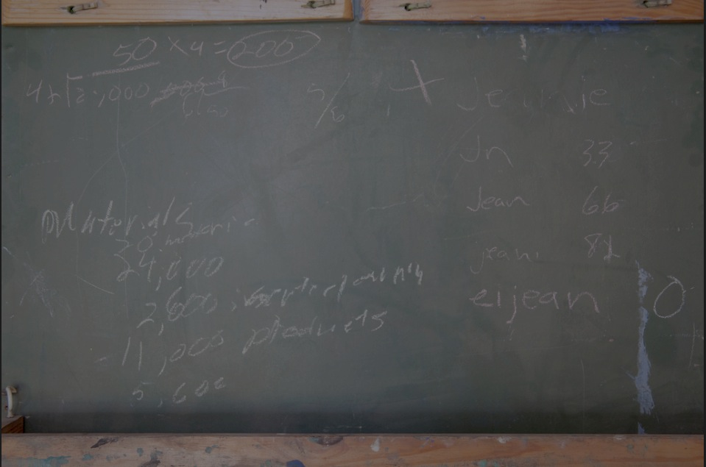
Setting Objectives
Who are We?
Why even look for Affiliation?
What’s in it for us?
What’s in it for them?
Only then, ask . . . Who are They?
1. Who?

Slide 36
PRESERVING THE BENEFIT OF THE BARGAIN:
Managing “Partner Risk”
Set Affiliation Objectives First
Engage your Community
Keep an open mind (Options are … Optional!)
Get Tough Contractual Commitments
Q1 Q2 Q3

Slide 37
PRESERVING THE BENEFIT OF THE BARGAIN
Remember:
Board seats are not as important as:
The power reserved for those seats
And the firm covenants in a definitive agreement
Q1 Q2 Q3

Slide 38
Overall goal:
A B r i g h t F u t u r e
For all the people in the community
Who depend on you for clear thinking
Protecting the sustainable excellence
Of their healthcare jewel.

Slide 39
PRESERVING THE BENEFIT OF THE BARGAIN
In a full merger, who’s left to enforce the contract?
Existing hospital foundation
New trust created to receive proceeds
Remnant of local governing entity
A local municipality?
The Thursday Morning Garden Club??
Notes:
Possibilities:
Previously existing fund-raising foundation
New entity created to receive funds
Local governmental entity
Remnant of local governing entity thrust into such role (not recommended).
Potential Mechanisms:
Named entity accepts by execution of agreement
Intended third-party beneficiary described in agreement

Slide 40
AFFILIATE WITHOUT ABANDONING OWNERSHIP?
Two tests to avoid per se antitrust violation
Test #1
Providers
share
significant
financial
risk
Test #2
Clinical integration on evidence-based guidelines
and
Trade independence
to follow guidelines
or
Note: Avoiding per se violation does not remove “rule of reason” analysis
Source: Statements of Antitrust Enforcement Policy in Health Care, FTC and DOJ (and not this recovering lawyer!).

