Slide 1


Encounter-Based Strategies to Population-Based Strategies
Keith J. Mueller, Ph.D.
Director, RUPRI Center for Rural Health Policy Analysis
University of Iowa College of Public Health
Presented During
36th Annual Iowa Healthcare Executive Symposium
October 31, 2014

Slide 2

Forces Motivating Change
“Form follows finance”
Commercial insurance changing, and employer plans changing
Medicare changes are dramatic and could be more so
Medicaid changes spreading

Slide 3

Commercial Insurance and Employers
Value-based insurance design to steer utilization: wellness, disease management, medication management
Payment methodologies shifting to value-driven, at least in part
Employers seeking deals, including national employers such as Walmart and Lowes

Slide 4

Medicare Payment Changes
Uncertain future (at best) for cost-based reimbursement
Demonstrations of new methods, including bundled payment, shared savings
Value-based purchasing across provider types
Includes non-payment for certain situations

Slide 5

Medicaid
ACO development being seen as an answer to cost of current and expanded program
Reduced payments in systems based on pay for service
Other innovations to reduce cost such as primary care case management, divert from emergency rooms

Slide 6

Concluding discussion of payment change with reminders of reality
Payment per event will moderate
Tolerance for services of questionable use will diminish
Systems will form and spread
Multiple payers moving in similar directions, opportunities to influence should be captured and exploited
Future is in health improvement for population served (community)

Slide 7

Convincing Evidence
Change is underway (not just “coming”)
Driven largely by needs to refinance
But also involving reorganizing to meet quality objectives
Respond to change or lead change but CHANGE

Slide 8

All About Value
Value will determine payment, initially partial eventually all
Responding to those changes
Value will take on a new meaning beyond the hospital/clinic walls

Slide 9

A Continuum of Value Strategies
12 strategies, but order and timelines will vary
A continuous transformation

Slide 10

1. Get Your FFS House in Order
Attention to
Market share
Expense management
Revenue cycle
PQRS/Meaningful Use
Payer contracts
Purchasing contracts
Inventory management
Appropriate volumes

Slide 11

2. Measure, Report, and Act
Measure and report performance
We attend to what we measure
Attention is the currency of leadership
Tell the performance story
Data → information → insight
When possible, control the data
Market share – who’s leaving and why
Our costs to payers, and our competitor’s costs

Slide 12
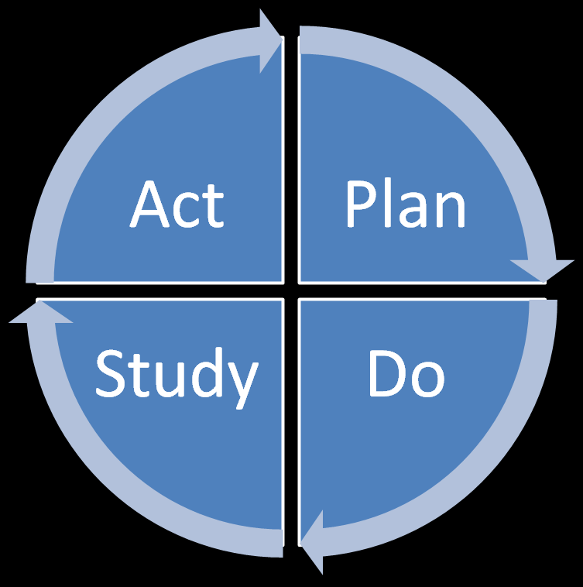
3. Prioritize Improvement
Clinical quality, patient safety, and the patient experience
Expectation: “Always above the mean. Always improving.”
Leadership priority
Every meeting
Charts, not spreadsheets
Un-blind the data!
Quality/safety performance
ACOs – 33 outpatient measures
Hospitals – Hospital Compare

Slide 13
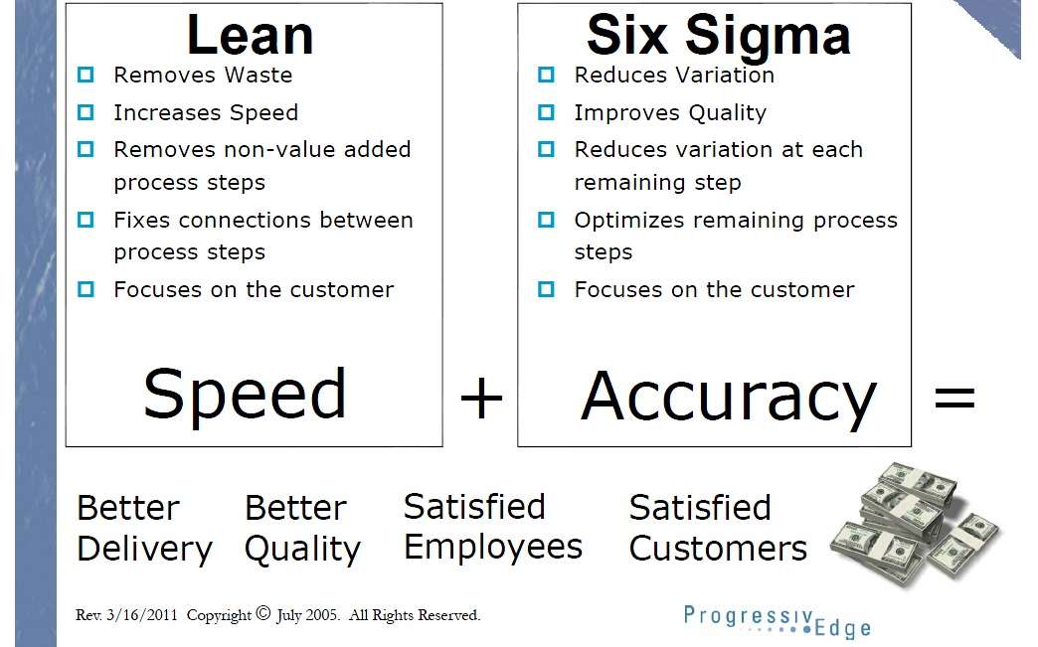
4. Improve Operations Efficiency
Resource: Jay Arthur. Lean Six Sigma for Hospitals: Simple Steps to Fast, Affordable, and Flawless Healthcare. 2011

Slide 14

5. Get Paid for Quality
Aggressively apply for value-based demonstrations and grants
Negotiate with third party insurers to pay for quality
Consider self-pay and employees first for care management

Slide 15

6. Engage Medical Staff Deeply
Educate, mentor, and engage physician leaders
Include physicians in key governance decision-making
Offer rewarding, yet reasonable salary
Notes:
ACOs demand hospital-physician alignment, especially primary care
Yet, provider autonomy and cottage industry practices are barriers
Strategic plan required
Goals
Objectives for each goal
Specific actions
Due dates
Resource allocations
Responsible individual
Suggested goals for a medical staff development plan
Recruitment and retention
Governance and engagement
Leadership development
Relationship development

Slide 16

7. Develop Medical Homes
Patient-centered medical homes are primary care practices that offer around-the-clock access to coordinated care and a team of providers that values patients' needs.
Access and communication
Coordination of care
Patient and family involvement
Clinical information systems
Revised payment systems
www.TransforMed.com
Sources: Commonwealth Fund and 2007 Joint Principles of Patient-Centered Medical Homes.

Slide 17

8. Cultivate New Skills
New skills required
We are comprehensivists
Data analytics
Quality improvement
Cost management
Team management – “leader” need not be a physician

Slide 18
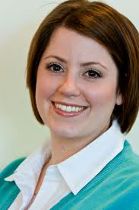
9. Coordinate Care
Supports provider care plans
Supports patients with frequent contact
Helps patients prepare for office visits
Identifies high-risk patients
Develops disease registries
Monitors reminder systems
Provides patient education
Coordinates care and transitions
The go-to person to connect the dots

Slide 19

10. Refer Based On Value
Who provides the best care to your patients?
How do you know?
Who provides the best value to your patients?
How do you know?
What kind of care do you want your mom to have?
Referral hospitals and specialists should earn our referrals

Slide 20

11. Consider Regionalization
Act locally; think regionally
Economies of scale may demand a contracted cottage industry
Goal: To care for populations expertly, efficiently, equitably
Resource: Lupica and Geffner. Enlightened Interdependence. Trustee. November/December 2012.

Slide 21

12. Engage Your Community
What is available locally to improve health care value?
Public Health
Social Service
Agency on Aging
Community health workers
Care transition programs
Churches and foundations
Do not duplicate!
Collaborations are less expensive than new clinic/hospital services – and build good will
Do what’s right

Slide 22
Lessons from Hospitals in Healthiest Counties
Dansville, NY: “change from thinking about the care that is given while the patient is within our walls to thinking about the care of the patient outside our walls”
Dansville: “We no longer see ourselves as a standalone organization, but rather as part of the region’s broader healthcare ecosystem”

Slide 23
Lessons from Hospitals in Healthiest Counties
Oakland CA: “just as our focus on total health–integration, prevention, and empowerment–drives internal planning for our members, it also drives planning for improving the health of our community”
Oakland CA: “we work closely with the county and state public health departments, reviewing various sets of data, including mortality and morbidity data, as well as substance abuse, drinking, and tobacco consumption figures”

Slide 24
Lessons from Hospitals in Healthiest Counties
Raleigh, NC: “a physician-led effort in partnership with the hospital to provide integrated, patient-centered care. This means coordination of care, more involvement in prevention as well as a more active role in helping people manager their overall health outside of the healthcare setting.”
Source: Rizzo E (2014) Population Health Lessons From Hospitals in the U.S.’ Healthiest Counties: 3 CEOs Share Successes. Becker’s Hospital Review. June 2.

Slide 25
Other Innovations
Chief Medical Financial Officer in Banner General Hospital in Sandpoint, Idaho (CAH)
Chief Patient Experience Officer named at Johns Hopkins Medicine
All about value for the patient/customer

Slide 26

Dr. Keith J. Mueller
Department of Health Management and Policy College of Public Health 145 Riverside Drive, N232A - CPHB
Iowa City, IA 52242 319-384-3832 keith-mueller@uiowa.edu

