Slide 1
Successful Physician Integration into Healthcare Systems
36th Annual Iowa Healthcare
Executive Symposium
Friday, 10.31.14
10:30 - noon

Slide 2
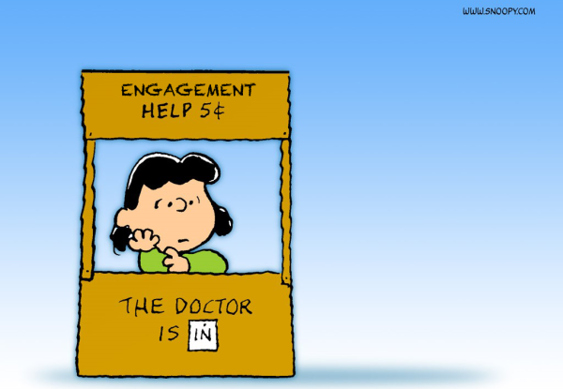
Focus: Reality-Based Guidance

Slide 3
Focus
Reality-Based Guidance
Notes:
Ian

Slide 4
Panelists
65 years of combined experience
Over 1,400 directly managed physicians (not counting other clinicians)
4,400 network physicians
450 physicians moved into alignment with health systems
275 physicians recruited
Notes:
Ian

Slide 5
Ian Montgomery ‘79 MA, CMPE Clinical Associate Professor EMHA Program Director Department of Health Management and Policy
Notes:
Ian

Slide 6
Aric Sharp ‘97 MA, FACHE, CMPE Vice President, Accountable Care Organization UnityPoint Health
Notes:
Aric

Slide 7
Eric Mooss
’04 MHA, FACHE, CMPE
Executive Director
Primary Care, Banner Health
Notes:
Eric

Slide 8
Our Five Basic Assumptions
“Format Follows Finance.” The Volume-to-Value transformation is underway.
2. Physician influence is key to Triple
Aim progress.
3. Few healthcare organizations have
no physician-integration strategy.
Notes:
Eric

Slide 9
4. Most organizations can offer a variety of alignment mechanisms.
5. Most physicians are now employed by non-physician-owned organizations.

Slide 10
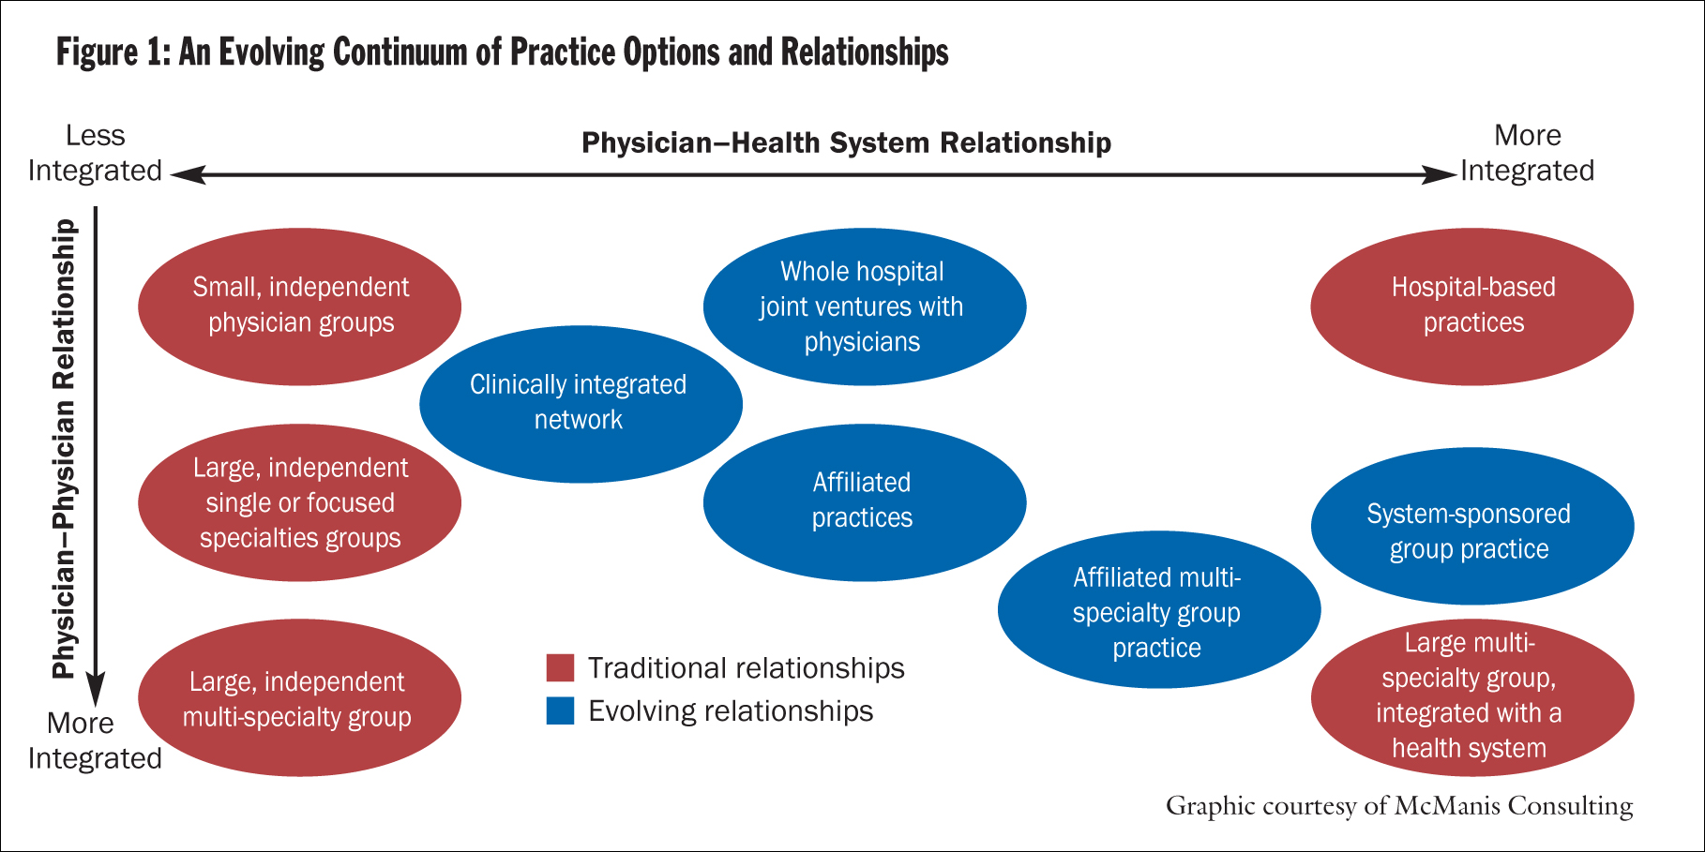
Physician Alignment: Paths to Partnership in “CHA” November-December 2008 Marc Bard, MD, Paul Conlon, Pharm.D., JD, Gale Gartner, and P. Terrence O'Rourke, MD
Notes:
Ian

Slide 11
Three Framing Questions for Today
Is physician employment the endgame?
What are the top integration failures?
What are the top integration successes?
Notes:
Ian

Slide 12
Is physician employment typically the best solution as we move to a value-based financing environment?
Notes:
Ian

Slide 13
What are the top physician integration failures?
Notes:
Ian

Slide 14
What are the top physician integration success factors?
Notes:
Ian

Slide 15
Conclusions

