Slide 1
Trinity Pioneer ACO
Challenges
Innovations
Lessons Learned

Slide 2
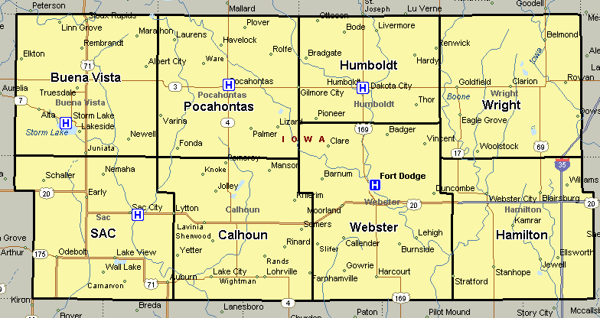
Trinity Pioneer ACO
Pioneer– ACO Service Area
8-county service area in Northwest Central Iowa
Population: 20,567
Median Income: $46,947
Rank: 35
Population: 7,154
Median Income: $42,138
Rank: 50
Population: 9,688
Median Income: $48,710
Rank: 72
Population: 12,972
Median Income: $45,713
Rank: 69
Population: 10,071
Median Income: $46,606
Rank: 17
Population: 9,926
Median Income: $45,097
Rank: 68
Population: 37,044
Median Income: $41,751
Rank: 93
Population: 15,312
Median Income: $45,691
Rank: 57

Slide 3

Achieving our Aim
AIM: Leverage every aspect of our “community” to achieve Best Outcome for Every Patient Every Time
Trinity Pioneer ACO
Primary Care Community
Primary Drivers
Health-Risk Assessment Iowa’s Healthiest State initiative Preventive screening Health Education and Literacy Wellness Program | Patient access to PCP PCMH and IHH Common screening and assessment tools Single, patient-centric care plan Med Therapy Management Mental Health Action Team | Care transitions – Extended Care Facilities ICCDM – all care settings Advanced Medical Team Telephonic-Telemonitoring Strategic Healthcare Partners Critical Access Hospitals | Risk stratification Med Therapy Management Disease Management Coaching Strategic Community Partners | Palliative Care: Inpatient Home-based Clinic Integration with PCP Hospice: Hospice Home Home-based
Secondary Drivers
Home/Neighborhood - Schools - Business - Healthcare Agencies - Government -Recreation - Church/Spiritual
3

Slide 4




The Trinity Pioneer Story
Using Data
Silo Busting
Forming Needs-Based Teams
Aligning Resources
Uniting Around the Vision – Care Coordination
And

Slide 5

Changes in Care Delivery
Science of Change – Adaptive Design
Approaching Chronic Care with a common language – ICCDM
Integrated Chronic Care Disease Management
Finding Leaders and Providers and Teams dedicated to the vision
Chemistry is important – so is forgiveness
SMEs have a role
Collaborators get the most done
The work gets more complicated, so stamina is an important attribute of people doing the work
Telling and sharing experiences and patient stories reenergizes the work
It is not a “program” thus the work will never end

Slide 6
Convening the right partners
Evaluate the capacity for transformation
Not all partners are created equal
Evaluate the capacity for risk/change
What are the drivers to participate in value-based arrangements
How much time do you have to change?
Depends on payor environment and aligned participants
Depends on a hospital’s capacity to sustain revenue without increasing PMPM
If you were to demonstrate ability to manage lives – who holds the capitation control?
Do you belong to the right networks?

Slide 7
The Trinity Pioneer Story
Needs Based Teams and Work
Programs Across the Continuum
Palliative Care
Health Risk Assessment
My Care Profile
Advanced Medical Team for High Risk Patients
Care at Home to Support Transitions
Telephonic Disease Management for Diabetes Care
Long Term Care Collaborative
Medication Therapy Management with Community Pharmacies
Partnership with Public Health Community Care Teams
Behavioral Health Assertive Community Treatment and Integrated Helath Home
Iowa Physician Order for Scope of Treatment to Honor End of Life Choices
Our Common Language Across the Continuum
Adaptive Design for Ideal Care
Integrated Chronic Care Disease Management
Patient Centered Medical Home
Teach-Back and Ask Me Three
One Team

Slide 8
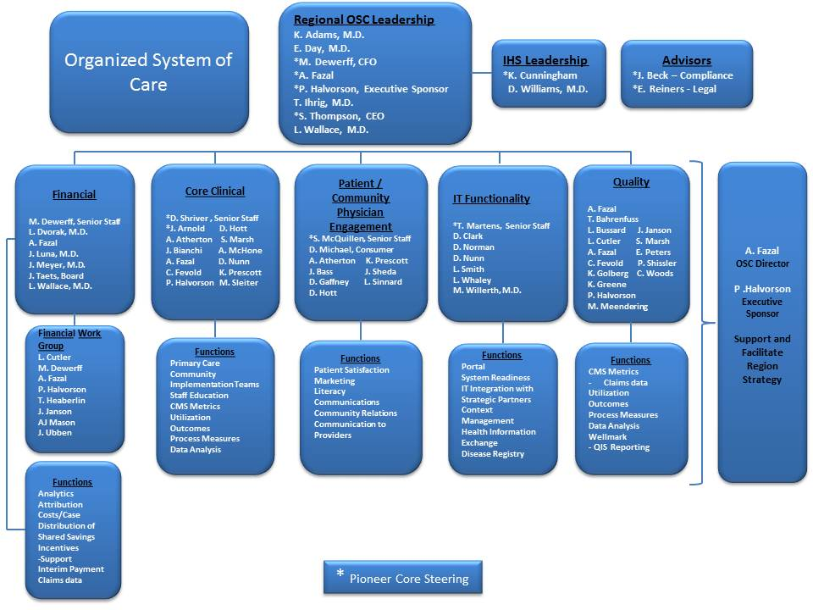

Trinity Pioneer ACO

Slide 9
