Slide 1
Housing and Health
Megan Sandel MD MPH June 22 2018

Slide 2
Roadmap
Dimensions how Homes affect Health
Quality, Stability, Affordability, Location
How a Home can it be like a Vaccine
Homes and People (Population Health)
Homes as a route to Health Equity

Slide 3
Evidence on Home Quality
Accidents/Injuries – exposed wiring, needed repairs
Development and worsening asthma, allergies tied to home
Pests (cockroaches and mice)
Molds/Chronic Dampness
Tobacco smoke
Lead exposure tied to long term effects
Developmental delay, Attention deficit
Heat or eat
Skinner et al, 2014

Slide 4
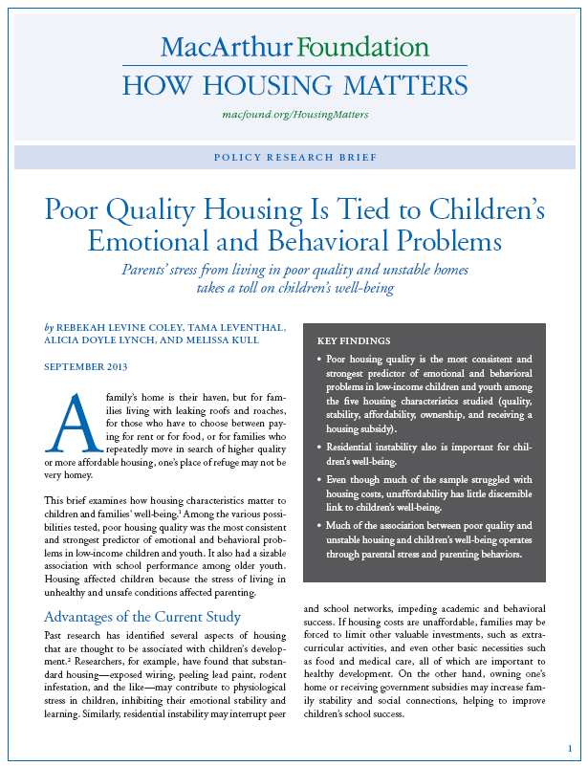
Home Quality and Mental Health
Poor housing quality strongest predictor of emotional and behavioral problems in low-income children
Much of association between poor housing quality and children’s wellbeing operates through parental stress, parenting behaviors and mental health
Notes:
QUALITY
One of the big take-aways from the housing quality literature is that poor housing quality affect both physical AND emotional health – the soft skills that we rely on to succeed

Slide 5
Stability: The Home Iceberg
HOMELESS
HIDDEN HOMELESS:
HOUSING INSECURE
Multiple moves
Overcrowded
Doubled Up
UNAFFORDABLE HOUSING
Notes:
STABILITY
When we look at housing stability or security, it looks like an iceberg

Slide 6
Exploring three forms of unstable housing with caregiver and child health
Among 22,234 families, 34% had at least one adverse housing circumstance:
27% behind on rent
8% multiple moves
12% history of homelessness
Each circumstance individually associated with adverse health and material hardship compared to stable housing
Pediatrics Feb 2018

Slide 7
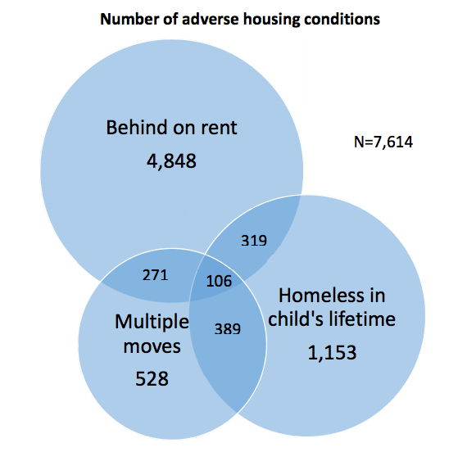
Little overlap among three adverse housing conditions
Most families were renters and behind on rent and impacted health
Pediatrics Feb 2018

Slide 8
Outcomes of unstable housing with health and material hardship outcomes
Sandel et al Pediatrics Feb 2018
Notes:
All statistically significant

Slide 9
Location: Poverty and Zip code remain linked

Slide 10
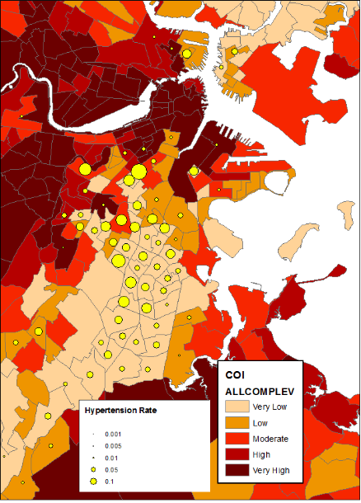
Place, Opportunity, and Health
Mapping elevations in the blood pressure of 3 years olds by Child Opportunity Index from diversitydatakids.org
Vital Village Network at Boston Medical Center maps relationship between opportunity and life course (elevated BP at age 3)

Slide 11
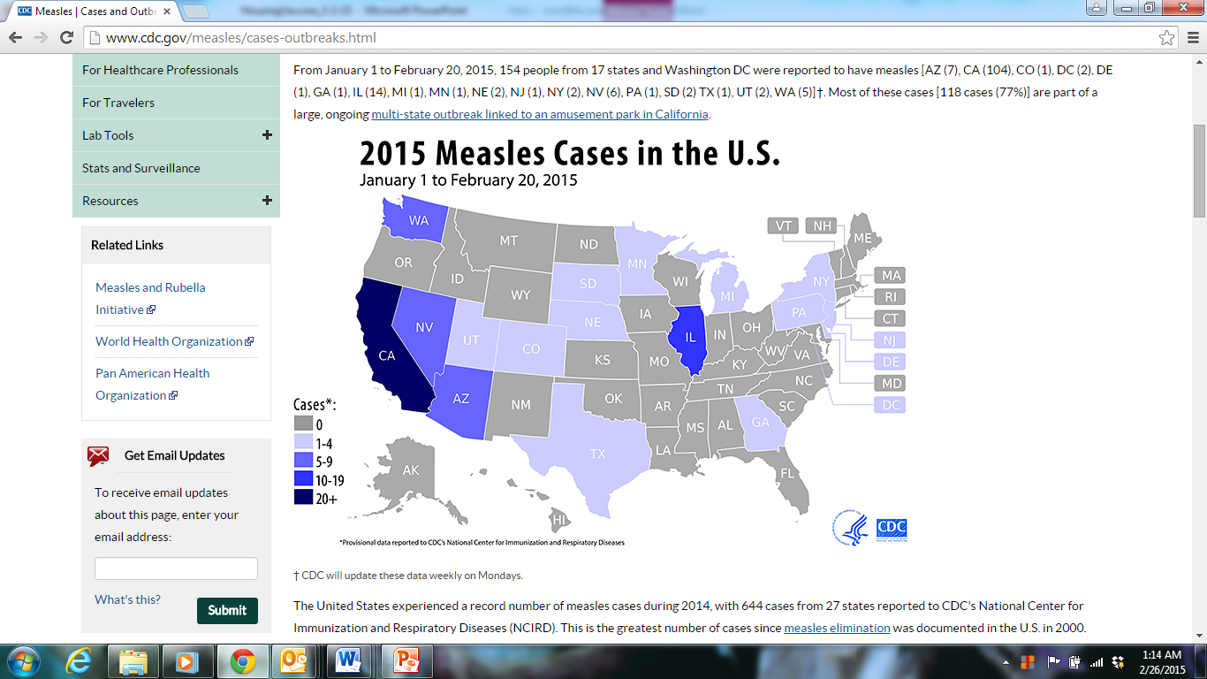
Public Health 101 – Vaccine Review
Why vaccinate?
Personal protection
“Herd immunity”
Community and economic benefit

Slide 12
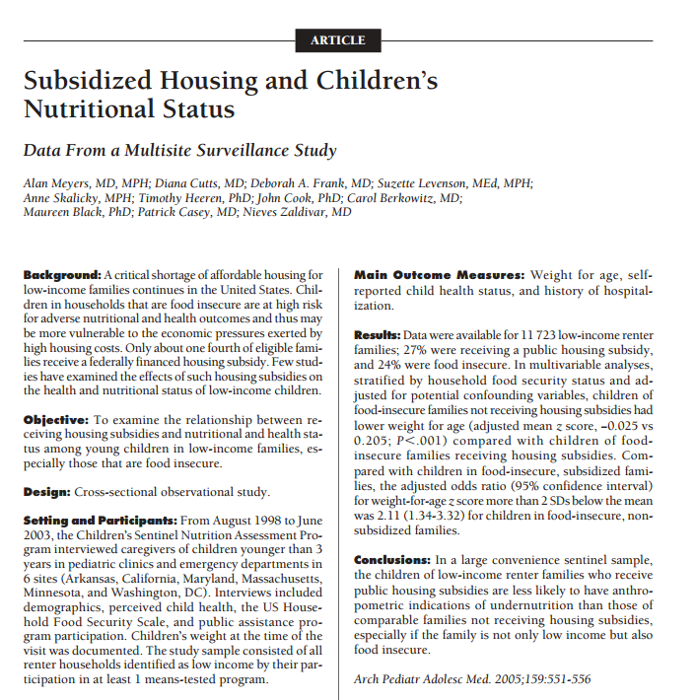
Kids in Food Insecure Families were TWO FOLD less likely to be underweight if they had a housing subsidy than similar kids who were eligible but did not receive a subsidized home
Notes:
What we can do to address homelessness and housing insecurity…

Slide 13
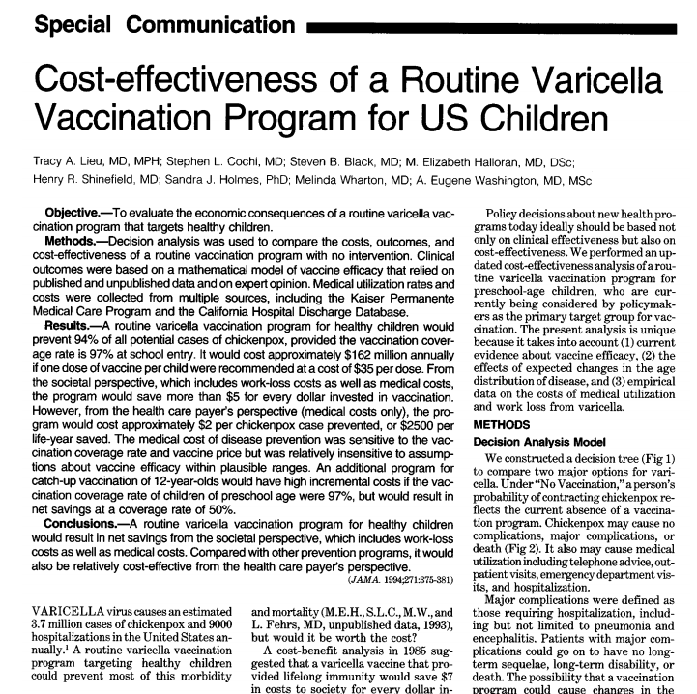
For Healthcare costs alone, it did not save money, but cost $2 per chicken pox case prevented. But by societal costs, every $1 invested in vaccines saved $5 including work-loss costs

Slide 14
How Should Population Health be Defined?
Population by Housing Risk
How Healthcare Alone Looks at Risk
High-Risk Clients Top 5%
Rising-Risk Clients 5-35%
Low-Risk Clients 60-80%
High-Risk Patients Top 5%
Rising-Risk Patients 5-35%
Low-Risk Patients 60-80%
Trade high-cost services for low-cost management
Homelessness Addressed
Avoid unnecessary, higher-acuity, higher-cost spending
Housing Instability Addressed
Keep patient healthy, loyal to the system
No Need Addressed

Slide 15
A pilot program for high risk patients is an example of new care models to improve health outcomes but social determinants remain key
Of 50 patients enrolled in Care Management between Dec 2016 and May 2017:
Inpatient stays
3 months pre/post intervention, n=20
Recent or current homelessness: 47%
Heart Failure: 49%
Substance use disorder: 38%
Average age: 57
Mental health condition: 79%
Pre
Post

Slide 16
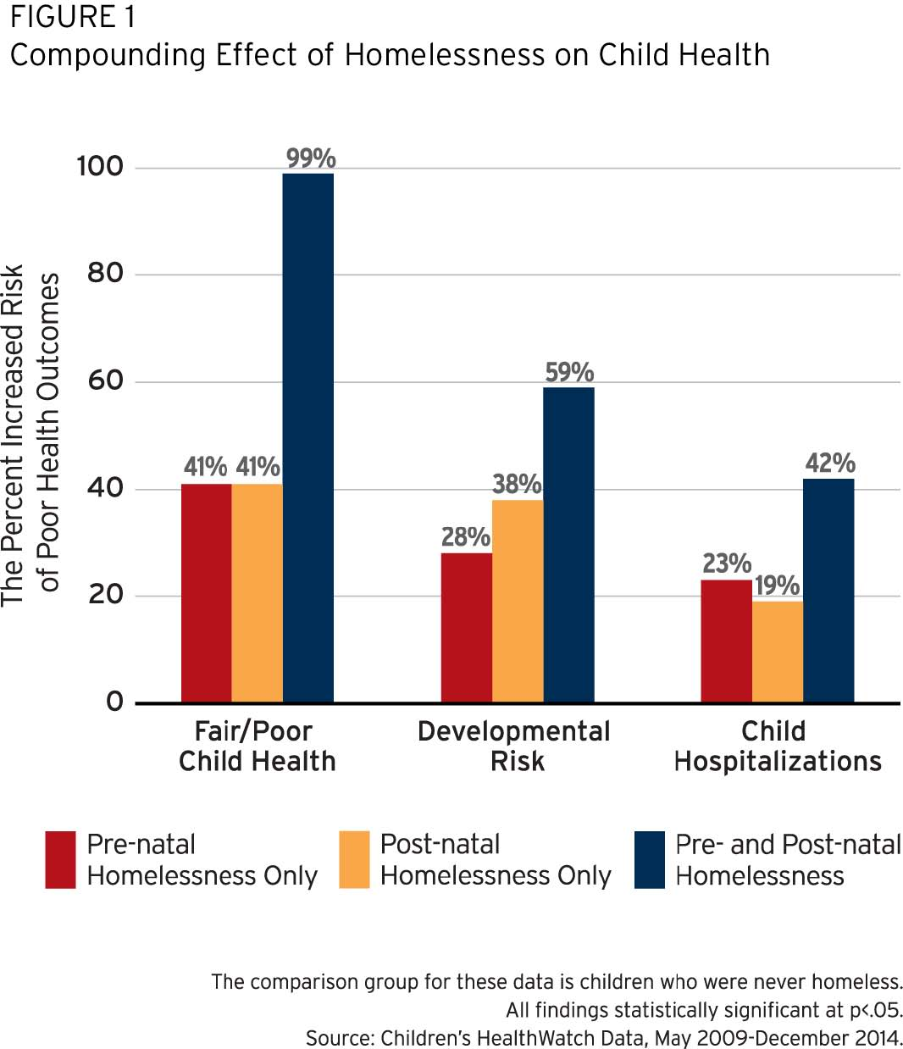
Notes:
STABILITY
HOMELESSNESS
No safe level of homelessness

Slide 17
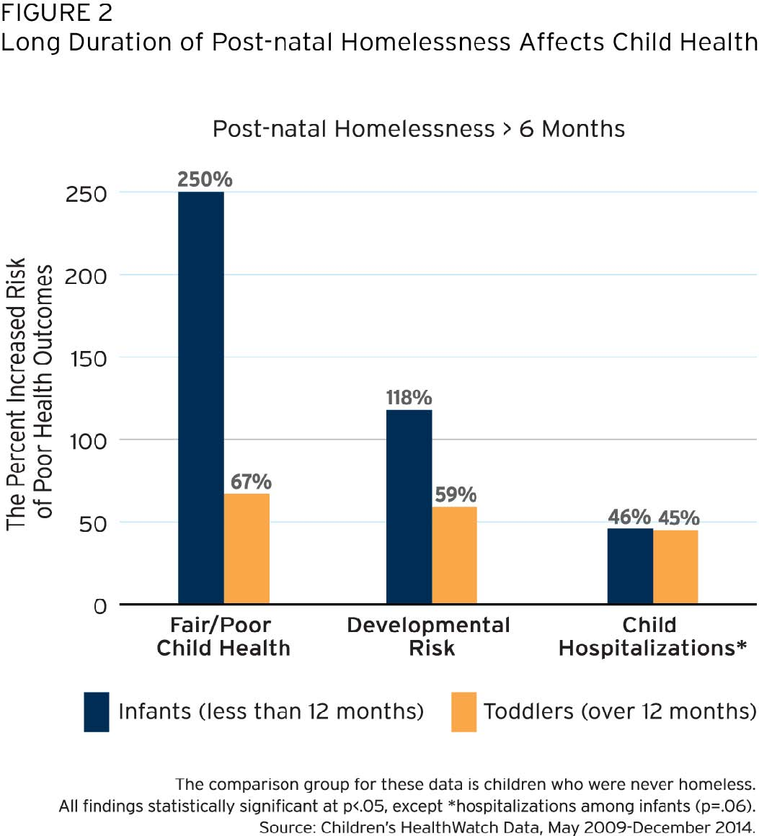
Notes:
STABILITY
HOMELESSNESS
No safe level of homelessness

Slide 18
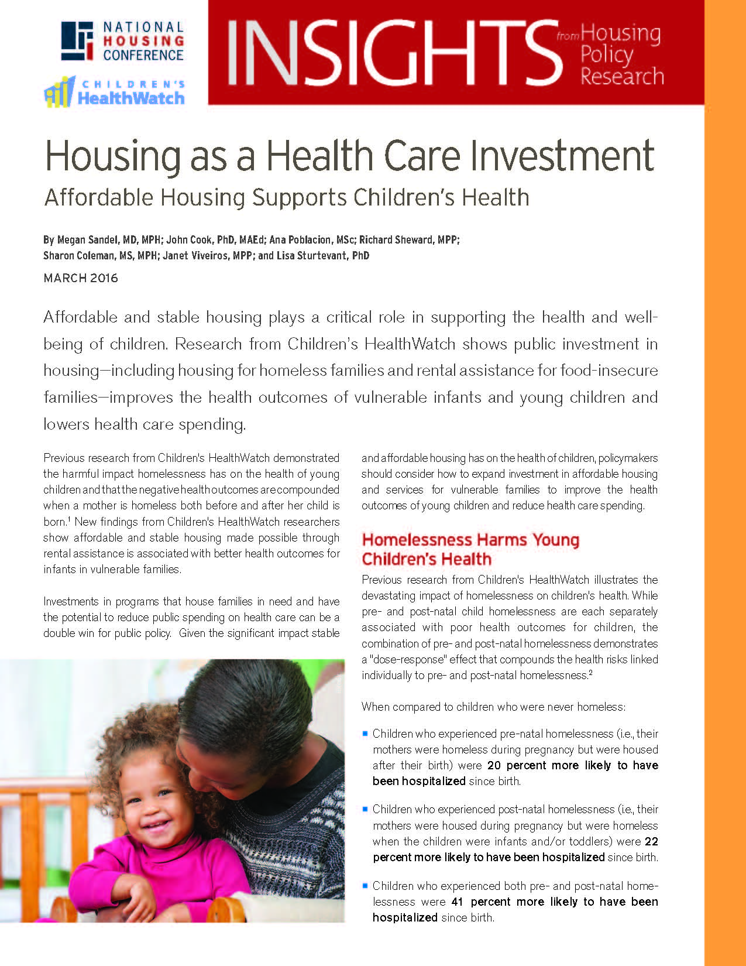
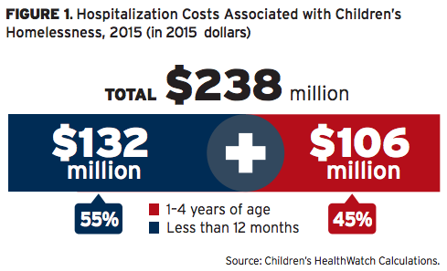
Notes:
STABILITY
HOMELESSNESS
No safe level of homelessness

Slide 19
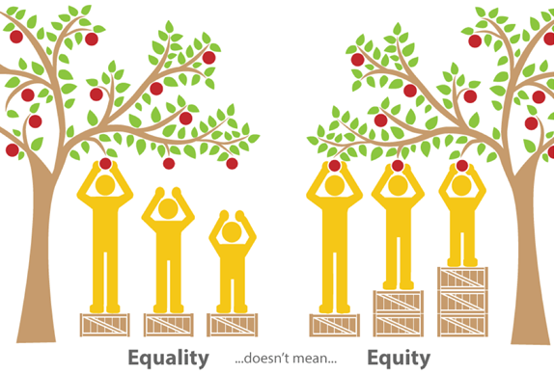
Neudorf C, Kryzanowski J, Turner H, et al. (2014). Better Health for All Series 3: Advancing Health Equity in Health Care. Saskatoon: Saskatoon Health Region. Available from: https://www.saskatoonhealthregion.ca/locations_services/Services/Health- Observatory/Pages/ReportsPublicatlions.aspx

