Slide 1
BMC Health System Housing Initiative
Megan Sandel MD MPH
June 2018

Slide 2

To achieve real change in SDOH we have to go deeper than typical clinical interventions to address root causes and test multi-level strategies
Social Inequities
Policy and Programs
Environment
Disease and Injury
Can we also work in populations or geographically to change SDOH in multi-level interventions as well?
Behavior
We spend the majority of time here intervening clinically, screen/refer

Slide 3


RCT New RCT studies in Housing
Housing Insecure families identified by Children’s HealthWatch OR Referred by Navigator/SW/Case Manager
Meets eligibility criteria (high health care utilization, high housing instability, BMC patient
Ineligible for study
Consent to participate in the study
Refusals
Intervention group:
Referral to Project Hope
Control group
Project Hope - Intake assessment/ housing needs characteristics/case management/conducts Problem Solving Education/ referrals to partners
Standard of care: Paper outreach resources with information on housing supports
Families may receive referrals to any combination of services offered by:
Nuestra Comunidad
Medical-Legal Partnership
Boston Housing Authority

Slide 4
Health system resource | Significance | How to leverage | Example
Investment dollars and expertise | Underinvested communities need risk-tolerant, patient/flexible capital | Take the lead in structuring transactions, especially in areas lacking partners Supply gap-filling capital, with longer terms, higher loan-to-value ratios than commercially available funds | Dignity Health
Grant money, from health system foundations, community benefit budgets or operational sources | Grant funding makes investment possible by boosting system/ actor capacity; reducing risk in transactions; and preparing the ground for projects | Pay directly for programs, infrastructure, or staff for cross-sector efforts Provide loan loss reserves and other forms of credit enhancement or subordinated capital Fund market studies, inventories of vacant properties or local businesses | Trinity Health
Data | Expertise in data analytics can help improve community decision-making. Cost data can be valuable in assessing the potential for savings. | Support collection and analysis of data Coordinate on CHNAs | Greater University Circle Initiative, Cleveland
Real estate expertise | Health institutions have internal capacity that can support development of community projects | Participate in community planning Help shape development RFPs to produce high quality results | Gundersen Lutheran
Land | Health institutions occupy and manage key parcels and buildings | Locate and develop facilities strategically, with an eye towards creating value/multiple benefits for the community Orient and open the campus to the community | Johns Hopkins
Reputation and relationships | As anchor institutions, hospitals and health systems have convening and coordination power that other community actors may not | Utilize existing public, private, and nonprofit relationships to support community investment priorities Leverage the institution brand in financial transactions | Cooper Foundation
    Source: “Strengthening Community” RWJ CCI IRI Issue Brief Investment March 2017

Slide 5
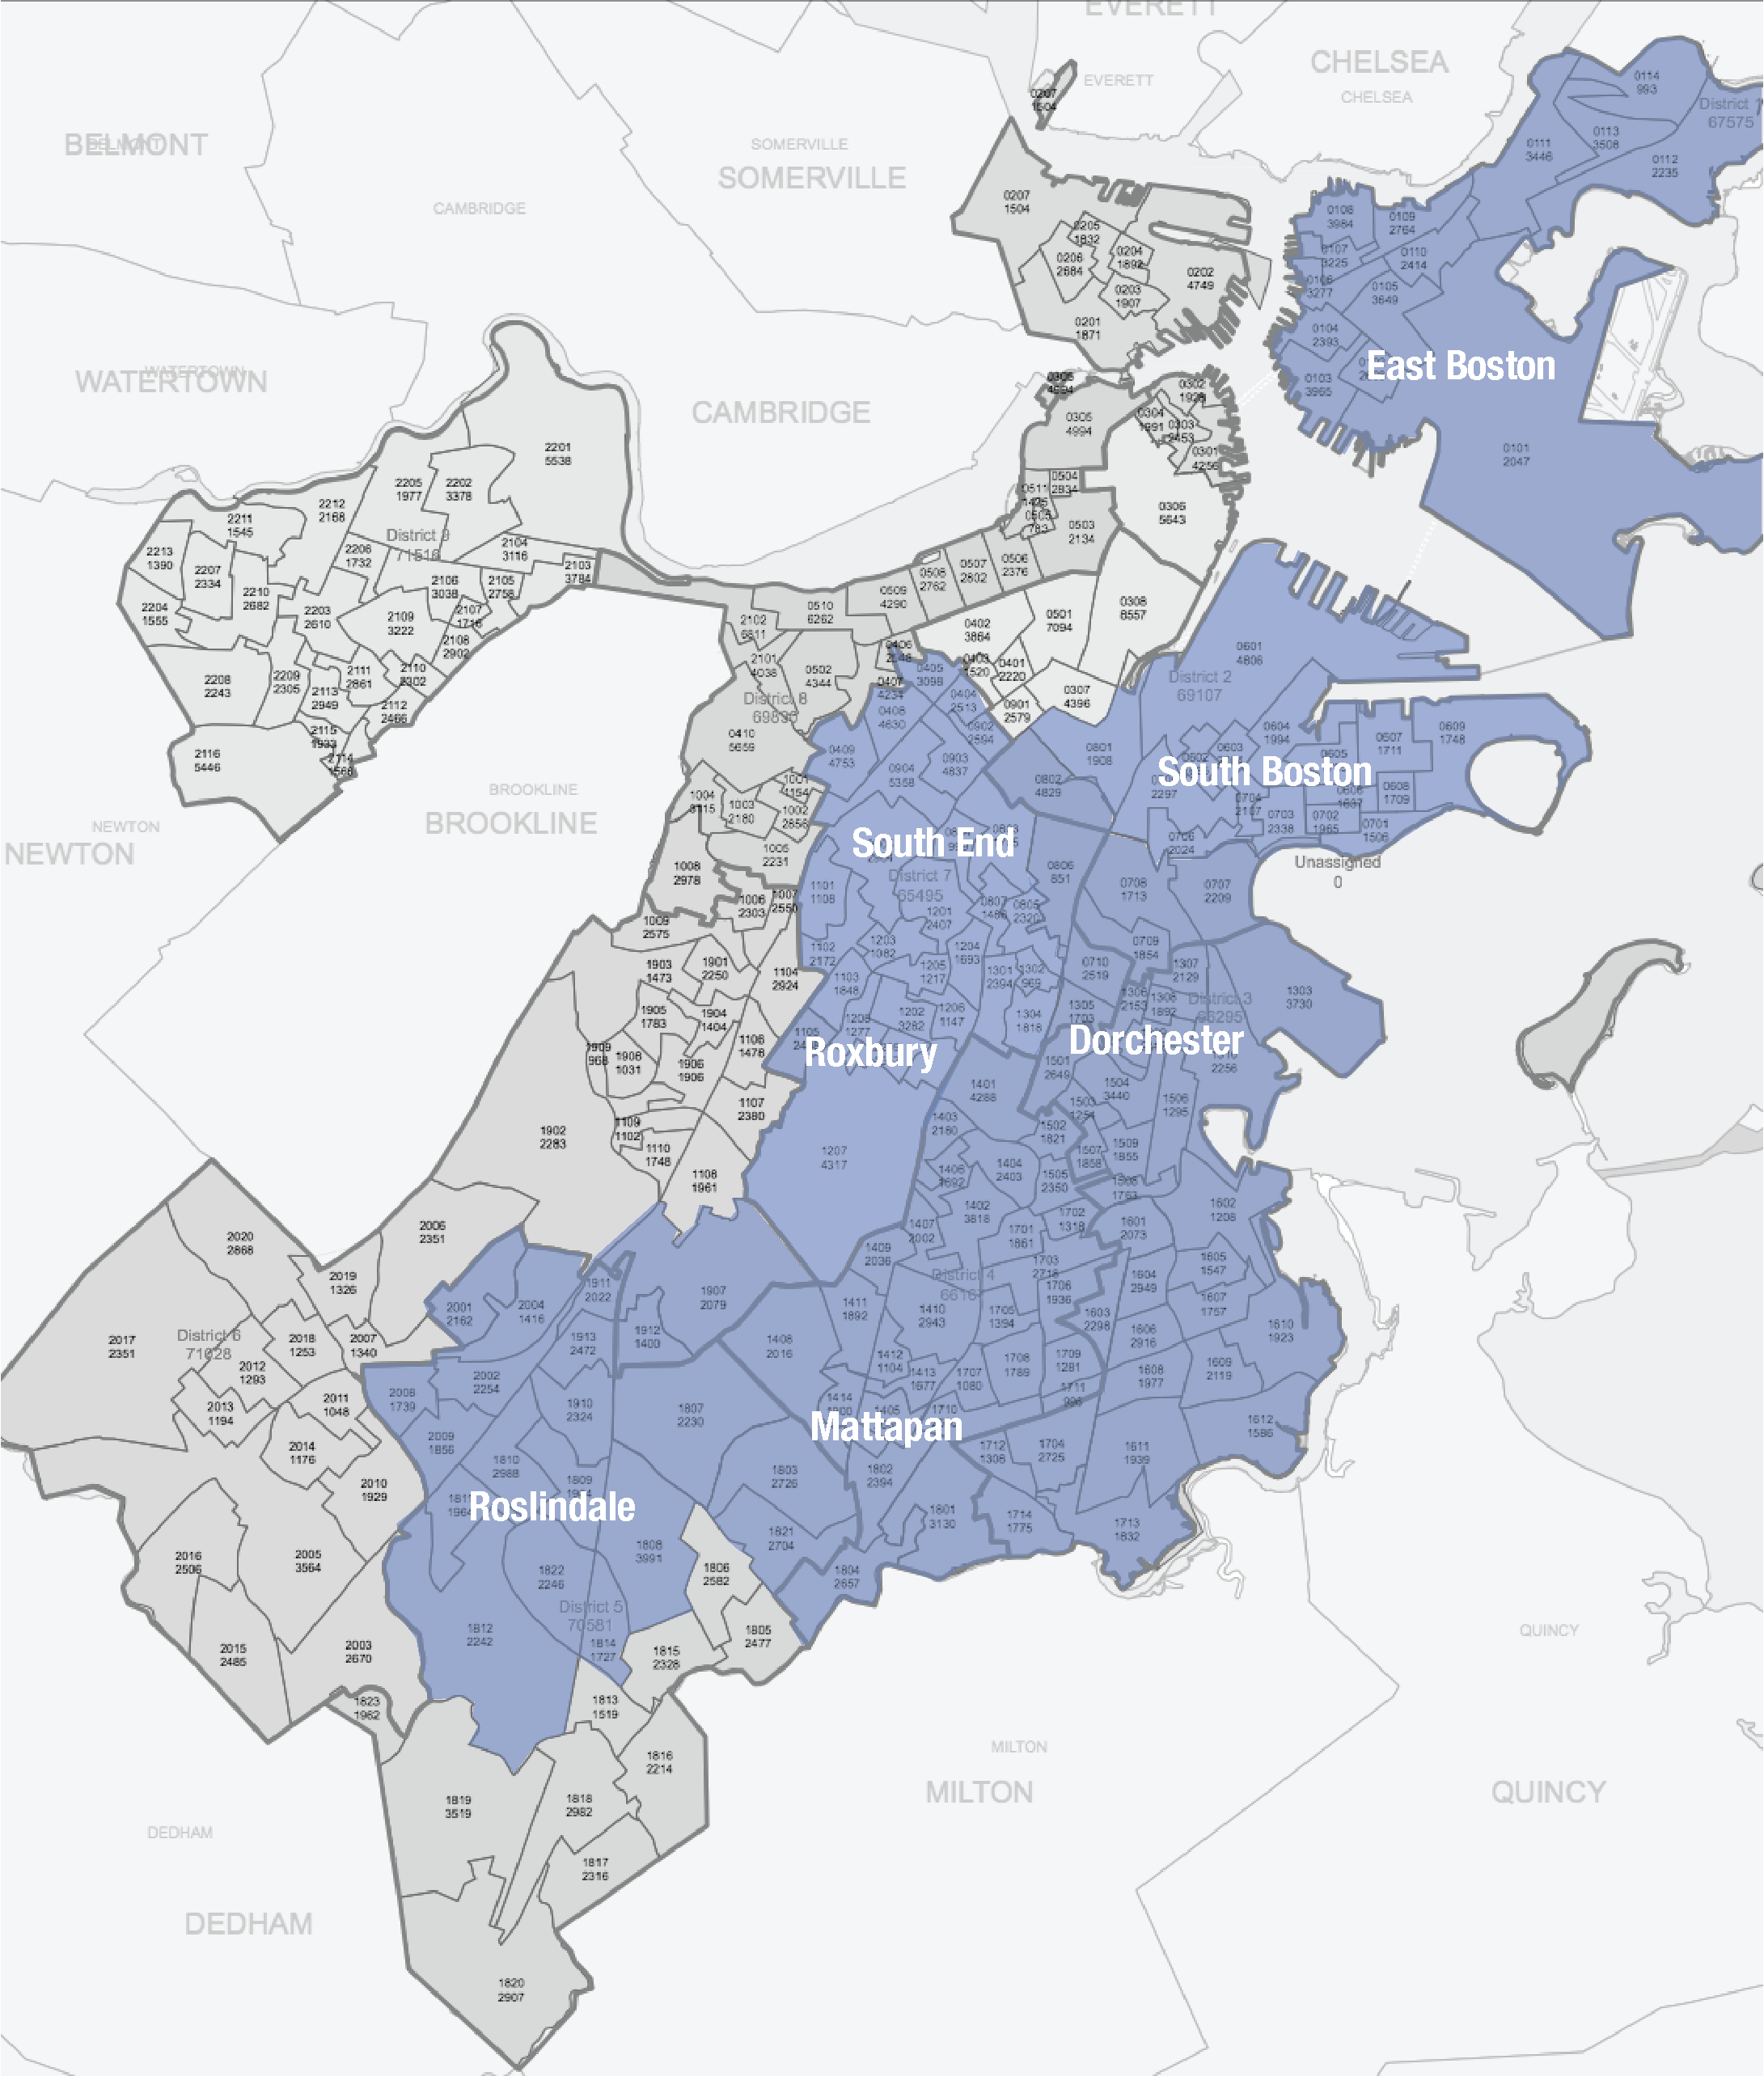
We have identified the Roxbury and North Dorchester areas of Boston where community investments may have the most impact to our patients given the concentration of high cost high need patients there
Among the top 3% of patients with the highest hospital charges, the top 5 zip codes are in our neighborhoods of interest:
Roxbury/South End 02119, 02118
Dorchester 02124, 02121, 02125

Slide 6
Our Housing Intervention is tied to Boston neighborhoods to maximize Community Health Improvement
Pine St Inn
Boston Medical
Center
Dudley Square
Madison &
Nuestra Comunidad
Franklin Field
The Community Builders
Fields Corner
Codman Sq NDC

Slide 7




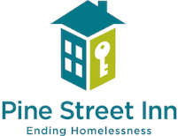
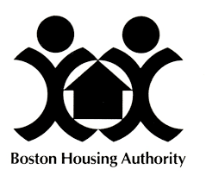



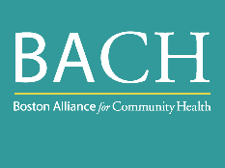

We are investing $6.5M from our Determination of Need obligated funding in housing initiatives in Boston’s most underserved neighborhoods
  Partners
  Funding
  Housing Project Investments
  $2.2M
  This fall, we innovatively guided Determination of Need obligated funding towards housing
  We aim to support housing and wrap-around services our patients and use Community Investment Tax Credits to stretch dollars
  We plan to test multiple approaches and have devoted $0.65M to evaluation and oversight to determine the best approach
  We look forward to working with other Boston hospitals to make similar investments and work collaboratively to improve community health
  Housing Support Service
  $0.9M
  Hybrid Housing Project Investment
  $1.3M
  Community Engagement & Housing Stability
  $1.7M
  Social Impact Fund
  $0.5M

Slide 8
We have committed to 8 investments using a multiple approach housing strategy that will benefit the community and our patients
Community Health improvement
Population Health benefit
  Funding
  Description
  Investment
  Nuestra Comunidad / Bartlett Station
  Mixed use development in Roxbury’s Dudley Square includes 323 market rate, and affordable rental housing, retail and green space
  Providing a $1M no interest loan for Good Food Markets, a healthy food market
  Providing a $400K subsidy for Good Food’s outreach to build relationships in the community
  High BACO membership in this community will benefit from more healthy food and housing options
  $1.4M
  Codman Square NDC / Waldeck Street
  Permanent supportive housing for individuals with mental health and disability issues
  Providing a $800K operating subsidy and capital improvements to property buildings
  35 units of housing in the Fields Corner neighborhood in Dorchester
  $800K
  Community Builders / Community Life Services
  Housing support services for those living in the Franklin Field community of Dorchester
  Providing $360K to support a Community Life Program Coordinator
  Supporting residents and community neighbors, and place homeless families when units turnover
  $360K

Slide 9
Our goal is to invest in a range of targeted housing opportunities in Boston’s most underserved neighborhoods…
Community Health improvement
Population Health benefit
  Funding
  Description
  Investment
  Madison Park Village Smith House / Dewitt Center
  263 units for families and 132 for the elderly
  Providing $300K to hire a full time service coordinator
  Providing $225K to hire a senior care coordinator
  New positions will support residents to maintain permanent residence and live independently
  $525K
  Hybrid Housing Support Services – Pine Street Inn / BHCHP
  Stabilization housing program for medically complex individuals. Creating medical respite to stabilize patients
  Providing $1M for capital improvements, services and program management of a new stabilization housing program
  $1.0M
  Hybrid Housing Support Services – BHA / BMC
  Upgrades and services to enable elderly and disabled residents to continue to live independently
  Providing $200K for unit upgrades focusing on residents’ wellness needs
  Providing $84K to hire a Community Wellness Advocate who will provide training to residents on many topics and will connect residents to services
  $284K

Slide 10
… In addition to maximizing collaboration among housing stakeholders
Community Health improvement
Population Health benefit
  Funding
  Description
  Investment
  Community Engagement and Innovative Stable Housing Initiative
  Collaborative project to design, implement and evaluate a Boston Housing Stabilization initiative and to conduct ongoing community engagement around affordable housing
  Providing $1M for mini-grants and financial assistance for individuals and families to avoid eviction
  Providing $700K in operating funds to support community outreach, youth development, and health career development
  $1.7M
  Healthy Neighborhood Equity Fund
  Private equity fund led by the Conservation Law Foundation and Mass. Housing Investment Corp. based on a socially responsible investment model that considers the community, environment and health benefits of the housing complex
  Invested $500K in a $22M social impact private equity fund that closed in May 2017
  HNEF has invested in 6 projects that have the potential of transforming neighborhoods. These 6 projects include 528 units of rental and ownership housing ranging from low-income to market rate units
  $500K

