Slide 1
Photo Album
by Duncan, Janet L

Slide 2
Indoor walking routes-CBRB into MERF
tunnel towards UIHC
Down and back .50 miles, no stairs in path

Slide 3
Lower level path (tunnel)

Slide 4
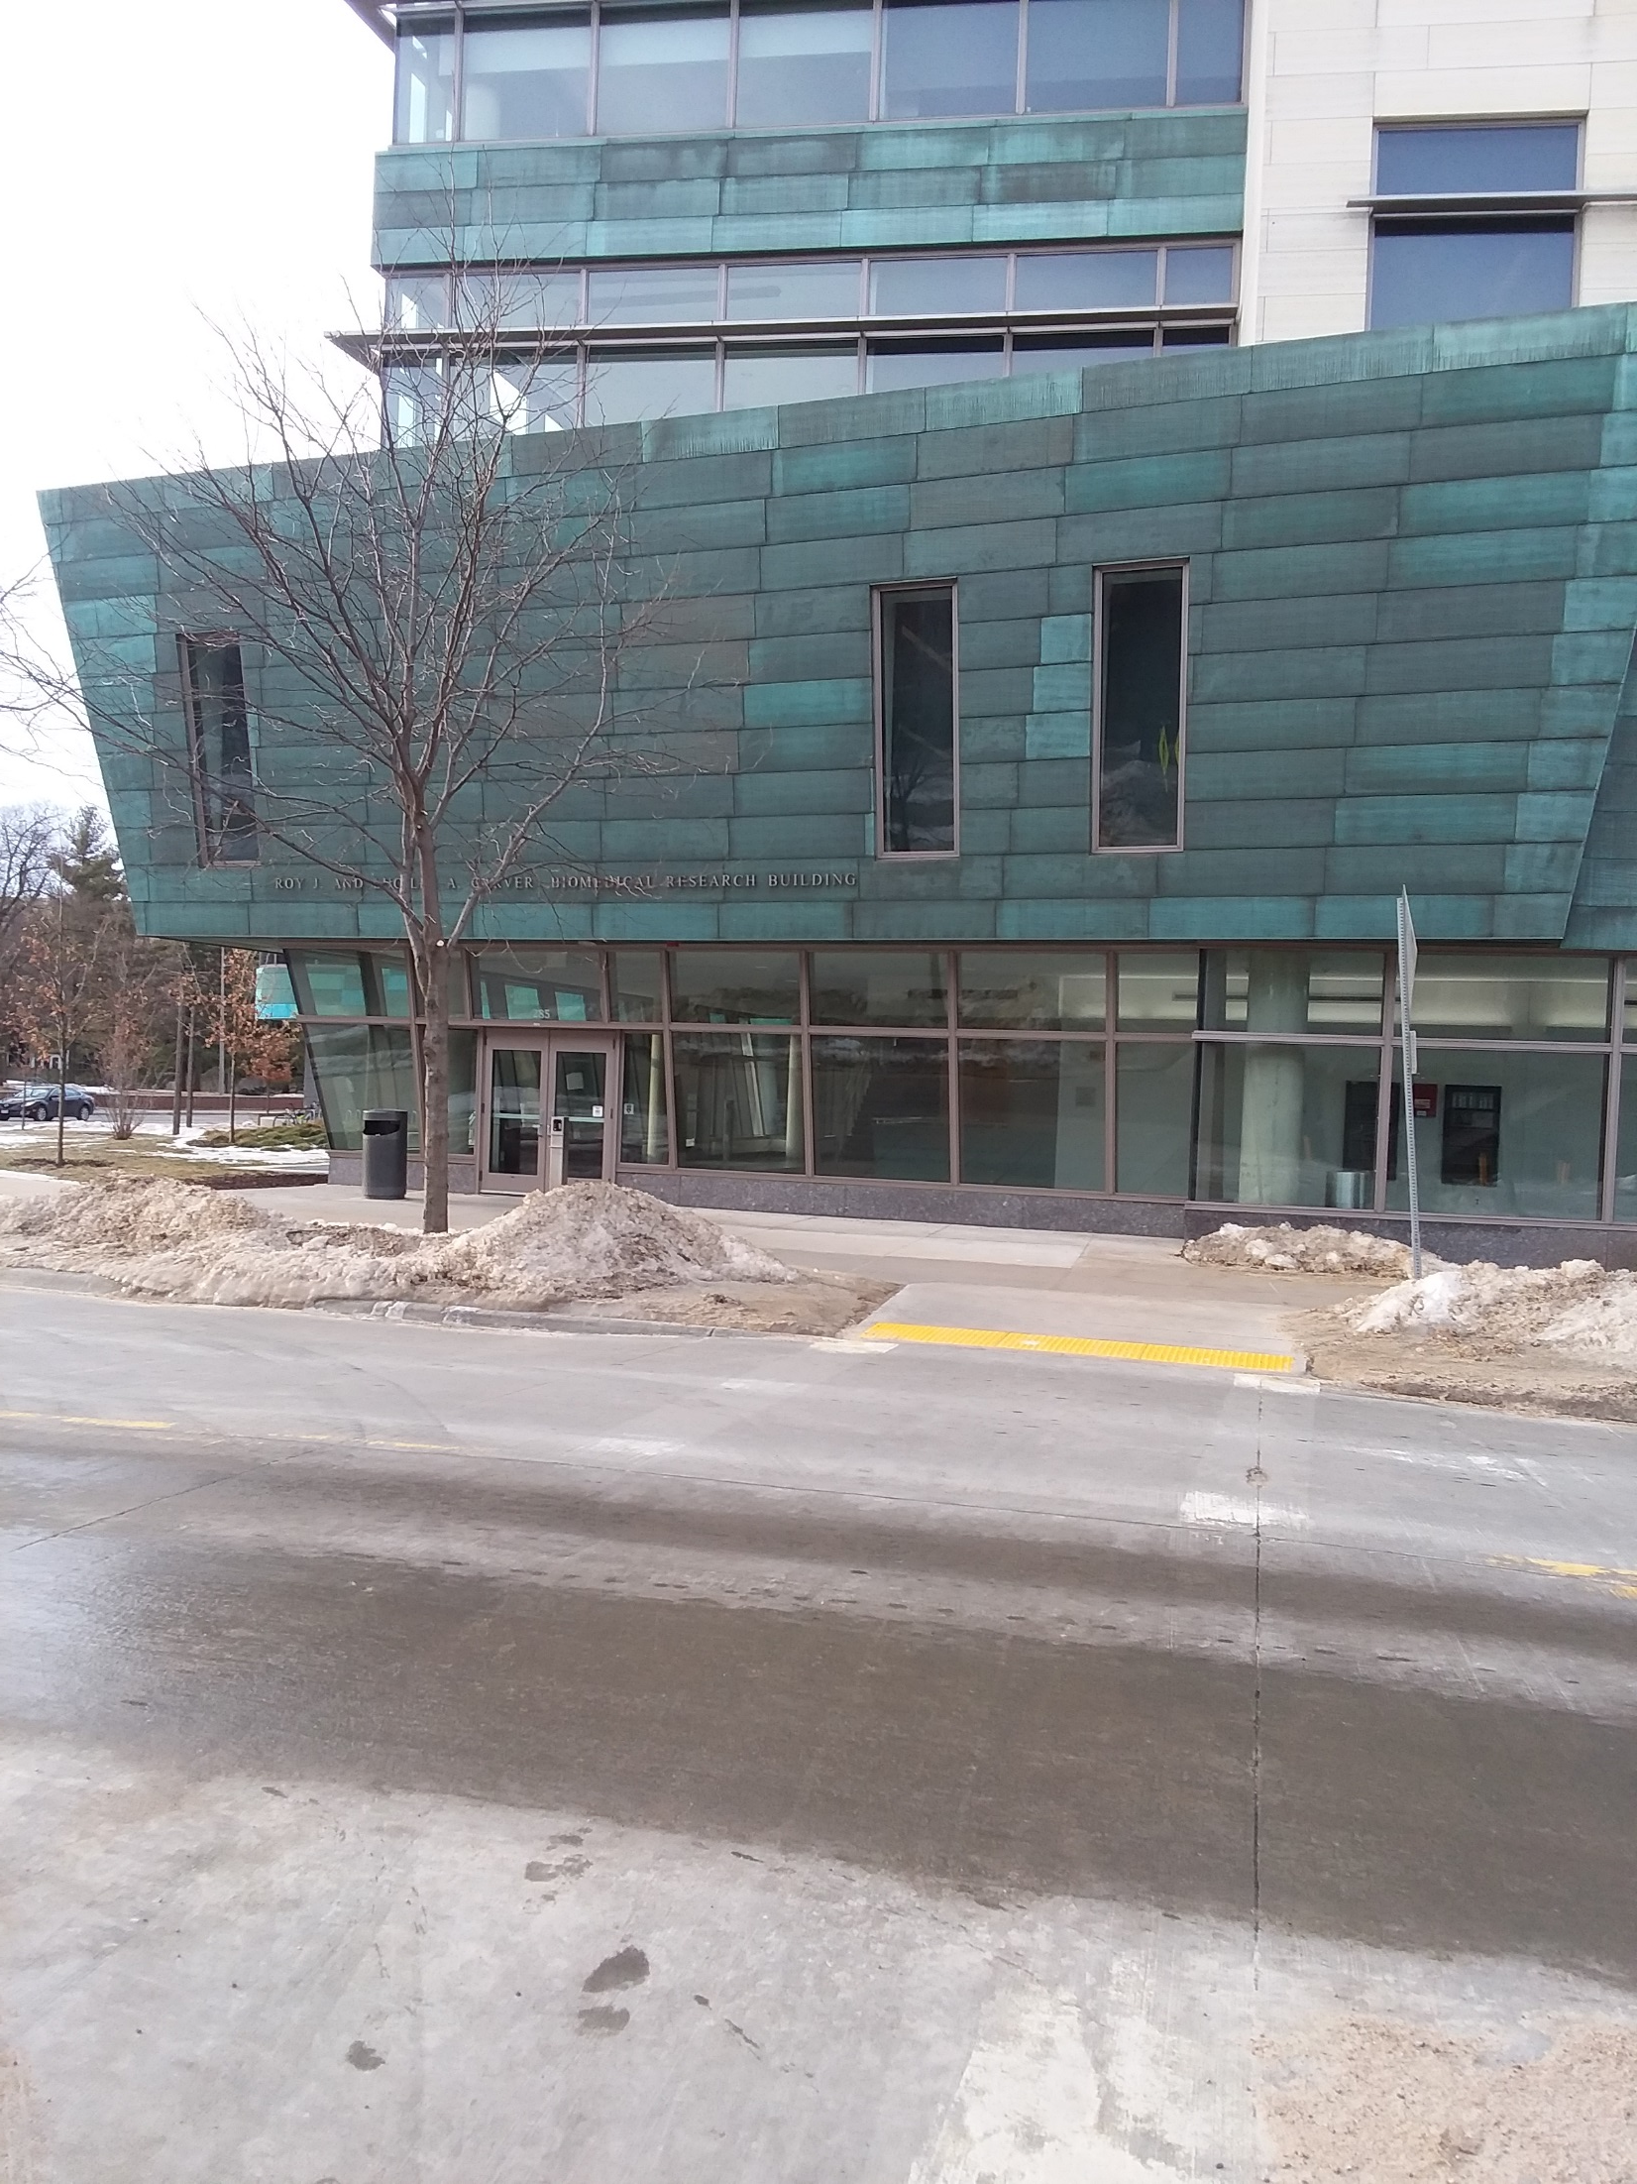

Slide 6
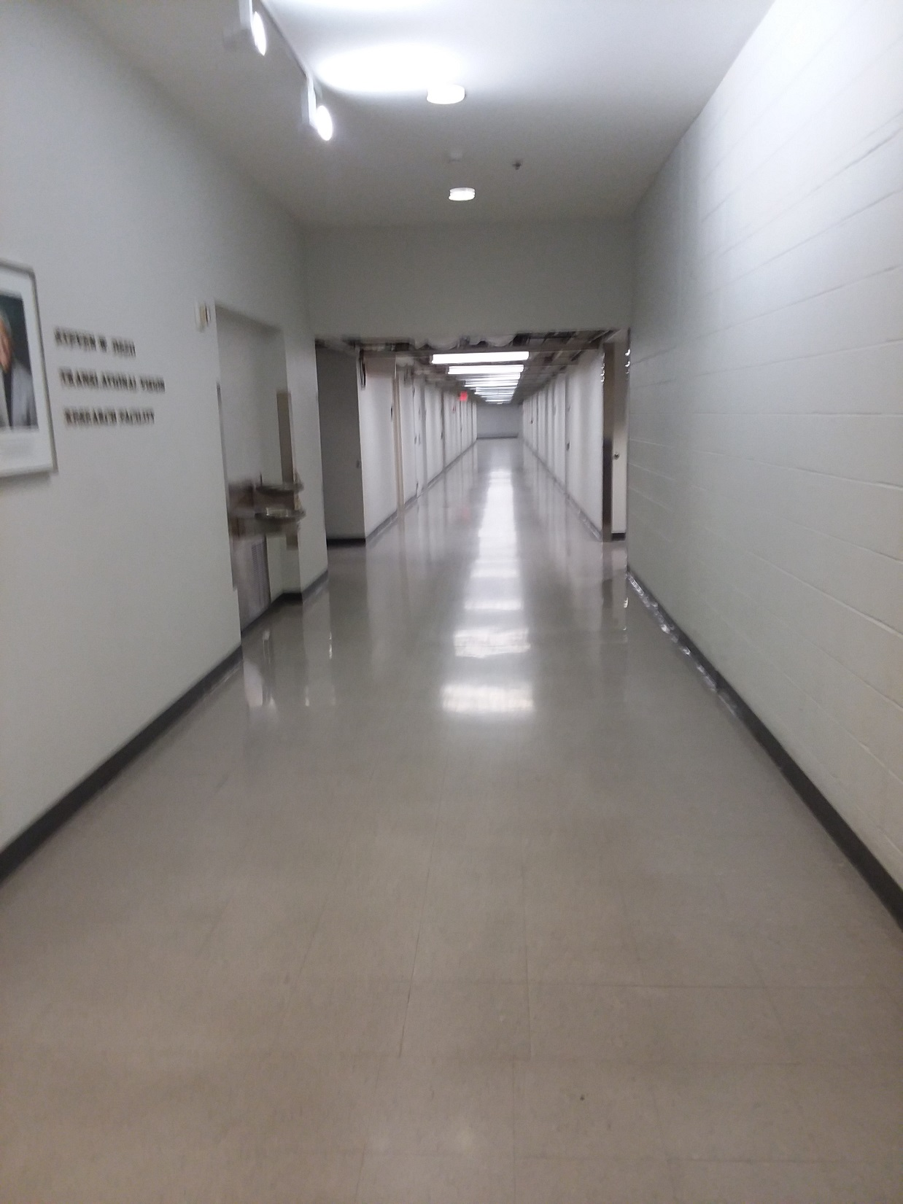

Slide 7
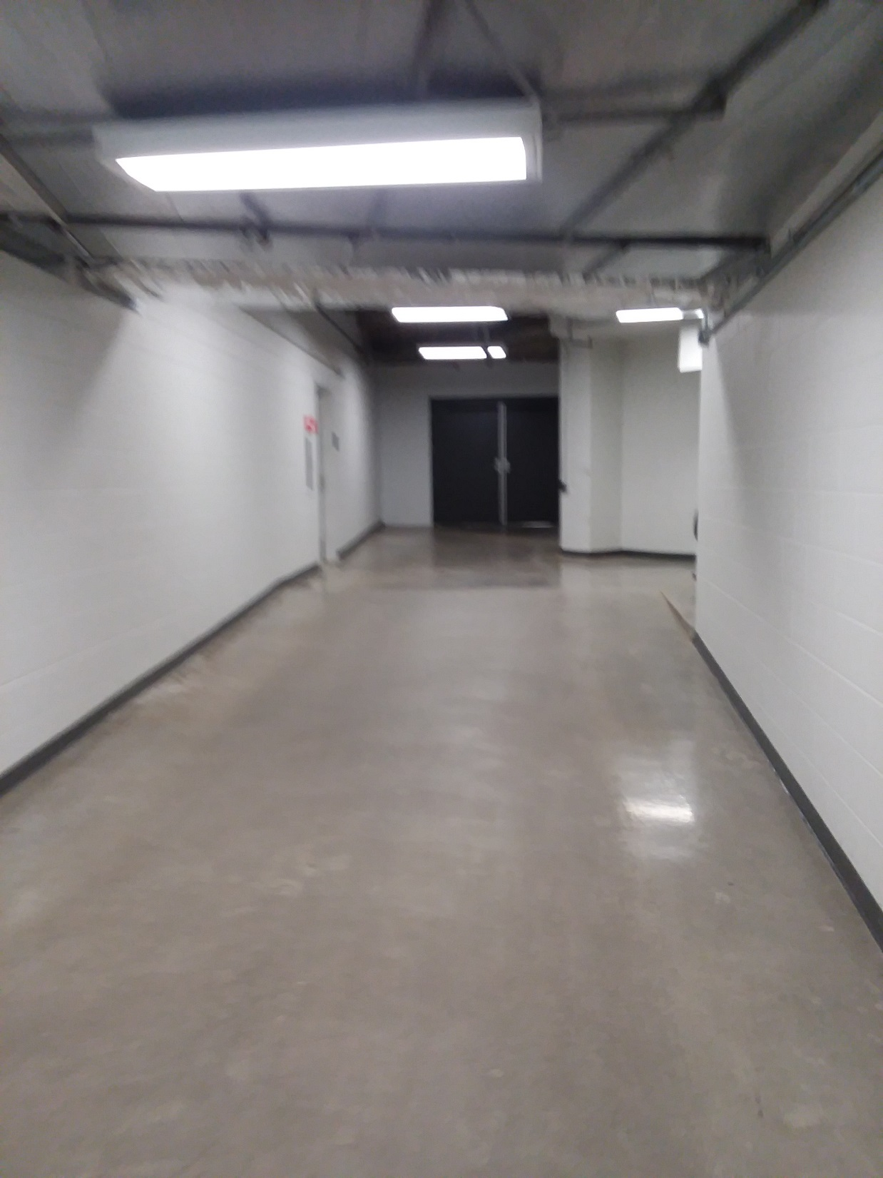

Slide 8
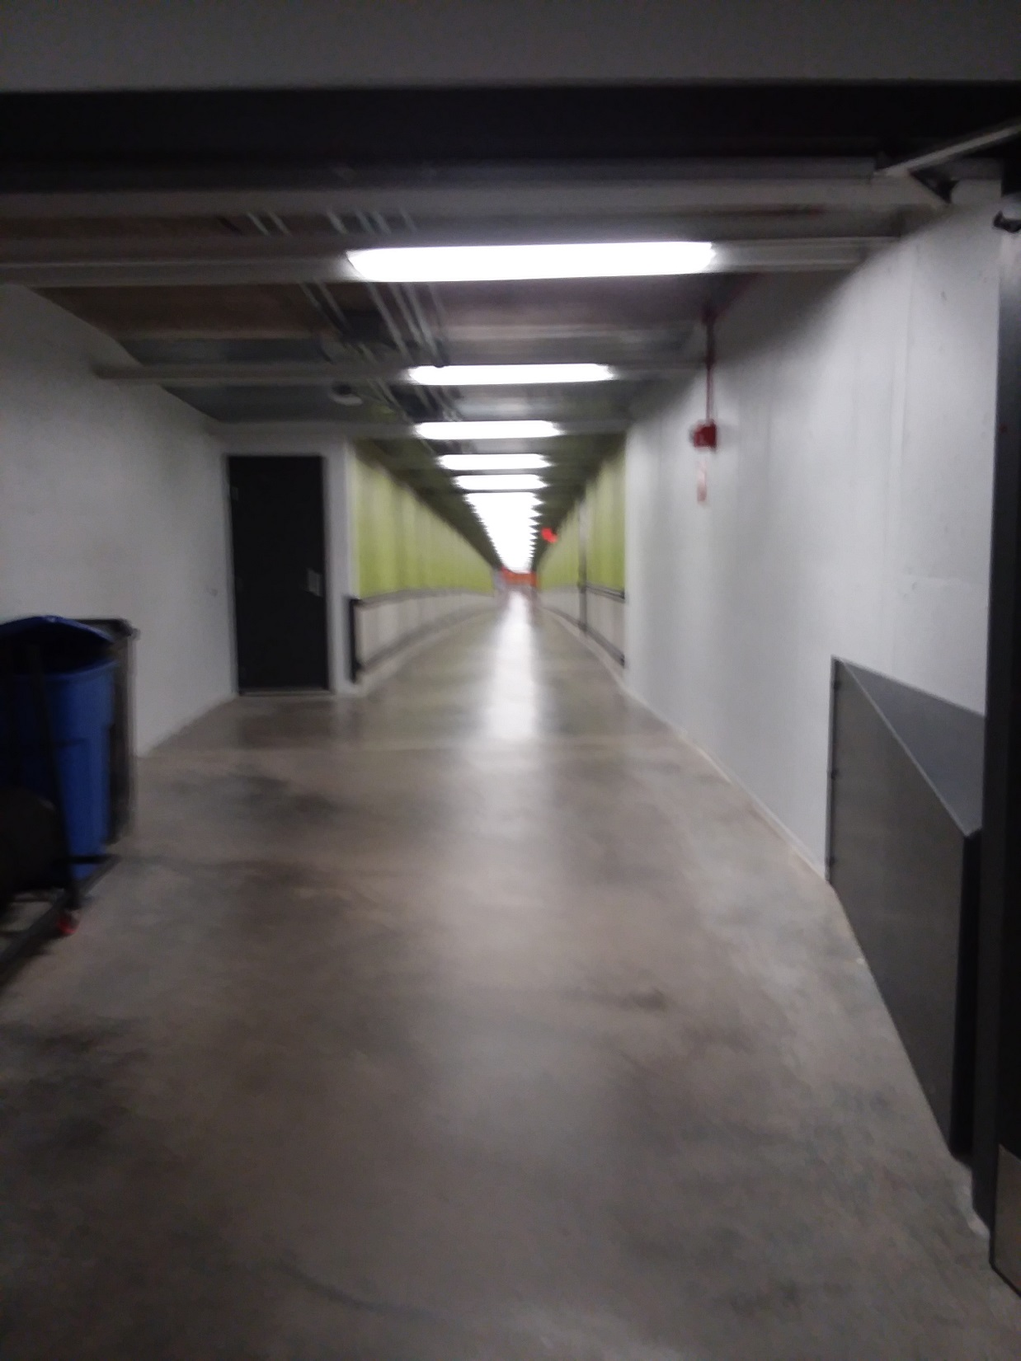

Slide 9
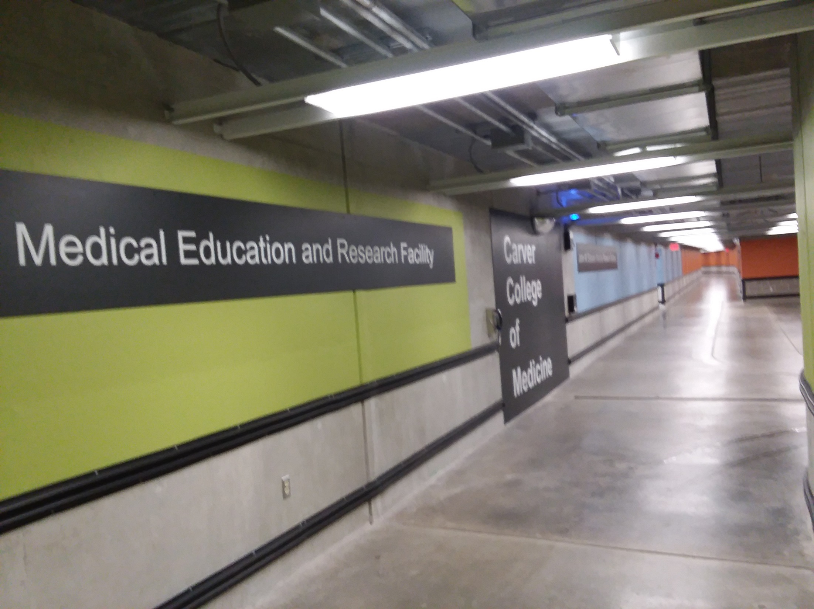

Slide 10
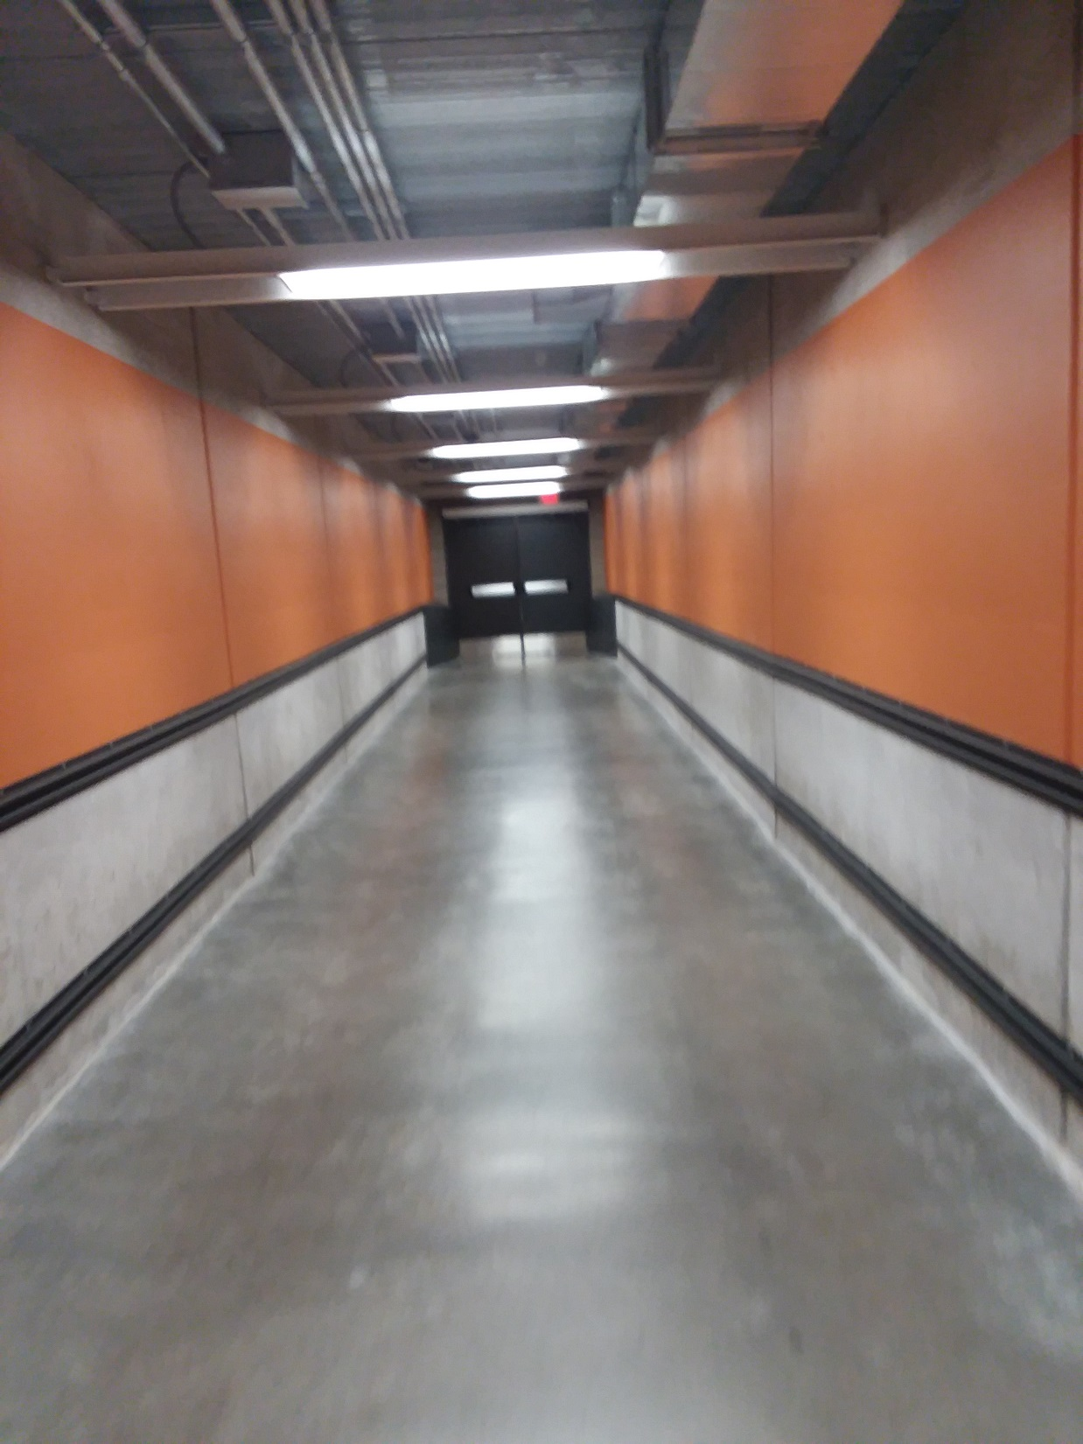

Slide 11
