Slide 1
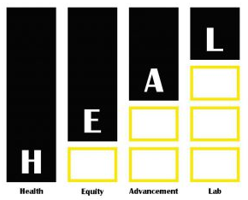
Migrant Farmworkers, Agricultural Practices, and Climate Change
The Effects of Climate Change on Iowa Migrant Worker Health
By: Cindy Chavez, Yanni Liang, Sefonobong Obot
Notes:
Hello everyone, My name is Sefonobong Obot and I will be presenting a case study on The Effects of Climate Change on Migrant Worker health on behalf of my team members Cindy Chavez and Yanni Liang. Our presentation will also touch upon some of the HEAL principles that are most important to point out during this case study.

Slide 2
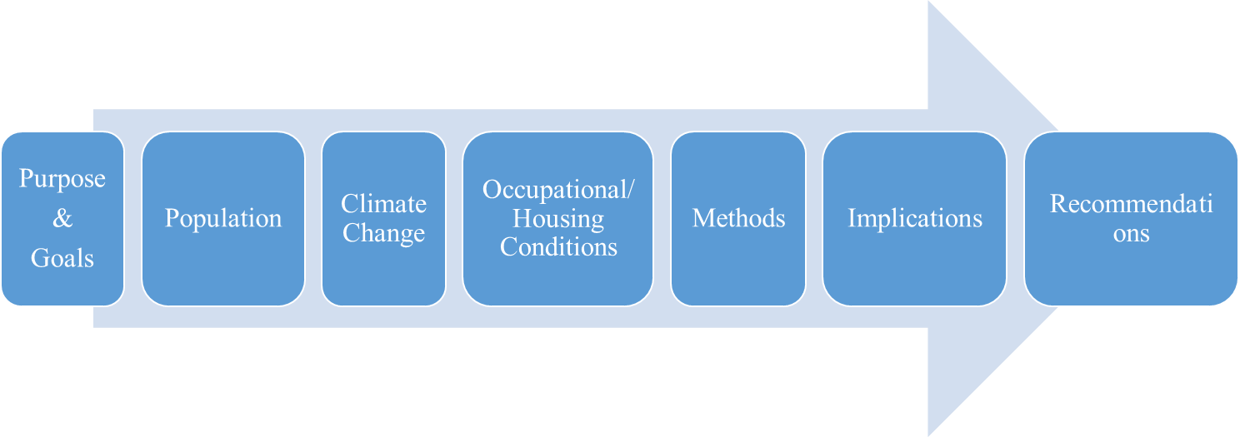
Notes:
Our presentation starts off with a statement of our purpose followed by background information on Iowa Migrant farmworkers, climate change, and occupational factors affecting Migrant farmworker health. I will talking about the Social Ecological Model we used as a method to assess the effects of Climate change increased heat exposure on out population of interest and then conclude with several our recommendations.

Slide 3
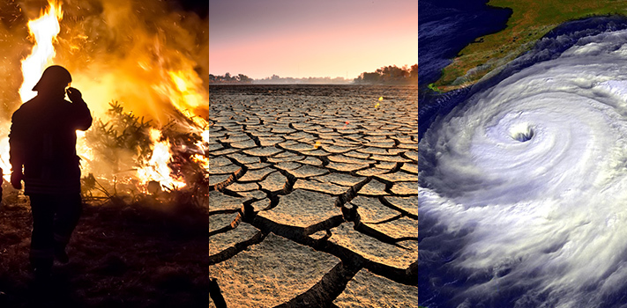
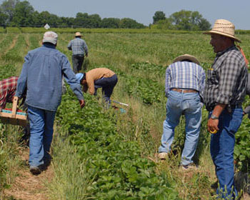
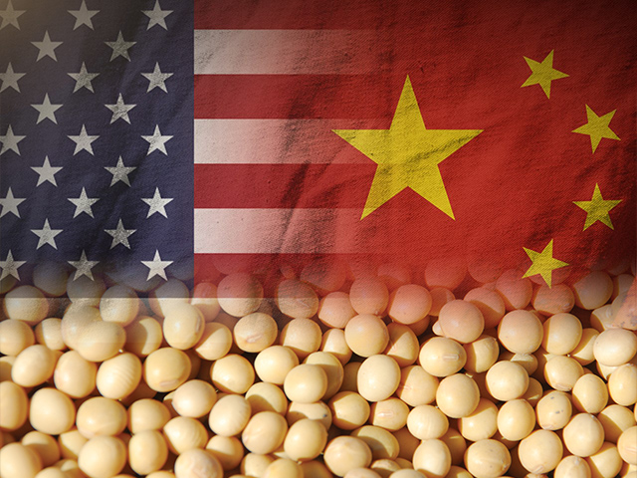
Purpose & Goals
Notes:
In bringing awareness to the relationship between climate change increased heat exposure and negative health outcomes for Iowa migrant farmworkers, we hope further research will be done with this population to bring about policy change to worker regulations that address root causes of predicted over heat exposure. Larger implication for future studies might highlight migrant farmworkers role in U.S. agricultural exports to global partners like China
https://www.agweb.com/article/china-buys-more-us-soybeans-as-agriculture-trade-woes-ease/
Previous one
The purpose of our case study is to highlight how increased heat exposure, driven by climate change, can equitably affects Iowa migrant farmworker health compared to the general population of farmworkers. This should be concerning because of its implications for migrant farmworkers and there role in U.S. agricultural exports to global partners like China.

Slide 4
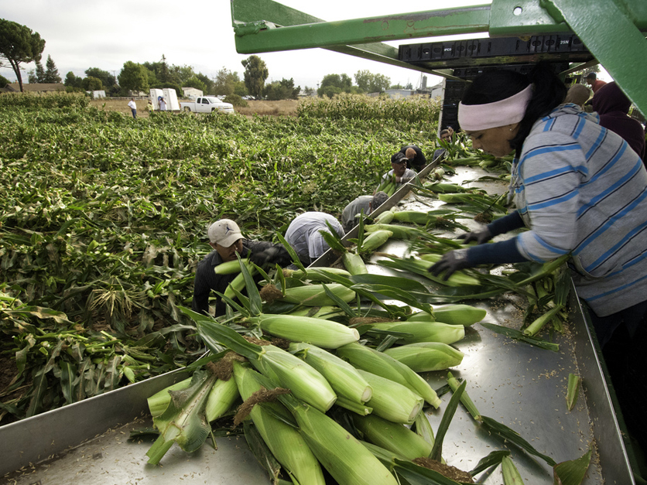
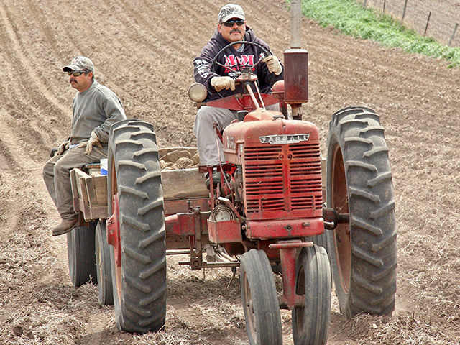
Population- Iowa Migrant Farmworkers
Notes:
Iowa migrant farmworkers (sometimes called seasonal farmworkers), are defined by the Iowa code to include “any person who usually and often travels from state to state to work seasonal jobs in agriculture…[and can also include] workers who come from other states or who live far away and need to sleep away from their home”.
https://www.farmworkerjustice.org/sites/default/files/resources/NAWS%20data%20factsht%2010-18-18.pdf
Images:
https://www.agri-pulse.com/articles/9233-democrats-push-legalization-of-farmworkers-amid-fears-of-crackdown
https://www.dtnpf.com/agriculture/web/ag/news/business-inputs/article/2018/09/04/using-h-2a-workers-increasing-serve
https://www.iowaagribusinessradionetwork.com/farmers-desperate-for-workers/
https://www.etsy.com/listing/458757380/corn-stalk-sunset-an-archival-pigment

Slide 5
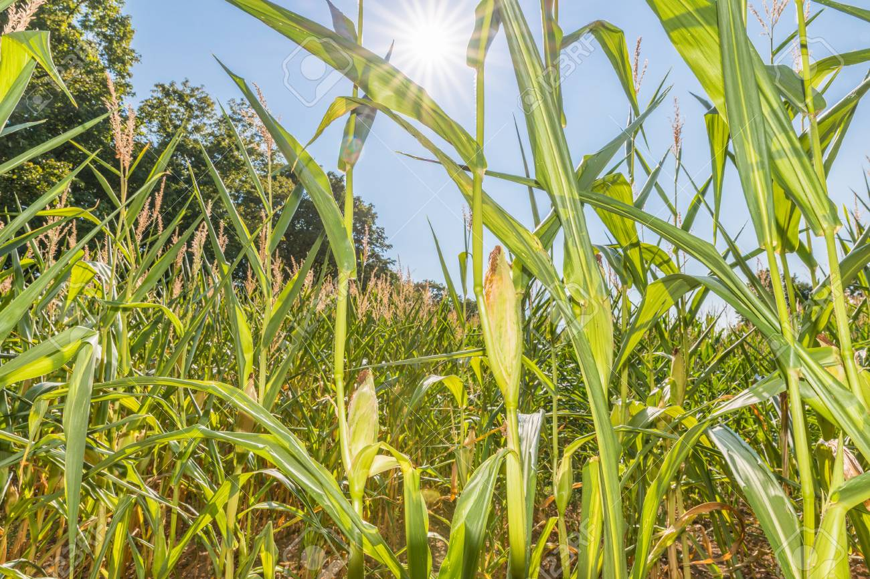
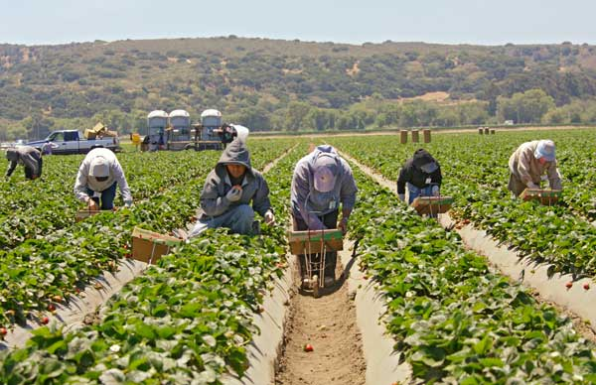
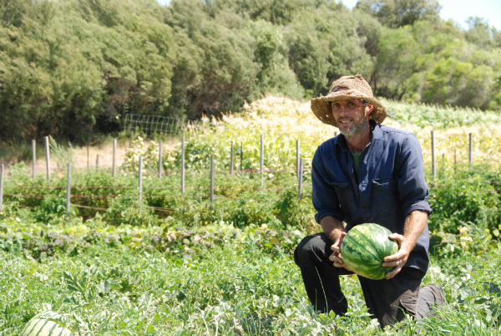
Population- Iowa Migrant Farmworkers
Cultural Humility
Notes:
Migrant farmworkers are more likely to be susceptible to health damaging health exposure because their occupation requires manual labor often in direct sun and adequate or upto code housing it not a mandatory to have to work seasonally. Other intersectional factors that might form compound risk include: Immigration status given that some, not all, migrant farm workers may not have U.S. Citizenship or work visa’s and Low SES. in 2018, minimum wage for Migrant farm workers was $7.25 and different studies estimate that 47% to 70% of all U.S. Farmworkers lack work authorization visa’s
While we don’t have available statistics on percentage of minimum wage workers it is important to realize that all workers can be overexposed to heat regardless of SES but that SES might be a variable that affects the extent to which a migrant workers health is affected.
Migration (changing living & working environments)
Access to legal/ medical services/ (throughout U.S.) when living temporarily away from permanent residence
Paid by piecework (i.e. how much they can pick)
Low SES (Socioeconomic Status) if payed iowa’s $7.25 dollar minimum wage
Other possible but undocumented vulnerabilities might include
Limited control/decision making in work and live environment
47 % of all farmworkers lack work authorization visa meaning they have less protection. In Iowa there is a mix of seasonal and authorized via farmworks but we lack data on there percentages immigration status (fear of deportation)
The biggest concern we have for our population is that we have little data on them so useful programing and or support for them is hard to figure out and nesseciate that interested researchers seek ways to get to know these communitutes before proposing programing and interventions.
Stats on farmworkers https://www.farmworkerjustice.org/sites/default/files/NAWS%20data%20factsht%201-13-15FINAL.pdf

Slide 6
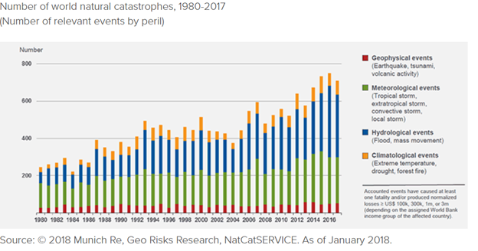
Climate Change Direct Impact
Notes:
There has been a vast number of literature showing that climate change affects agriculture production including soil moisture, sleety, precipitation, pest vitality, and vector-borne diseases. The rise in temperature has also impacted the Midwest with the growing season increasing by 2 weeks since 1990. As seen in the graph, there have been an increase in severe weather events including higher frequency of extreme temperature.

Slide 7
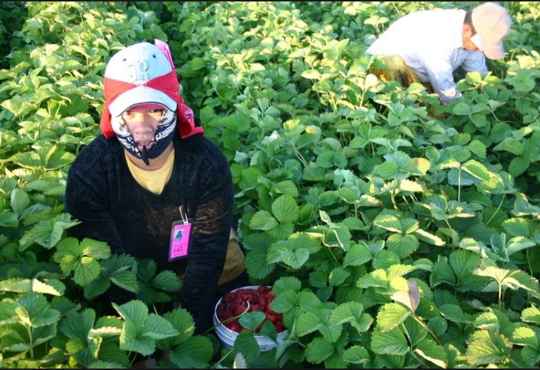
Occupational Condition
Notes:
Expected increases in frequency of extreme warm temperature can add to and exacerbate other occupational hazard for Migrant Farmworker who already have little control over when they can take breaks from work in direct sun, access to different forms of heat protection like shade, hats and sunscreen. Prolonged exposure to heat can lead to heat stress, nausea, heat stroke, and even death
No control over work process/breaks - need better wording
Access to shades, water, heat-protection (e.g., hats, clothing & sun-screen)
Increase risk of heat stress, stroke, nausea death
Working under extreme heat
No control over work process/breaks - need better wording
Access to shades, water, heat-protection (e.g., hats, clothing & sun-screen)
Increase risk of heat stress, stroke, nausea death

Slide 8
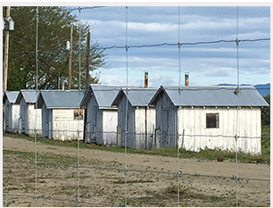
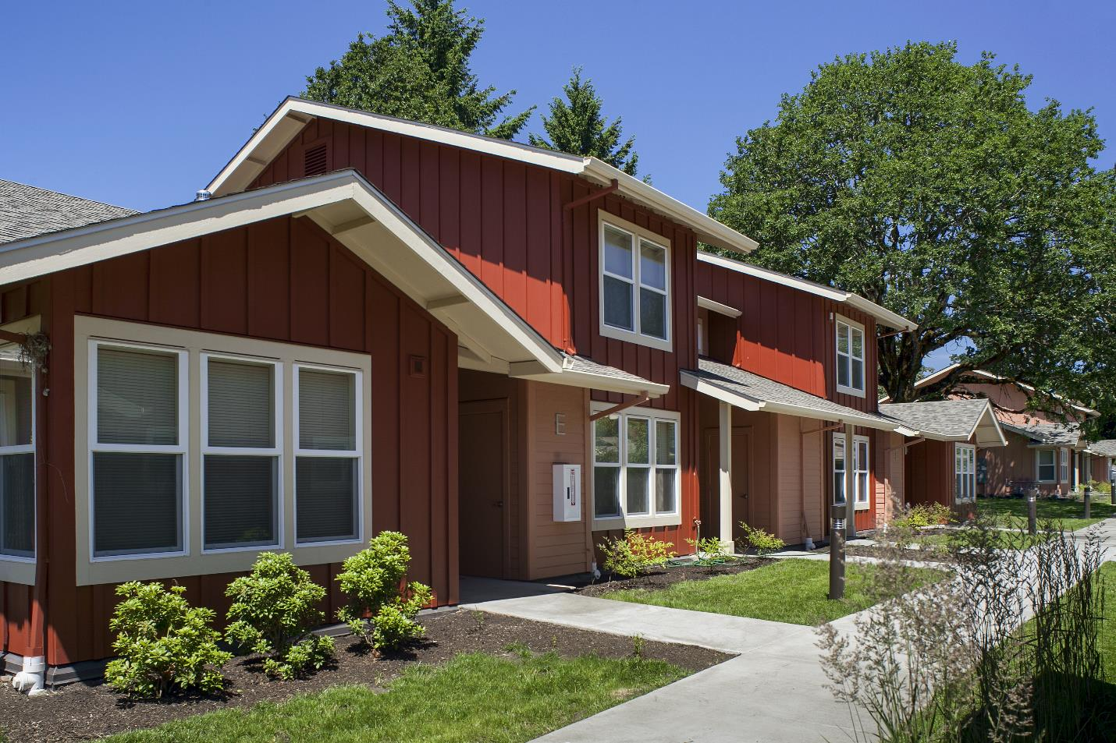
Housing Condition
Notes:
Moreover, heat exposure can further prolonged when Migrant workers go home to housing that does not have adequate temperature control facilities like A/C or fans. A workers heat exposure related symptoms like nausea and fatigue can go untreated or attributed to other causes due to poor housing conditions.
https://www.beyondtoxics.org/blog/page/3/
https://www.huduser.gov/portal/pdredge/pdr_edge_inpractice_090913.html

Slide 9
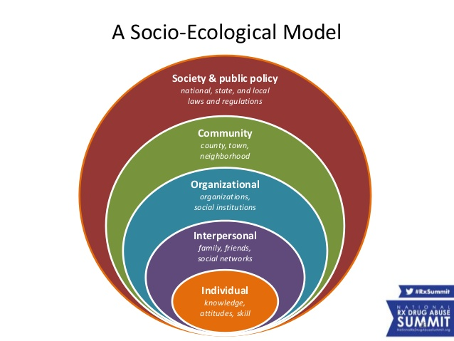
Socio-Ecological Model
Notes:
We will be following the Socio-Ecological Model to offer recommendations. This model includes 5 levels that can intersect to address heat exposure among migrant farmworkers

Slide 10
SEM - Individual
Knowledge - linguistic and cultural barriers limit access to safety information to reduce heat exposure
Perception - fear of employer retaliation and reluctant to seek heat protection
Poverty - prevent access to safe housing
Immigration policy impact - fear of deportation and thus less likely to demand safe working and living environments
Notes:
At the individual level factors that might be affecting migrant workers can include knowledge about heat exposure risk, perception of risk and susceptibility, barriers to addressing risk like income, and legal risk like policy if they fear raising concern about heat exposure might cause deportation if they do not have protected status.
https://www.dreamstime.com/royalty-free-stock-images-conceptual-crowd-stick-figures-one-circled-vector-illustration-individual-being-image38557329

Slide 11
SEM - Interpersonal & Community
Direct communication with employers
Migrant farmworkers’ working and living conditions are largely “invisible” by community members and consumers
Notes:
Interpersonal risk factors include who, where, and to what extent a migrant farmworkers social network like family, friends, employer, affects their access to quality living conditions, empowerment/support, and access to health care. Being able to consider an employer part of their social network could affect how able they are to advocate for heat exposure accommodation under there employers control
http://bizsuey.cf/muri/blue-figures-2360.php

Slide 12
SEM- Organization
Employers - Do workplace policies provide safe and working conditions?
Flexible work schedules
Onsite heat protection
Housing (air-conditioning)

Slide 13
SEM - Policy
Migrant and Seasonal Agricultural Worker Protection Act
Working: Occupational Safety and Health (OSH) Act requires employers to provide safe working environment
Housing: OSHA Housing Standard (29 C.F.R. §1910.142)
Farms employ less than 11 workers are exempted from OSH Act
Notes:
https://www.dol.gov/whd/mspa/
https://www.colourbox.com/vector/vector-black-government-building-icons-set-vector-19077438
https://www.123rf.com/photo_31805643_stock-vector-support-group-meeting-stick-figure-pictogram-icons.html

Slide 14
Implications
Figure 1. U.S. agricultural exports markets in 2017
Notes:
The health of farm workers has direct implication on local and global agricultural economics. Examples include: Stable food supply in the USA, USA farm owners’ income ,Local communities economy and US trading partner (i.e. China) food supply.
Because we have very little data on this population our recommendations should be seen as possible avenues to both learn more about this population and support them in access what they believe their greatest needs are

Slide 15
Recommendation - Individual Farm Workers
Self-inform heat stress and heat stroke symptoms
e.g., heat stroke: core body temperature ≥ 104 ⁰F (40 ⁰C)
confusion, nausea, and headache
Wear sun-protective clothing, hats, and sunscreen
Notes:
Assuming an individual Migrant farmworker has enough autonomy during their work, individuals can wear sun-protective clothing, hat, and sunscreen to protect from heat exposure. INdividuals can also support other workers by being aware of what prolonged heat exposure looks like and ways to combat early signs
https://civileats.com/2016/01/29/all-the-news-thats-fit-to-eat-the-fightfor15-in-iowa-locol-opens-in-watts-and-farmworkers-obamacare-bind/
Mayo Clinic https://www.mayoclinic.org/diseases-conditions/heat-stroke/symptoms-causes/syc-20353581

Slide 16
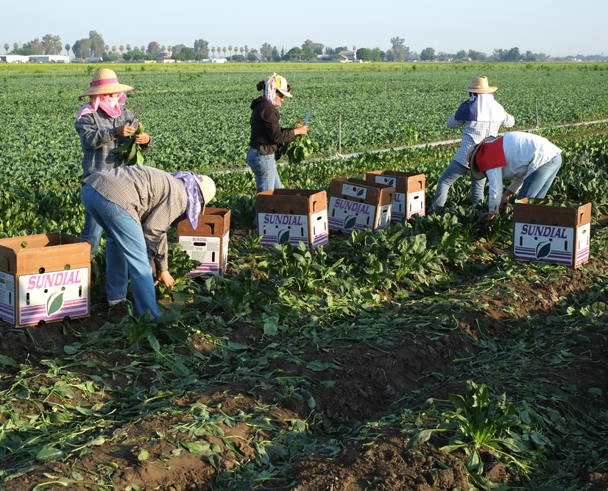
Recommendation - Interpersonal
Cultural Humility
Establish peer support (e.g., co-workers watch out for potential heat stress, remind co-workers to wear heat-protective gear, inform family members about heat risk and prevention)
Assist co-workers with heat stress or heat stroke to get medical treatment
Notes:
At the interpersonal level coworkers learned the signs of prolonged heat exposure can be aware of potential heat stress, remind co-workers to wear heat-protective gear, inform family members about heat risk and prevention, and inform employers/supervisors if a worker is in need of medical attention or time to rest. who Migrant workers work alongside and if those relationships/social networks are strong would be something worth further research in
image=Promotional poster to increase family and interpersonal awareness about risk and signs of heat exposure: http://pulse.ncpolicywatch.org/2018/07/18/coalition-of-groups-calls-on-osha-to-save-worker-lives-adopt-heat-stress-rules/

Slide 17
Recommendation - Employers
Social Justice
Occupational Setting
Offer water and shade in the fields
Provide breaks
Schedule work early or later in the day
Limit heavy work tasks
Housing
Increase general ventilation
Provide cooling fans
Install air conditioning
Notes:
Employers have the ability to encourage and or enforce heat breaks, water, flexible work shifts like working early morning and later afternoon for workers that may more susceptible to risks related to prolonged heat exposure. These are things the employer would need to decide though conversations with all their workers, including those who may have assign light tasks during hours with unsafe heat
OSHA recommendations https://www.osha.gov/dts/osta/otm/otm_iii/otm_iii_4.html

Slide 18
Recommendation - Community
Cultural
Humility
Notes:
In Migrant farmworkers and Employers in Iowa can partner with public health departments like Migrant Labor Camp Program-(housing) and organizational programs like Proteus: Health and Occupational Training (Heat related training). Moreover, partnerships can a climate where migrant
Establish partnerships between migrant clinics and farm employers and public health departments to deliver training preventing heat stress and heath stroke
Proteus: Health and Occupational Training (Heat related training)
Department of PH: Migrant Labor Camp Program-(housing)

Slide 19
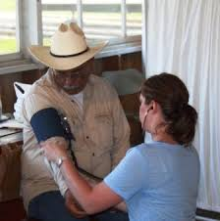
Recommendation - Policy
Reciprocity
& Accountability
Standardized breaks
Access to medical and legal aid (accessible distance and cost to workers)
Mandatory reporting of heat-related illnesses
Notes:
At the policy level, policy that standardizes breaks, increases accessible medical and legal aid by making these resources a accesble distance from workers and cost accessible, and or enforces reporting of heat-related illnesses can positively impact

Slide 20
Recommendations - Researchers
Community- Engaged Research
Reciprocity
&
Accountability
Notes:
Finally, our recommendation for researchers interested in Climate change, Migrant farmworkers, and heat exposures is to build collaborative process between this community and researchers that studies direct and indirect determinants of health in the community, building a relationship from trust and takes into consideration all partners while determining the focus of the research, and or conducting research that empowers this community to create/advocate for policy that favors there needs.
Thank you

