Slide 1

The Double Burden of Malnutrition
A Case Study
3rd Annual HEAL Summit
April 4, 2019
Notes:
A: My name is Akpevwe, I am a senior studying health and human physiology and my name is Erin and I’m a senior also studying health and human physiology, and our case study will describe the causes of the double burden of malnutrition using the social ecological model, impacts of this burden, examination of the burden in the United States and India, and subsequent social justice approach solutions.

Slide 2
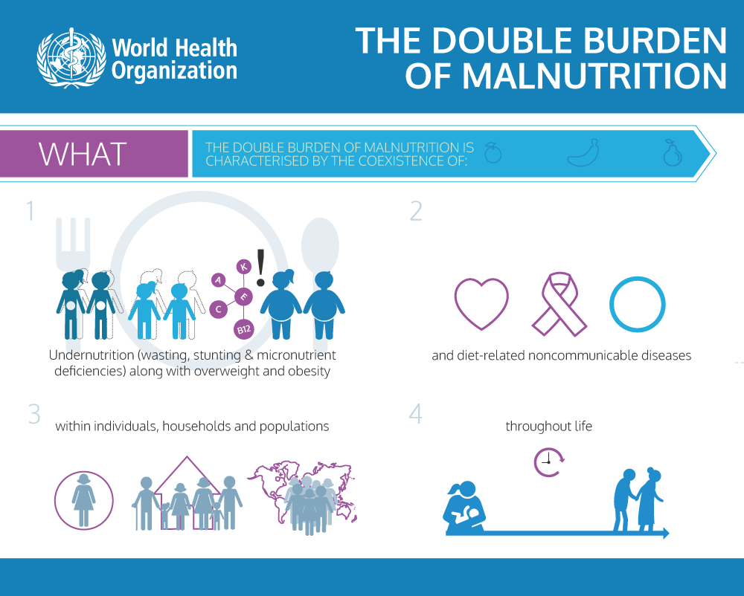
Notes:
E: According to the World Health Organization, the double burden of malnutrition is characterised by the coexistence of undernutrition along with overweight and obesity, or diet-related noncommunicable diseases, within individuals, households and populations, and across the lifecourse. There are three forms of malnutrition - stunting, wasting and obesity.

Slide 3
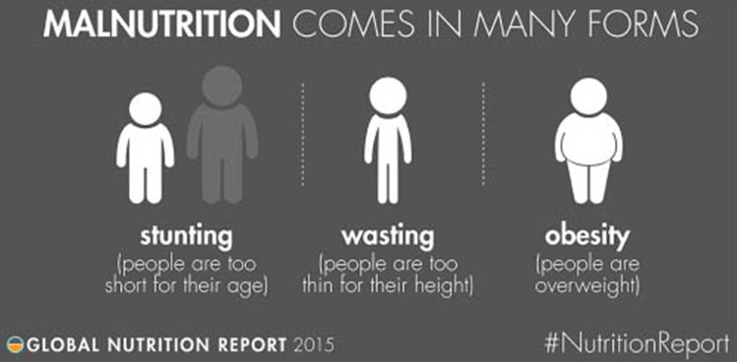
Notes:
A: There are two types of undernutrition - stunting and wasting. Stunting is being too short for age, and wasting is being too thin for height. The other type of malnutrition - obesity - is due to to overnutrition and is classified as being over what is considered a healthy weight for height. Today, nearly one in three persons globally suffers from at least one form of malnutrition.

Slide 4
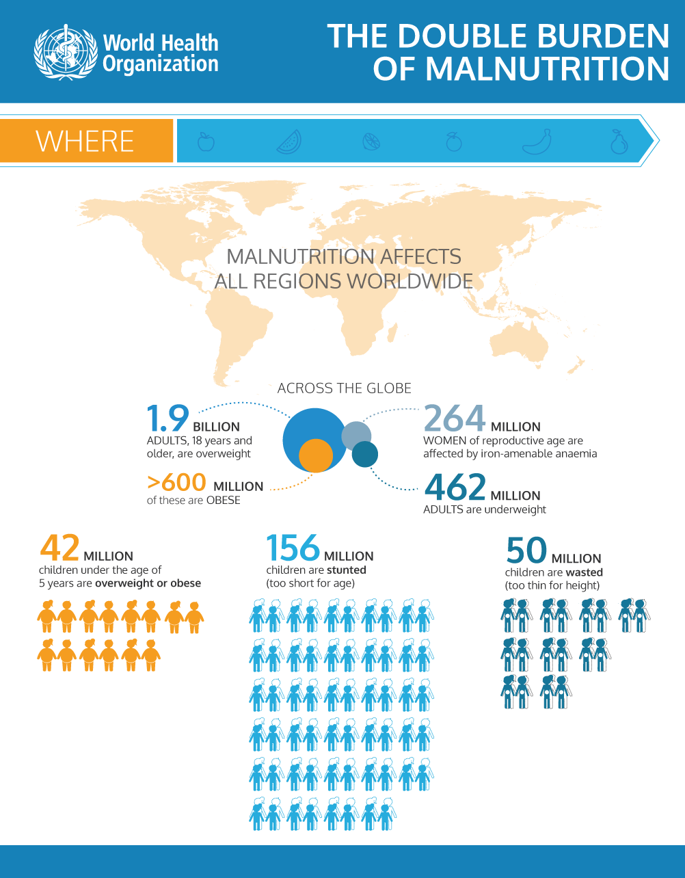
Notes:
E: Currently, 462 million adults are underweight and 156 million children are stunted. On the other hand, 1.9 billion adults are overweight, while 41 million children under 5 are overweight or obese. Every region of the world is affected by the double burden of malnutrition, or at least one aspect of it. Developed countries suffer more from overnutrition, while developing countries tend to carry the burden of both under and overnutrition.

Slide 5
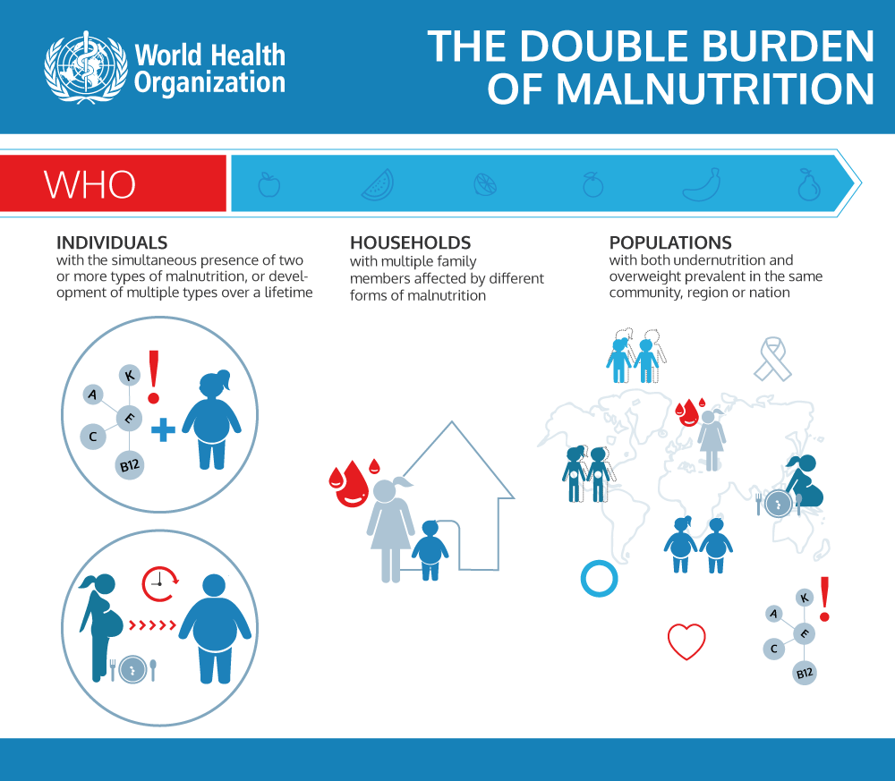
Notes:
A: This affects multiple facets of society. Individually, there can be development of two or more types of malnutrition - like obesity along with nutritional deficiencies. It can also occur across the life-course - such as being malnourished as a child, but then being an overweight adult. Households can have a member that is malnourished while another is overweight, and populations can have the coexistence of under and overnutrition.

Slide 6
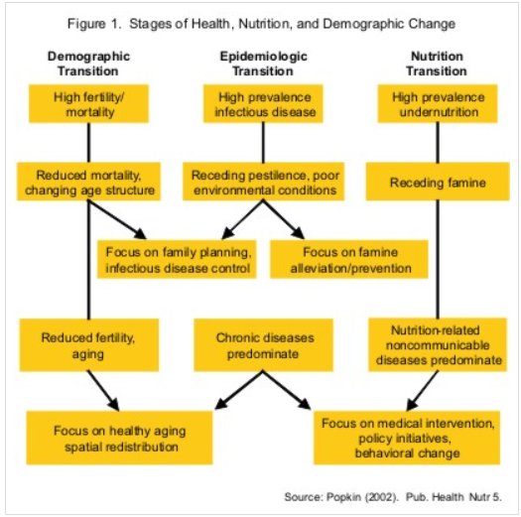
Determinants:
Population Transitions
Notes:
E: One of the key determinants in the double burden are various population transitions. The demographic transition is the shift from populations experiencing high birth and death rates to low, while the epidemiologic transition is disease burden moving from infectious to chronic diseases. The nutrition transition may be the most critical and is shifting from diets high in cereals and fiber to Western diets.

Slide 7
THE SOCIAL ECOLOGICAL MODEL FOR THE DOUBLE BURDEN OF MALNUTRITION
Policy
Healthcare systems
Agriculture Subsidies
Trade policies Globalization
Food Systems
Built Environment
Institutions
Changes in portion sizes, habits, diets
Corporations & Influence
Prevention Programs
Availability of Food
Community
Food Deserts
Food Security/Insecurity
Availability of Medical Care
Interpersonal
Relationships
Culture
Individual
Epigenetics
Early Nutrition/Maternal Nutrition
Lifestyle
Notes:
A: There are other determinants that contribute to the double burden of malnutrition, best described by the social ecological model. At the individual level, epigenetics, lifestyle factors and early life nutrition all play a role. At the interpersonal level, the influences of family and friends, and cultural factors regarding eating habits, can contribute.

Slide 8
THE SOCIAL ECOLOGICAL MODEL FOR THE DOUBLE BURDEN OF MALNUTRITION
Policy
Healthcare systems
Agriculture Subsidies
Trade policies Globalization
Food Systems
Built Environment
Institutions
Changes in portion sizes, habits, diets
Corporations & Influence
Prevention Programs
Availability of Food
Community
Food Deserts
Food Security/Insecurity
Availability of Medical Care
Interpersonal
Relationships
Culture
Individual
Epigenetics
Early Nutrition/Maternal Nutrition
Lifestyle
Notes:
E: Community influences include the quality of food available, food desserts and access to medical care and food. At the institutional level, the influence of corporations, increases in the western diet and portion sizes are examples. At the policy level, food and healthcare systems, trade policies favoring processed food, agricultural subsidies and the built environment are key factors.

Slide 9

APPLICATION:
The US & India
Notes:
A: We decided to do a comparative analysis on the double burden of malnutrition in the United States and India. We believed these two countries would highlight some of the key social epidemiologic principles as well as foster good conversation for possible solutions to solving the double burden of malnutrition. We’ll first look at this burden in India.

Slide 10
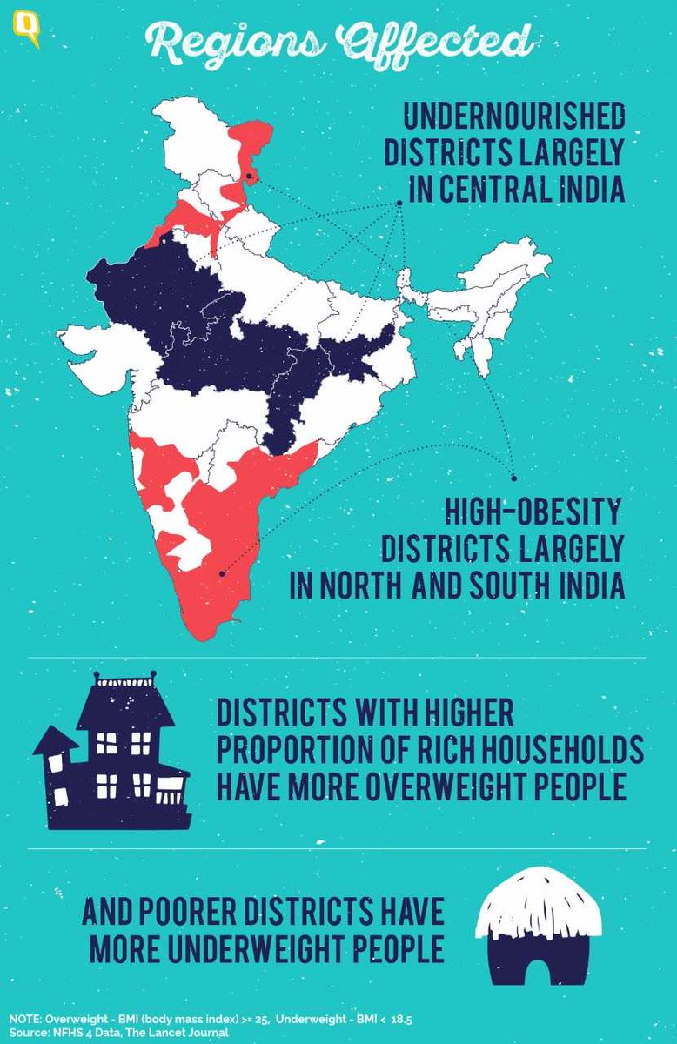
India
&
The Double Burden of Malnutrition
Notes:
E: India is undergoing rapid socio-economic, demographic and nutritional transition. Undernutrition is still prevalent in many states in India, however rates of people being overweight or obese are steadily increasing. Often times more attention is focused on undernutrition programming overshadowing obesity. There is a need for public health programs that are able to address both simultaneously.

Slide 11
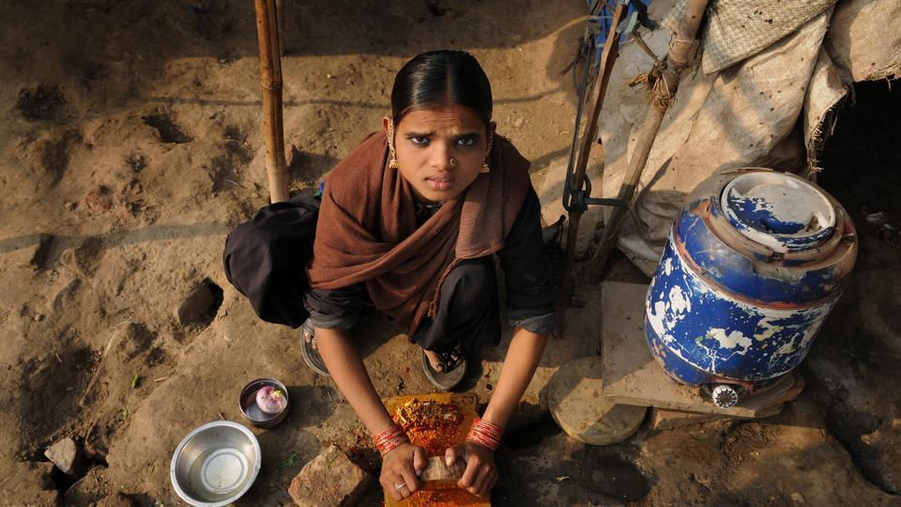
Notes:
A: In a large population study of over 8,000 married women in India researchers found several factors contributing to the double burden. Malnutrition varied with the economic situation of the household: women in the wealthiest indices were more likely to be overweight. Among the richest women, 48.9% were obese and among the poorest indices 4% were obese.

Slide 12
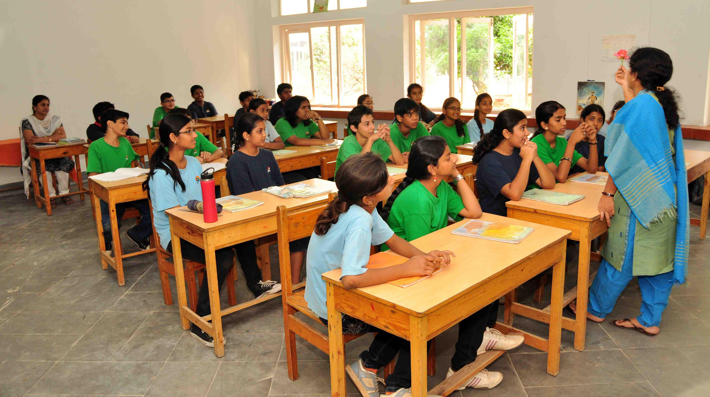
Notes:
E: Malnutrition varied with age: younger women were more likely to be underweight and older women were more likely to be obese. It also varied with education. Prevalence of undernutrition was nearly five times higher among women with no education than those with 12 or more years of schooling in south and east of the country. Obesity was 8 times higher among women with 12+ years of schooling than those without education in the east.

Slide 13

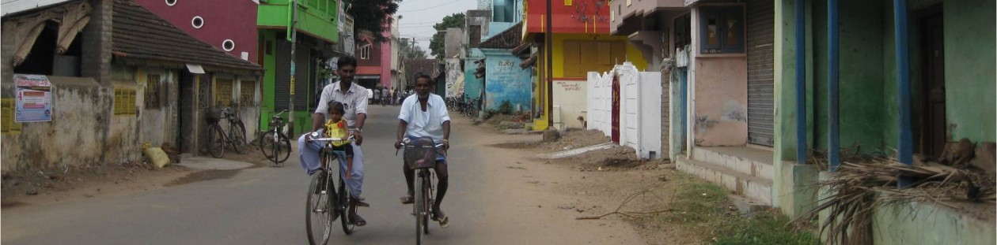
Notes:
A: Geography is also a factor. Obesity was higher in urban areas, however obesity fatality rates were higher in rural areas due to poor access to healthcare, and delayed treatment and diagnosis. Malnutrition in India costs around $10 Billion annually. In conclusion, researchers determined that many regions in India are experiencing the double burden of malnutrition, however the extent of the problems may differ.

Slide 14

The United States & The Double Burden of Malnutrition
Notes:
E: Shifting gears to the US - 53% of households with an underweight person also have an overweight or obese person in the same house. This phenomenon tends to occur mostly in lower income homes. Many of these homes tend to receive food from community food banks. Half of the food banks in the US have nutrition policies, but less than ⅓ of the policies eliminate sugary food products from inventories.

Slide 15
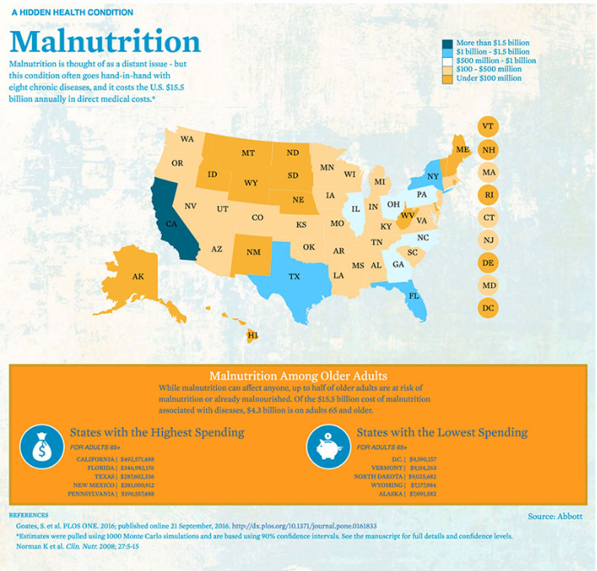
Malnutrition
In the US
Notes:
A: The United States has healthcare costs higher than any other country, one of the main contributors to this cost is treating chronic disease. Malnutrition increases the cost of treating disease. A recent study showed that the impact of malnutrition associated with eight common diseases costs an additional $15.5 billion for the US in direct medical spending.

Slide 16


Iowa
Notes:
E: Locally, one in eight Iowans often goes hungry, with children being the most vulnerable to food insecurity. However, Iowa is ranked 10th highest in the nation for youth obesity, and fourth in the nation for adult obesity. This is an example of how the double burden of malnutrition affects a population level and illustrates the need for policies and programs that help promote access to health and affordable foods that are nutritious.

Slide 17
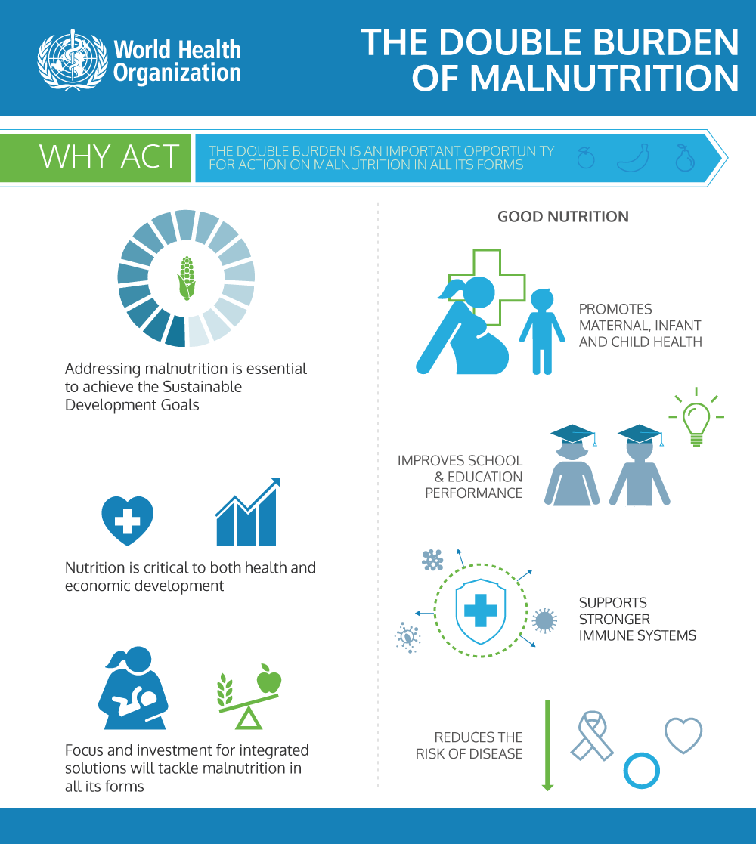
Notes:
A: The implications of this double burden are long term and far reaching. Both obesity and undernutrition lead to adverse, comorbid outcomes, no matter the population or region. Nutrition helps to promote maternal and child health to set children up for success later in life, leads to improvements in education, and supports better health outcomes, leading to reduced healthcare costs.

Slide 18


Recommendations
Notes:
E: Although there are interventions that could be made at every level, the World Health Organization recommends programs and policies that address both burdens. These include creating food systems for healthy, sustainable diets, integrating nutrition policy with agriculture policy, implementing universal health care coverage, increasing nutrition related education, and focusing on trade and investment that improves nutrition.

Slide 19

Example: Fresh Fruit and Vegetable Program
Notes:
A: One such example of a policy is the Fresh Fruit and Vegetable Program in the US. A study noted that feeding children nutrient-dense foods can be challenging, given that they need to be introduced to a food up to 17 times before accepting it. However, federal policies such as this have exposed more children to nutrient-dense foods and therefore these foods are accepted earlier.

Slide 20
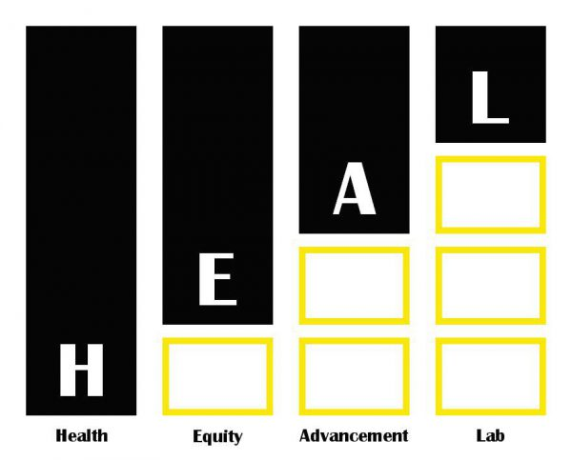
Notes:
E: Lastly, we believe the HEAL Principles that are most critical in these policy centered recommendations include capacity building and utilizing community based research in order to create specific solutions. Sustainability is also critical, as communities need long term strategies to handle the double burden of malnutrition. Lastly, cultural competency must be considered when addressing these issues and their solutions.

