Slide 1
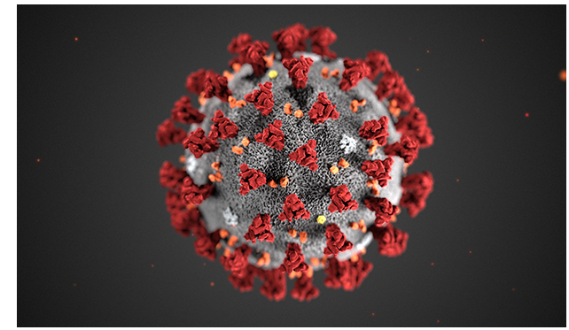
2019 Novel Coronavirus (2019nCoV) SARS CoV-2 COVID-19

Slide 2
________________________________________ ____________________________________________
Emerging Pathogens by Decade
Chikungunya
MERS
Enterovirus D68
Ebola
Measles
Zika virus
Candida auris
Helicobacter pylori
E. Coli O157
Prions
VRE
Cryptosporidium
Hanta virus
Legionella pneumophila
Norwalk virus
MRSA
1970
1980
1990
2000
2010
2020
HIV
Campylobacter
Toxic Shock Syndrome
Ehrlichia
West Nile virus
SARS
Nipah virus
Novel H1N1
Mumps
COVID-19
Blue denotes outbreaks in recent past

Slide 3
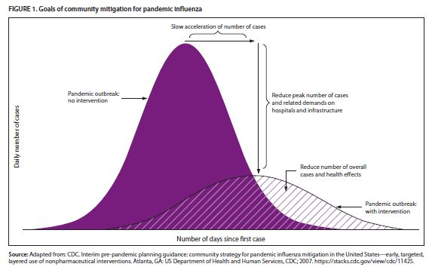
Pandemic Curve

Slide 4
WHO: Fundamental Public Health Intervention
Testing capacity to quickly identify cases
Isolate infected patients
Tracing contacts and place at risk individual in quarantine
When clusters of cases emerge, prohibit mass gatherings

Slide 5
CDC Steps to take to prevent illness
Wash Hands often
Avoid close contact with people who are sick
Stay home if you are sick
Cover coughs and sneezes
Clean and disinfect
If you are sick, wear a facemask when around others before entering a physician’s office, clinic or emergency room
If not ill, do not wear a facemask

Slide 6
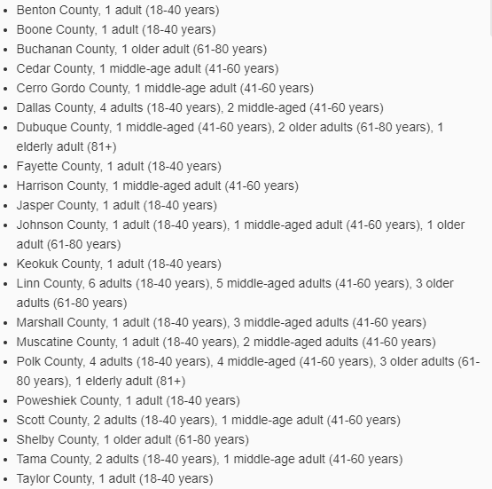
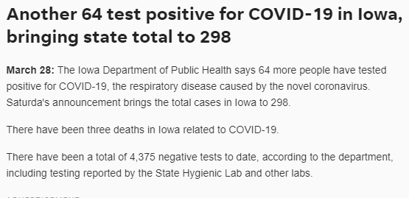
COVID-19 transmission in Iowa continues

Slide 7
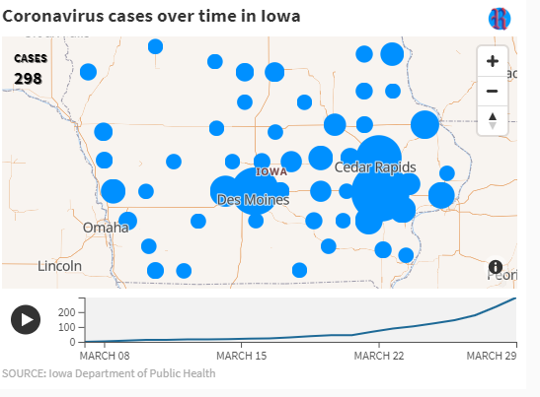
Iowa Case Count Increase March 8-29

Slide 8
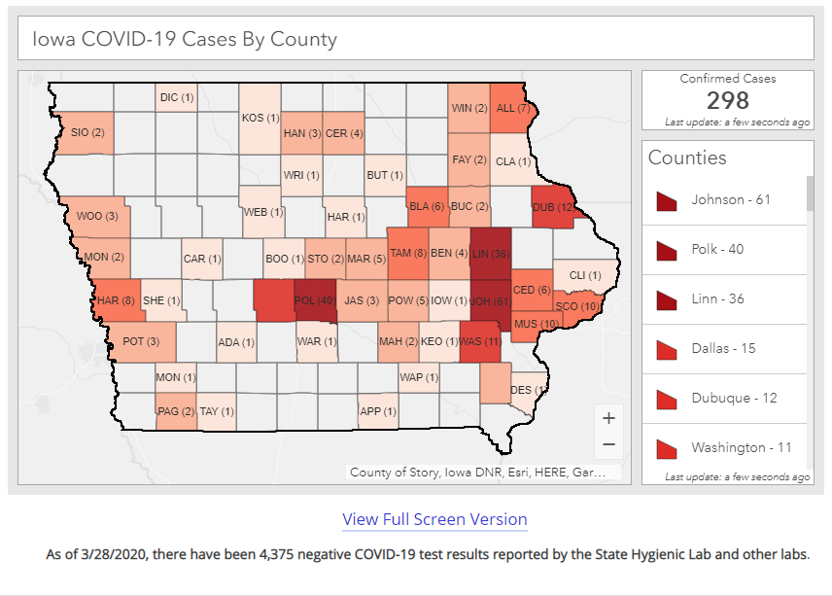

Slide 9
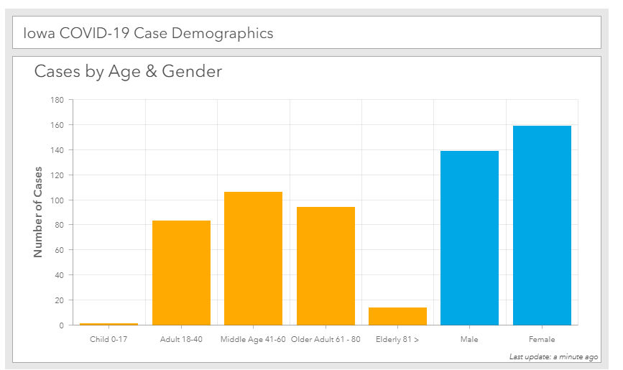

Slide 10
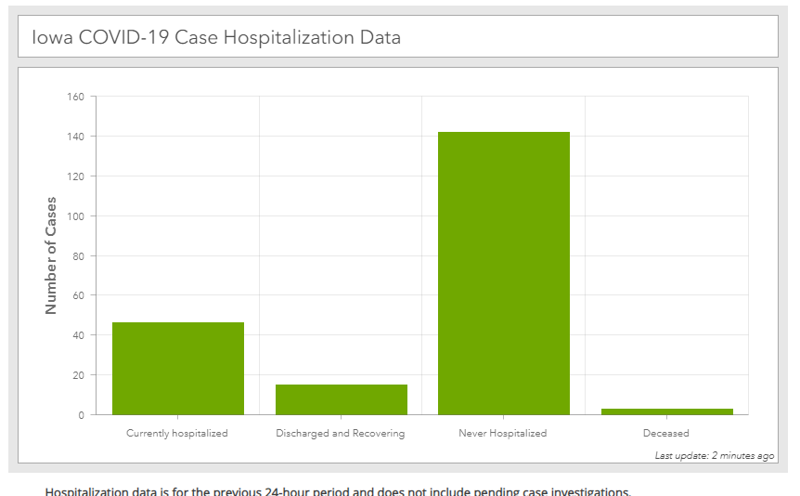

Slide 11
COVID-19 Testing Forecast

Slide 12
Positivity Forecast

Slide 13
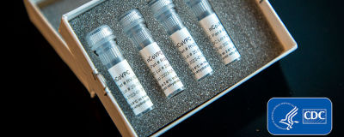
FDA approved the test EUA on February 4, 2020
SHL uses the CDC test that has emergency use authorization by the FDA.
It is a PCR test and is very sensitive and specific to the 2019 novel coronavirus
However, on verification the test failed to pass the required verification
CDC and FDA determined that the test could still be reliable without the failed portion
Testing went live in Iowa on February 27

Slide 14
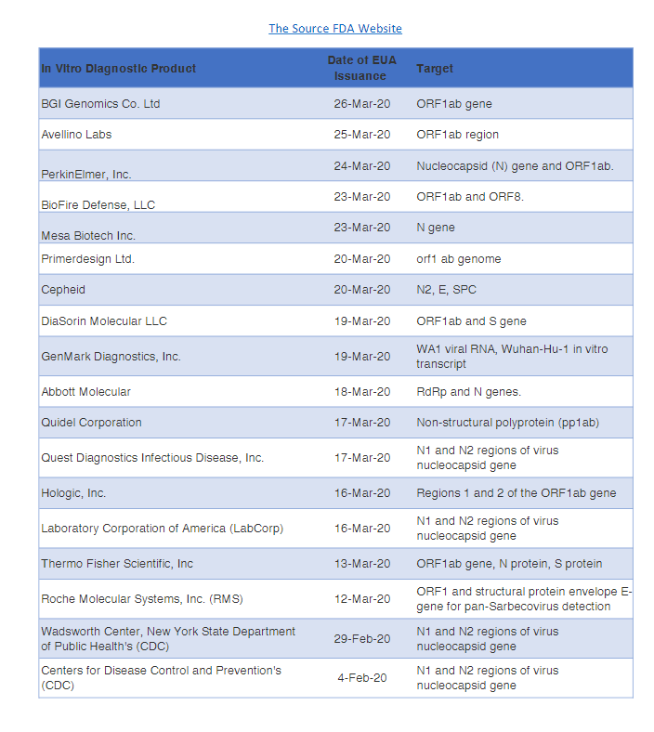
Available Tests as of March 29, 2020

Slide 15
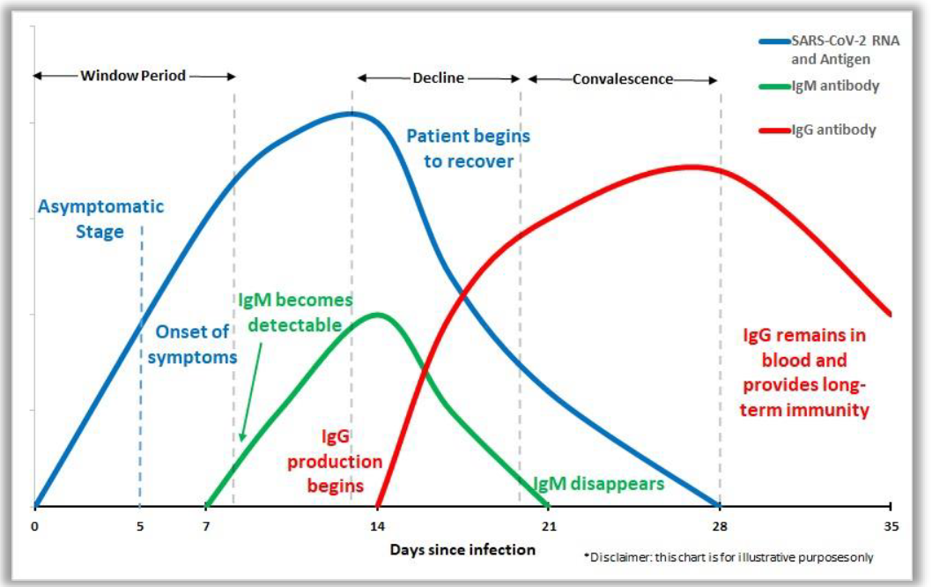
Would a serologic test be useful?

Slide 16
Important Websites for Information
https://idph.iowa.gov/
http://www.shl.uiowa.edu/
https://www.cdc.gov/coronavirus/2019-nCoV/summary.html
https://www.cdc.gov/coronavirus/2019-ncov/lab/lab-biosafety-guidelines.html?CDC_AA_refVal=https%3A%2F%2Fwww.cdc.gov%2Fcoronavirus%2F2019-ncov%2Flab-biosafety-guidelines.html (Biosafety)
https://www.cdc.gov/coronavirus/2019-ncov/lab/biosafety-faqs.html
https://www.who.int/
https://www.youtube.com/watch?v=ksGqd9qSNqA&feature=youtu.be packaging and shipping video

