Slide 1
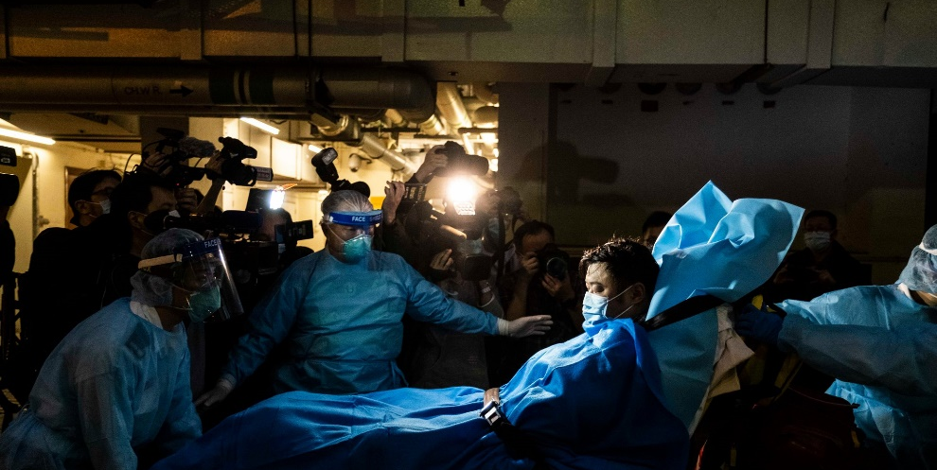
Novel Coronavirus basics
Dr. Christy Petersen
Director, Center for Emerging Infectious Diseases
Professor, Dept. of Epi
christine-petersen@uiowa.edu
April Fools Day, 2020

Slide 2
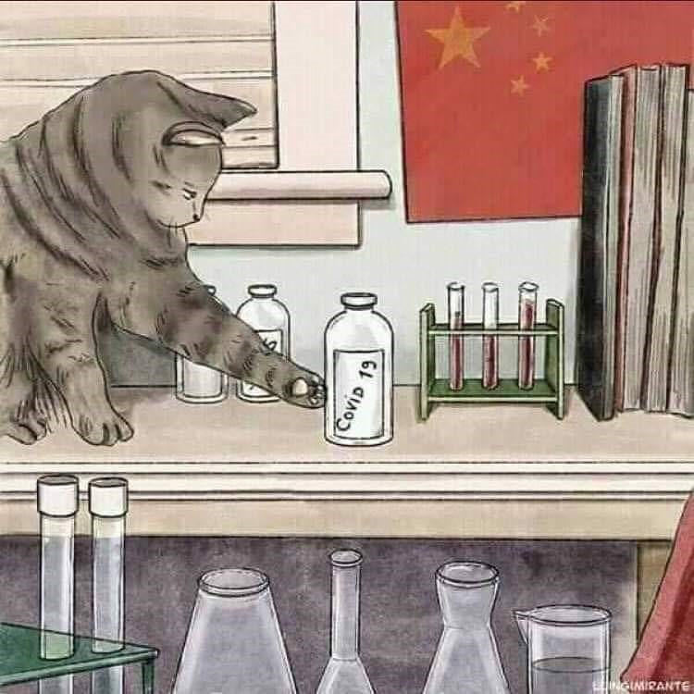
April 1 levity…

Slide 3
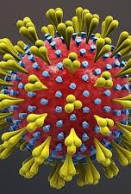
Coronaviruses
Enveloped + sense ss RNA viruses
Rapid mutation and recombination
Both α and β coronaviruses have gene sources from bats, γ and δ from birds
Novel 2019/20 strain is β coronavirus lineage B, or subgenus sarbecovirus, includes human SARS virus.

Slide 4
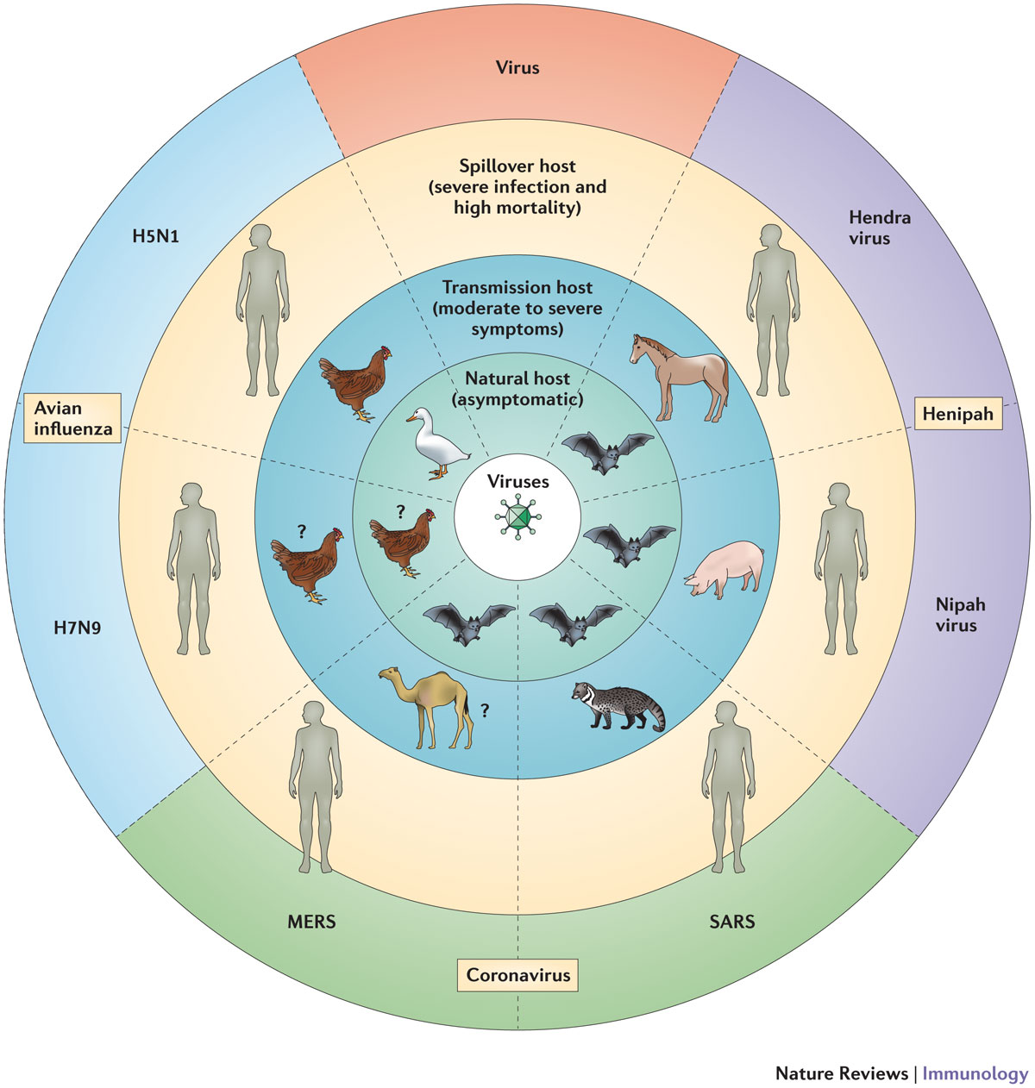
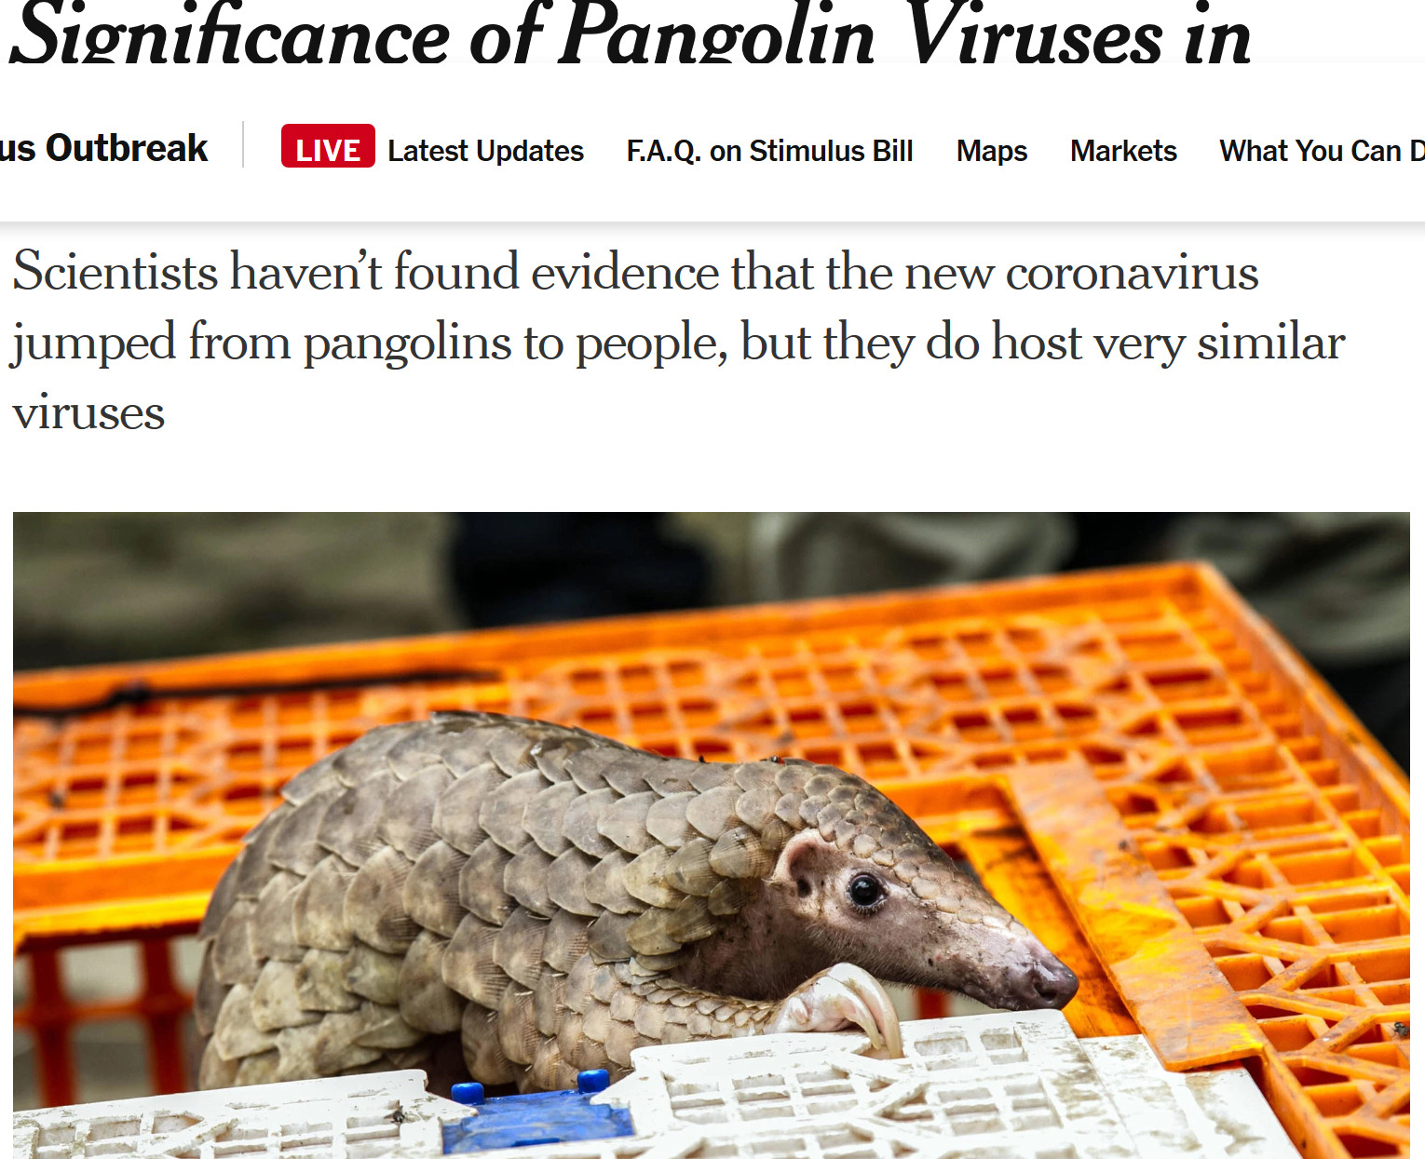
Why are coronaviruses “favored” EID?

Slide 5
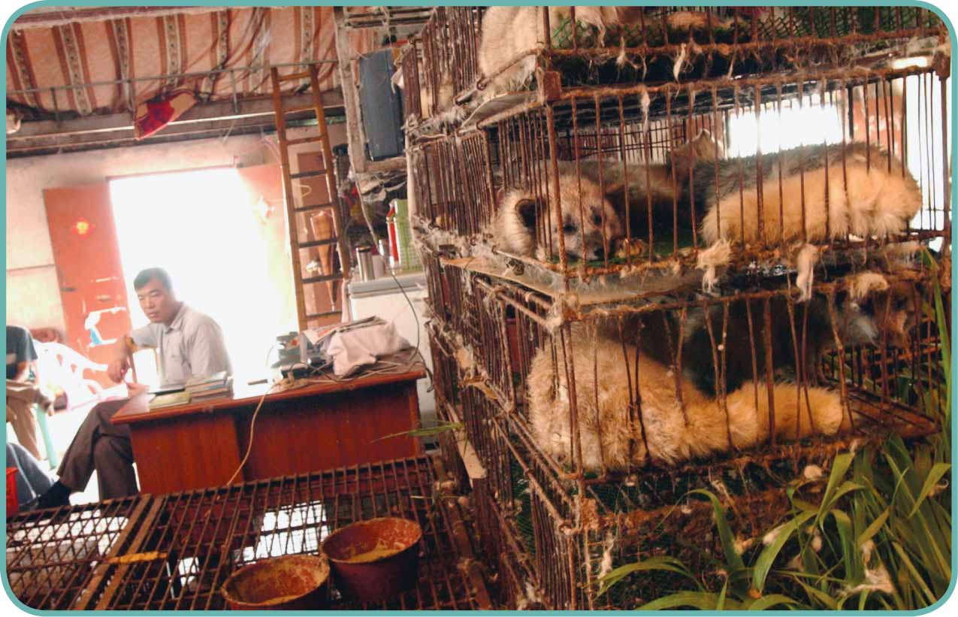
China’s live animal markets: ideal environment for mutation and adaption to humans
Dennis Normile Science 2013;339:1269-1273
Published by AAAS
Notes:
Uncaged.Guangdong's live animal markets provided an ideal environment for a SARS precursor to mutate and adapt to humans.

Slide 6
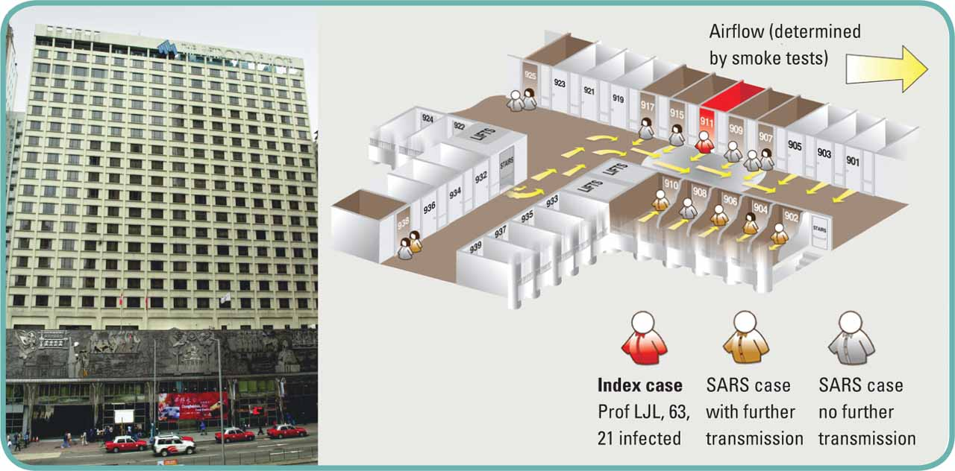
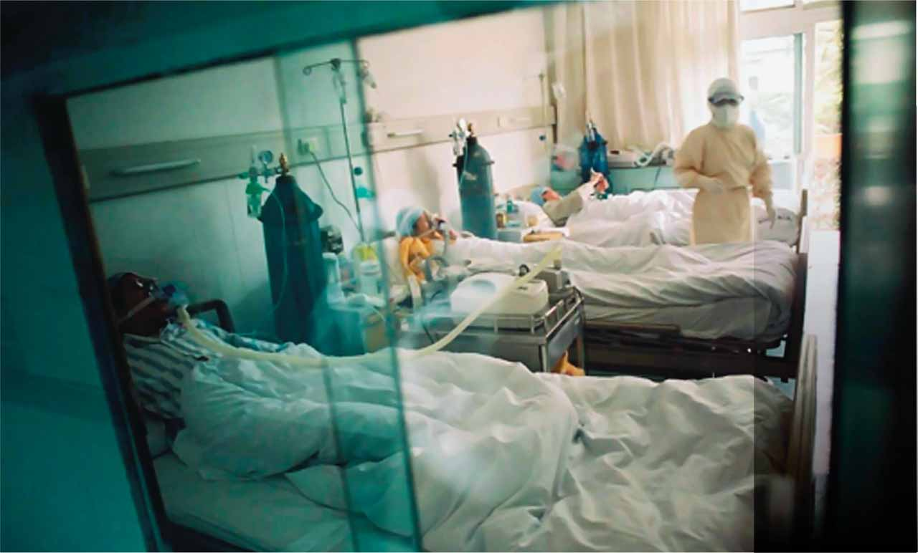
Doctor at Hong Kong's Metropole Hotel (left) spread SARS to 9th floor guests
sparked outbreaks in Hanoi, Toronto, and Singapore
Dennis Normile Science 2013;339:1269-1273
Published by AAAS
Notes:
No touching.Patient isolation and staff member protection halted SARS transmission in hospitals.

Slide 7
SARS “super spreading events”
Multiple locations/events evidence that this has happened with SARS-2 CoV as well

Slide 8
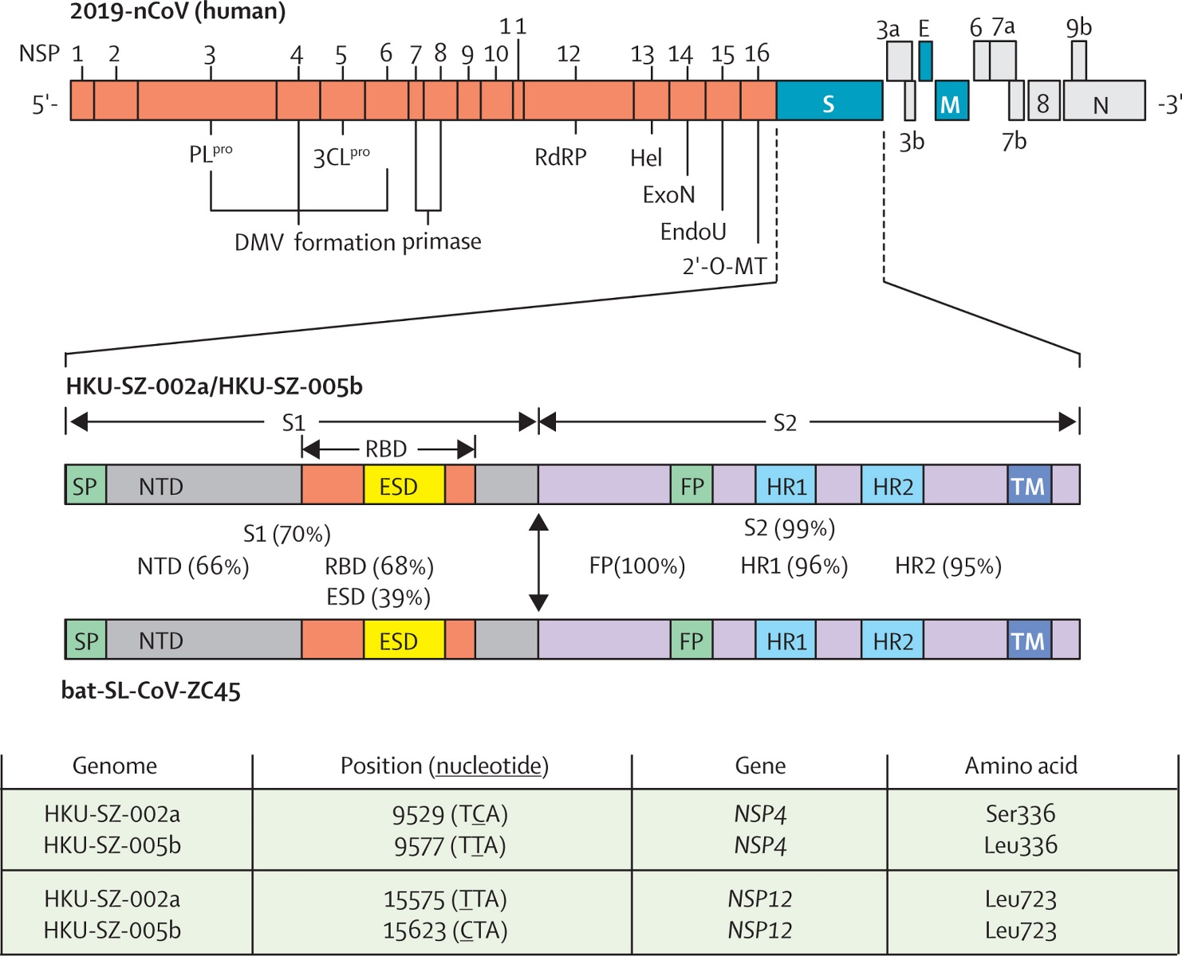
Figure 4
Chinese horseshoe bats, Rhinolophus sinicus
The Lancet DOI: (10.1016/S0140-6736(20)30154-9)
Copyright © 2020 Elsevier Ltd Terms and Conditions
Notes:
Genome organisation of 2019-nCoV and the amino acid identities of different subunits and domains of the Spike between human 2019-nCoV strains (HKU-SZ-002a and HKU-SZ-005b) and bat-SL-CoV-ZC45
2′-O-MT=2′-O-ribose methyltransferase. 3CLpro=3C-like protease. DMV=double-membrane vesicles. E=envelope. EndoU=endoribonuclease. ESD=external subdomain. ExoN=exonuclease. FP=fusion peptide. Hel=helicase. HR1=heptad repeat 1. HR2=heptad repeat 2. M=membrane. N=nucleocapsid. NSP=non-structural protein. NTD=N-terminal domain. ORF=open reading frame. PLpro=papain-like protease. RBD=receptor binding domain. S=spike. S1=subunit 1. S2=subunit 2. SP=signal peptide. TM=transmembrane domain.

Slide 9
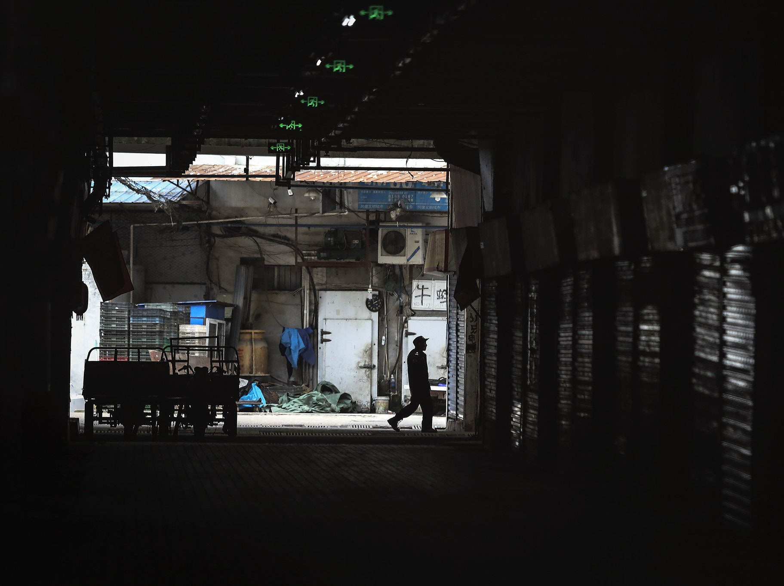
Huanan Seafood Market in Wuhan, disinfected and closed after linked to outbreak
first week of 2020

Slide 10
One Health
https://www.onehealthcommission.org/

Slide 11
Role of CEID/Petersen group in COVID19 pandemic
Past One Health work laying essential connections between SHL/ ISU VDL to allow donation of diagnostic reagents
Collaboration with Nigerian groups to help with statistical analyses/modeling as needed as their caseload grows
Donation of equipment and PPE to UIHC emergency department and elsewhere
Provide education and awareness to local, state, national and international media

Slide 12
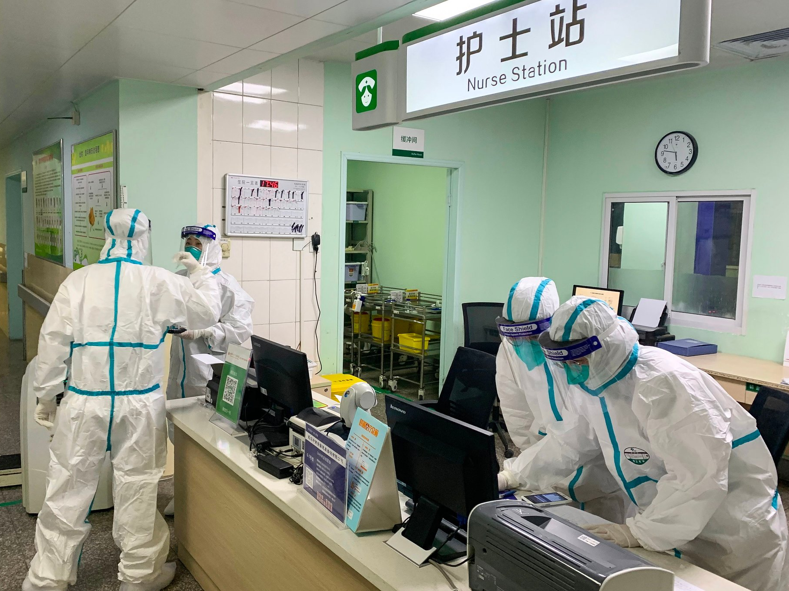
Questions?

