Slide 1
MPH Overview
August 18, 2020

Slide 2
Agenda
Introductions & Icebreaker
MPH Overview
MPH Student Handbook
Organizational Chart
Professional Development Activities
Financial Support
Applied Practice Experience, IPE, Capstone, Core Courses, & the MPH website
Q&A

Slide 3
Introductions & Icebreaker
Name + UG institution and major + MPH Program of Study….and:
Hersheys: What did you do over the summer?
Hersheys Dark: Who is your favorite actor/actress and what is your favorite t.v. show or movie?
Mr. Goodbar: What is your favorite hobby?
Krackel: What is a fun fact about yourself?

Slide 4
MPH Overview
MPH Student Handbook
Organization Chart

Slide 5
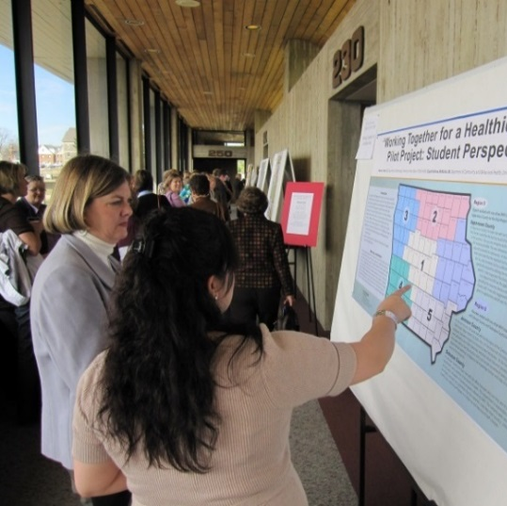
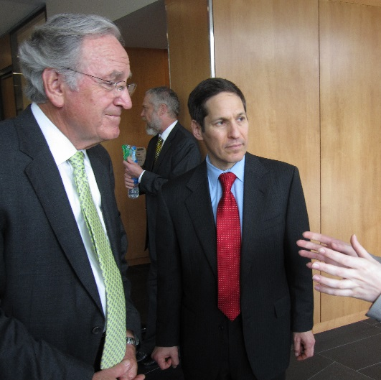
MPH Overview
Involvement in Professional Activities
APHA
Iowa Governors Conference
Other Professional Conferences
Spotlight Series

Slide 6
MPH Overview
Financial support specific to MPH Students:
Professional development funding
Applied Practice Experience funding
Searchable scholarship database: http://www.aspph.org/study/financing-your-degree/

Slide 7
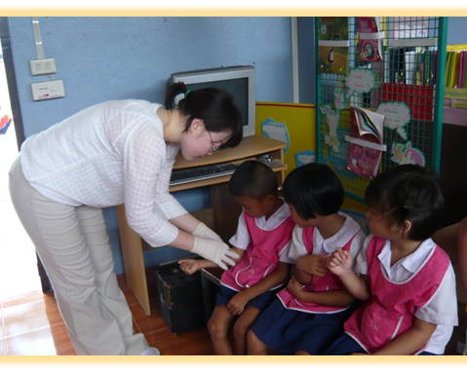
MPH Overview
Interprofessional Education
Applied Practice Experience
Capstone
MPH Website

Slide 8
You will receive additional information at your departmental orientation and throughout the day.

