Slide 1
Welcome Students!
College of Public Health New Student Orientation
August 18, 2020

Slide 2
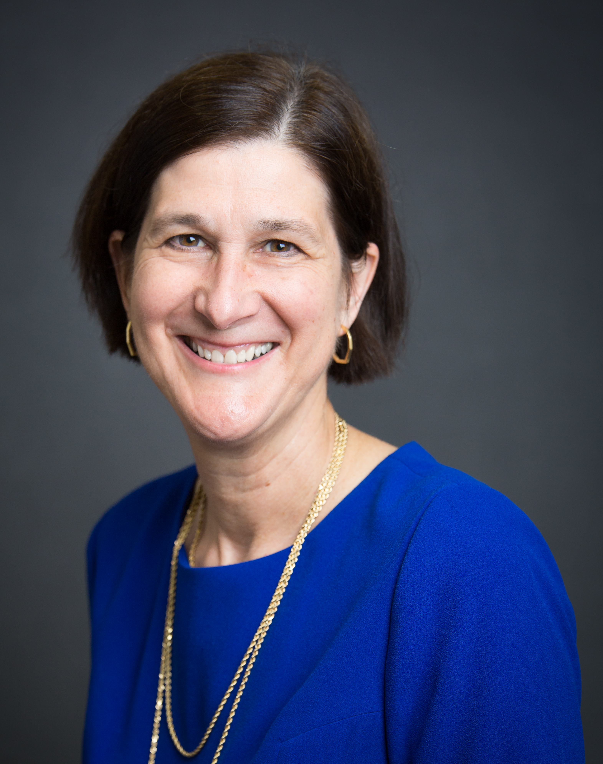
CPH Leadership Located 1st floor, south side
Edith Parker, DrPH, MPH
Dean
College of Public Health
Tom Vaughn, PhD
Interim Associate Dean for Academic Affairs
College of Public Health

Slide 3
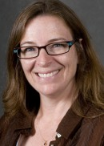
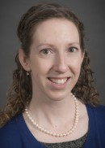
CPH Leadership Located 1st floor, south side
Corrine Peek-Asa, PhD Associate Dean for Research
Jeffrey Dawson, ScD Associate Dean for Faculty Affairs
Lori Cranston, MBA Associate Dean for Administration
Maggie Chorazy, MPH, PhD
Director of Undergraduate
Programs

Slide 4
CPH Student Services Located 1st floor, north side
Scot Reisinger
Director of Student Services
Lexie Just
Associate Director of Admissions and Recruitment
Jeanie Kimbel
Practicum Director, MPH Program
Sophie Switzer
Assistant Director, Engaged Learning and Career Preparation
Kim Klinedinst
Advisor, Undergraduate Program
Justin Denman
Admissions Assistant
Ray Bennett
Distance Learning and Learning Technologies

Slide 5
Mission, Vision, and Core Values
Mission: To promote health and to prevent injury and illness through commitment to education and training, excellence in research, innovation in policy development, and devotion to public health practice.
Vision: To serve Iowa and the Midwest as one of the nation’s premier state-assisted schools of public health and lead the global community in rural public health education and training, research, and practice.
Core Values: Our Core Values reflect those of The University of Iowa: Excellence, Learning, Community, Diversity, Integrity, Respect, Responsibility, and Social Justice.

Slide 6
CPH Overview
One of 11 colleges at The University of Iowa
Founded in 1999
Roots originate in the Department of Preventive Medicine and Environmental Health and the Graduate Program in Hospital and Health Administration
Created the Department of Community and Behavioral Health and the MPH Program
Now Five departments: Biostatistics, Community and Behavioral Health, Epidemiology, Health Management and Policy, and Occupational and Environmental Health

Slide 7
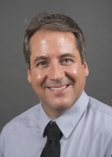
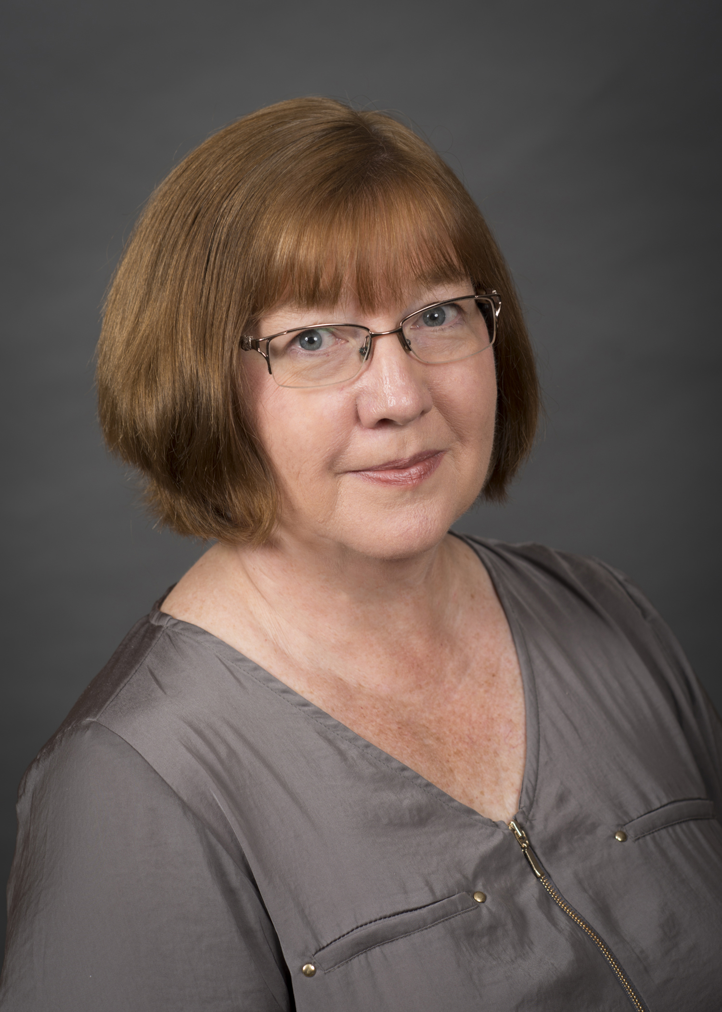
Biostatistics
Administrative offices located on 3rd floor, north side
Degrees offered:
MPH, MS, and PhD in Biostatistics
Certificate in Biostatistics
Joe Cavanaugh, PhD
Department Head
Terry Kirk
Graduate Program Coordinator

Slide 8
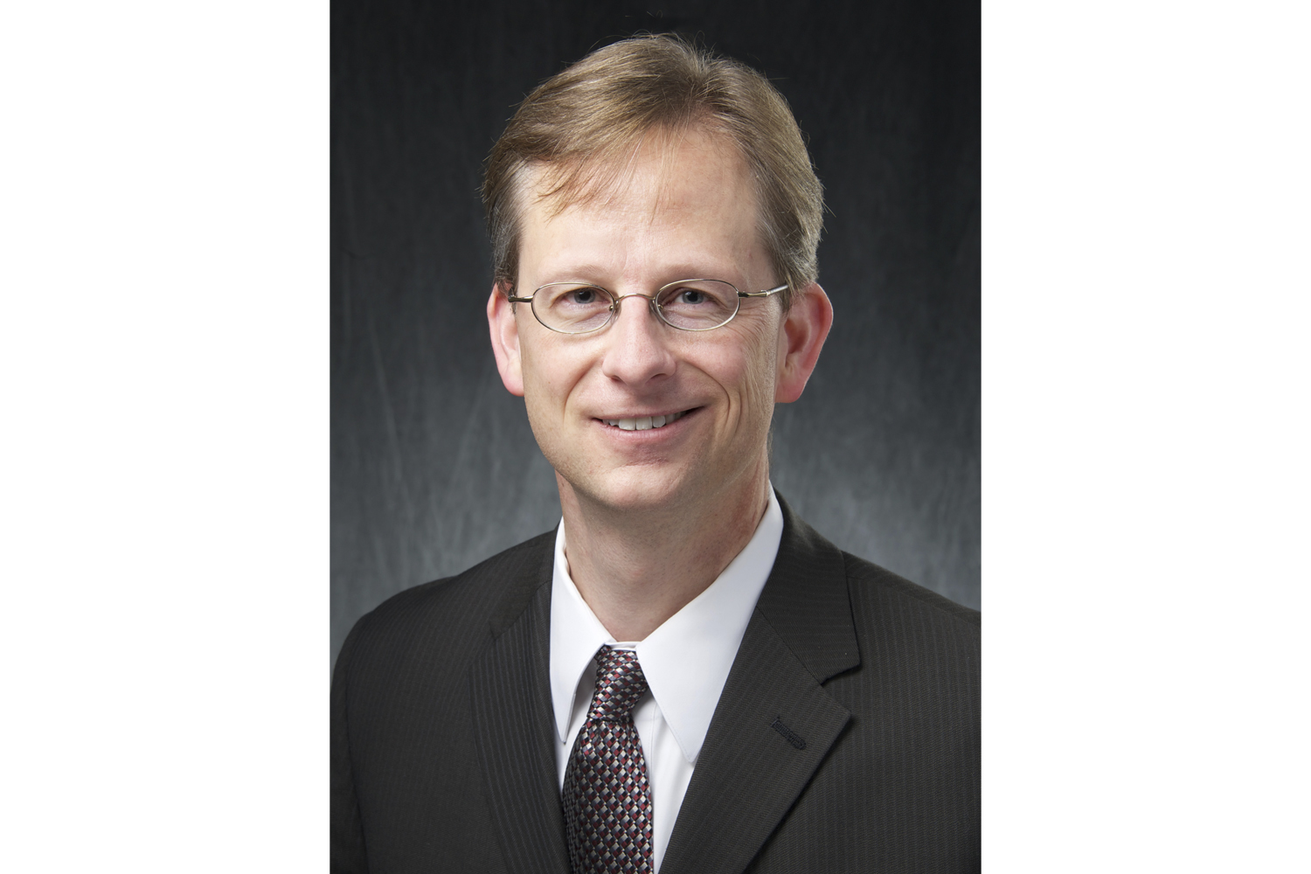
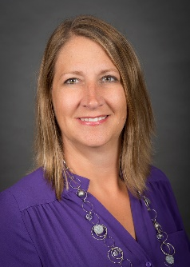
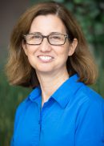
Community and Behavioral Health
Administrative offices located on 4th floor, north side
Degrees offered:
MPH and PhD in Community and Behavioral Health
Mark Vander Weg, PhD
Department Head
Torrie Malichky
Graduate Program Coordinator

Slide 9
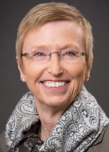
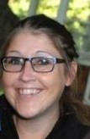
Epidemiology
Administrative offices located on 4th floor, south side
Degrees offered:
MPH, MS, and PhD in Epidemiology
MS in Clinical Investigation
Certificate in Emerging Infectious Diseases
Certificate in Translational and Clinical Investigation
Betsy Chrischilles, PhD
Department Head
Megan Riley
Graduate Program Coordinator

Slide 10
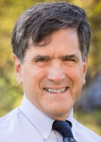
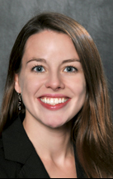
Health Management and Policy
Administrative offices located on 2nd floor, north side
Degrees offered:
MPH, MS, and PhD in Health Policy
MHA
Executive MHA
Certificate in Healthcare Administration
Keith Mueller, PhD
Department Head
Gwendolyn Archibald
Graduate Program Coordinator

Slide 11
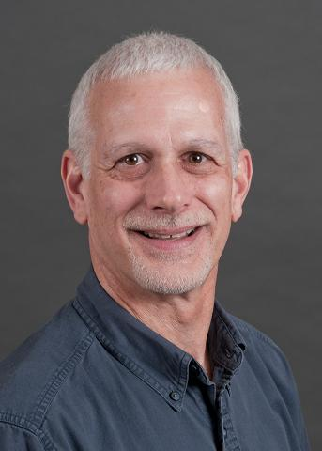
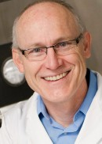
Occupational and Environmental Health
Administrative offices located on 3rd floor, south side
Degrees offered:
MPH, MS, and PhD in Occupational and Environmental Health
MS and PhD in Industrial Hygiene and Agricultural Safety and Health
Certificate in Agricultural Safety and Health
Peter Thorne, PhD
Department Head
Dave Asa
Graduate Program Coordinator

Slide 12
Master of Public Health Program
Five Departmental Program of Study options
Joint Degrees
MD/MPH
PharmD/MPH
JD/MPH
DVM/MPH
MPH for Practicing Veterinarians
MPH for Professionals

Slide 13
Undergrad to Graduate Program And Bachelors Degree
Undergrad to Grad (U2G):
Students can pursue an undergraduate to graduate degree, completing both in 5 years. Agreements are in place with these institutions:
University of Iowa
Grinnell, Coe, Cornell Colleges
Bachelors Degree:
The College offers a BA and BS in public health
Our first full graduating class was in May 2020!

Slide 14
Spotlight Series & Collegiate Funding Opportunities
Spotlight:
Monday’s and Wednesday’s 12:30-1:30 pm
Professional Development opportunities to
Broaden your knowledge of Public Health
Enhance your education
Network
You are encouraged to attend all that you can
Funding:
Advancing Graduate Student Success Award
Graduate Professional Student Government Travel Awards
Outside Scholarships
Global Travel Grant

