Slide 1
Student Orientation WELCOME!
College of Public Health Building/Facilities
August 2020

Slide 2
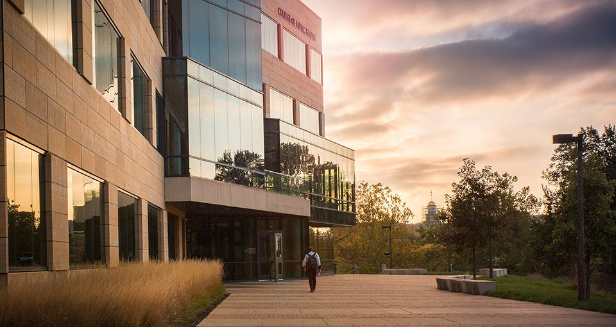
College of Public Health Building
Fall 2020 Building Hours:
Monday – Friday: 7:30 AM – TBD
After Hours/Weekend: UI ID Card Access Only
Student Access:
All CPH undergraduate and graduate students are granted electronic access via the student ID card based on their student registration status.
Basic Student ID Access:
Building Entrances
Student Computer Labs
Small group rooms
Access is a privilege intended only for you!

Slide 3
Student Computer Labs -
Quiet Lab (S206) - Users of this lab are encouraged to be courteous to others in the room by quietly using the machines in this area.
Group Lab (S207) - This lab is a great place to work in small groups on projects with computing requirements.
Guidelines:
No food or drink.
Users must abide by the University of Iowa Acceptable Use Policy.
Watching streaming videos or non-class related material is prohibited.
No offensive materials.
The installation of software on the lab machines is prohibited.

Slide 4
Small Group Rooms -
There are 4 group rooms located off the atrium on floors 1-4.
Rooms are available for scheduling via Outlook calendar.
Outlook names:
RES-CPHB-N160
RES-CPHB-C212
RES-CPHB-C312
RES-CPHB-C412
Fall 2020 capacity has been reduced to 2 only (normally 6-8).
Technology is available in N160 & C212.

Slide 5
Student Commons -
Individual and group work.
Be mindful of others using the space.
Shared Kitchen:
Refrigerator should be cleaned out periodically!
Student responsibility for cleaning up spills in microwave!
Disinfect high touch surfaces regularly.

Slide 6
Parking & Transportation
Short-term Parking
Limited metered visitor spaces are available outside CPHB.
Due to limited availability, we encourage students who drive to class to park at Newton Road Ramp and walk across the Hwy 6 bridge.
Accessible Transportation –
Cambus: On-campus, fixed route, accessible bus service.
Bionic Bus: Specialized transportation service for persons with disabilities that provides door-to-door service.
Bikes
Bike racks are located on the west side of the building and along Riverside Drive (bottom of steps on east side of CPHB).
Bikes are not allowed in the building.
Forget your lock? IT has a limited supply for check-out (N140).

Slide 7
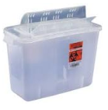
Recycling & Waste Reduction
Support sustainability principles – reduce waste & support recycling practices!
Trash & Recycling Centers are located in the atrium on each floor.
Before placing items in the recycling bin, be sure items are:
CLEAN - items must not have any food residue, liquids, or grease spots on them.
DRY - items must be dry
EMPTY - items must be empty
Sharp Container – The FDA recommends that used needles and other sharps be immediately placed in appropriate disposal containers. The first-floor restrooms in the CPHB are equipped with disposal containers.

Slide 8
Accessibility & Inclusion
Single User Gender Inclusive Restrooms located on lower level.
Restrooms on first floor are equipped with ADA accessible entrances.
Service Animals –
The Americans with Disabilities Act covers service animals and no documentation is needed to bring a service animal into a classroom. However, an instructor may ask if the animal is a service animal and what specific tasks it performs for the student.
Emotional support animals are not allowed in university classrooms.
Questions regarding animals can be directed to Student Disability Services.
Lactation Room –
Located in the lower level, Room S042.
This space can be reserved using Outlook (RES-CPHB-S042).

Slide 9
Food & Beverages
River Ridge Café – temporarily closed Fall 2020
Vending Machines – located in the lower level near the elevators
Water –
Drinking fountains will remain operational Fall 2020 and cleaned at a higher level but you are encouraged to bring your water to reduce touch points.
Reminder:
No food allowed in classrooms.
Water bottles are acceptable.

Slide 10
Other Information
Lost & Found – located in Information Technology Suite (N140)
Showers – Lower level restrooms (S046 & S044).
Lockers – Process for checking out lockers will be communicated within the next few weeks.
Building Repair or Maintenance:
Notice something in the building in need of repair or maintenance? If so, let us know via e-mail at CPH-Facilities@uiowa.edu
Notes:
Note – in the past the lockers were first come, first serve and students just used their own locks. We will start a process to check these out on a semester basis but are still waiting for the locks to come in. Once they come in we will communicate a process to request these and begin working with those with existing lockers to switch over.

Slide 11
COVID-19
Fall 2020

Slide 12
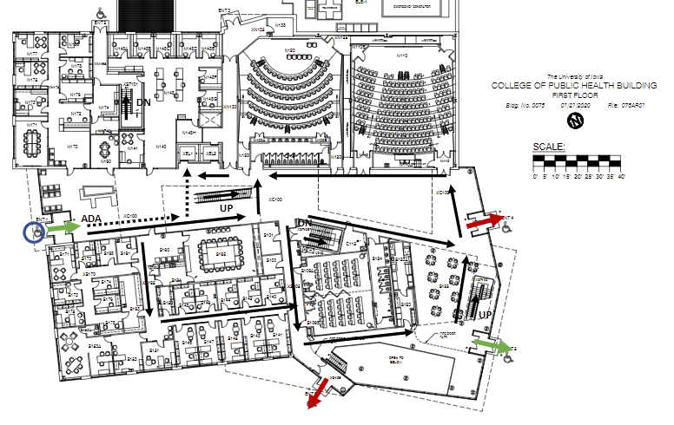
Traffic Flow
Designated Building Entrances
CPHB Traffic Plan
UP - Open Atrium Stairs
Down – Enclosed Emergency Stairs
Classrooms with multiple doors will have designated entrance/exit.
Be mindful & physically distance
Elevators
Restrooms
Atrium
Computer Lab
Notes:
Might need to explain where emergency stairs are – north & south side of the building.

Slide 13
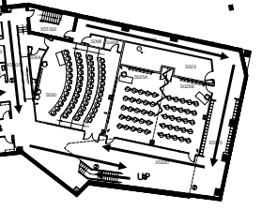
Lower Level Classrooms
Take stairs to lower level
Two exits – follow signage
S030
S025A/B
Physically distance when waiting to enter classrooms.
S030
S025A/B
Notes:
Might need to explain where emergency stairs are – north & south side of the building.

Slide 14
Classrooms
Sanitizer & disinfectant wipes will be available in all classrooms.
Grab a wipe as you enter to wipe down your space.
As you enter the room – take the furthest seat back to allow those behind you to enter.
Do not move furniture to maintain 6 foot distancing.
Be mindful of the Instructor Zone and practice physical distancing.
Notes:
Might need to explain where emergency stairs are – north & south side of the building.

Slide 15
Online Courses
We realize some students may have online classes immediately following face-to-face classes and will be looking for space in the building to utilize. Below are a few options to consider:
Reserve a small Group Room via Outlook.
Find an available classroom (schedules posted outside classroom)
Student Computer Labs
Student Commons
Tables available in the Atrium
Notes:
Might need to explain where emergency stairs are – north & south side of the building.

Slide 16
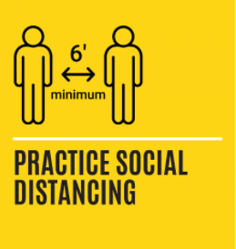
Other Fall 2020 Things to Remember
Face Coverings Required
Social Distancing Important
Capacity – for your health and those of your fellow students, please be respectful of the capacity in spaces and don’t exceed them.
Notes:
Might need to explain where emergency stairs are – north & south side of the building.

Slide 17
Questions?

