Slide 1
The University Counseling Service: During the Time of Covid-19
Barry A. Schreier, Ph.D.
University Counseling Service

Slide 3
How Many Does the UCS See?

Slide 4
How Many Does the UCS See?

Slide 5
What Does UCS See?

Slide 6
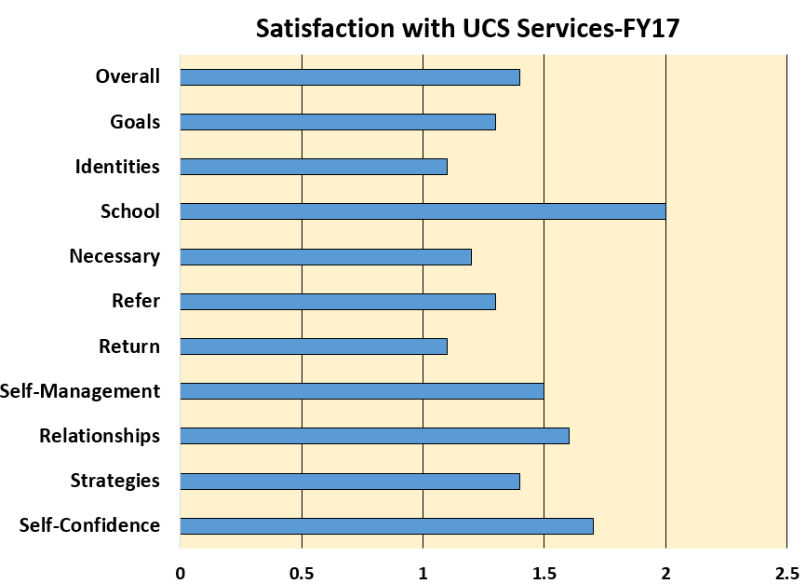
Overall Benefits
00

Slide 7
. . .And the Dean’s List. . .again. . .

Slide 9
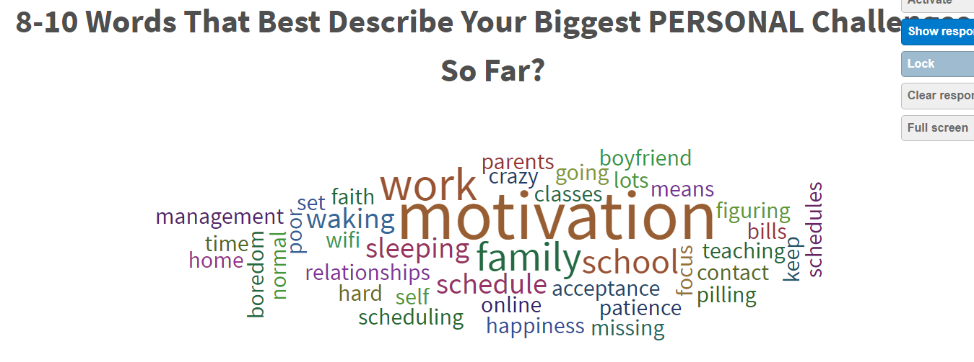

Slide 10
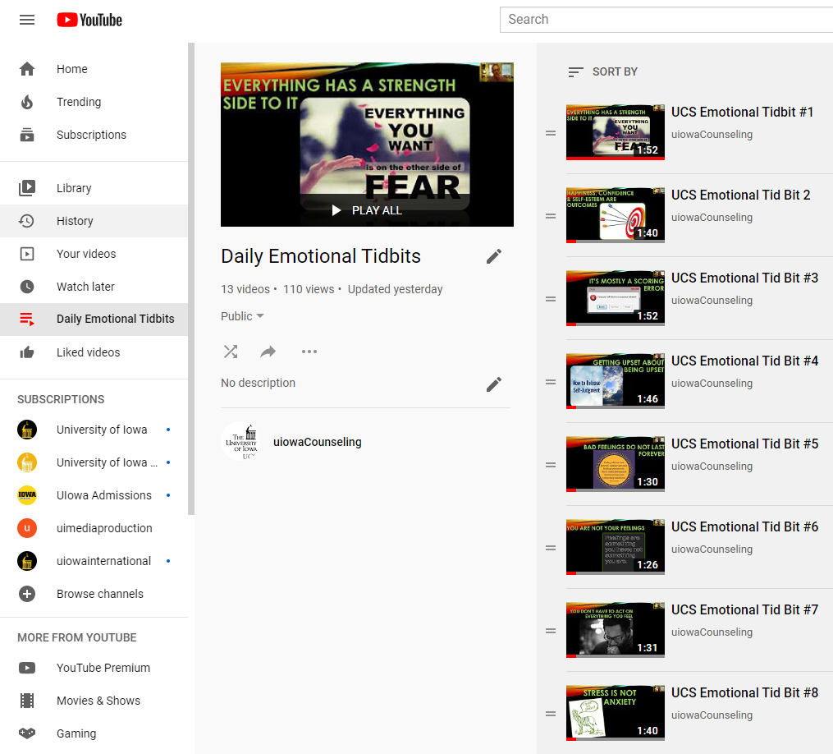
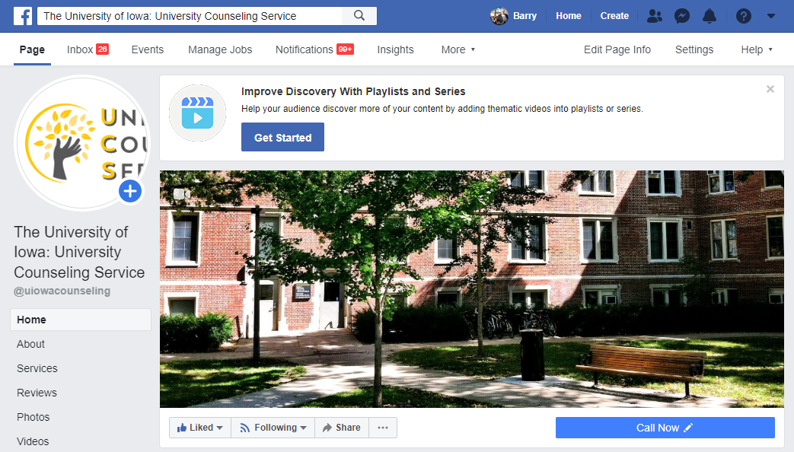
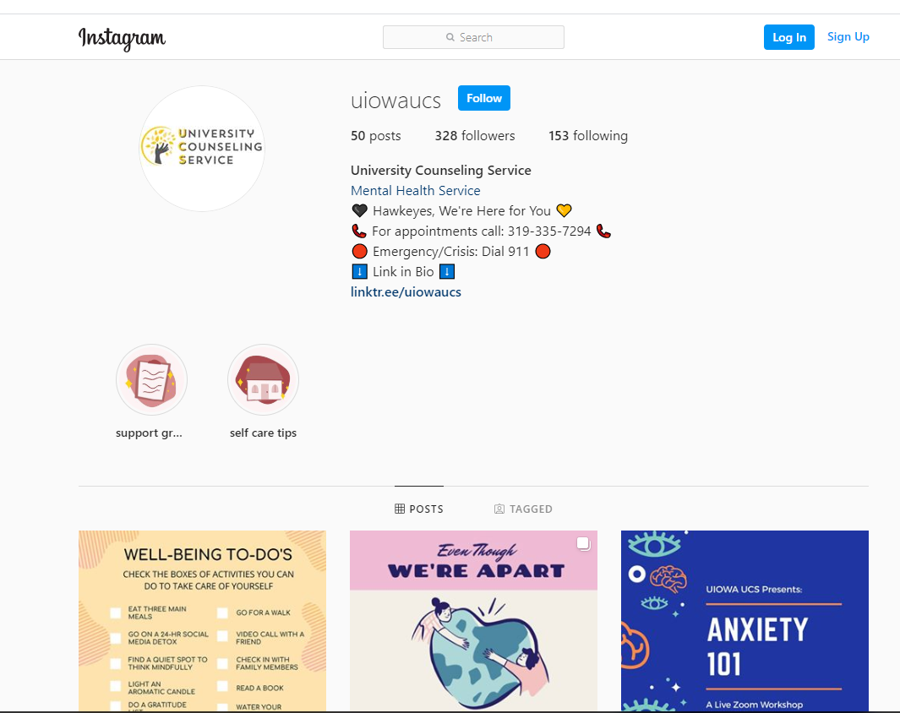
Daily Social Media Presence

Slide 12
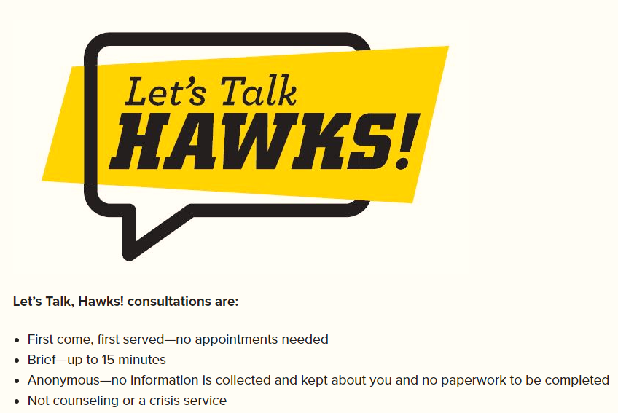
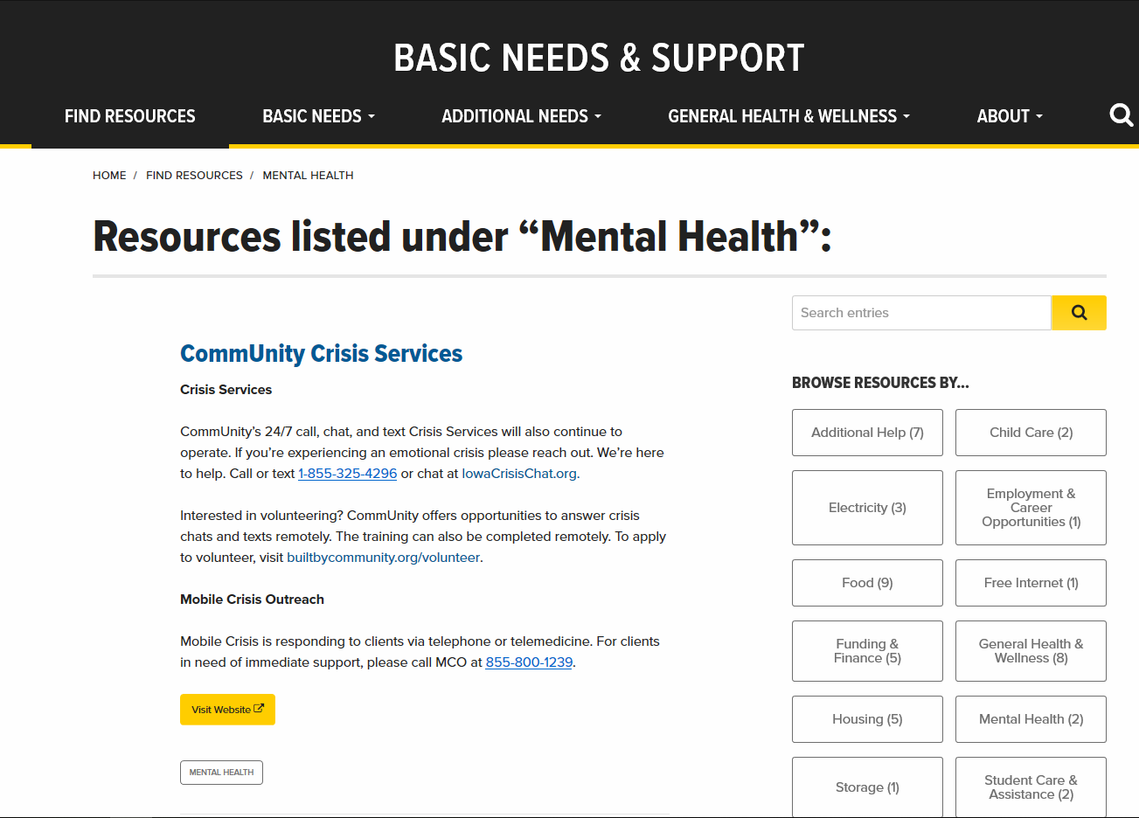

Slide 13
Ongoing Counseling via Tele-Mental Health
State Boundary Issues
Live Workshops
Anxiety Toolbox, Kind Mind, Mindfulness Matters
Self-Paced Workshops
Mindfulness, Coping, Distress Tolerance, and Many Others
Guides
Seeking Care at Home & The “Self-Care Package”
Support Groups
Loss; Chronic Health; ADHD; Asian/Asian American Solidarity, Success Not Excess
Videos
Emotional Tid Bits, Mindfulness, Art & Creative Writing Therapy

Slide 14
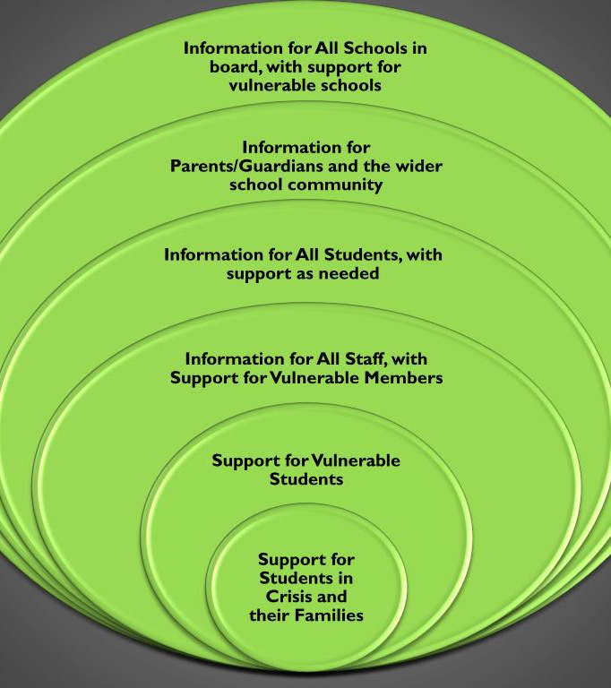
Postvention Planning
Continuity Planning
Contingency Planning

Slide 15
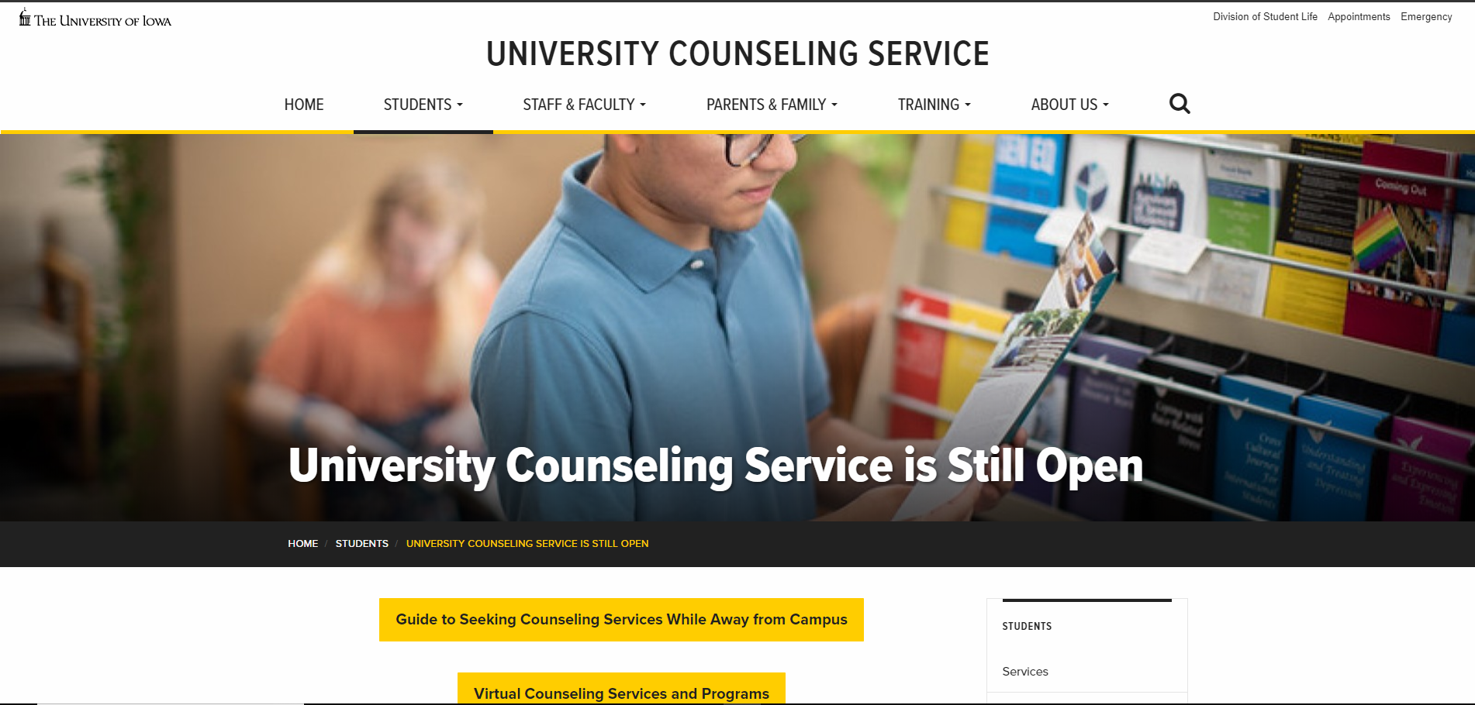
Counseling.uiowa.edu

Slide 18
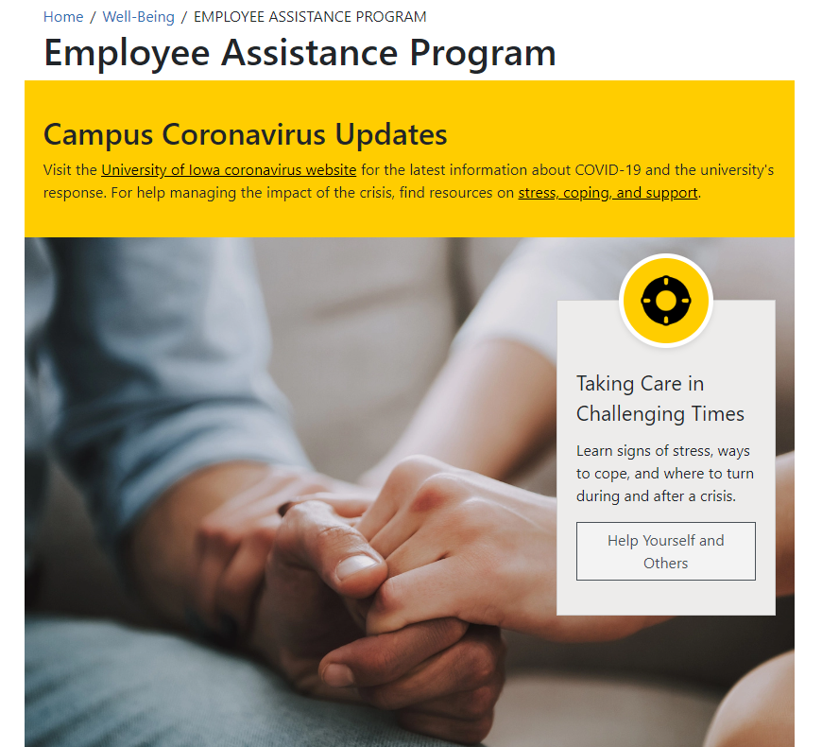
Employee Assistance Program (EAP)

