Slide 1
Notes:
Also encourage applications for independent research, not limited to highlighted opportunities here
All students enrolled in CPH are eligible
Graduate students can apply for up to $5000
Rolling application process
Must apply at least 3 months before planned departure date

Slide 3
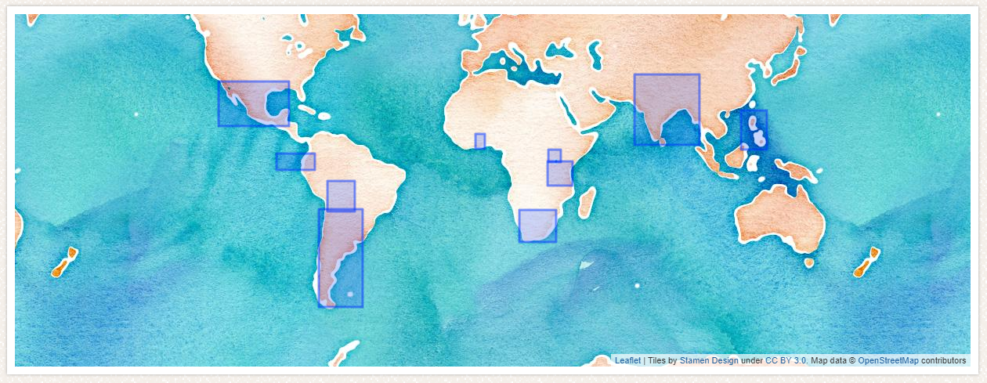
Notes:
Partnership started in 2017
30+ programs in 10 countries around the world
These are semi-customized practical internships in public health, variety of topics including healthcare access, community outreach, disease, etc
Affiliate of WHO
Rolling deadline but if you want to apply for Summer 2019, earlier is better as they do fill up (absolute last date is February 1)

Slide 4
Notes:
Will highlight a few global experience options, but not limited to these.
Interdisciplinary course with courses on campus and service project in Xicotepec, Mexico over spring break
Project will be a continuation of last year’s needs assessment
If interested, speak with peers who went
This year’s instructor is Jeff Dawson, Biostatistics
Counts as MPH elective
Application deadline October 10

Slide 6
Notes:
Coming up in just 2 weeks
Full itinerary online with multiple speakers, free lunch, and food drive, plus other activities

Slide 8
Notes:
Interdisciplinary competition designed to simulate a real-world intervention. Great professional experience and resume builder. Any UI student is welcome to participate.
Sign up as team or individual. Please check out the website to ensure your team meets all the eligibility requirements
Case will be announced Sept 25th
Competition is October 21st. Bring in panel of expert judges. Winning team gets $500 per person.

Slide 9
Notes:
Not in office today, but otherwise will be available.
If at all interested in an international experience during your time here, please come speak to me as soon as possible.
Planning an international experience always takes longer than you think and the sooner we start, the more likely we are to find you an ideal experience.

