Slide 1
Tools For Starting a CT Lung Cancer Screening Program
Rural hospitals already have what it takes to be successful!
Lori Pietig, MHA, CT, RT, (R)- St. Anthony Regional Cancer Center
No Disclosures

Slide 2
Proposed Rule Changes
Proceed with caution!

Slide 3
Access is Key
It has been proven that early detection of any kind of cancer is key to increased survival.
The 2018-2022 Iowa Cancer Plan made the adherence to cancer screening guidelines a priority.
These goals and initiatives are not out of reach for rural hospitals.
Take the resources you have and build programs to best serve your community.

Slide 4
Misconceptions
There is a huge cost
Dedicated full-time staff are needed
You need a fancy interface and tracking system
Complex levels of care are needed at your facility
You need to be ACR accredited to have a program

Slide 5
St. Anthony Regional Hospital Our Journey to Success
2014- Family practice physician kept asking for the program.
Research and Education
Many programs in place but were all cash programs
CMS and insurance companies did not have set guidelines for billing
No way to easily submit data for tracking
NRDR did not have their site up and running
Radiologist was not on board with starting the program
Retiring Soon

Slide 6
Times Have Changed
2016
NRDR was moving forward with launching their website to enter and track data.
We brought on a new radiologist that was part of a CT lung screening program at his previous facility. (Cash program at the time)
CPT codes (G-Codes) were available and we could now bill for the service and not rely on a cash payment model.
Guidelines were set to help identify who would qualify for the program
Lung Cancer Screening Program is very similar to a mammography program
Tracking
Letters
Yearly reminder
Follow-ups

Slide 7
How does a facility get started?
Starting a lung cancer screening program in a rural hospital does not have to be difficult.
Talk to your administration to get them on board
Start the conversation with your radiologist and their group
Learn and understand the Lung-RADS codes
Do they have an active program at another site
Identify a referring provider to champion and to be part of the conversation
This is not required but can help bridge the gap when it comes to provider education.
Start researching the registration process to become part of the ACR/NRDR Lung Cancer Screening Registry.

Slide 8
ACR/NRDR Registry
This site provides the platform and tools to register and track your registry information.
Participation Agreement
Cost
Based on number of radiologist and number of sites the organization is registered for.
Continued updates and information plus tools for Q & A.

Slide 9
ACR/NRDR Registry Continued…..
What will a facility need to register?
Corporate Account Administrator/Facility Administrator
Total number of Rads reading
Scanner Information
Tax ID
Provider Information

Slide 10
Building Your Program
Scan Protocols
Order Creation
Billing/HIM/Authorizations
Letters
Data Entry
Provider Education
Outreach and Marketing

Slide 11
Scan Protocols
Build scan protocols with the help of your App’s or service personal.
Specific criteria set by the ACR.
Training for the staff performing the scan.
Use this time to education staff about the importance of this program and to have ownership of the scan protocols.

Slide 12
Physician Order Requirements
Electronic or Paper Orders
Must have the following criteria
Shared Decision Making
Between 55-77 years of age
Current smoker or quit within the past 15 years
30+ pack year history
Asymptomatic of lung cancer
Packs/day (20 cigarettes/pack):_____x Years smoked:_________=Pack years*:___________
EX: 2packs x 20years = 40 pack years

Slide 13
Billing-HIM-Authorization
CPT 71271 CT Low Dose Lung Screening
You can only bill for one CT Low Dose Lung Screening every 365 days.
Follow-up scans need to be billed as a standard chest CT with or without contrast but potentially protocolled as a low dose scan.
Work with your radiologist to assure the recommendations and wording is clear in the reports.
Diagnosis Codes
Authorizations
Traditional Medicare will not require an authorization
Commercial and HMO products will require an authorization

Slide 14
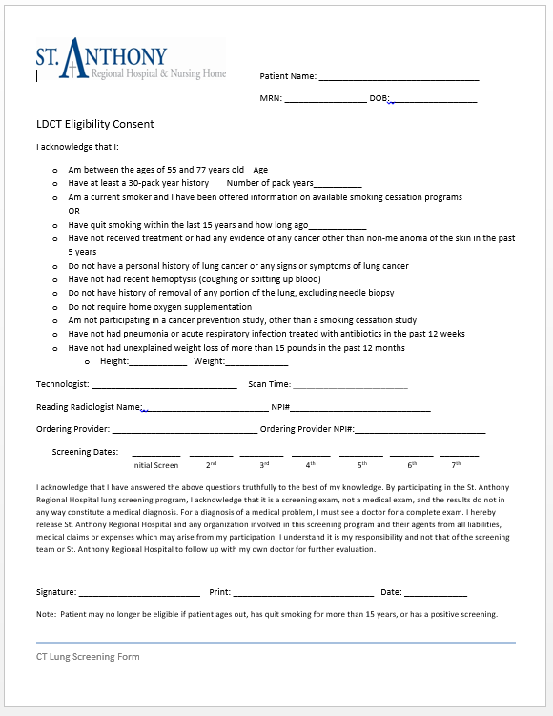
Building Letters and Forms
Building Letters
Lung-Rads 1-4
Yearly Reminder Letter
End of Participation Letter
Work with your EMR
Could already have a reporting system built into your EMR
LDCT Eligibility Consent Form
CT staff complete with patients

Slide 15
Lung Rads 1 Letter Example
Yearly Reminder Letter

Slide 16
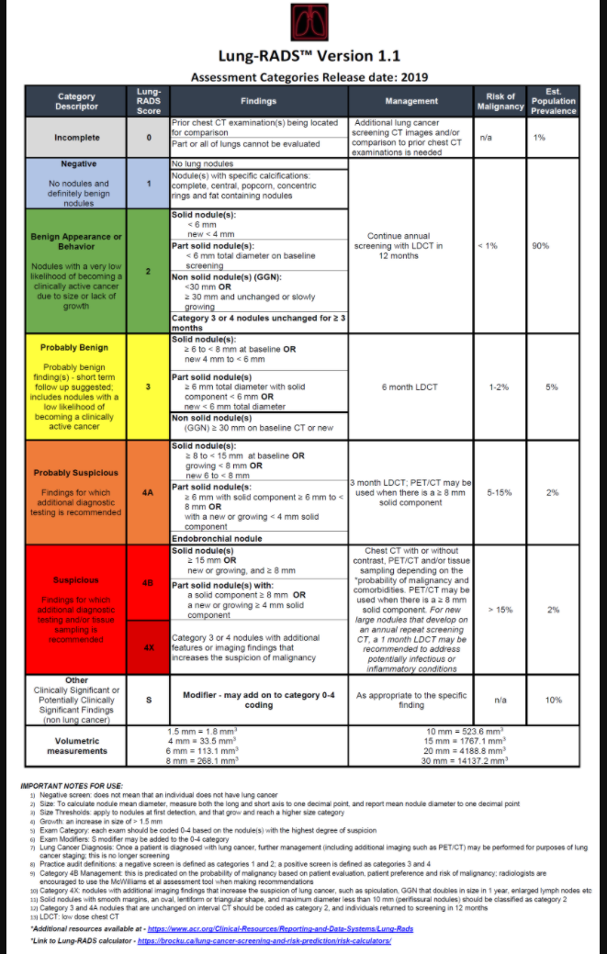

Slide 17
Tracking Results and Follow-up Exams
Tracking Results
Each patient is entered into the NRDR website
Manually or file upload
Follow-up Folder
Monthly Hanging Folder
Keep Eligibility Form
Reference back for yearly reminder and end of participation letters.
Follow-up Exams
Patient is tracked as soon as they need a F/U, status, and completion
Add notes and office communication

Slide 18
Provider Education
Learning Objectives
To identify who is a eligible to be a candidate for the CT Lung Screening Program.
The importance of the shared decision making process in deciding who is a candidate for the CT Lung Screening Program.
The process in which to order a CT Lung Screening Exam.
The follow-up process

Slide 19
Outreach and Marketing
Create a flier to send to referring providers in your area
Take advantage of social medial outlets
Print and radio adds
Health Fairs
American Lung Association
Ads and marketing

Slide 20
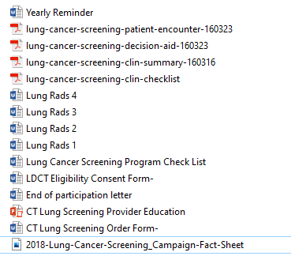
Program Checklist & Resources

Slide 21
Success at St. Anthony
Active program for 5 years
716 scans to date
Helped 9 facilitates get their programs started
Most were critical access
Support
Resources
Ongoing guidance
Meeting the screening needs of our region
Contact information
Lori Pietig MHA, CT, RT, (R)
lpietig@stanthonyhospital.org
712-794-5505

Slide 22
Resources
American Lung Association
http://www.savedbythescan.org/
Lung-RADS Assessment Tool
https://www.acr.org/-/media/ACR/Files/RADS/Lung-RADS/LungRADSAssessmentCategoriesv1-1.pdf
ACR/NRDR Lung Cancer Screening Registry
https://www.acr.org/Practice-Management-Quality-Informatics/Registries/Lung-Cancer-Screening-Registry
https://nrdrsupport.acr.org/support/solutions/articles/11000029003-items-you-ll-need-to-register
Decision Making Tools- Provider
https://effectivehealthcare.ahrq.gov/decision-aids/lung-cancer-screening/static/lung-cancer-screening-clin-checklist.pdf
Decision Making Tools- Patient
https://effectivehealthcare.ahrq.gov/decision-aids/lung-cancer-screening/static/lung-cancer-screening-decision-aid.pdf

Slide 23
References
https://www.ncbi.nlm.nih.gov/pmc/articles/PMC4624749/
https://effectivehealthcare.ahrq.gov/decision-aids/lung-cancer-screening/static/lung-cancer-screening-clin-checklist.pdf
https://effectivehealthcare.ahrq.gov/decision-aids/lung-cancer-screening/static/lung-cancer-screening-decision-aid.pdf

Slide 24
Shared decision making for lung cancer screening UI Rural Cancer Collaboratory
Richard M. Hoffman, MD, MPH
University of Iowa Carver College of Medicine
Division of General Internal Medicine
University of Iowa Holden Comprehensive Cancer Center
Cancer Epidemiology and Population Science Program

Slide 25
Disclosures
Author, UpToDate®, prostate cancer screening chapter
Co-Author, Bates Guide to Physical Examination and History Taking
Member, National Lung Cancer Roundtable

Slide 26
Outline
Lung cancer screening
Shared decision making
Implementing shared decision making for lung cancer screening

Slide 27
Lung cancer burden

Slide 28
Reducing the burden

Slide 29
Lung cancer stage and survival
%
Howlader N., et al. SEER Cancer Statistics Review, 1975-2018

Slide 30
Lung cancer screening
The evidence for screening
Chest radiography (CXR), sputum cytology are ineffective (Manser R. Cochrane Database Syst Rev 2013:6)
Low-dose CT (LDCT) scanning is effective
National Lung Screening Trial (National Lung Screening Trial Research Team. New Engl J Med 2011;365:395)
NELSON (de Koning HT. New Engl J Med 2020:382:503)

Slide 31
National Lung Screening Trial (2011)
Randomized controlled trial
Subjects
53,454 adults 55-74, 30+ pack-years, smoked within past 15 years
Intervention
Three annual screenings with either LDCT or CXR
Median follow up 6.5 years
NLST Research Team. New Engl J Med 2011;365:395

Slide 32
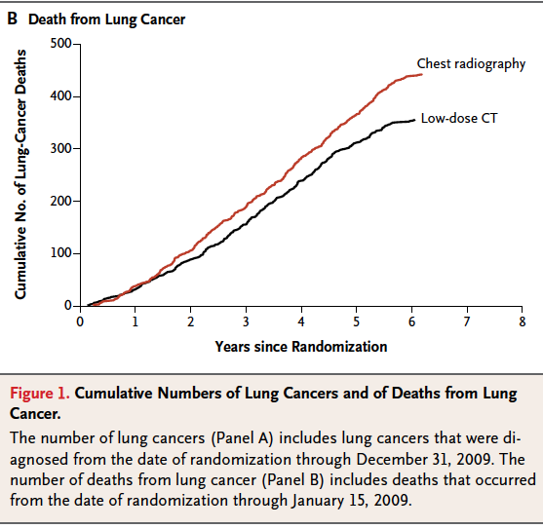
National Lung Screening Trial (NLST)
Relative risk reduction 20% (95% CI 6.8-26.7)

Slide 33
Screening benefits
Lung cancer mortality reduced
Absolute risk reduction: 0.4 percentage points
320 persons needed to be screened 3 times to prevent one lung cancer death after 6.5 years

Slide 34
Screening harms
False positives
40% with abnormal scans during 3 screenings
96% false positives
Complications from invasive diagnostic tests
Incidental findings
Overdiagnosis
Radiation exposure

Slide 35
US Preventive Services Task Force
Grade B recommendation
Annual screening
Ages 55 to 80
30 + pack year smoking history
Current smoker or quit < 15 years
Moyer VA. Ann Intern Med 2014;160:330.

Slide 36
US Preventive Services Task Force
Screening cannot prevent most lung cancer deaths, and smoking cessation remains essential
Lung cancer screening has substantial harms
The decision to begin screening should be the result of a thorough discussion [shared decision making] of the possible benefits, limitations, and known and uncertain harms
Moyer VA. Ann Intern Med 2014;160:330.

Slide 37
What is shared decision making?

Slide 38
Shared decision making
Collaborative process that allows patients and their providers to make health care decisions together, taking into account the best scientific evidence available, as well as the patient’s values and preferences
http://informedmedicaldecisions.org/

Slide 39
Why do we need to do SDM?
Centers for Medicare & Medicaid Services (CMS)

Slide 40
CMS determination (2015)
Preventive service benefit
Counseling visit documenting:
Eligibility
Shared decision making (SDM) using a decision aid to address benefits, harms, follow-up diagnostic testing, over-diagnosis, false positive rate, radiation exposure
Counseling on adherence
Counseling on tobacco cessation/abstinence
https://www.cms.gov/medicare-coverage-database/details/nca-decision-memo.aspx?NCAId=274

Slide 41
Why should we do SDM?
Preference-sensitive care
Value of SDM

Slide 42
Preference-sensitive care

Slide 43
Preference-sensitive care
Preference-sensitive care comprises [interventions] that involve significant tradeoffs [benefits and harms] affecting the patient’s quality and/or length of life.
https://data.dartmouthatlas.org/downloads/reports/preference_sensitive.pdf

Slide 44
Preference-sensitive care
Decisions about these interventions – whether to have them or not, which ones to have – ought to reflect patients’ personal values and preferences, and ought to be made only after patients have enough information to make an informed choice.
https://data.dartmouthatlas.org/downloads/reports/preference_sensitive.pdf

Slide 45
Value of SDM using decision aids
Benefit to participants
Improves knowledge of disease and options
Reduces decisional conflict
More accurately able to estimate benefits and harms
Be more involved in decision making
Make values-c0ncordant decisions
Stacey D. https://www.cochrane.org/CD001431/COMMUN_decision-aids-help-people-who-are-facing-health-treatment-or-screening-decisions

Slide 46
How do we perform SDM?
Decision aids
SDM discussions
Implementing SDM in practice

Slide 47
Decision Aids
Tools that provide evidence-based information about a health condition, the options, associated benefits and harms, uncertainties
Help patients recognize the values-sensitive nature of the decision and to clarify their preferences
Provide structured guidance for communicating with providers
O’Connor AM. Cochrane Database Syst Rev 2009;Jul 8;(3):CD001431

Slide 48
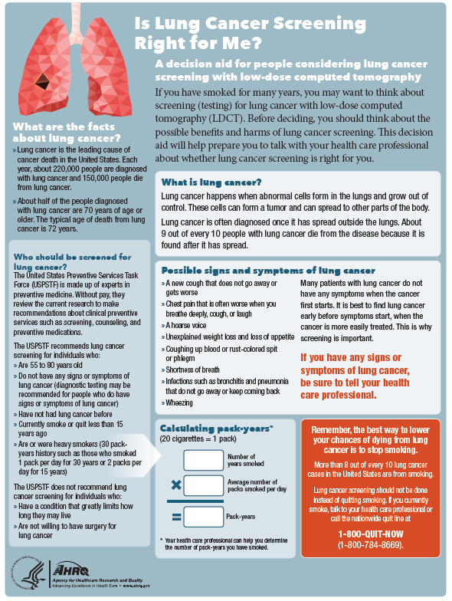

Slide 49
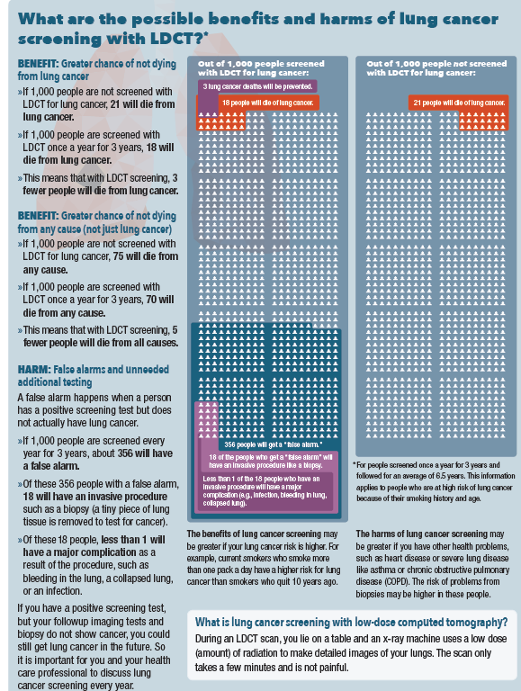

Slide 51
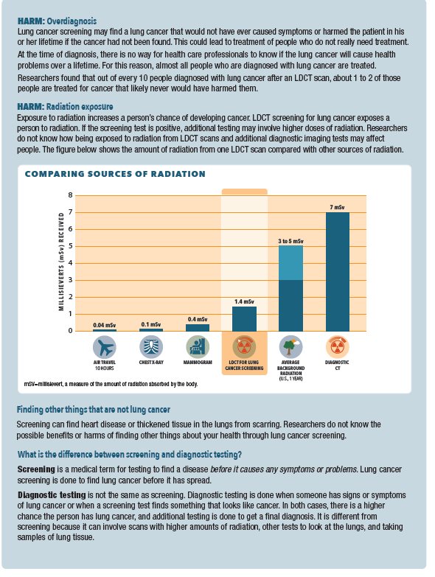

Slide 54
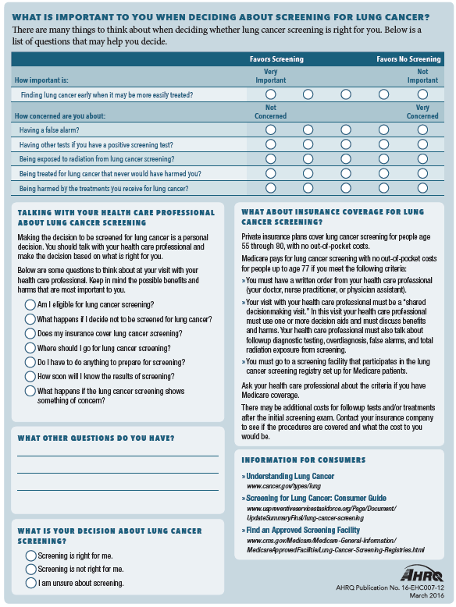

Slide 57
Decision Aids
Agency for Healthcare Research and Quality https://effectivehealthcare.ahrq.gov/decision-aids/lung-cancer-screening/patient.html
American Thoracic Society https://www.thoracic.org/patients/patient-resources/resources/decision-guide-lcs.pdf
University of Michigan http://www.shouldiscreen.com

Slide 58
SDM discussions
Discussion framework
Team talk
Patient and clinician work together to make a decision
Option talk
Present alternatives using risk data
Decision talk
Make preference-based decisions
Elwyn G, et al. BMJ 2017;359:j4891

Slide 59
SDM is not occurring
Primary care discussions
Quality of SDM poor (Brenner AT. JAMA IM 2018:178:1311)
Audiotaped discussions averaged 59 seconds
Harms not addressed, screening universally recommended
Patient perspectives (Wiener RS. JGIM 2018;33:1035)
Received minimal information
Unaware of purpose of CT
Not engaging in deliberations
Medicare SDM visits (Goodwin JS. JAMA IM 2019;179:716)
< 10% underwent SDM visit before LDCT
40% did not proceed with LDCT after SDM

Slide 60
Clinician barriers to SDM
Unaware of trial results and guidelines
Lack of training in SDM
Lack of decision support tools
Limited time, competing demands
National Academies of Science, Engineering, and Medicine. Implementation of lung cancer screening; 2016

Slide 61
Implementing SDM
Clinician training in SDM
CHEST® Shared Decision-Making in Lung Cancer Screening: https://www.chestnet.org/learning%20and%20events/learning/e-learning-library
SDM discussion (University of Wisconsin): https://www.youtube.com/watch?v=Kx3V2iBOzM8

Slide 62
Implementing SDM
Delegate counseling to non-physicians
CMS (currently) requires licensed independent practitioners
Trained non-LIP decision coaches can effectively deliver SDM
Genetic counselors, nurses, pharmacists, psychologists, health educators (Stacey D. Med Decis Making 2012;32:E22)
Nurses for lung cancer screening (Lowenstein L. JCO Onc Pract 2020; epub)
Centralize screening program

Slide 63
Implementing SDM
Telemedicine
Acceptable
Screening uptake (88%) and decision satisfaction (high) similar between telephone and in-person SDM (Tanner NT. Chest 2019;155:236)
CMS reimburses telehealth visits
Advantages
Telemedicine does not disrupt clinic flow
Can be delivered by non-physicians

Slide 64
Key points
Goal of SDM is to achieve high-quality decisions—not to increase screening
Informed patient making a preference-concordant decision
Decision can/should be revisited annually
SDM counseling visits could increase adherence with screening process

Slide 65
Key points
Counseling visit
Shared decision making is essential
Tailor SDM to practice setting
Provide decision aid
Delegate to health coaches
Centralize
Utilize telemedicine
Integrate smoking cessation/abstinence into screening

Slide 66
Thank you
Questions?
Richard-M-Hoffman@uiowa.edu

Slide 67
Sarah Averill, MD, MA University of Iowa Carver College of Medicine Department of Diagnostic Radiology VAH Iowa City Co-Chair Lung Cancer Screening UI Rural Cancer Collaboratory

Slide 68
Disclosures: None

Slide 69
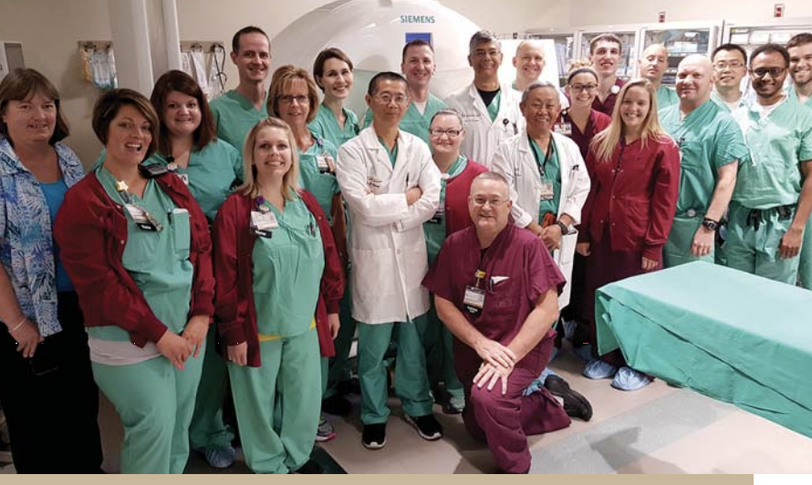
Radiologist Are Your Partners
Centralized
Decentralized
Hybrid
Support from department leadership
Radiologist lead
Oversight of internal radiologists credentialing and day to day problem solving
Lung-RADS and standardized reporting
Lead technologist
Training CT Technologists in scan parameters and problem solving
Administrative staff
Oversight of day-to-day scheduling and exams, review eligibility and assist in program navigation
PACS support (Templating/reporting/ coding)
QI/Database – internal compliance with standardized interpretations
Collegial peer group with passion for LCS
Collaborate in outreach efforts

Slide 70
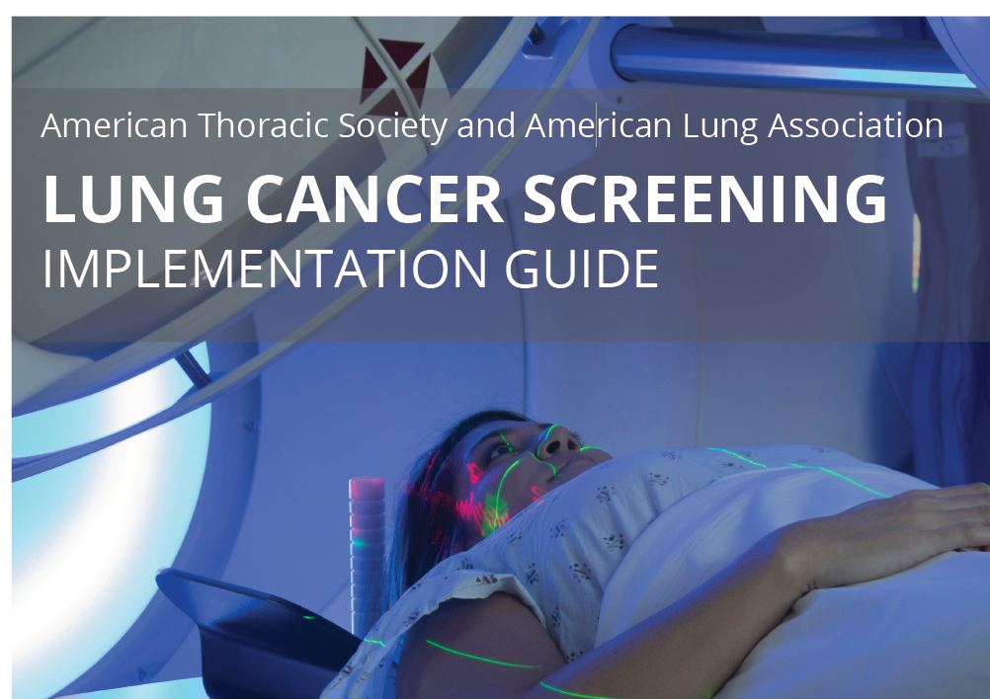
Where can a radiologist interested in learning about lung cancer screening get started?
Resources for radiologists
American College of Radiology: acr.org
American Thoracic Society
American Lung Association
Notes:
There are a number of resource guides out there, but for the radiologist getting started, the place I’d start is with the ACR.

Slide 71
Core responsibilities of radiologist and/or radiology group or department in lung cancer screening
Technical Oversight of Screening Exams
Interpretation of Screening Exams
Reporting on Incidental Findings
Reporting of Exam Results
Templated
Patient Centered
Participation in QI
Participation in ACR registry/ Independent Peer Review and/or Peer Learning
MIPS
Lung and soft tissue formats
Thin slice
Low Dose
Application of LUNG-RADS
Notes:
Many Roles of Radiologists and Rad-Technologists and Support Staff
https://www.acr.org/Practice-Management-Quality-Informatics/ACR-Bulletin/Articles/February-2021/Establishing-Effective-Peer-Learning-Workflows

Slide 72
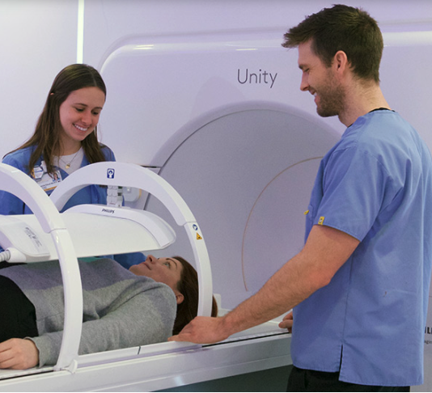
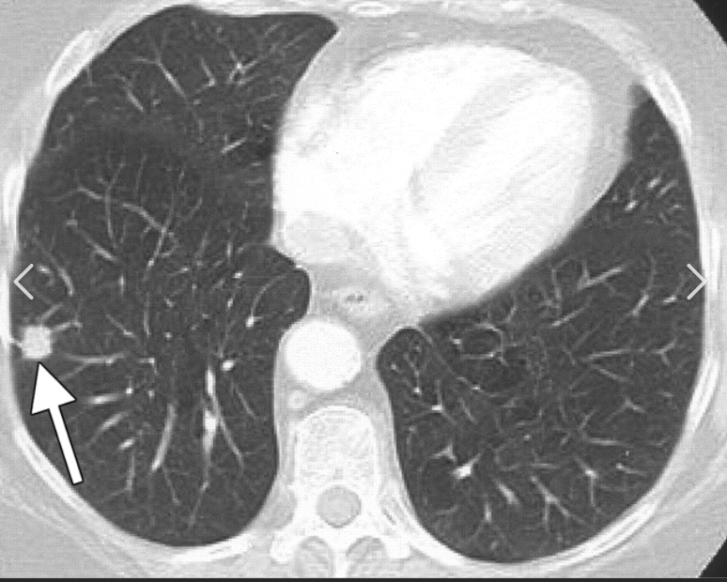
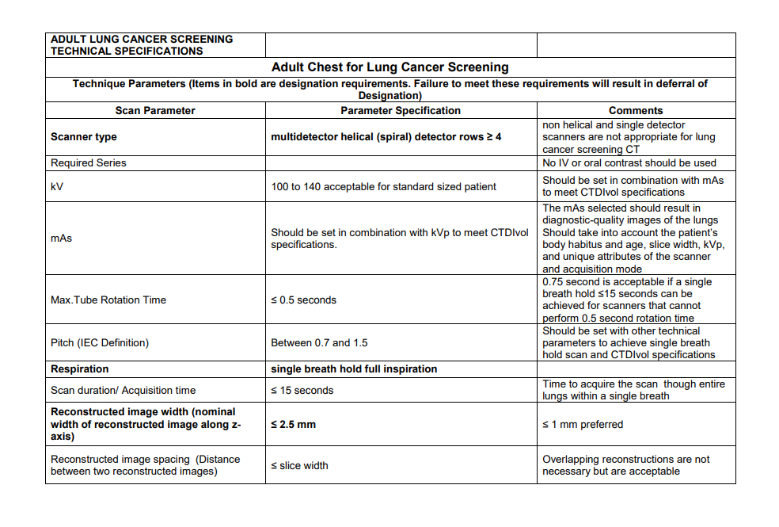
Day to Day Oversight of Technical Parameters
Technologist (RTs), Radiologist (MD,Dos), + PACS
Notes:
May have a larger group involved as Lori Petig described, but once parameters are programmed into the scanner, radiologists and technologists are the “eyes” and ears of the program. Flag technical errors when they occur.

Slide 73
FAQs regrading who can interpret lung cancer screening exams:
Do you need to be subspecialty trained in cardiothoracic imaging? No
2) Do you need to be credentialed? Yes.
3) What are the minimum requirement for credentialing by CMS?
Board-certified or board-eligible with the American Board of Radiology with up-to-date CME and credentialing.
Supervision and interpretation of at least 300 chest CTs in the past three years.
Provide LDCT lung cancer screening in a radiology imaging facility that meets the radiology imaging facility eligibility criteria
Notes:
Lori Petig has touched on this so I’ll be brief.
Nice to have access to someone in your group in case questions arise, but not required. General radiologists have the skillset to interpret Screening Chest CTs

Slide 74
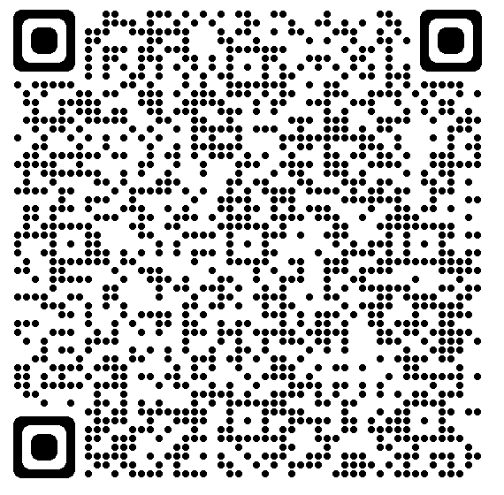
Education Resources Beyond Minimum Requirements
Free On-Line Course Co-sponsored by ACR & STR with 15 CME
(last updated August 4, 2021).
Program implementation
LUNG RADS introduction
Practice cases
On Demand Webinars from NLCRT from ACR
Lung Cancer Screening Education | American College of Radiology | American College of Radiology (acr.org)
Notes:
Going beyond basic CME requirmenets
Lung-RADS is not consistently taught in radiology residency programs.
Free Educational Resources for the radiologist starting out.
Most radiologists will need to undergo additional training.

Slide 75
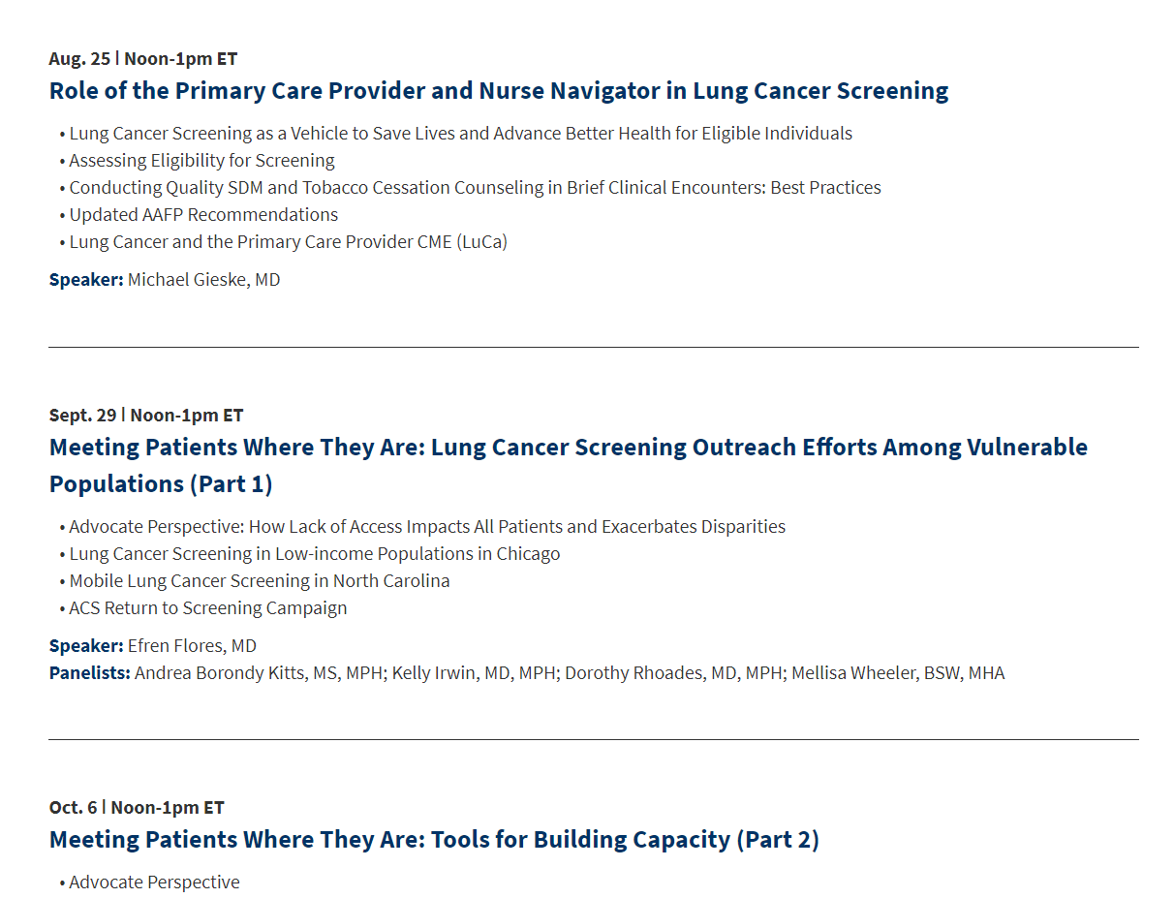
Sampler of upcoming topics
ACR Webinar

Slide 76
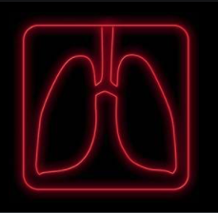
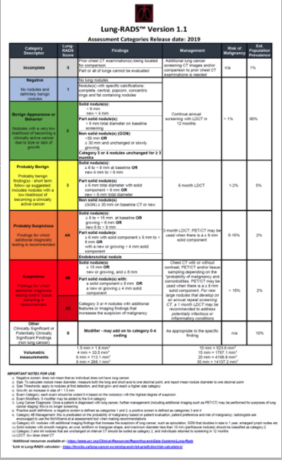
Lung-RADS Quick Reference
WHY Use Lung RADS
To provide a common lexicon & definitions
To standardize practice among radiologists for communicating with ordering providers
To define a positive screen
To address uncertainty in positive screen management
To facilitate quality assurance and improvement
To be updated as knowledge evolves
Notes:
I don’t think I need to explain to this audience the benefits of standardized lexicon for reporting, but there can be resistance, so these are points you can reinforce in your organization over time.

Slide 77
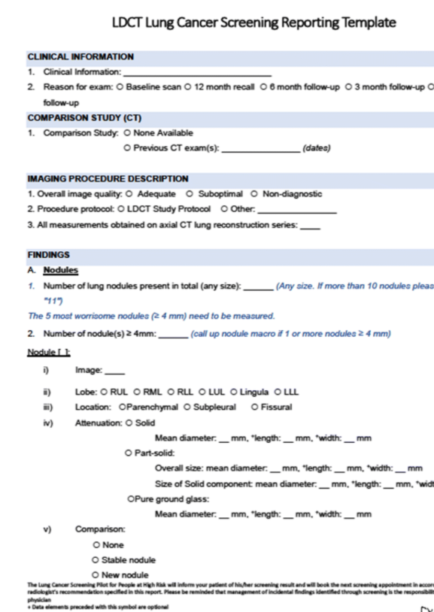
Reporting Results: Standardized Templates & Macros Improve communication Facilitate research and quality improvement Track and follow up with Lung-rads 3 and 4 nodules Lung- Rads “0” If there are signs of infection or active inflammation or a scan is technically inadequate a radiologists should assign a code of 0 and request the patient return to complete the screening process in appropriate time frame. Ancillary Code “S” applied when there is a important finding not related to the lung cancer. Broad categories Some very common: emphysema and coronary artery disease Some are “incidental” such as findings in vessels (aneurysms) bone (fractures), adrenal glands, liver, or other upper abdominal organs seen on the scan.
Notes:
1) Resistance to using templates and standard reporting.
Seek leadership support in advance
Select willing radiologists to participate
Create structures that make template utilization easy (link/auto populate templates)
2) Timely feedback to radiologist for continuous improvement.
Bi-Weekly/Monthly/Quarterly review
Interdisciplinary team meetings to review Positive-Screens
Regular Updates

Slide 78
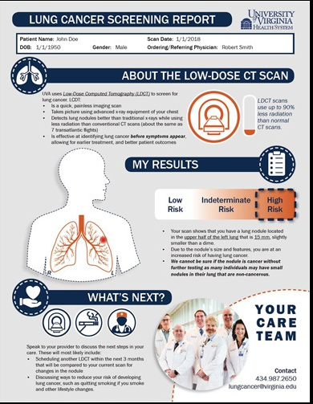
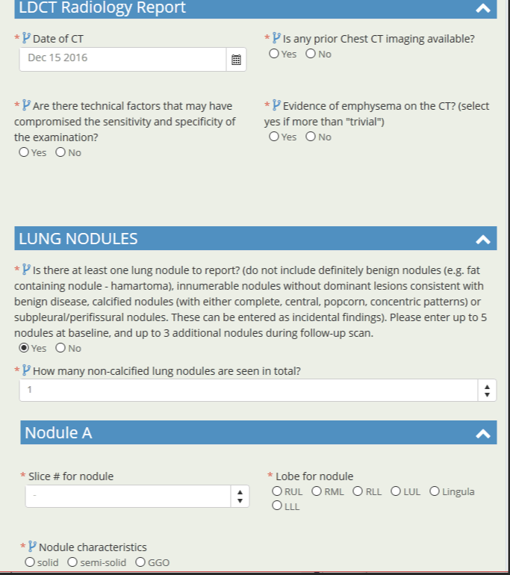
Model Practices= Synoptic & Patient-Centered Templates

Slide 79
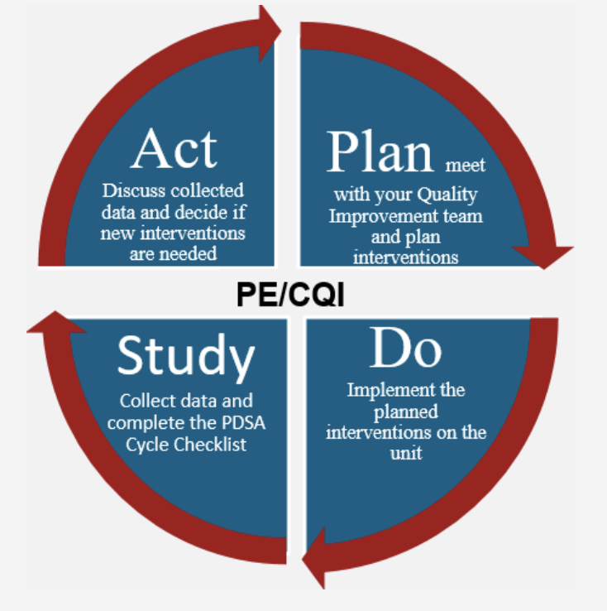
Radiology Team Can Play a Role in Continuous Improvement efforts
Peer Review/ Peer Learning
Interdisciplinary conferences
Data collection
Outcome research

Slide 80
Emerging Roles for Radiologists and Radiology Department Personnel
Notes:
Lung cancer screening is a comlex and known to be somewhat more administratively burdensome that other screening programs. Requires creative problem solving and cooperation of many health care professionals. Radiology is an evolving field and radiologists are a diverse group of physicians with a broad skill set.

Slide 81
Potential for Additional Roles For PACS/Admin and Technologist
Confirm patient eligibility upon arrival
Database entry
Communication with referring providers
Optimizing templates
Role models for compassionate treatment for patients with cancer stigma

Slide 82
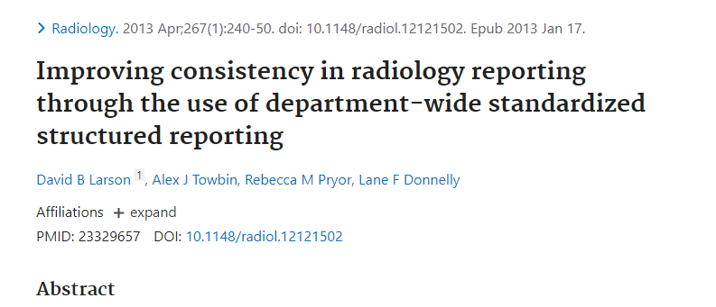
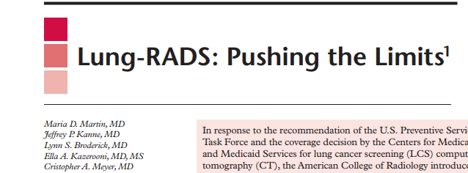
Resources:
Lung Cancer Screening Implementation Guide Planning an LCS Program - Lung Cancer Screening Implementation Guide (lungcancerscreeningguide.org)
https://www.acr.org/Lifelong-Learning-and-CME/Learning-Activities/Lung-Cancer-Screening-Education
https://pubs.rsna.org/doi/pdf/10.1148/rg.2017170051
https://jamanetwork.com/journals/jamanetworkopen/fullarticle/2777211

Slide 83
Thank you! sarah-averill@uiowa.edu @averillMD

