Slide 1
Causal Inference Collaboratory End of Semester Retreat
Overview, Accomplishments, Next Steps

Slide 2
Causal Inference Collaboratory
Creative group process to
solve complex problems
connect collaborators from different backgrounds and disciplines
expand the scope, scale, and impact of public health research
Supported by IPHPRP at CPH at Iowa 2024-2025
Causal inference helps us understand cause-and-effect relationships and can help us understand the impact of some intervention – applicable across the college and university

Slide 3
Causal Collaboratory Team
Emily Roberts
Jonathan Platt
Kai Wang
Nathan Wikle
Hari Sharma
Lila Basnet - Graduate Research Assistant
and you! More than 100 members on Teams platform

Slide 4
Goals and Progress of Collaboratory
Build upon the existing strengths and pillars of excellence of the college
Bring together researchers with diverse expertise and causal inference interest
Foster causal reasoning and collaborate to yield novel strategies and grant proposals
Meetings for learning and networking, assistance for projects and grants
Advance causal methods and reasoning
Address challenges central to public health research

Slide 5
Specific Collaboratory Aims
Aim 1. Conduct a comprehensive and empirical review of how causal theory and methods can provide innovative insights into public health research. We aim to align this research with the primary goals of the College of Public Health, which includes exploring how causal techniques can enrich the goals of comparative effectiveness to inform healthcare.
Aim 2. Develop a comprehensive program that provides training and projects with a Graduate Research Assistant. Organize meetings with various research methods to equip participants with the skills to conduct their own research and contribute to ongoing causal projects.
Aim 3. Create a platform for collaboration and continuous learning via working groups. A primary focus of this component is to collaborate on competitive grants related to causal inference research.

Slide 6
Recap of Efforts 2024-2025
Meetings have been fairly well attended
Participants and Teams members are spread across the university in diverse fields
Interest in continuing meet ups after semester ends

Slide 7
Fall 2024 Recap
Introduced causal reasoning: rigorous way to define effects of interventions, usually based in counterfactual thinking (difference in potential outcomes based on whether or not treatment is taken)
Causal inference in public health
Confounding and propensity scores
Dynamic treatment regimes
Spatial causal inference
Targeted maximum likelihood estimation
Differences-in-differences policy analysis

Slide 8
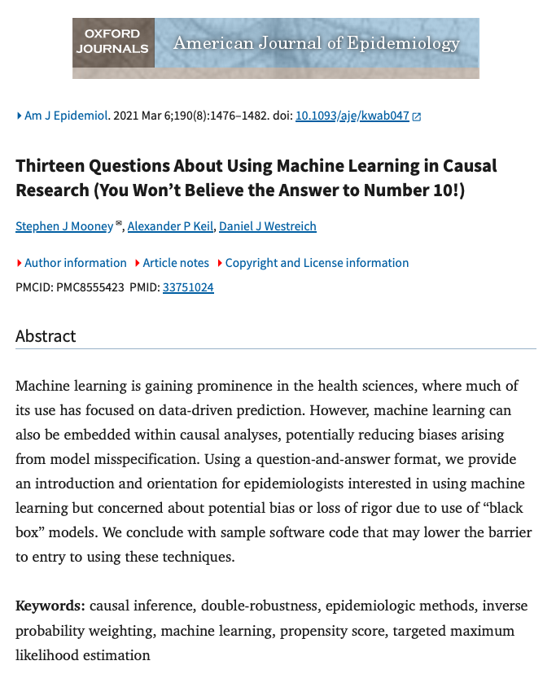
Spring 2025 Recap
Causal inference and machine learning
Instrumental variables/mendelian randomization
Causal inference and clinical trials
Bayesian causal inference
Differences-in-differences policy analysis
Causal Inference Applied: A Clinician's Viewpoint
Causal Inference and Cancer Research

Slide 9
Aim 1
Working on empirical review: Scoping Review of Causal Inference Methods in Comparative Effectiveness Research
Objectives:
1) Identify causal inference methods applied in comparative effectiveness studies
2) Identify how the identification challenges were addressed in comparative effectiveness studies

Slide 10
Aim 1
Include studies with a clear causal question related to the effect of an exposure/policy on health outcome; evaluate comparative effectiveness; explicitly use or discuss causal inference methods
Database: PubMed, Scopus, Web of Science
Preliminary Observations:
Frequent application areas: Oncology, Cardiology, Psychiatry, Policies
Variation in reporting standards and clarity of causal design

Slide 11
Aim 1
Working on review of courses at Iowa: Instructional approach to Causal Inference in Public Health Courses
Content analysis of syllabi of the courses covering causal inference methods in CPH
Courses are transdisciplinary and cover a broad range of topics that provide foundational knowledge and skills for research in public health

Slide 12
Aim 1
BIOS:6650/EPID:6655 - Causal Inference
HMP: 7950 - Design Issues in Health Services Research
HMP:7960 - Analytic Methods for Health Services Research I
HMP:7965 - Analytic Issues in Health Services Research II
Commonly cover: potential outcomes, study design, instrumental variables, diff-in-diff, propensity scores, bias

Slide 13
Aim 3
Several causal-related grants have been submitted to date
Collaborators in biostatistics, epidemiology, statistics, psychiatry, orthopedics and rehabilitation, geographical and sustainability sciences

Slide 14
Aim 3
Please let us know if you have submitted a grant so we can track the impact of our group’s efforts
Goal to continue progress going forward
Final purpose of today is to brainstorm grant ideas and mechanisms for applications (some RFAs in Teams folder)

Slide 15
Today’s Schedule
11-11:15 Causal Inference Collaboratory Overview, Accomplishments, Next Steps
11:15-12:15 Speed Presentations on Causal Inference Research
12:15-12:30 Break/lunch is served
12:30-1:20 Spotlight presentation and full group brainstorming
1:30-2:00 Small group grant brainstorming (Move to Ellig Auditorium)

Slide 16
Brainstorming sessions
Chronic conditions/cancer research
Mental health/social research
Causal inference studies using PCORnet (National Patient-Centered Clinical Research Network)
If there is a topic you would like to break out into, please let me know so we can announce at 1:20

Slide 17
Today’s Spotlight Presentations
Nathan Wikle 11:15-11:21
Kirtikanth Kalapatapu 11:22-11:28
Xin Zan 11:29-11:35
Kai Wang 11:36-11:42
Hari Sharma 11:43-11:49
Lila Basnet 11:50-11:56
Jonathan Platt 11:57-12:03
Emily Roberts 12:04-12:10

Slide 18
PCORI Presentation
Jason Gerson, PhD
Senior Advisor for Research Infrastructure and Innovation at the Patient-Centered Outcomes Research Institute (PCORI). He is responsible for providing leadership in setting strategic directions for the methodological work PCORI funds and the advancement of the science of patient-reported outcomes; designing and implementing new initiatives to ensure the methodological rigor of the clinical research PCORI funds; and leading PCORI’s initiatives on open science
During the spotlight presentation, Dr. Gerson will present on research opportunities within PCORI and recently funded projects. He will help lead a discussion on how PCORI can be a funding source for innovative causal inference projects which will lead into small group brainstorming

Slide 19
Next steps
Thank you for attending!
Can add access to our Teams page if not already
Let’s keep collaborating!
Plans after year-long collaboratory finishes – informal meetings/consulting
Feel free to share feedback about this event

