Slide 1
Valid inference for two sample summary data Mendelian randomization
Causal Collaboratory Speed Presentations
Kai Wang
May 7, 2025

Slide 2
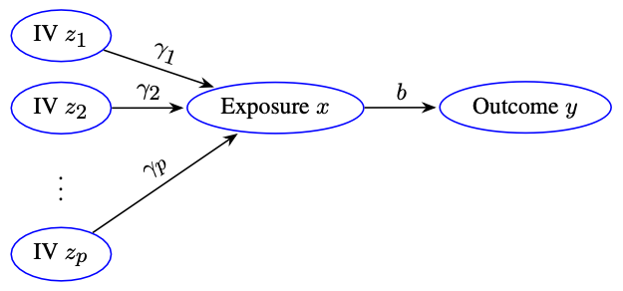
Structural Models

Slide 3
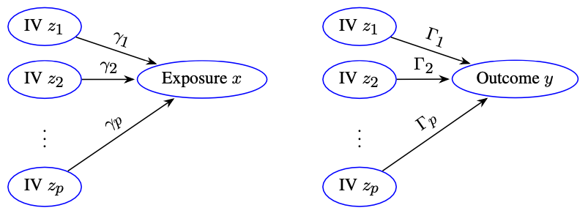
Reduced-Form Models

Slide 4
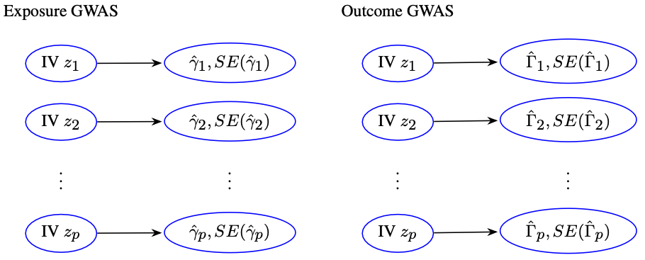
GWAS Summary Statistics

Slide 5
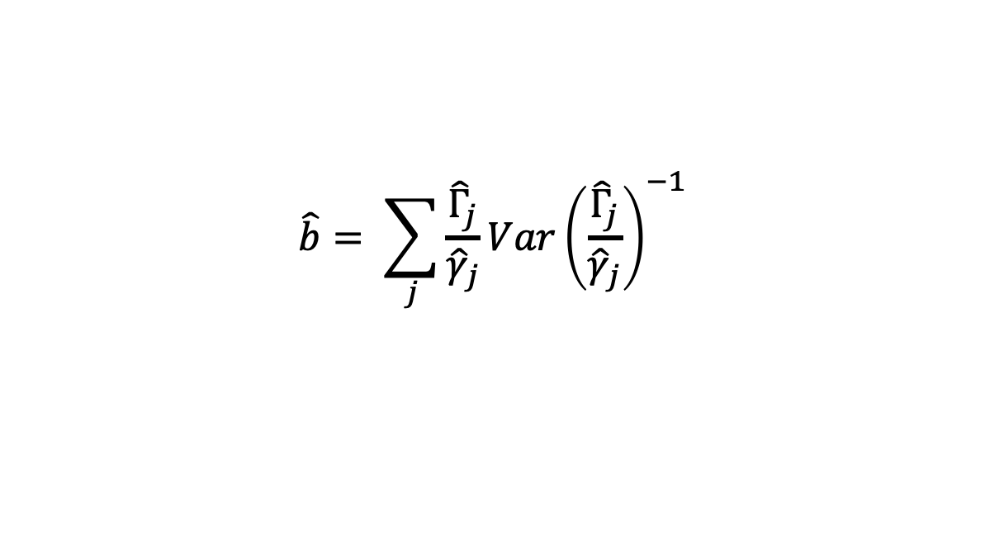
Variance of Inverse Variance Weighted Estimator
$Var\left(\hat{b}\right)= Var\left(\hat{b}|z_{1},z_{2},…,z_{p}\right)$
${Var(\hat{Γ}}_{j})=Var\left({\hat{Γ}}_{j} | z_{1},z_{2}, …, z_{p}\right)$
${Var(\hat{γ}}_{j})=Var({\hat{γ}}_{j}|z_{1},z_{2}, …, z_{p})$
However, current methods use variances of marginal regressions:
${Var(\hat{Γ}}_{j})=Var\left({\hat{Γ}}_{j} | z_{j}\right)$
${Var(\hat{γ}}_{j})=Var({\hat{γ}}_{j}|z_{j})$
Note: IV SNPs are chosen to be in linkage equilibrium
$$\hat{b}= \sum_{j}{\frac{{\hat{Γ}}_{j}}{{\hat{γ}}_{j}}}Var{\left(\frac{{\hat{Γ}}_{j}}{{\hat{γ}}_{j}}\right)}^{−1}$$

Slide 6
Thank you
uiowa.edu

