Slide 1
Targeted estimation of the effects of childhood adversity on fluid intelligence in a U.S. population sample of adolescents
Jonathan Platt, MPH, PhD
Department of Epidemiology, University of Iowa
May 7, 2025

Slide 2
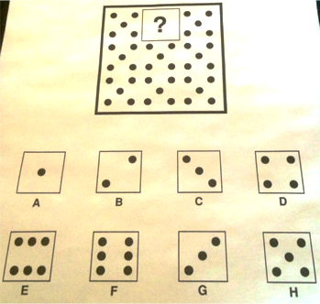
Constructs
Fluid intelligence
Childhood adversity
Complex and contentious (Sternberg, 1985; Gardner, 2000)
Reasoning and novel problem solving (Cattell, 1987; Revlin, 2012)
K-BIT (Kaufman & Kaufman, 1990)
Deprivation: Absence of expected environmental inputs
Threat: Harm to physical integrity
Cognitive development (Noble et al, 2007)
Sheridan & McLaughlin, 2014
Notes:
These different experiences are important to distinguish because they may influence cognitive development and intelligence through different mechanisms.
Threat may influence many different brain regions through well-characterized stress pathways associated with reductions in hippocampal volume and associated para-hippocampal regions, which may in turn influence learning and memory
Deprivation may reduce cognitive ability, mediated by accelerated and extreme synaptic pruning in cortical regions involved in complex cognitive functions in response to an absence of expected environmental inputs
Almas AN, Degnan KA, Radulescu A, Nelson CA, Zeanah CH, Fox NA. Effects of early intervention and the moderating effects of brain activity on institutionalized children’s social skills at age 8. Proc Natl Acad Sci. 2012;109(Supplement 2):17228–31.
Dodge KA, Pettit GS, Bates JE, Valente E. Social information-processing patterns partially mediate the effect of early physical abuse on later conduct problems. J Abnorm Psychol. 1995;104(4):632.
Cicchetti D, Toth SL. A developmental psychopathology perspective on child abuse and neglect. J Am Acad Child Adolesc Psychiatry. 1995;34(5):541–65.
Turner HA, Butler MJ. Direct and indirect effects of childhood adversity on depressive symptoms in young adults. J Youth Adolesc. 2003;32(2):89–103.
Carrey NJ, Butter HJ, Persinger MA, Bialik RJ. Physiological and cognitive correlates of child abuse. J Am Acad Child Adolesc Psychiatry. 1995;34(8):1067–75.
Liaw F, Brooks-Gunn J. Cumulative familial risks and low-birthweight children’s cognitive and behavioral development. J Clin Child Psychol. 1994 Dec 1;23(4):360.
Noble KG, McCandliss BD, Farah MJ. Socioeconomic gradients predict individual differences in neurocognitive abilities. Dev Sci. 2007;10(4):464–80.
Sheridan, M.A., McLaughlin, K.A., 2014. Dimensions of early experience and neural development: deprivation and threat. Trends Cogn. Sci. 18, 580–585.

Slide 3
Adversity and Intelligence
How to model a complex, multidimensional exposure?
Individual exposures
Linear accumulations
Latent variable framework
Assumptions?
No interaction between adversities
The effect of cumulative exposures is linear
Notes:
Many studies have shown inverse associations between childhood adversity and intelligence (IQ), though most are based on small clinical samples and fail to account for the effects of multiple co-occurring adversities
TMLE: A semi-parametric estimation method used to minimize bias in the relationship between each adversity and the outcome, including interactions and non-linearity
van der Laan M, Rubin D (2006). “Targeted Maximum Likelihood Learning.” The International Journal of Biostatistics, 2(1).

Slide 4
Current Study
What are the effects of childhood adversity on Fluid intelligence (K-BIT)?
Targeted Maximum Likelihood Estimation (TMLE) (van der Laan & Rubin, 2006)
US representative study of adolescents (NCS-A)
ages 13-18
n =10,073
years = 2001-2004

Slide 5
TMLE | Step 1. Identify causal parameters of interest
(Gruber & van der Laan, 2011)
Marginal risk differences
  Risk of low K-BIT (<85) if all adolescents had experienced each adversity – risk in the absence of that adversity
Ψi(1) – Ψi(0)= E[Yi | Ai=1, W] − E[Yi | Ai= 0, W]
Population attributable risk difference
  Risk of low K-BIT (<85) given the observed prevalence of all adversities – prevalence if none had been experienced
Ψ(A) – Ψ(0) = E[Y | A=a, W] − E[Y | A=0, W]
Notes:
First, we estimated the differences in the covariate-adjusted mean K-BIT of adolescents who experienced each adversity separately, compared to the mean of those who did not experience that adversity.
Second, we estimated the covariate-adjusted population attributable differences in the mean K-BIT, given the observed levels of all adversities, minus the mean K-BIT if none had occurred.
Third, we estimated the risk of low vs. average K-BIT score if all adolescents had experienced a given adversity, compared to the risk in the absence of that adversity.
Fourth, we also estimated the population attributable risk difference comparing the risk of low K-BIT, given the observed levels of all adversities, minus the risk of low K-BIT if none had occurred.

Slide 6
TMLE | Step 2. Build outcome models
Threat adversities (A_{t})
Deprivation adversities (A_{d})
Physical abuse
Domestic violence
Sexual abuse
Violence
Witnessing violence
Emotional abuse
Financial insecurity
Food insecurity
Neglect
Parent education
  < HS, HS grad, some college
  vs. college degree+
Poverty
  IPR: <1.5, 1.5-3, 3.1-6
  vs. >6 times
Covariates (W)
Race/ethnicity; age; US/foreign born; # of siblings; birth order; sex; survey weight
Notes:
Eleven childhood adversities were considered, based on socio-demographic variables and a trauma checklist administered in the Composite International Diagnostic Interview (CIDI)
*KBITbin = (KBITcont-min)/(max-min)

Slide 7
TMLE | Step 3. Build exposure models
Pr(A=1|W)
Update the outcome models to minimize the bias and maximize the precision of the targeted estimator of each parameter
Influence curve to construct 95% Wald-type confidence intervals
Doubly-robust estimator: unbiased if either the outcome regression or the propensity score model is correctly specified
Notes:
This score was used to update the initial outcome model in order to minimize the bias and maximize the precision of the targeted estimator of the parameter of interest. The resulting estimator is asymptotically normal with a known influence curve, thereby allowing construction of 95% Wald-type confidence intervals.

Slide 8
TMLE | Step 4. Build the best- fitting model
A weighted combination of estimators that best captures the functional relationships between model variables using SuperLearner (Polley et al, 2011)
Multiple candidate estimators
10-fold cross-validation minimizing MSE in 10% random draws
Parameter | GLM: All main terms | GLM: Main terms & interactions | Forward stepwise: Main terms | Stepwise: Main terms & interactions | Stepwise: Main terms & interactions | GAM | Neural Network
Population-attributable RD | 0 | 0 | 0.65 | 0.06 | 0.15 | 0 | 0.14
Notes:
The best combination was determined via 10-fold cross-validation, whereby, for each adversity Y, an estimator of the outcome regression was fitted on a 90% random sample of the observed data (i.e., the training data). To prevent overfitting, cross-validated mean-squared error was minimized through subsequent iterations of 10% random samples of the data (i.e., the testing data).
The need to incorporate this information is seen in the model parameter weights, which utilized estimates from multiple candidate algorithms, including methods to model high-dimensional non-linear data with potentially multiple interactions
Gruber S, van der Laan MJ. tmle: An R package for targeted maximum likelihood estimation. 2011;
Polley E, van der Laan M. SuperLearner: Super Learner prediction, Package Version 2.0-4. Vienna R Found Stat Comput. 2011;

Slide 9
Results | Low K-BIT RDs
0.06 (0.01, 0.10)
0.05 (0.0, 0.09)
0.08 (0.01, 0.16)
0.06 (0.03, 0.10)
0.13 (0.06, 0.19)
0.11 (0.02, 0.21)
0.07 (0.03, 0.11)
0.06 (0.03, 0.10)
0.07 (0.03, 0.12)
7 cases per 100 with low (vs. not low) K-BIT scores can be attributed to the observed levels of all adversities
Notes:
Figure 1. TMLE estimated differences in K−BIT means in the presence vs. absence of childhood adversities among a representative sample of 10,073 adolescents in the United States, 2001−2004

Slide 10
Overall
Consistent with previous literature
Different experiences & different pathways
Threat: increased trauma, stress, and fear
Hippocampal neurons and hippocampal volume
Learning and memory
(McClelland et al, 1995; Squire, 1992)
Deprivation: decreased stimulation
Cortex development, fronto-parietal, and fronto-temporal systems
Working memory, cognitive control, language processing
(Noble et al, 2015; McLaughlin et al, 2014)
Notes:
Although many are untestable, careful consideration of the assumptions necessary for valid causal inference allows us consider the specific strengths and limitations of the data with respect to interpreting results as causal effects.
The population attributable difference in KBIT means due to childhood adversities is also nearly three points, highlighting how these individuals are being left behind in the cognitive development compared to their counterparts who did not experience adversity.
Noble KG, Houston SM, Brito NH, Bartsch H, Kan E, Kuperman JM, et al. Family income, parental education and brain structure in children and adolescents. Nat Neurosci. 2015;18(5):773–8.
Mackey AP, Finn AS, Leonard JA, Jacoby-Senghor DS, West MR, Gabrieli CF, et al. Neuroanatomical correlates of the income-achievement gap. Psychol Sci. 2015;26(6):925–33.
McLaughlin KA, Sheridan MA, Winter W, Fox NA, Zeanah CH, Nelson CA. Widespread reductions in cortical thickness following severe early-life deprivation: a neurodevelopmental pathway to attention-deficit/hyperactivity disorder. Biol Psychiatry. 2014;76(8):629–38.
Noble KG, Houston SM, Kan E, Sowell ER. Neural correlates of socioeconomic status in the developing human brain. Dev Sci. 2012;15(4):516–27.
McClelland JL, McNaughton BL, O’reilly RC. Why there are complementary learning systems in the hippocampus and neocortex: insights from the successes and failures of connectionist models of learning and memory. Psychol Rev. 1995;102(3):419.
Squire LR. Memory and the hippocampus: a synthesis from findings with rats, monkeys, and humans. Psychol Rev. 1992;99(2):195.

Slide 11
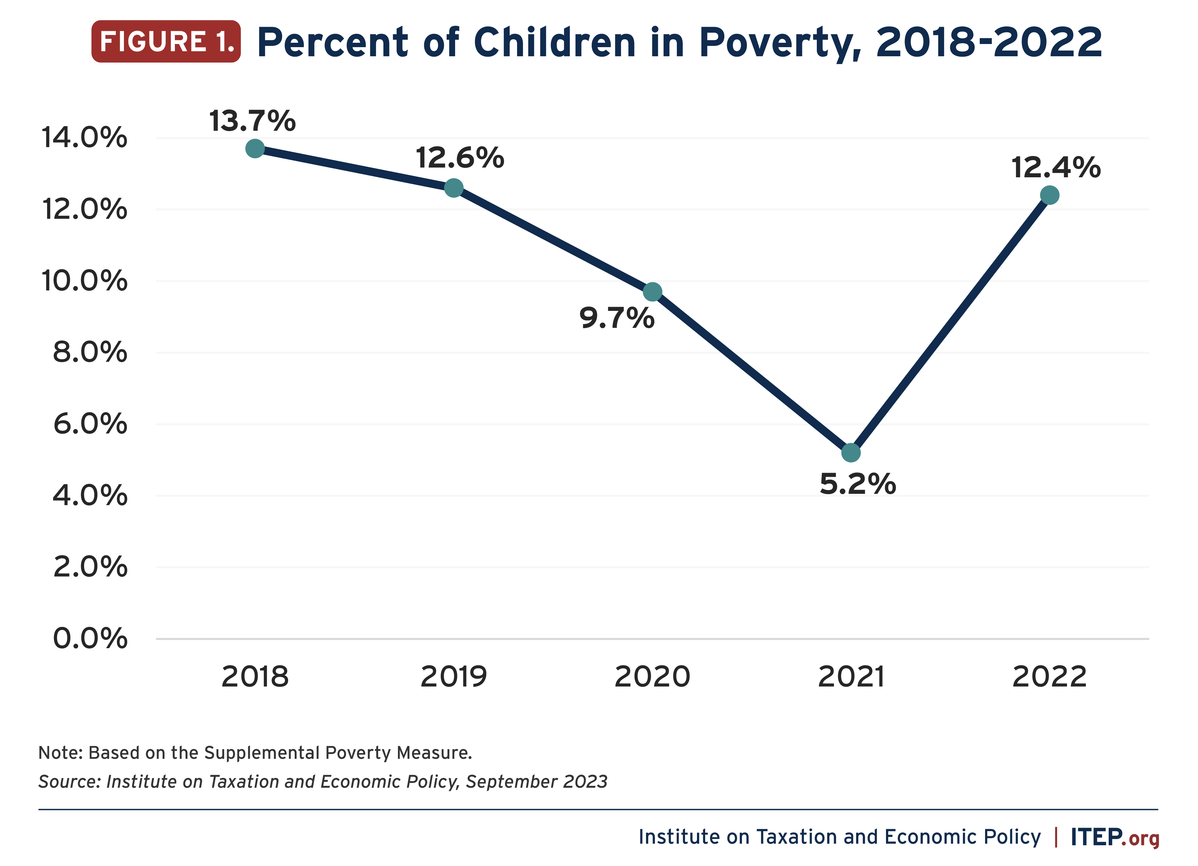
Interventions
Structural interventions (Jackson, 2015; Duncan & Brooks-Gunn, 2000)
Child tax credits
Women, Infants, and Children (WIC)
Temporary Assistance to Needy Families (TANF)
Clinical/school-based interventions
Trauma-focused Cognitive Behavioral Therapy (Cohen et al, 2011)
Child-focused psychotherapy (Lieberman et al, 2000)
Notes:
Interventions to improve cognition in those who experience childhood adversity can be a useful complement to interventions for emotional and behavioral disturbances.
Fortunately, there is evidence that interventions and improvements to developmental environment leads to cognitive recovery in children.
Financial assistance programs like Women, Infants, and Children (WIC), and Temporary Assistance to Needy Families (TANF) have positive effects on the cognitive functioning and academic achievement of children in those households
Jackson MI. Early childhood WIC participation, cognitive development and academic achievement. Soc Sci Med. 2015;126:145–53.
Duncan GJ, Brooks‐Gunn J. Family poverty, welfare reform, and child development. Child Dev. 2000;71(1):188–96

Slide 12
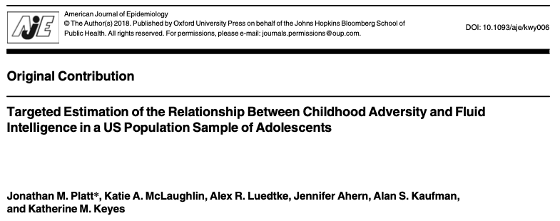
Questions?

Slide 13
General intelligence?
General intelligence and fluid reasoning are, to some extent, social constructs
Factor structure is consistent across ethnic groups in the U.S. and elsewhere (Chabris, 2007)
g found to be the most invariant of all factors in cross-cultural comparisons (Jensen, 1998)
Differences in g between the sexes found in some specific domains; greater variance in men (Mackintosh, 2011)
Notes:
General intelligence and fluid reasoning are, to some extent, social constructs
Factor structure is consistent across ethnic groups in the U.S. and elsewhere (Chabris, 2007)
g factor found to be the most invariant of all factors in cross-cultural comparisons (Jensen, 1998)
Differences in g between the sexes found in some specific domains; greater variance in men (Mackintosh, 2011)

Slide 14
Causal assumptions
Temporality: all adversities occurred prior to the K-BIT administration, though IQ and adversities measured cross-sectionally
Assume conditional exchangeability
Interference unlikely in a nationally representative sample
Consistency violation if there is heterogeneity in the potential outcomes of respondents who report experiencing the same adversity
  If so, estimates could be interpreted as a random draw of the variation present under each adversity (van der Laan, et al, 2005)
Minimal influential outliers in our mean difference estimates (IC mean=0; 99% CI: -1.5, 1.8), satisfying the positivity assumption
Notes:
exposure must precede the outcome (temporality), all confounding must be controlled (exchangeability), one person’s potential outcomes must not depend on another’s treatment (no interference), and no unrepresented versions of treatment (consistency), and individual’s must have a positive probability of receiving every level of exposure for every level of exposure and confounders (positivity).
With respect to temporality, all adversities occurred prior to the K-BIT administration, though there was no measure of IQ prior to adversity exposures. While the estimates were adjusted for confounding due to observed covariates, we cannot empirically verify that the exchangeability has been met using observational data. Interference between individuals is unlikely in a nationally representative sample. Consistency might be violated if there is heterogeneity in the potential outcomes of respondents who report experiencing the same adversity. If this were to occur, the estimates could be interpreted as a random draw of the variation present under each adversity (63). The positivity assumption was assessed by examining the influence of individual observations on the estimator, as a highly influential observation indicates near positivity violations in that individual’s covariate strata (64). There were minimal influential outliers in our mean difference estimates, satisfying the positivity assumption. A description of the estimated model weights and influence curve quantiles can be found in supplementary appendix 1.
Although many are untestable, careful consideration of the assumptions necessary for valid causal inference allows us consider the specific strengths and limitations of the data with respect to interpreting results as causal effects (65).

Slide 15
Limitations
Cross-sectional data, though adolescent recall period is short
No measures of timing, duration, severity of adversities
Confounding by other environmental exposures?
Notes:
The results of this study should be interpreted in the light of several limitations. The study data are cross-sectional, which limits the ability to assign temporality and may affect the recall of adversity experiences. However, as data are from an adolescent sample, the period of recall was relatively short which we expect to mitigate any significant effects of recall bias. Also, we were unable to examine differences in the timing, duration, and intensity of the adversities. Further research in this area might consider the differences in the consequences related to these potentially meaningful characteristics of childhood adversity, including the effects of cognitive deficits that occurred prior to childhood adversity (89). While parameter estimates were adjusted for a number of known confounders, there may be unmeasured confounding leading to violations of exchangeability assumption. For example, poverty and low-SES are complex and are likely related to a host of related experiences that may themselves affect adolescent IQ, such as physical health, nutrition, and harmful environmental exposures such as air and water pollutants, lead, and other toxins (90). Unfortunately, these exposures were not measured in the NCS-A. While we do not believe that environmental exposures would fully explain the relationship between fluid reasoning and such a broad array of adversities, they should be considered in future replication studies.
Two pieces of evidence argue for a stronger influence of environmental than genetic factors. First, although children raised in low-SES environments have consistently been shown to exhibit differences in cortical structure and function (35,73), a recent study demonstrated that no such differences were present at birth (80)—such differences would be expected if effects were solely due to genetics. Second, when children raised in deprived institutional settings were randomized into high-quality family placements, significant improvements in IQ were observed, particularly for children placed earlier in development (30). The experimental design of this study provides strong evidence for environmentally-mediated effects of cognitive enrichment and stimulation on IQ in children.

Slide 16
National Comorbidity Study Adolescent Supplement
NCS-A
(Merikangas et al, 2009; Kessler et al, 2009)
2001-2004
US representative study of adolescents, ages 13-18
Prevalence, demographic correlates, and risk factors for psychiatric disorders in adolescence
n=10,073 (99.3%)
Notes:
Merikangas K, Avenevoli S, Costello J, Koretz D, Kessler RC. National comorbidity survey replication adolescent supplement (NCS-A): I. Background and measures. J Am Acad Child Adolesc Psychiatry. 2009;48(4):367–9.
Kessler RC, Avenevoli S, Costello EJ, Green JG, Gruber MJ, Heeringa S, et al. National comorbidity survey replication adolescent supplement (NCS-A): II. Overview and design. J Am Acad Child Adolesc Psychiatry. 2009;48(4):380–5.

Slide 17
Kaufman Brief Intelligence Test K-BIT
(Kaufman & Kaufman, 1990)
Non-verbal fluid reasoning/ novel problem solving using abstract matrices
48 items of progressive difficulty; participant continues until failing a complete set of 5 items
Re-normed to standardized score (μ=100, SD=15) by 6-month age-groups
  Low score: <85
Notes:
Kaufman, A. S., & Kaufman, N. L. (1990). Manual for the Kaufman Brief Intelligence Test. Circle Pines, MN: American Guidance Service.

Slide 18
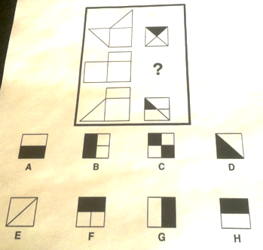
K-BIT
Basic fluid reasoning
Visuo-spatial processing
“A hat (POINT) goes on a head (POINT); a shoe (POINT) goes on a foot (POINT).”
Repeat the item. (If the respondent seems confused)
“On what part of your body do you wear a hat?”

Slide 19
K−BIT mean differences
Low K-BIT RDs
0.06 (0.01, 0.10)
0.05 (0.0, 0.09)
1.97 (0.5, 3.4)
0.08 (0.01, 0.16)
1.86 (0.5, 3.6)
0.06 (0.03, 0.10)
1.82 (0.8, 2.8)
3.58 (1.8, 5.4)
0.13 (0.06, 0.19)
2.29 (1.5, 3.1)
0.11 (0.02, 0.21)
0.07 (0.03, 0.11)
2.32 (1.2, 3.4)
0.06 (0.03, 0.10)
2.02 (0.9, 3.1)
0.07 (0.03, 0.12)
2.91 (1.6, 4.3)
Compared to the observed score, eliminating the adversities reported by respondents would increase the mean K-BIT score by 2.91 standard units
7 cases per 100 with low (vs. average) K-BIT scores can be attributed to the observed levels of all adversities
Notes:
Figure 1. TMLE estimated differences in K−BIT means in the presence vs. absence of childhood adversities among a representative sample of 10,073 adolescents in the United States, 2001−2004

