Slide 1
Effect of Paid Sick Leave on Child Health
Lila Basnet
May 7th, 2025

Slide 2
Background:
Paid sick leave (PSL) refers to policies that provide regular wages(or maximum %) when workers need to take shorter leaves.
There is currently no federal law guaranteeing access to paid sick leave.

Slide 3
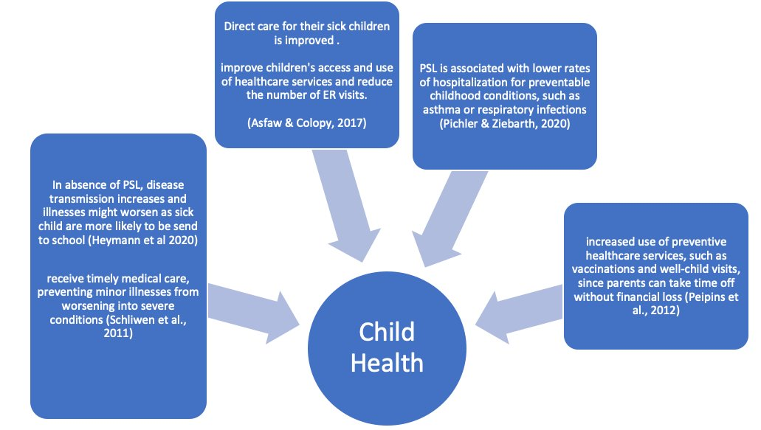
Summary of Literature review

Slide 4
Mechanism of Effect
Indirect
Increase time spending with children
Improving Parental Health and mood
Direct
Improving care of sick children
Increase preventive care utilization and timely treatment
Child Health
Child Health outcomes
Reduction in ER Visits (+ -)
Child Behaviour
PSL

Slide 5
Groups by PSL
No PSL |  | Always PSL (Before 2016) | Changers (No PSL to PSL) in 2016-2023
01 = Alabama (AL) 02 = Alaska (AK) 05 = Arkansas (AR) 10 = Delaware (DE) 12 = Florida (FL) 13 = Georgia (GA) 15 = Hawaii (HI) 16 = Idaho (ID) 17 = Illinois (IL) 18 = Indiana (IN) 19 = Iowa (IA) 20 = Kansas (KS) 21 = Kentucky (KY) 22 = Louisiana (LA) 23 = Maine (ME) 27 = Minnesota (MN) 28 = Mississippi (MS) | 29 = Missouri (MO) 30 = Montana (MT) 31 = Nebraska (NE) 32 = Nevada (NV) 33 = New Hampshire (NH) 37 = North Carolina (NC) 38 = North Dakota (ND) 39 = Ohio (OH) 40 = Oklahoma (OK) 42 = Pennsylvania (PA) 45 = South Carolina (SC) 46 = South Dakota (SD) 47 = Tennessee (TN) 48 = Texas (TX) 49 = Utah (UT) 51 = Virginia (VA) 54 = West Virginia (WV) 55 = Wisconsin (WI) 56 = Wyoming (WY) | 06 = California (CA) 2015 09 = Connecticut (CT) 2011 11 = District of Columbia (DC) 25 = Massachusetts (MA) 2015 41 = Oregon (OR)2016 | 50 = Vermont (VT) -2017 24 = Maryland (MD) - 2018 53 = Washington (WA) -2018 04 = Arizona (AZ) - 2017 (2018) 34 = New Jersey (NJ) -2018 (2019) 44 = Rhode Island (RI) -2018 (2019) 26 = Michigan (MI) -2019 36 = New York (NY) -2020 (2021) 08 = Colorado (CO) -2021 35 = New Mexico (NM) -2022 (2023)

Slide 6
Methods:
To examine the effect of paid sick leave policies on child health, we identify the paid sick leave policies in each state and analyze data from the National Survey of Child Health from 2016 to 2023 for this study.
We used TWFE regression and due to the heterogeneity of timing when policies were adopted, we used the Callaway-Sant’Anna staggered difference-in-differences approach.

Slide 7
Variables
Outcome variables
State level Covariates
Child Health Care Utilization
ER Visits : Binary ( 0 or at least 1)
Doctor Visit , Preventive Visits (0/1)
Dental Visit , Preventive Dental Visits (0/1)
Hospitalization (0/1)
Child Functioning / Education
School absenteeism (Missed school days (0/1))
Child Behavioral Health
Behavioral problem (0/1)
Source | Year | Variables
Census Bureau Data through the University of Kentucky Center for Poverty Research Files | 2016-2023 | Unemployment rate Poverty rates
Census Bureau Data through the University of Kentucky Center for Poverty Research Files | 2016-2023 | State EITC Rates (%) State Refundable EITC (0/1) State minimum wage per hour (dollar amount)
KFF : Status of State Action on the Medicaid Expansion Decision |  | State with Medicaid expansion (0/1)

Slide 8
To identify the effect of Paid Sick Leave (PSL) policy implementation on child health outcomes:
Yₛₜ = α + δ·PSLₛₜ + β·Xᵢₛₜ + γ·Zₛₜ + ρₛ + τₜ + εᵢₛₜ
Y_ist: Outcome for child i in state s at time t
PSL_st: Indicator for whether a Paid Sick Leave (PSL) policy is active in state s during year t
X_ist: Vector of individual- and family-level covariates (e.g., age, sex, race, parental education)
Z_st: Vector of state-level covariates (e.g., unemployment rate, poverty rate, minimum wage, Medicaid expansion)
ρ_s: State fixed effects (controls for time-invariant state characteristics)
τ_t: Year fixed effects (controls for national time trends and shocks)
ε_ist: Error term
Standard errors are clustered at the state level

Slide 9
Objectives of the study
Innovation
This study examines the effect on utilization of child health services and will provide insights on design and consideration of paid sick leave using NSCH data.
This study will estimate dynamic treatment effects of PSL/PFL enactment over the last decade, using recent methodological advances in staggered policy evaluation.
Objectives:
-Identify the effect of state-level Paid Sick Leave (PSL) on children's healthcare utilization
-Identify the effect of Paid Leaves on access to child health services across different family structures, income levels, and racial/ethnic groups.

Slide 10
Table1: TWFE Regression of PSL on Child Health access Outcomes, NSCH 2016-2023
 | Outcomes
Policy | ER Visits | Preventive Visits | Dental Visits | Preventive Dental Visits | Hospitalization | Missed School | Behavioral Problem | Unmet Health Care Need
Paid Sick Leave (PSL) | 0.002 | -0.002 | -0.007 | 0.003 | -0.002 | -0.004 | 0.002 | 0.003*
 | (0.005) | (0.006) | (0.009) | (0.008) | (0.003) | (0.013) | (0.004) | (0.002)
Adjusted model
Paid Sick Leave (PSL) | 0.003 | -0.002 | -0.010 | 0.001 | -0.002 | 0.009 | -0.000 | 0.002
 | (0.004) | (0.006) | (0.007) | (0.008) | (0.003) | (0.014) | (0.004) | (0.002)
Paid Family Leave (PFL) | -0.015 | 0.021** | -0.029*** | -0.031** | -0.000 | 0.011 | 0.006 | 0.002
 | (0.009) | (0.008) | (0.008) | (0.012) | (0.005) | (0.007) | (0.006) | (0.002)
N | 333265 | 326965 | 333494 | 324230 | 261755 | 219111 | 283959 | 333384

Slide 11
Table1. TWFE Models – Age 0–5 Only (NSCH 2016–2023)
 | (1) | (2) | (3) | (4)
 | Emergency Room Visits | Preventive Visits | Hospitalization | Unmet Healthcare Need
Paid Sick Leave | 0.010 | -0.000 | 0.017** | -0.003
 | (0.011) | (0.006) | (0.007) | (0.004)
Fully Adjusted TWFE Models
Paid Sick Leave | 0.011 | -0.011 | 0.015* | -0.004
 | (0.012) | (0.008) | (0.008) | (0.005)
Paid Family Leave | -0.051* | 0.021* | 0.007 | 0.004
 | (0.029) | (0.011) | (0.005) | (0.003)
N | 111073 | 110154 | 90481 | 111113
Standard errors in parentheses
* p < 0.1, ** p < 0.05, *** p < 0.01

Slide 12
Table 2. TWFE Models – Age 6–17 (NSCH 2016–2023)
 | Emergency Room Visits | Preventive Visits | Dental Visits | Preventive Dental Visits | Hospitalization | Missed School | Behavioral Problem | Unmet Health Care Need
Paid Sick Leave | -0.002 | -0.004 | -0.012** | -0.005 | -0.011*** | -0.004 | 0.002 | 0.006***
 | (0.005) | (0.008) | (0.006) | (0.006) | (0.004) | (0.013) | (0.005) | (0.002)
Adjusted TWFE
Paid sick Leave | -0.001 | 0.002 | -0.017*** | -0.006 | -0.010** | 0.009 | 0.001 | 0.005*
 | (0.006) | (0.009) | (0.006) | (0.008) | (0.004) | (0.013) | (0.004) | (0.003)
Paid Family Leave | 0.002 | 0.019* | -0.002 | 0.001 | -0.004 | 0.010 | 0.010 | 0.001
 | (0.004) | (0.010) | (0.005) | (0.006) | (0.008) | (0.007) | (0.006) | (0.003)
N | 222192 | 216811 | 222284 | 219804 | 171274 | 219111 | 222128 | 222271
Standard errors in parentheses
* p < 0.1, ** p < 0.05, *** p < 0.01

Slide 13
Assessing heterogenous effect by Income group
Low Income group (<200FPL) | ER Visits | Preventive Visits | Hospitalization | Unmet Health Care Need
Paid Sick Leave | 0.002 | -0.015* | 0.002 | 0.005
 | (0.013) | (0.009) | (0.009) | (0.004)
Adjusted TWFE
Paid Sick Leave | 0.001 | -0.018* | 0.006 | 0.004
 | (0.009) | (0.010) | (0.009) | (0.004)
Paid Family Leave | -0.012 | 0.031* | 0.037 | 0.001
 | (0.014) | (0.016) | (0.027) | (0.004)
Observations (N) | 93035 | 90760 | 74155 | 92976
High Income group (>=200 FPL)
Paid Sick Leave | -0.000 | 0.006 | -0.005* | 0.002
 | (0.004) | (0.008) | (0.003) | (0.003)
Adjusted TWFE
Paid Sick Leave | 0.003 | 0.008 | -0.007** | 0.001
 | (0.005) | (0.008) | (0.003) | (0.003)
Paid Family Leave | -0.020 | 0.017** | -0.018*** | 0.001
 | (0.013) | (0.007) | (0.005) | (0.003)
Observations(N) | 240230 | 236205 | 187600 | 240408

Slide 14
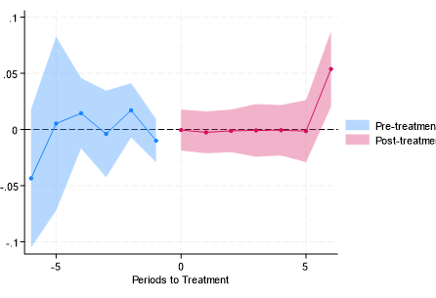
CSDID : event-study plots
ER Visits
Preventive Visit
Dental Visits
Preventive Dental Visits
Missed School
Hospitalization
Unmet HC Need

Slide 15
References :
1) Arora, K., & Wolf, D. A. (2024). Paid leave mandates and care for older parents. Milbank Quarterly. https://doi.org/10.1111/1468-0009.12708
2) Schuster, M. A., Chung, P. J., Elliott, M. N., Garfield, C. F., Vestal, K. D., & Klein, D. J. (2008). Awareness and use of California's Paid Family Leave Insurance among parents of chronically ill children. JAMA, 300(9), 1047–1055. https://doi.org/10.1001/jama.300.9.1047
3) Family and Medical Leave Act. (n.d.). DOL. https://www.dol.gov/agencies/whd/fmla
4) Klerman JA, Daley K, Pozniak A. Family and Medical Leave in 2012: Technical Report. Abt Associates; 2012. Accessed September 16, 2024. https://www.dol.gov/sites/dolgov/files/OASP/legacy/files/FMLA-2012-Technical-Report.pdf
5) Jorgensen H, Appelbaum E. Expanding federal family and medical leave coverage: who benefits from changes in eligibility requirements? Washington, DC: Center for Economic and Policy Research; February 2014. https://www.cepr.net/documents/fmla-eligibility-2014-01.pdf
6) Lamsal, R., Napit, K., Rosen, A. B., & Wilson, F. A. (2021). Paid Sick Leave and Healthcare Utilization in Adults: A Systematic Review and Meta-analysis. American journal of preventive medicine, 60(6), 856–865. https://doi.org/10.1016/j.amepre.2021.01.009
7) Peipins LA, Soman A, Berkowitz Z, White MC. The lack of paid sick leave as a barrier to cancer screening and medical care-seeking: results from the National Health Interview Survey. BMC Public Health. 2012;12(1):520. https://doi.org/10.1186/1471-2458-12-520.
8) Asfaw, A., & Colopy, M. (2017). Association between parental access to paid sick leave and children's access to and use of healthcare services. American journal of industrial medicine, 60(3), 276–284. https://doi.org/10.1002/ajim.22692
9) Schuster, M. A., Chung, P. J., & Vestal, K. D. (2011). Children with health issues. The Future of children, 21(2), 91–116. https://doi.org/10.1353/foc.2011.0017
10) Khan M. S. (2020). Paid family leave and children health outcomes in OECD countries. Children and youth services review, 116, 105259. https://doi.org/10.1016/j.childyouth.2020.105259

Slide 16
PSL provisions at different states :
https://legislature.maine.gov/legis/bills/bills_129th/billtexts/SP011001.asp https://dlt.ri.gov/sites/g/files/xkgbur571/files/documents/pdf/ls/HSFWfactsheet.pdf https://www.ny.gov/new-york-paid-sick-leave/new-york-paid-sick-leave#accruals https://leg.colorado.gov/bills/sb20-205 https://does.dc.gov/sites/default/files/dc/sites/does/publication/attachments/DOES%20ASSLA%20Fact%20Sheet_0.pdf https://www.dws.state.nm.us/NMPaidSickLeave https://www.mass.gov/info-details/earned-sick-time#overview- https://www.oregon.gov/das/Policies/60-000-01.pdf https://labor.vermont.gov/sites/labor/files/doc_library/Earned%20Sick%20Time%20FAQ%20modified.pdf http://arizonapaidsickleave.com/ https://www.lni.wa.gov/workers-rights/leave/paid-sick-leave/ https://labor.maryland.gov/paidleave/paidleavemodel.shtml https://www.nj.gov/labor/wageandhour/assets/PDFs/Forms%20and%20Publications/MW-565%20(12-21)%20BLUE%2011x17%20Sick%20Leave%20poster-English.pdf https://www.michigan.gov/-/media/Project/Websites/leo/Documents/WAGE-HOUR/WHD-99xx-Information-Sheets/WHD-9911-PMLA-Poster/Paid_Medical_Leave_Act_Poster_9911_English.pdf?rev=85573d330de641cfb503107f1cc7c7b1 https://labor.nv.gov/uploadedfiles/labornvgov/content/employer/sb%20312%20paid%20leave%20english.pdf

Slide 17

Questions?

